Slide 1
Showcase the industries recruiting Data Analytics and Data Science Professionals in VA
G. Holt Williams

Slide 2
U.S. Bureau of Labor Statistics: Occupational Employment Statistics (VA)
The data set used for this presentation can be foudn at: https://www.bls.gov/oes/tables.htm
The code used to import and clean the dataset is as follows:
## Import df<- read.csv("state_M2019_dl.csv") ## Pull out important rows df<- df%>% select(area,area_title,occ_title,tot_emp, h_mean, a_mean) ##Clean numbers df$tot_emp <- as.numeric(gsub(",","",df$tot_emp))
## Warning: NAs introduced by coercion
df$h_mean <- as.numeric(gsub(",","",df$h_mean))
## Warning: NAs introduced by coercion
df$a_mean <- as.numeric(gsub(",","",df$a_mean))
## Warning: NAs introduced by coercion
## Subset to Virginia only values va<- df%>%filter(area=="51")

Slide 3
All VA Occupations
Total Virginia Employment as of May 2019
## tot_emp ## 1 3878770
Top Occupations by Total Employment

Slide 4
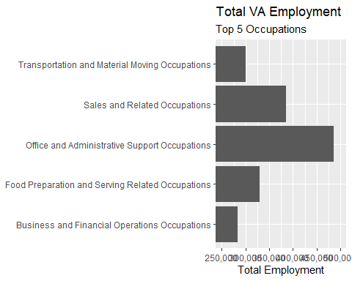

Slide 5
Data Specefic Professionals (Table)
Next lets look at possible careers in Data Analytics and Data Science

Slide 6
occ_title
Management Analysts
Market Research Analysts and Marketing Specialists
Budget Analysts
Credit Analysts
Financial and Investment Analysts, Financial Risk Specialists, and Financial Specialists, All Other
Computer Systems Analysts
Information Security Analysts
Database Administrators and Architects
Software Developers and Software Quality Assurance Analysts and Testers
Operations Research Analysts
Data Scientists and Mathematical Science Occupations, All Other
News Analysts, Reporters, and Journalists

Slide 7
All of these posotions are possible careers in the areas we are looking at. We removed the Data Entry Keyer as it is not a job position in the professiosn we are considering.

Slide 8
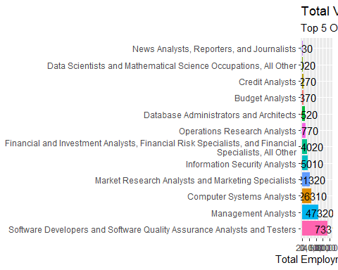
Data Specefic Professionals (Graph)

Slide 9
## sum ## 1 220170
In Virginia we can see there are 220K postiions as of May 2019 that relate to the use of data. This is roughly 5.7% of all working professionals in Virginia.

