Slide 1

Showcase Data Analytics and Data Science Employment in VA
G. Holt Williams

Slide 2

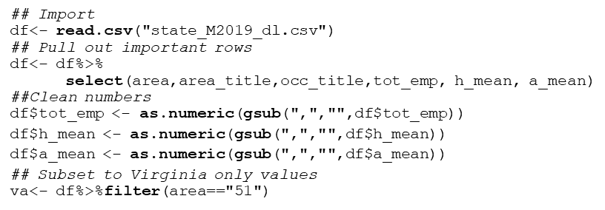
U.S. Bureau of Labor Statistics: Occupational Employment Statistics (VA)
The code used to import and clean the dataset is as follows:
Data for all 50 states is available and can be found at: https://www.bls.gov/oes/tables.html
Code developed for this analysis can be found at: https://github.com/Holt-Williams
Notes:
As.numeric used to coerce NA as the values for the NAs are not consistent with R syntax

Slide 3
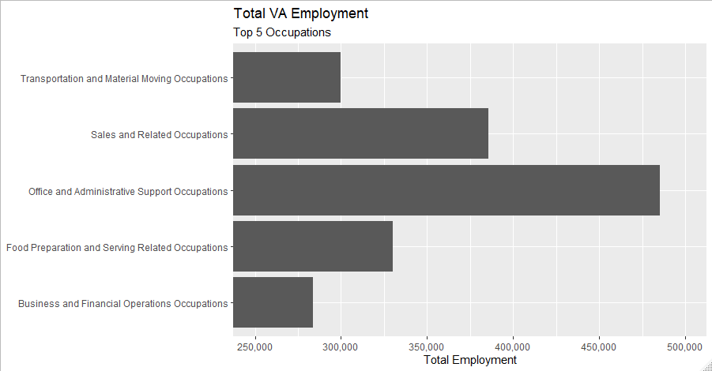

All VA Occupations
Total Virginia Employment as of May 2019 = 3,878,770
Notes:
In Virginia we can see there are 220K postiions as of May 2019 that relate to the use of data. This is roughly 5.7% of all working professionals in Virginia.

Slide 4
Titles Filtered on “Data | Analyst”
Occupation Title
Management Analysts
Market Research Analysts and Marketing Specialists
Budget Analysts
Credit Analysts
Financial and Investment Analysts, Financial Risk Specialists, and Financial Specialists, All Other
Computer Systems Analysts
Information Security Analysts
Database Administrators and Architects
Software Developers and Software Quality Assurance Analysts and Testers
Operations Research Analysts
Data Scientists and Mathematical Science Occupations, All Other
News Analysts, Reporters, and Journalists
Data Analytics and Data Science professionals (VA)
Notes:
All of these posotions are possible careers in the areas we are looking at. We removed the Data Entry Keyer as it is not a job position in the professiosn we are considering.

Slide 5
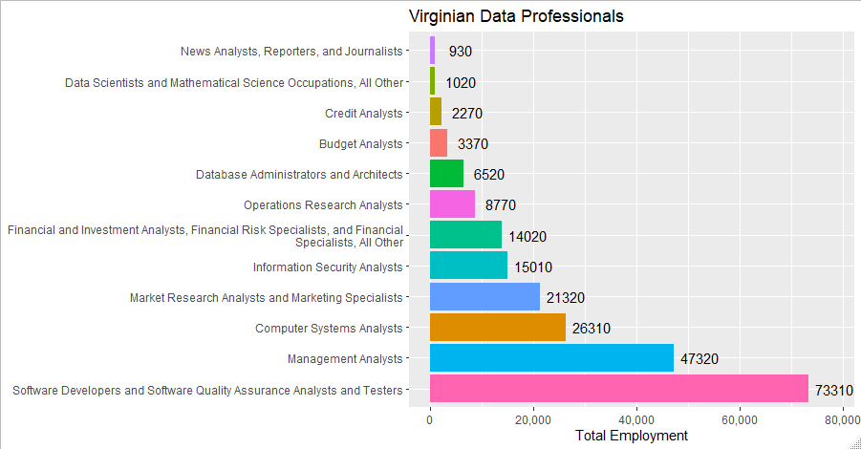
Data Specific Professionals:
Total VA Data Professional Employment = 220,170
Notes:
In Virginia we can see there are 220K positions as of May 2019 that relate to the use of data. This is roughly 5.7% of all working professionals in Virginia.

Slide 6

Salary

Slide 7
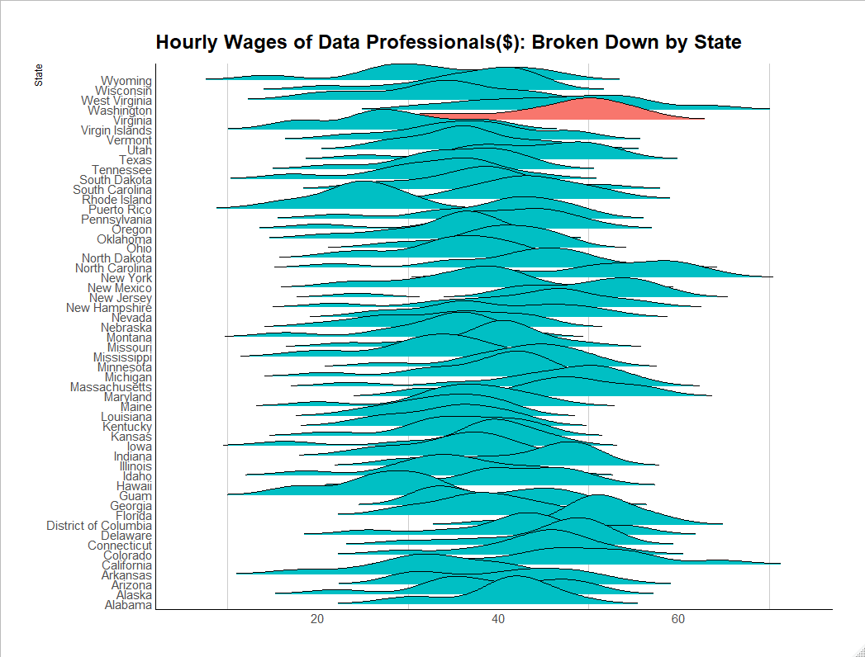
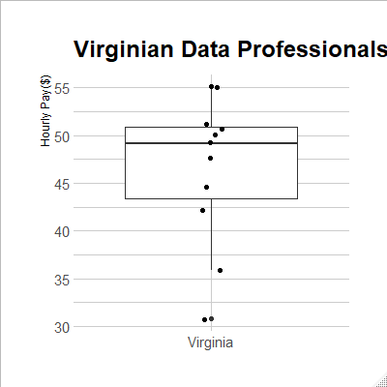

Slide 8
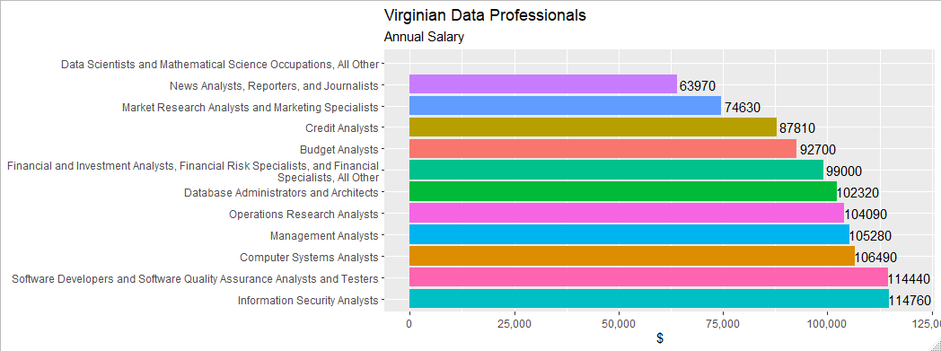
VA Average Annual Salary = $97,000 VA Weighted (Total Employment) Average Annual Salary = $105,000

Slide 9
Projected Employment Growth

Slide 10
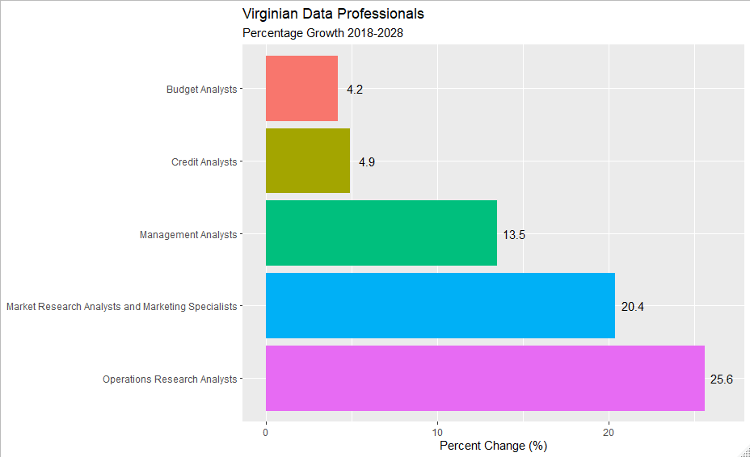
Projected Employment Growth: 2018 - 2028
Data is limited due to the data source and how occupation titles are coded

Slide 11
Thank You!
G. Holt Williams
Data Source: https://www.bls.gov/oes/tables.htm

