Slide 1

SDE-Net: Equipping Deep Neural Networks with Uncertainty Estimates
Санкт-Петербургский Политехнический Университет Петра Великого
Институт компьютерный наука и технологии (ИКНТ)
Студент: Эспинола Ривера, Хольгер Элиас
1-й курс магистратура искусственный интеллект и машинное обучение
2023

Slide 2
Contents
Introduction and Related Works
Model and Method
Experimental Results
Conclusion

Slide 3
Introduction and Related Works

Slide 4
Introduction
Purpose and Motivation
This research is a purpose of a novel method to estimate an uncertainty in complex deep learning models.
Problem
Bayesian and Non-Bayesian approaches don’t have the necessary scalability that neural networks require to estimate the uncertainty.
Approach
Implementation of Stochastic Differential Equation Network (SDE-Net) interpreting Deep Neural Network (DNN) as state evolution of stochastic dynamical system with Brownian motion term.
Results and Conclusion
The SDE-Net outperforms the capacity to estimate uncertainty in comparison with currently methods.

Slide 5
Importance of the study
Despite the great results achieved by Deep Neural Network models, many times these models make erroneous predictions with high confidence in scenarios where the evidence to support those predictions are not enough (overconfidence). The overconfidence usually produces inaccurate and unreliable results.
To avoid this scenario, is necessary quantify the uncertainty and define what these models don’t know.
Currently have 2 main approaches to fix this problem: Bayesian and non-Bayesian methods.

Slide 6
Model and Method

Slide 7
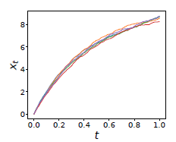
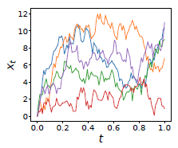
SDE-Net: Mathematical Modeling
ResNet is a discretized form of ordinary differential equation (Chen et al, 2018)
The ODE-Net is deterministic and cannot represent uncertainty
We add a Brownian motion term to capture epistemic uncertainty in a stochastic differential equation
Low uncertainty
High uncertainty

Slide 8
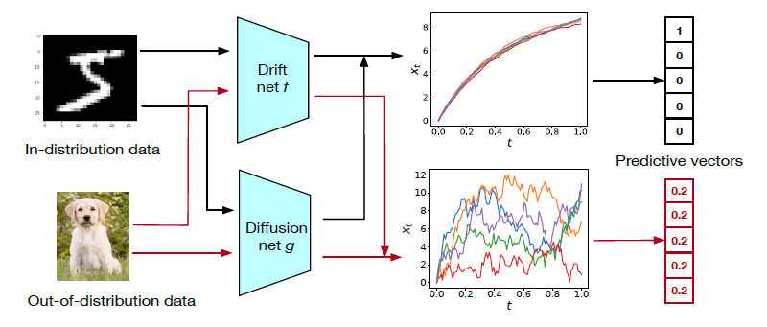
SDE-Net: Neural Network Architecture
Aims to achieve high accuracy prediction
Represents uncertainty in the system

Slide 9
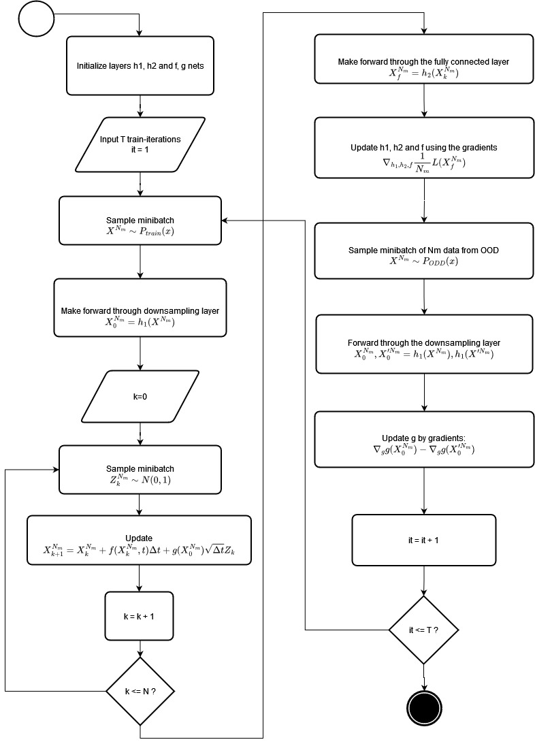
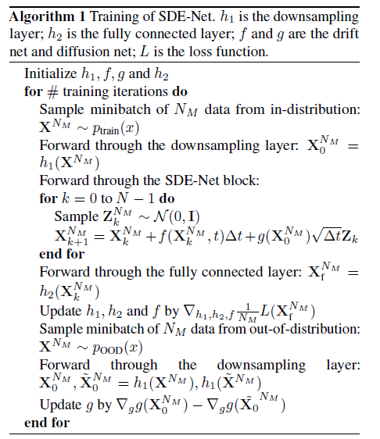
SDE-Net: Training Algorithm

Slide 10
Experimental Results

Slide 11
Experimental Schema and Datasets
MNIST
Train-set: 60,000 images
Test-set:
10,000 images
SVHN
Train-set:
73,257 images
Test-set:
26,032 images
Year prediction MSD
Train-set:
463, 715 samples
Test-set:
51, 630 samples
Datasets
Experiments
Out-of-distribution detection
Misclassification detection
Adversarial sample detection
Active learning

Slide 12
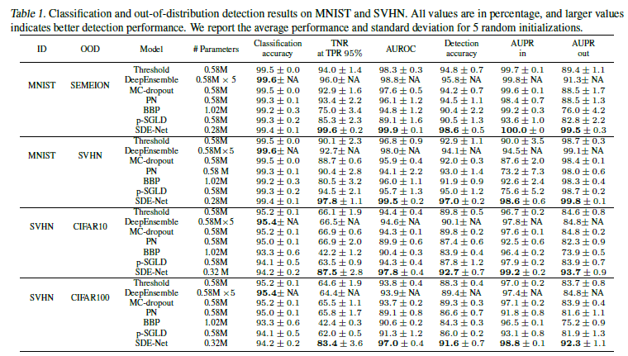
Tables of results

Slide 13
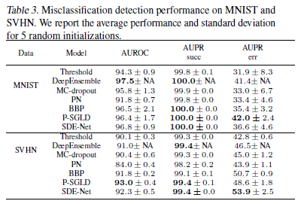
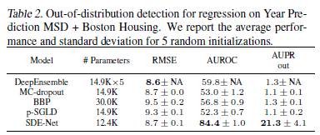
Tables of results

Slide 14
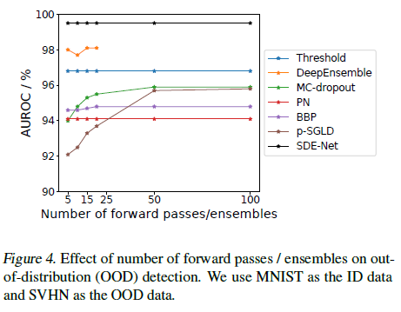
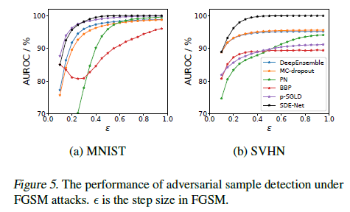
Graphics of results
OOD detection for classification
Adversarial sample detection for FGSM attacks

Slide 15
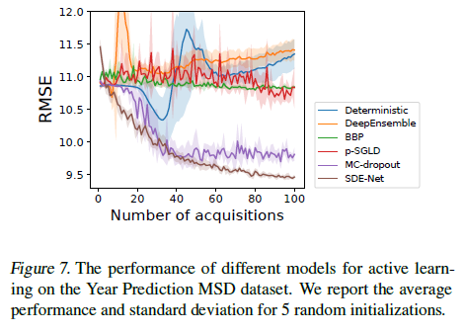
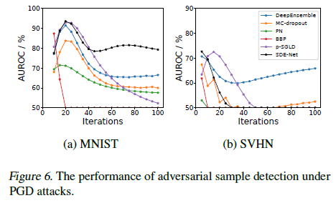
Graphics of results
Adversarial sample detection for PGD attacks
Active learning on Year Prediction MSD dataset

Slide 16
Discussion and Conclusion

Slide 17
Discussion: SDE-Net benefits
Able to model both aleatoric uncertainty and epistemic uncertainty
Efficient and straight-forward to implement
Don’t specify model priors and infer posterior probability distributions
It’s not necessary to train multiple DNNs and apply ensemble methods
Generally appliable for classification and regression tasks
Have strong performance in scenarios when uncertainty plays important role

Slide 18
Conclusion
The model of SDE-Net can separate the different sources of uncertainty in comparison with existing non-Bayesian methods and in more straight-forward way in comparison with Bayesian methods.
Experimentally was demonstrated that SDE-net outperforms state-of-art techniques the quantification of uncertainty and achieves robustness under different scenarios where uncertainty plays an important role.
This research successfully established the connection between stochastic dynamical systems and neural networks for uncertainty quantification
In future directions, this approach has the potential to solve the problem of overconfidence under uncertainty scenarios in models which stay present in different deep learning applications.

Slide 19
Thank you for your attention!
Эспинола Ривера, Хольгер Элиас
espinolarivera.h@edu.spbstu.ru
holtech94@bk.ru

