Slide 1
Cats vs Dogs
Group 3
Chenlu Ji, Chi Li, Danmo Wang, Haoyang Chen, Ruixiong Shi
Notes:
Good afternoon everyone, We are group 3 and till yesterday the best try for the model score 87% on validation set.
Before introducing our final model, I would like to briefly go through the base model and then show you how we improve it step by step

Slide 2
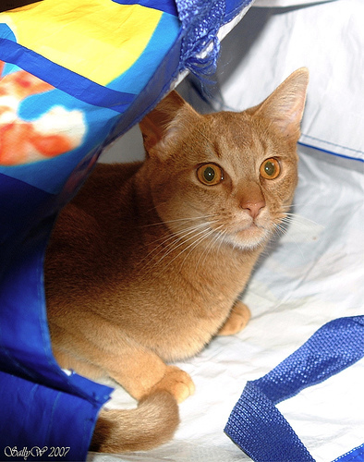
Base Model

Slide 3
Base Model
We divided red, green and blue channel into 8 intervals
Count frequency
Train a linear SVM with C = 1 (default) give us 60.3% accuracy with 10 fold cross-validation
Notes:
How we improve it? There are two ways:
1, we explore better classifier instead of linear SVM
2, we need to find out some powerful features
Intuitively speaking, color feature is not very important to classify cats and dogs even for a human being
In this project we spent nearly all of our times on feature engineering: finding better features, create better bag of word model,
How to ensemble these features to avoid overfitting

Slide 4
The Final Model

Slide 5
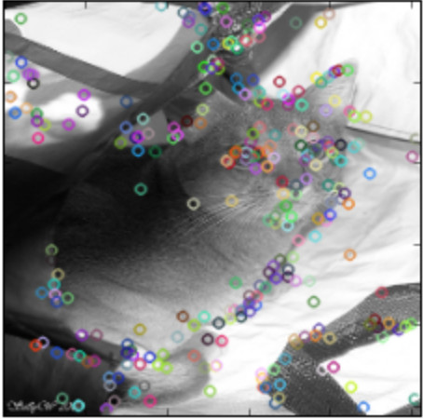
Color feature:
RGB
Feature: SIFT
Feature Selection
Linear SVM
10 fold CV:
87%
Deep features
Notes:
SIFT feature capture some key information (corners) of the both cats and dogs
Now suppose we have some important points to identify cats and dogs, what else can we have ? Shape and spatial information of the key points We took the first two layers of ImageNet 2012 award wining neural network from Caffe and use those two layers as powerful feature extractor
–
------ Deep feature

Slide 6
SIFT
K-means with 2000 centroids
Code Book
Cat
nose
Dog
nose
Cat
tail
… 2000

Slide 7
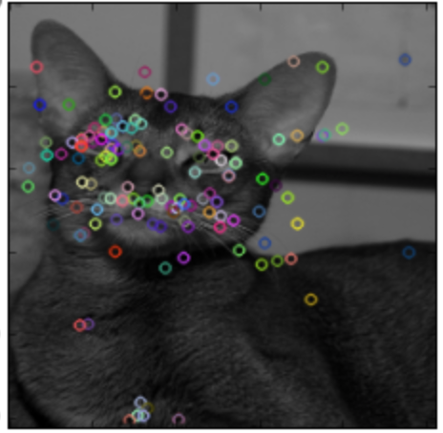
Code Book
Cat
nose
Dog
nose
Cat
tail
… 2000

Slide 8
Comparing with base model
Feature | Classifier | Accuracy (cv= 10)
RGB | Linear SVM C=1 | 60.3%
SIFT 1000 words Iteration = 10 | Linear SVM C=1 | 68%
SIFT 2000 word, iteration = 10 | Linear SVM C=1 | 71%
SIFT 2000 word, iteration = 30 | Linear SVM C=1 | 74%
SIFT 2000 words iteration = 30 | SVM chi2 kernel C = 1 Gamma = 1 | 79%
Back

Slide 9
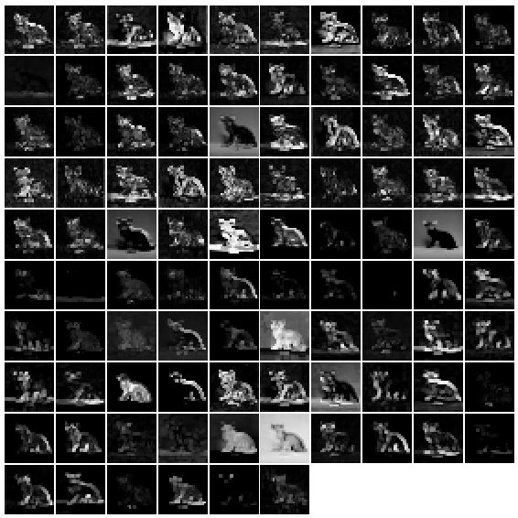
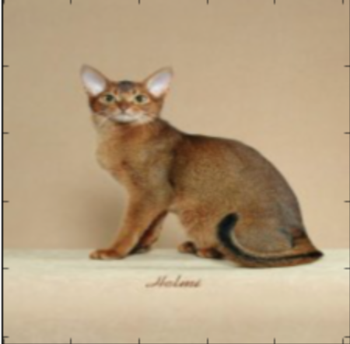
First layer
96 kernels
Shape
Notes:
You can think the 96 kernels as 96 filters and after filtering our picture, the edge of the image is preserved

Slide 10
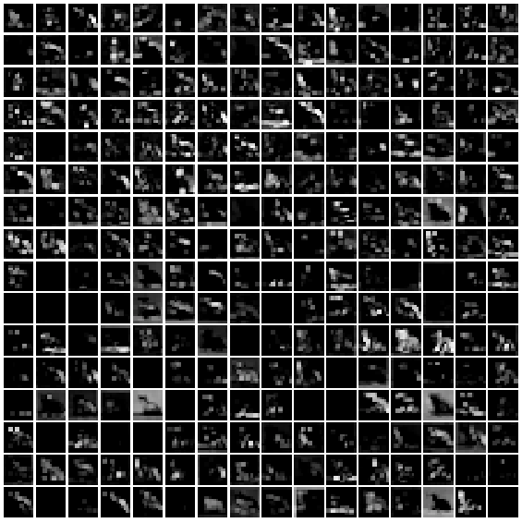
The head and body (key info) of the cat is captured
The relative position of these information is also been captured
Second Layer

Slide 11
Comparing with base model and SIFT
Feature | Classifier | Accuracy
RGB | Linear SVM C=1 | 60.3%
SIFT 2000 words iteration = 30 | SVM chi2 kernel C = 1 Gamma = 1 | 79%
Deep feature Layer 1 | Linear SVM C = 1 | 73%
Deep feature Layer 2 | Linear SVM C = 1 | 81% (5 min)
Deep feature Layer 2 | SGD classifier | 80.5% (10 sec)
Back

Slide 12
Feature Selection
Ensemble different features with different classifiers and vote for final prediction
Performance is unstable (2% - 3%)
R:
no customize kernel
no SGDclassifer
slow SVM training with huge dimensional data (nearly 50000 features)
Can not solve problem with rPython
Stack all the features together
Random forest to evaluate importance of feature
Dimension reduction (9000)
5%-6%
Notes:
Too many features, two problem: Overfitting; Building a classifier is time-consuming and too slow. Thus we want to do feature selection to extract important features, making the procedure more efficient and also improve the accuracy. Random forest to evaluate feature importance

Slide 13

Other thing we have tried

Slide 14
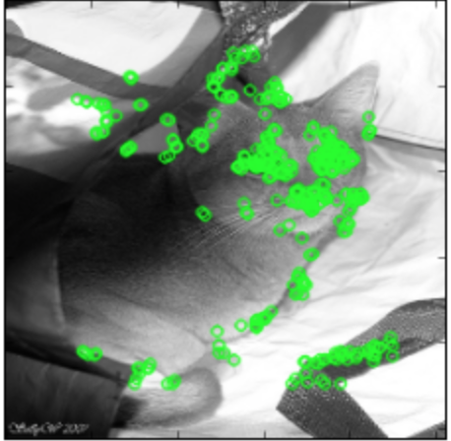
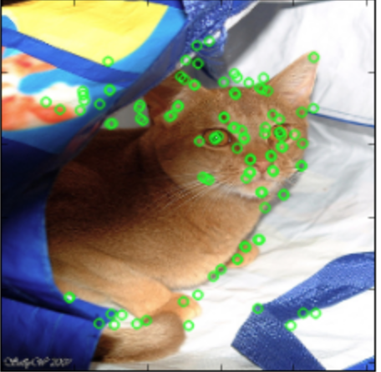
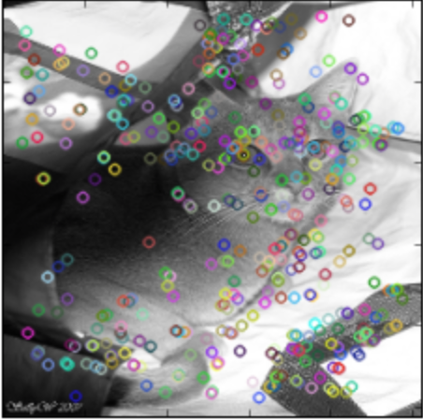
ORB
AKAZE
SURF
SIFT

Slide 15
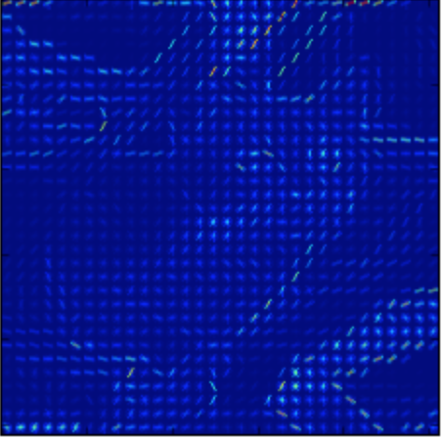
Level 1 SIFT
Leevl 2 SIFT
HOG
HSV

Slide 16
Normalization
For the SIFT code book
L1 normalization
TF-IDF normalization

Slide 17
Things we can do better
Preprocessing:
Deep feature: extract mean, resize to 227*227
SIFT: resize to 256*256
RGB: none
Keep Ratio, crop at center
Do not use R for training
50000 → 9000, lose information
Faster training algorithms in Python
Tune final SVM classifier harder (current C = 1000)

Slide 18
THANK YOU!
We are group 3!

