Slide 1


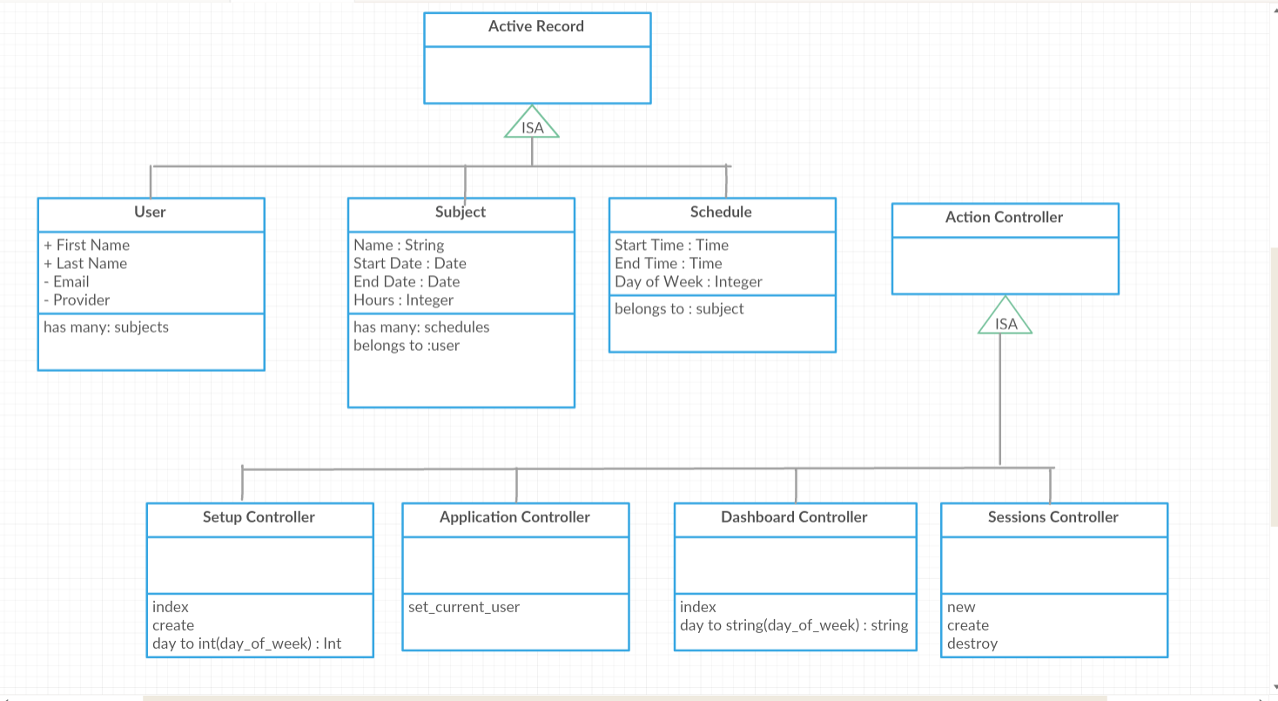
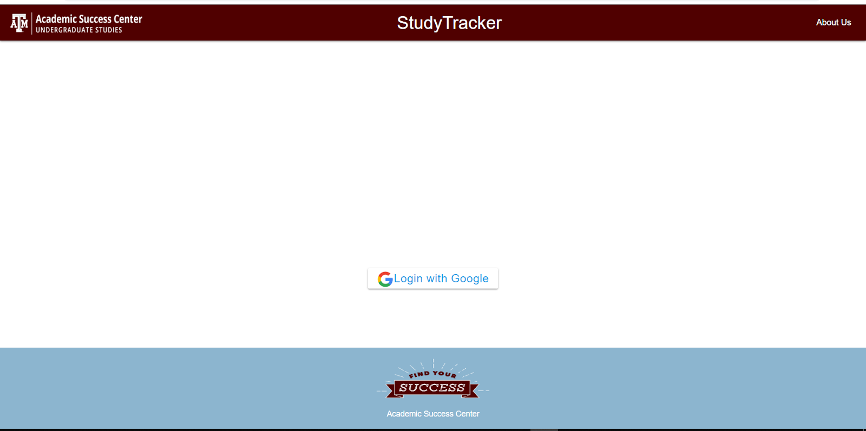
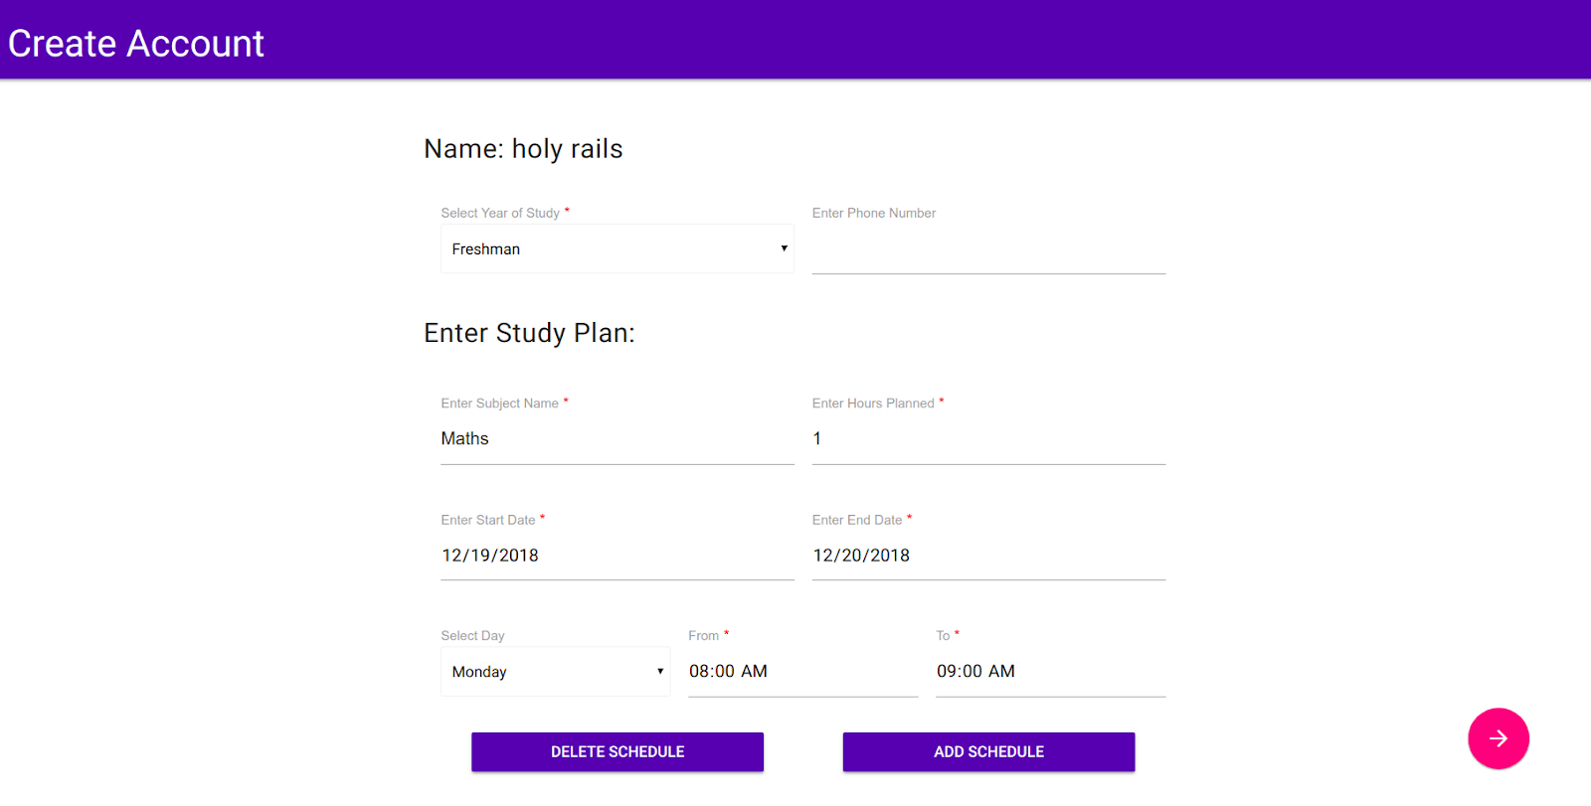
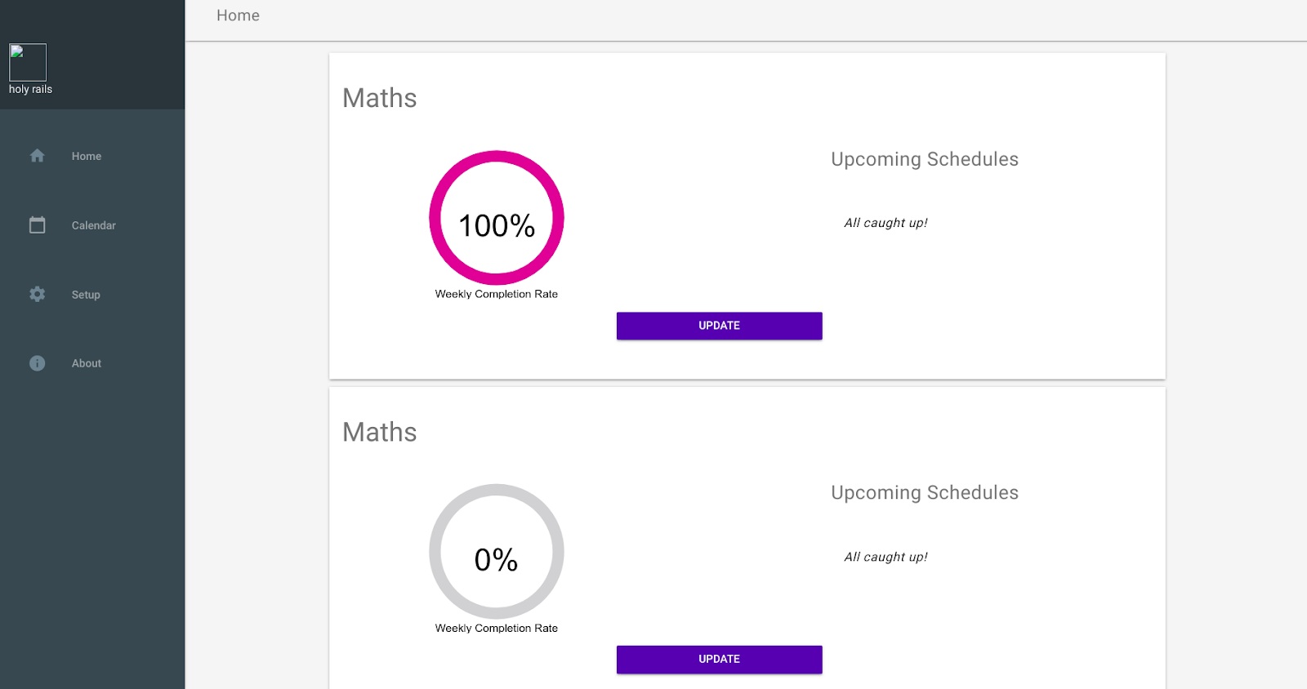
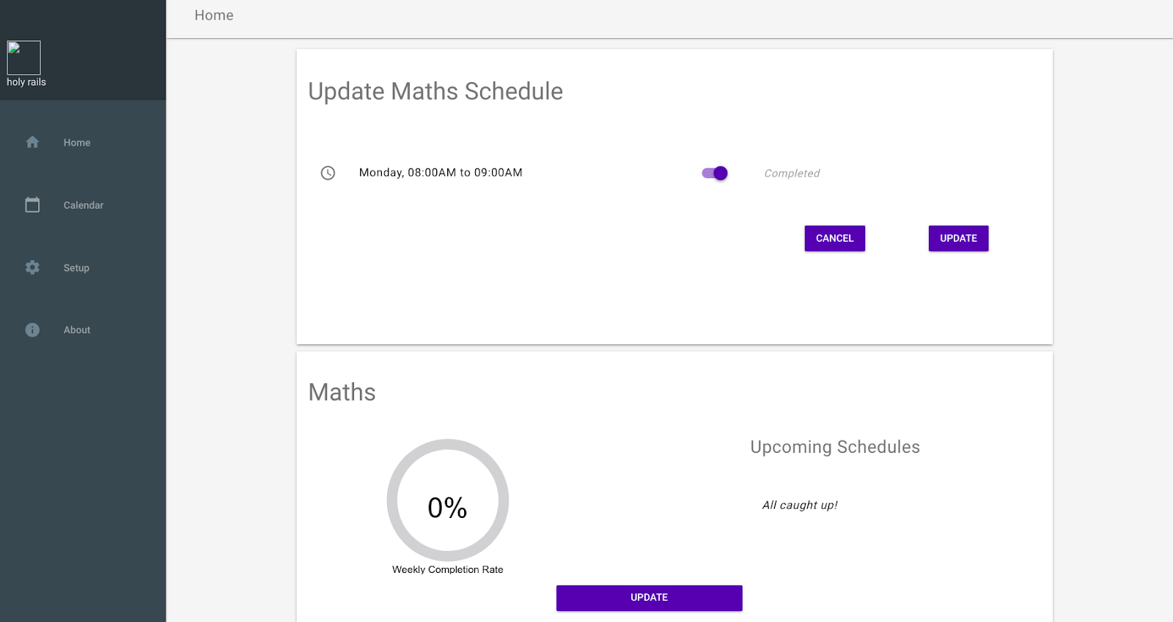
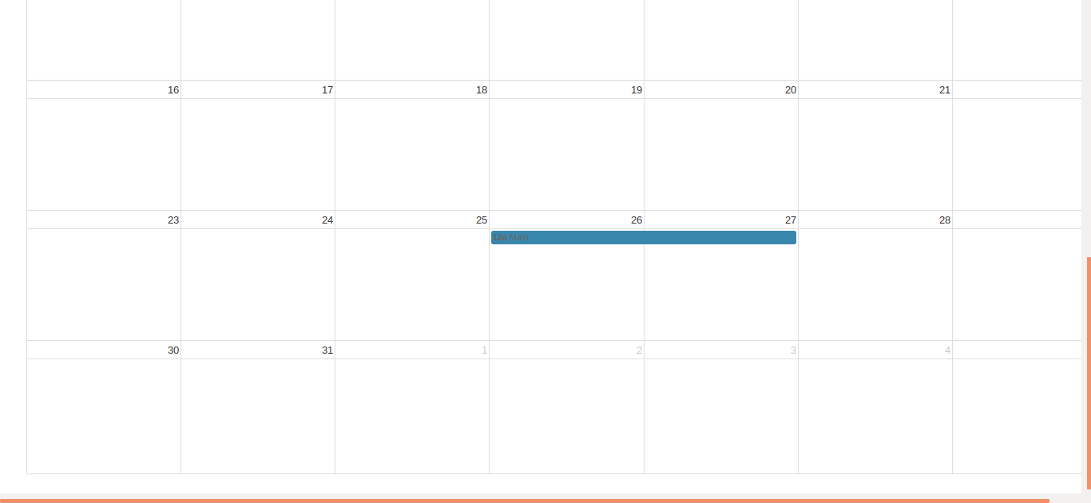
Study Tracker
Akshaye Anitha Pradeep, Anurag Das, Varsha Khanna, Manmeetkumar Patel, Akhilesh Rawat
CSCE 606 Software Engineering, Department of Computer Science and Engineering, Texas A&M University
Introduction
Through this application, we create a platform for students to enter study goals, track amount of time spent working on a goal and their progress for a given topic, and also the ability to adjust goals. A student should be able to enter his study goals and the number of hours he/she has planned on studying the subject per week. He should then be able to plan a schedule by which he will be able to meet his study goals. He should, at any point of time, be able to view his planned schedule and how much of it he has completed. He should also be able to view his weekly schedule in a calendar.
Our application, Study Tracker, initially takes the information about a student’s study goals and his proposed schedule and sets up a dashboard view where he can see his progress and upcoming study sessions. It also provides a calendar view where he can see his schedule populated graphically. From the dashboard, he will be able to update his study goals as well as tweak his schedule. If he is unable to complete planned study sessions, he can reschedule it to a later time.
Class Diagram
The Study Tracker app uses three tables : the User table, the Subjects table and the Schedules table. We illustrate relationships between the three with the following class diagram.
User Stories
This application was developed across four iterations. Each iteration a set of user stories, or features, were developed. Below is the culmination of the implemented features accompanied by the UIs of the app where these features are on display.
Lessons from Software Engineering
Agile Development.
Using MVC architecture.
Enhancing product based on customer requirements.
Working in a team to achieve deadlines.
As a user of Study Tracker,
So that I can view and edit my study sessions,
I want to login to Study Tracker with my gmail account.
★
As a user of Study Tracker,
So I can setup my study sessions,
I want to add details of my subjects and my study sessions.
As a user of Study Tracker,
So that I can manage my study goals,
I want to view my study schedules and current completion status
Add/Modify Question Page
SCREENSHOT
(filled out new question for with a picture attached)
Additional User Stories
As a user, I want to logout so that I can end my current session
As a user, I want to switch between the setup screen and dashboard so that I can navigate smoothly.
As a user, so I can remove subjects entered erroneously, I want to delete subjects.
As a user of Study Tracker,
So that I can update my study plan,
I want to mark my schedule as completed
As a user of Study Tracker,
So that I can view all my schedules,
I want to view my schedule in a calendar format

