Slide 1


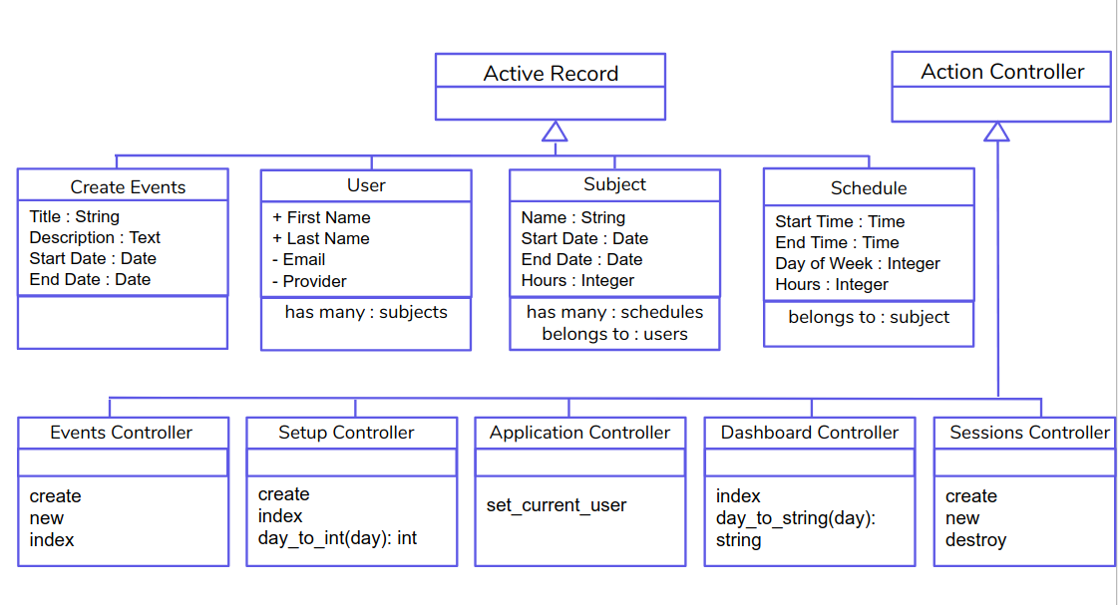
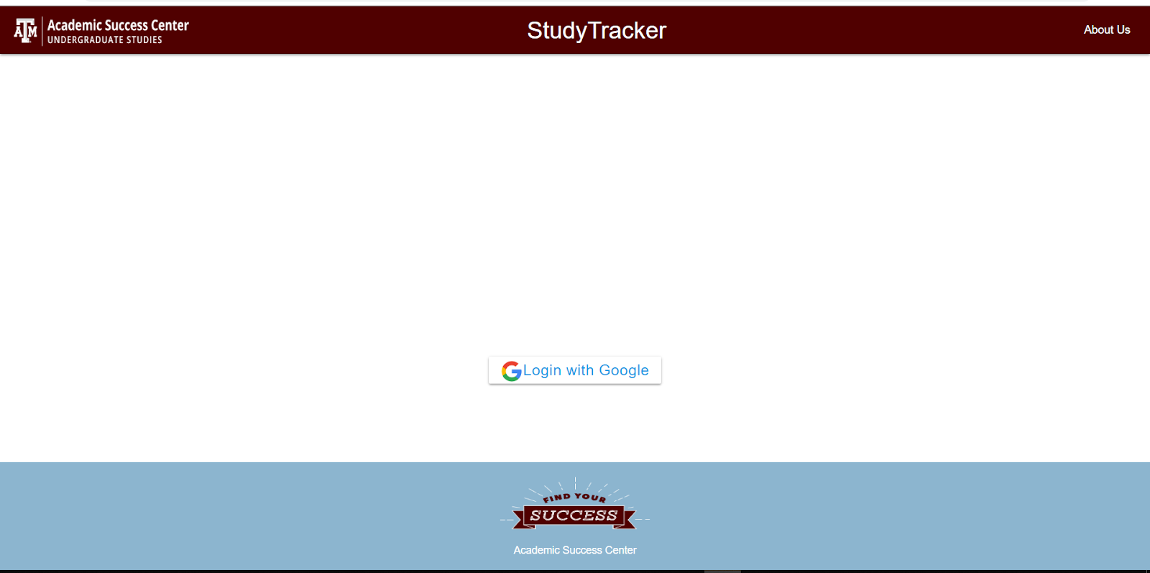
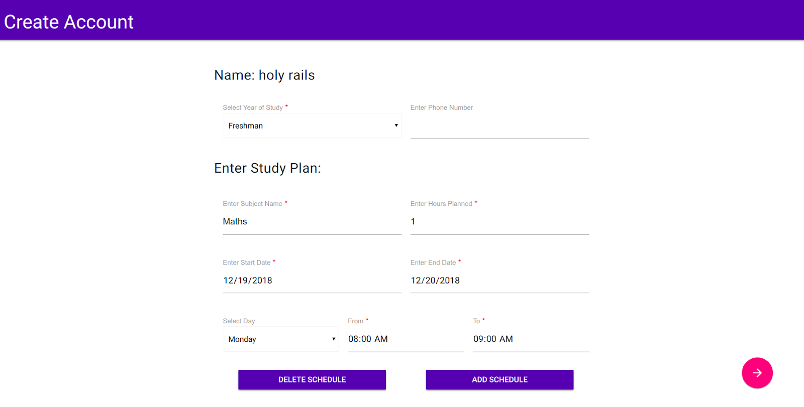
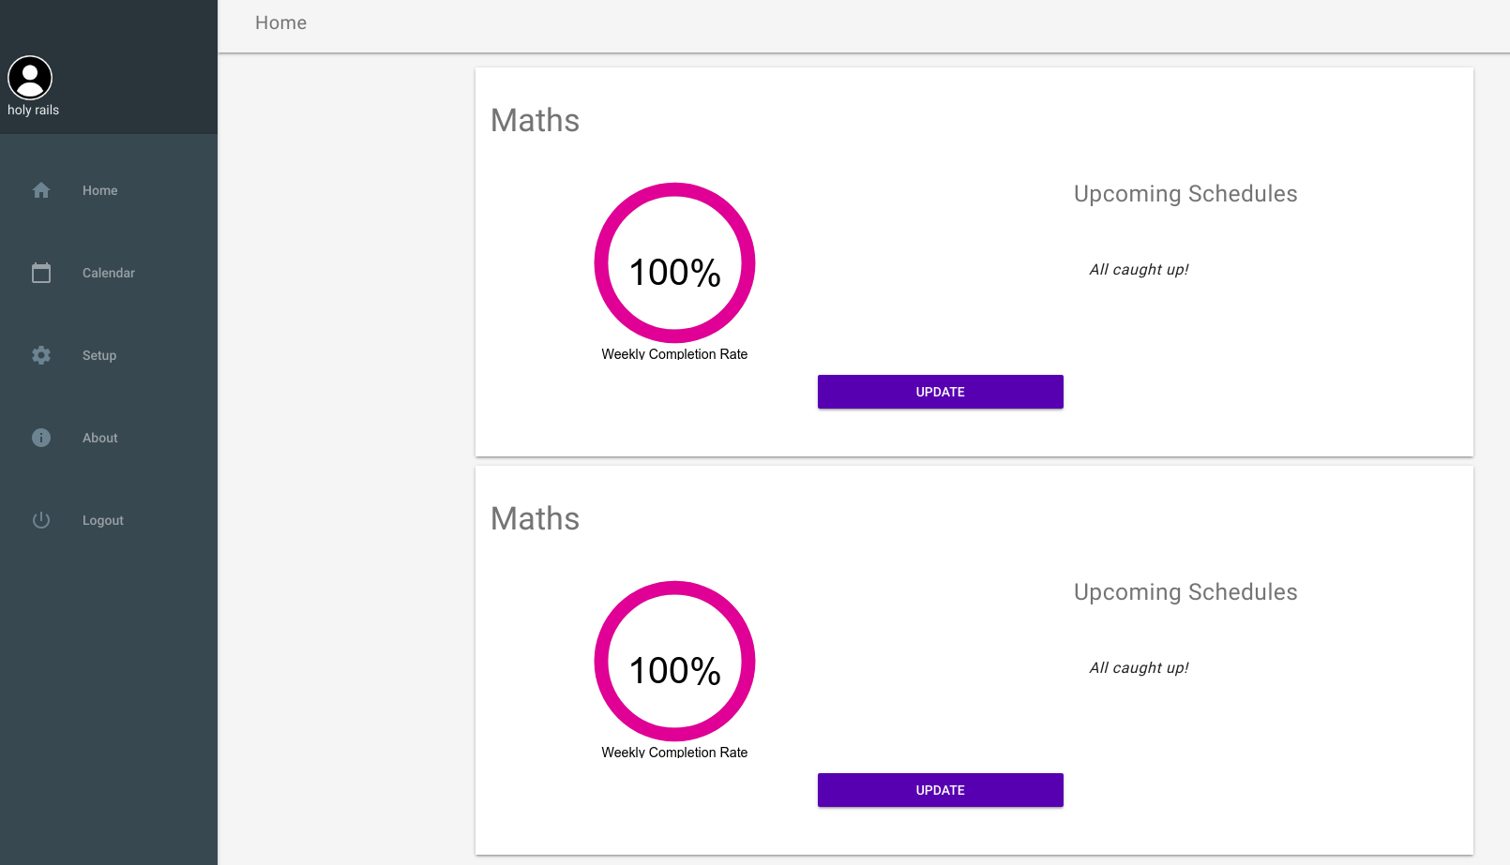
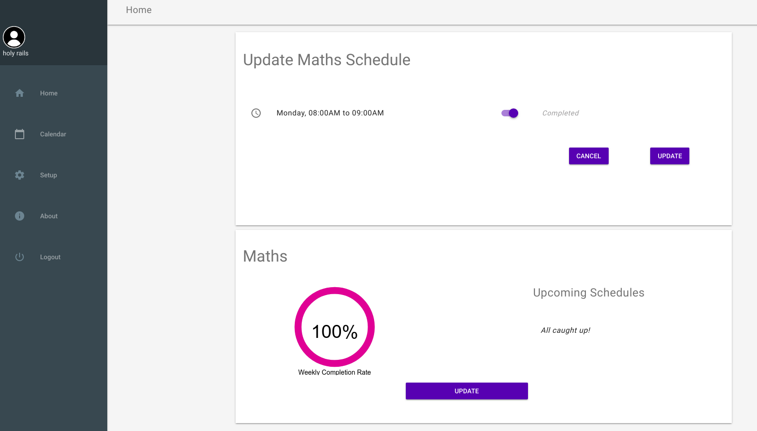
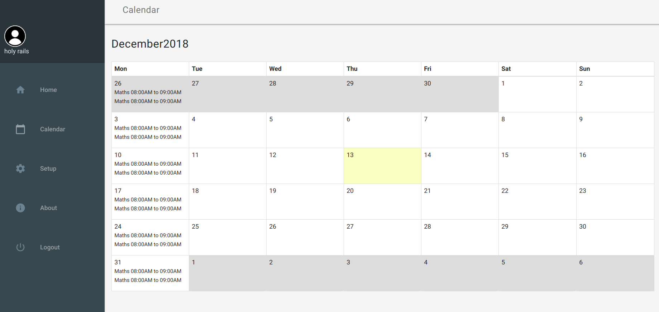
Study Tracker
Akshaye Anitha Pradeep, Anurag Das, Varsha Khanna, Manmeetkumar Patel, Akhilesh Rawat
CSCE 606 Software Engineering, Department of Computer Science and Engineering, Texas A&M University
Through this application, we create a platform for students to enter study goals, track amount of time spent working on a goal and their progress for a given topic, and also the ability to adjust goals. A student should be able to enter his study goals and the number of hours he/she has planned on studying the subject per week. He should then be able to plan a schedule by which he will be able to meet his study goals. He should, at any point of time, be able to view his planned schedule and how much of it he has completed. He should also be able to view his weekly schedule in a calendar.
Our application, Study Tracker, initially takes the information about a student’s study goals and his proposed schedule and sets up a dashboard view where he can see his progress and upcoming study sessions. It also provides a calendar view where he can see his schedule populated graphically. From the dashboard, he will be able to update his study goals as well as tweak his schedule. If he is unable to complete planned study sessions, he can reschedule it to a later time.
Introduction
Class Diagram
The Study Tracker app uses the tables : User table, Subject table, Schedule table and the Events table. We illustrate relationships between the four and the controllers with the following class diagram.
Additional Gems and Design Tools
User Stories
The Study Tracker application developed across four iterations uses the following set of stories. In each iteration the following set of user stories, or features, were developed. The stories starting from left to right also represent the flow of our application.
Websockets gem for persistent connection
Omniauth gem for email authentication, simple calendar gem for calendar view
Material design lite for incorporating material design in our application.
Heroku for application deployment
As a user of Study Tracker,
So that I can view and edit my study sessions,
I want to login to Study Tracker with my gmail account.
★
As a user of Study Tracker,
So that I can setup my study sessions,
I want to add details of my subjects and my study sessions.
As a user of Study Tracker,
So that I can manage my study goals,
I want to view my study schedules and my completion status.
Additional User Stories
Add/Modify Question Page
SCREENSHOT
(filled out new question for with a picture attached)
As a user, I want to logout so that I can end my current session
As a user, I want to switch between the setup screen and dashboard so that I can navigate smoothly.
As a user, I want to delete subjects. so that I can remove subjects entered erroneously,
As a user, I want to see pre-filled entries in the study details page, so that I know what to enter.
As a user of Study Tracker,
So that I can update my study plan,
I want to mark my schedule as completed
As a user of Study Tracker,
So that I can view all my schedules,
I want to view my schedule in a calendar format

