Slide 1

NTB
Stamp Duty and Registration Detail

Slide 2
NTB
Stamp Duty and Registration Detail
Faculty: Mr. Nguyen Hua Pho
Batch No: Accp 0906
Group No: 1
Team Members:
  1. Nguyen Dang Hoan accp0906-12
  2. Nguyen NgocNhat ktv0904b-01
  3. Pham Van Doan accp0904a-10
  4. Nguyen Quoc Hung accp0906-09

Slide 3

Introduction
National Territory Builders” (NTB) is one of the famous builders in the territory. They are currently facing the following problems with the current system such as : misplacement of the records, difficulties in communication and updating data due to distributed set up, calculate…
Now, the builder wants to incorporate an online application system through which he can automate the process and reduce the paper work by maintaining the whole data on to this application, so as to increase the rate of ease for tracking, and modifying the date that is once maintained.

Slide 4
Types of user
Administrator: manage NTB website.
Moderator: manage NTB website.
User : view information and update acc’ info
Guest: view information.

Slide 5
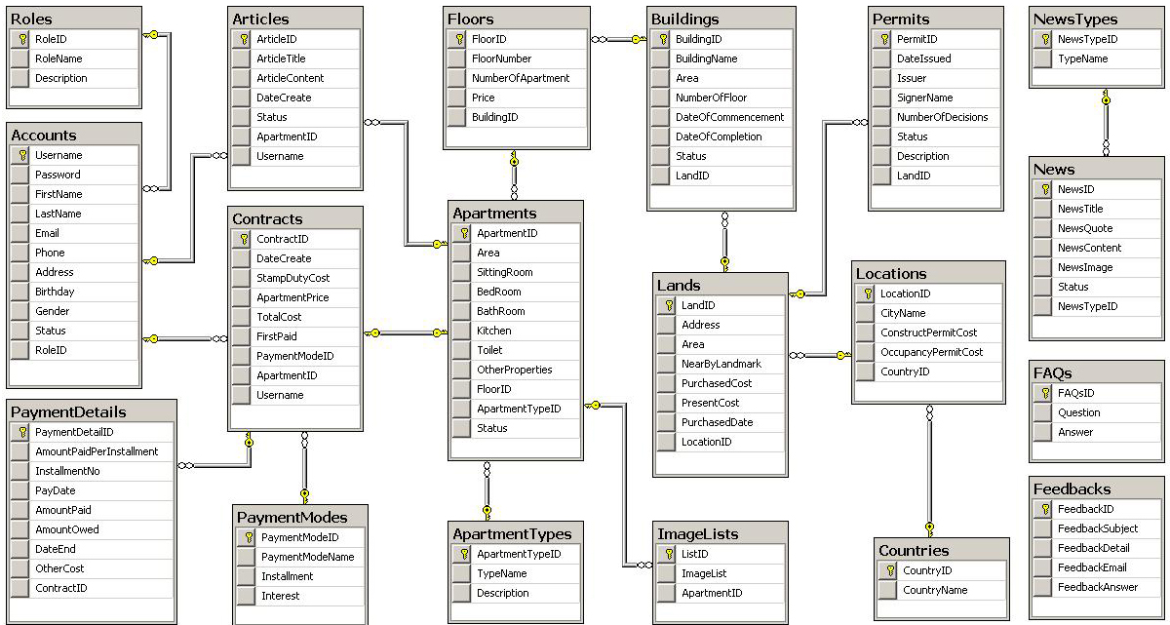
Database

