Slide 1
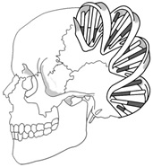
aDNA characteristics
Ancient DNA (aDNA)
Microbial DNA
Present-day human DNA
aDNA modifications

