Slide 1
The BitTorrent Protocol

Slide 2
What is BitTorrent?
Efficient content distribution system using file swarming. Does not perform all the functions of a typical p2p system, like searching.
The throughput increases with the number of down loaders via the efficient use of network bandwidth

Slide 3
File sharing
To share a file or group of files, the initiator first creates a
.torrent file, a small file that contains
Metadata about the files to be shared, and
Information about the tracker, the computer
that coordinates the file distribution.
Downloaders first obtain a .torrent file, and then connect
to the specified tracker, which tells them from which
other peers to download the pieces of the file.

Slide 4

How it works
The file to be distributed is split up into pieces and an SHA-1 hash is calculated for each piece

Slide 5
BT Components
The peers first obtain a metadata file for each object
The metadata contains:
The SHA-1 hashes of all pieces
A mapping of the pieces to files
Piece size
Length of the file
A tracker reference

Slide 6
BT Components
The tracker is a central server keeping a list of all peers participating in the swarm
A swarm is the set of peers that are participating in distributing the same files
A peer joins a swarm by asking the tracker for a peer list and connects to those peers.

Slide 7
BitTorrent Lingo
Seeder = a peer that provides the complete file.
Initial seeder = a peer that provides the initial copy.
Leecher
Initial seeder
One who is downloading
(not a derogatory term)
Leecher
Seeder

Slide 8


Simple example
{1,2,3,4,5,6,7,8,9,10}
Seeder: A
{}
{1,2,3}
{1,2,3,5}
{}
{1,2,3}
{1,2,3,4}
{1,2,3,4,5}
Downloader C
Downloader B

Slide 9
Basic Idea
As a leecher downloads pieces of the file, replicas of the pieces are created. More downloads mean more replicas available
As soon as a leecher has a complete piece, it can potentially share it with other downloaders. Eventually each leecher becomes a seeder by obtaining all the pieces, and assembles the file. Verifies the checksum.

Slide 10
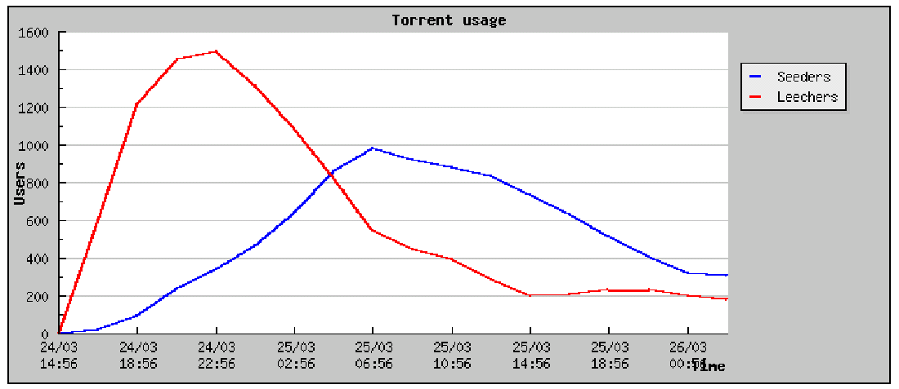
Operation

Slide 11
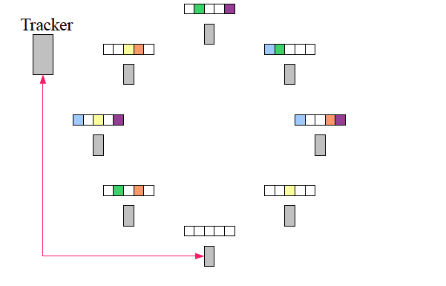
Download in progress

Slide 12
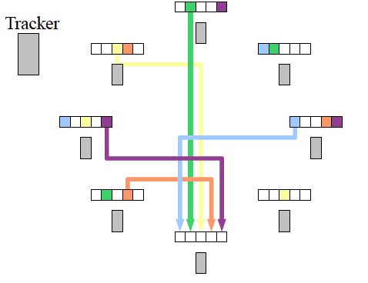
Download in progress

Slide 13
Pipelining
When transferring data over TCP, always have several requests pending at once (typically 5), to avoid a delay between pieces being sent.
Every time a piece or a sub-piece arrives, a new request is sent out.

Slide 14
Piece Selection
The order in which pieces are selected by different peers is critical for good performance
If an inefficient policy is used, then peers may end up in a situation where each has all identical set of easily available pieces, and none of the missing ones.
If the original seed is prematurely taken down, then the file cannot be completely downloaded! What are “good policies?”

Slide 15
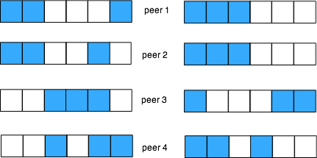
Piece Selection
Small overlap is good
Large overlap is bad
-- wastes bandwidth

Slide 16
Piece selection
Strict Priority
Rarest First
  General rule
Random First Piece
  Special case, at the beginning
Endgame Mode
  Special case

Slide 17
Random First Piece
Initially, a peer has nothing to trade
Important to get a complete piece ASAP
Select a random piece of the file and download it

Slide 18
Rarest Piece First
Determine the pieces that are most rare among your peers, and download those first.
This ensures that the most commonly available pieces are left till the end to download.

Slide 19
Endgame Mode
Near the end, missing pieces are requested from every peer containing them.
This ensures that a download is not prevented from completion due to a single peer with a slow transfer rate.
Some bandwidth is wasted, but in practice, this is not too much.

Slide 20
BT: internal mechanism
Built-in incentive mechanism (where all the magic happens):
  Choking Algorithm
  Optimistic Unchoking

Slide 21
Choking
Choking is a temporary refusal to upload. It is one of BT’s most powerful idea to deal with free riders (those who only download but never upload).
Tit-for-tat strategy is based on game-theoretic concepts.

Slide 22
Choking
Reasons for choking:
  Avoid free riders
  Network congestion
A good choking algorithm caps the number of
simultaneous uploads for good TCP performance.

Slide 23
More on Choking
Peers try out unused connections once in a while to find out if they might be better than the current ones (optimistic unchoking).

Slide 24
Optimistic unchoking
A BT peer has a single “optimistic unchoke” to which it uploads regardless of the current download rate from it. This peer rotates every 30s
Reasons:
  To discover currently unused connections that are better than the ones being used
  To provide minimal service to new peers

Slide 25
Upload-Only mode
Once download is complete, a peer can only upload. The question is, which nodes to upload to?
Policy: Upload to those with the best upload rate. This ensures that pieces get replicated faster, and new seeders are created fast

Slide 26
Questions about BT
What is the effect of bandwidth constraints?
Is the Rarest First policy really necessary?
Must nodes perform seeding after downloading is complete?
How serious is the Last Piece Problem?
Does the incentive mechanism affect the performance much?

Slide 27
Trackerless torrents
BitTorrent also supports "trackerless" torrents, featuring a DHT implementation that allows the client to download torrents that have been created without using a BitTorrent tracker.

