Slide 1
GraphQL Motivation (purpose of use )
GraphQL is a query language for your API, and a server-side runtime for executing queries by using a type system you define for your data.
GraphQL isn't tied to any specific database or storage engine and is instead backed by your existing code and data.
Multiple REST API End Points :
Only Single GraphQL End Point:

Slide 2
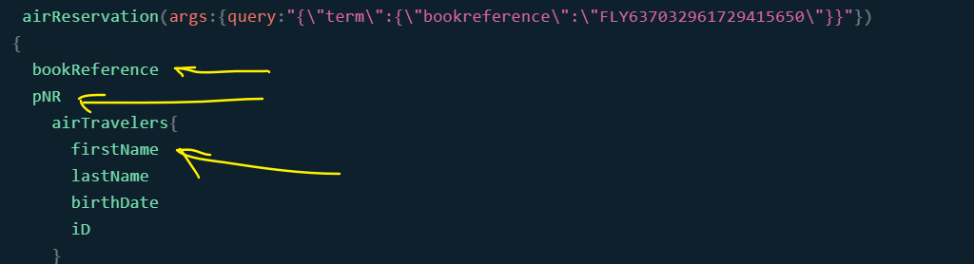
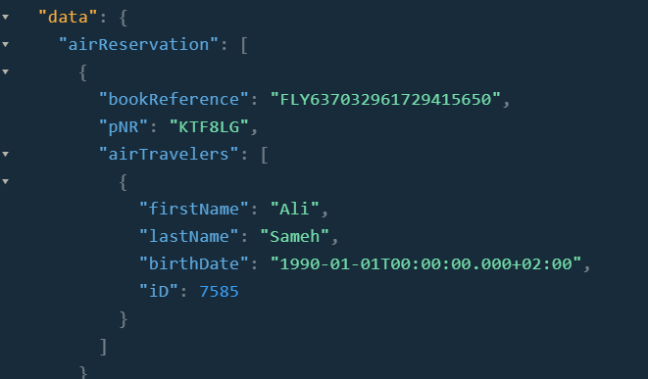
➔ The consumer of a GraphQL API defines the data structure it want to receive in a query
Output ➔

Slide 3
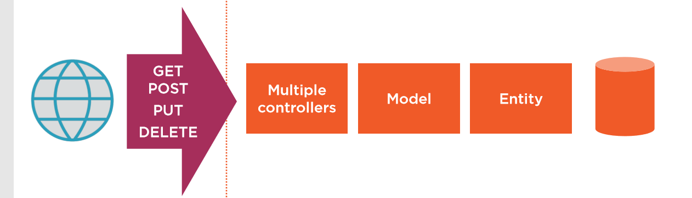
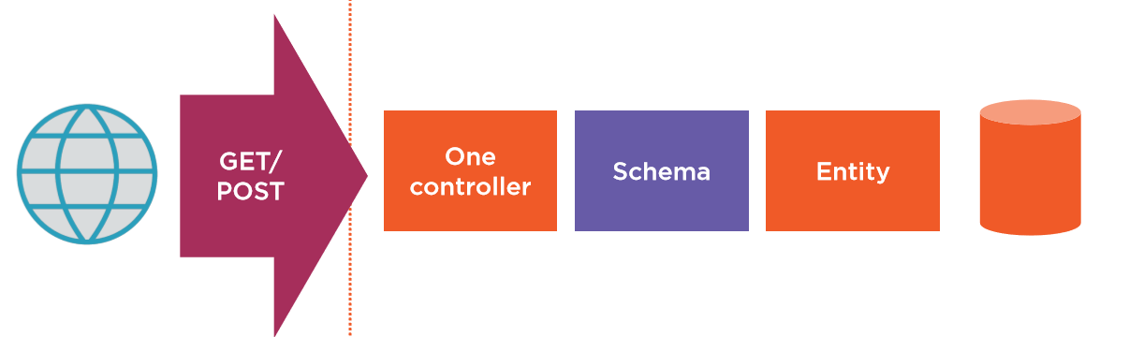
REST API
GraphQL API

Slide 4
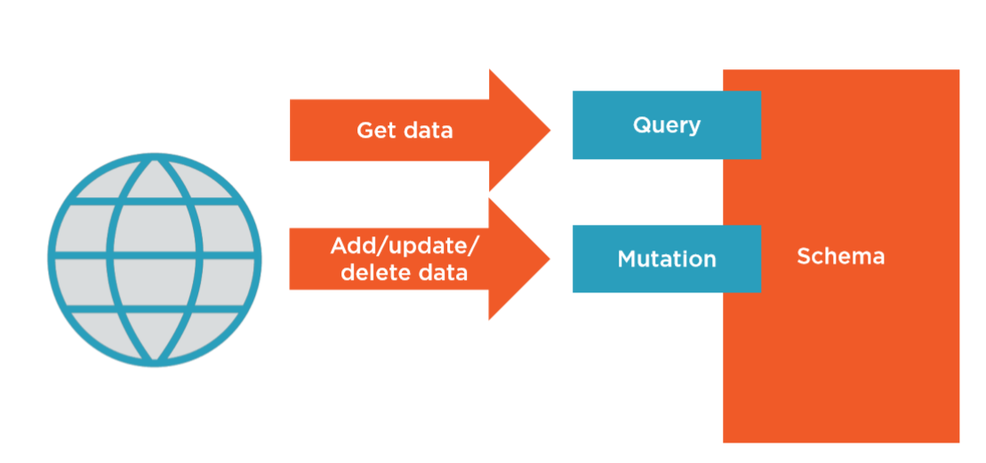
Operations :

Slide 5

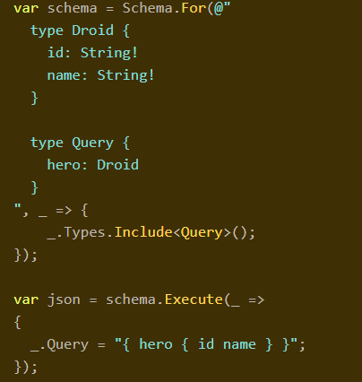

Slide 6

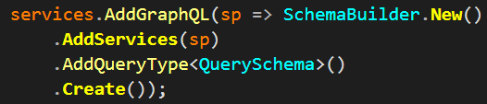
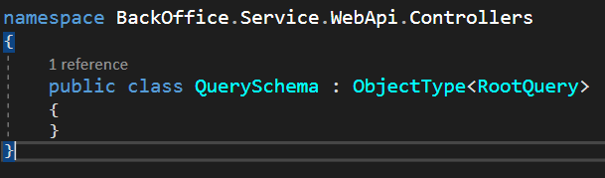
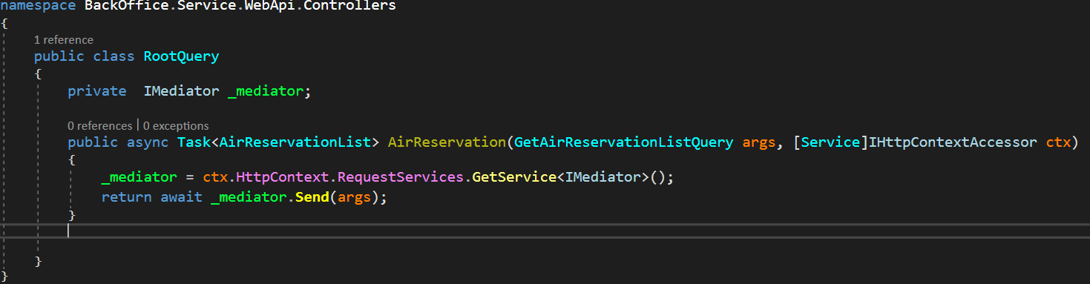

Slide 7
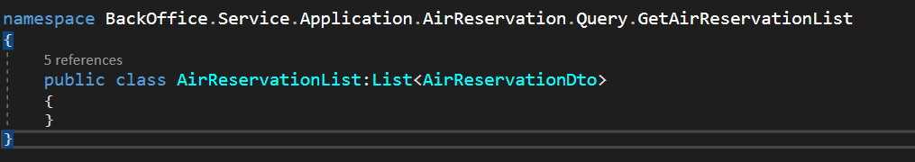
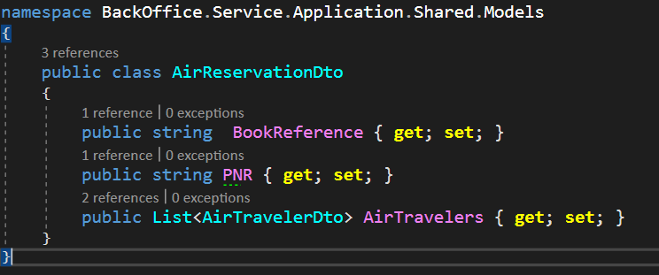
➔ How the Schema Understands my DTOs ?

Slide 8
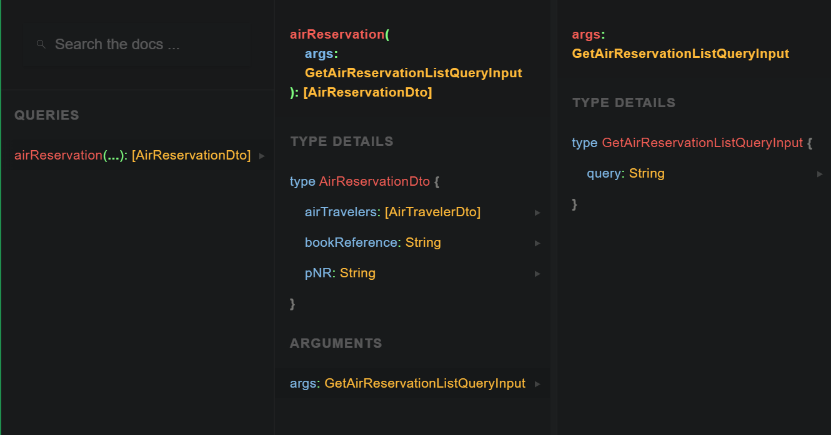
➔ Querying on Fields ( DOCS on Playground)

Slide 9

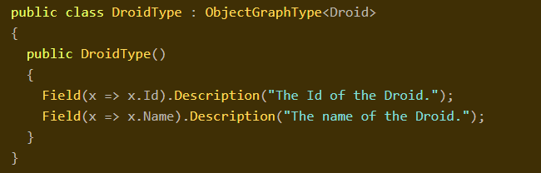
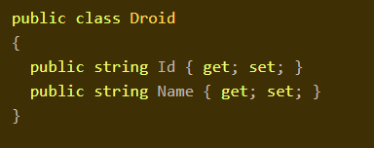

Slide 10
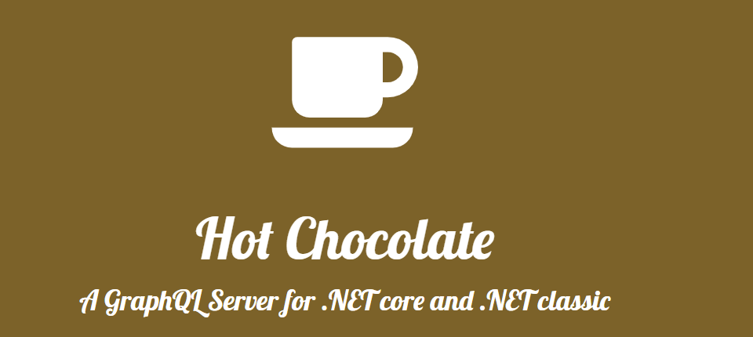


Install-Package HotChocolate.AspNetCore -Version 10.1.1
Install-Package HotChocolate.AspNetCore.Playground -Version 10.1.1

