Slide 1





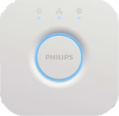
hue
mqtt
external control
3d mouse hover
3d mouse touch click
3d mouse touch hold
properties change
activate control
animation
color
3d slider

Slide 2
properties change
activate control
animation
color
single value
slider
function slider
states linear
states slider
multi slider
states interpolation
XY slider
multi slider

