Slide 1




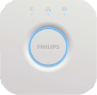

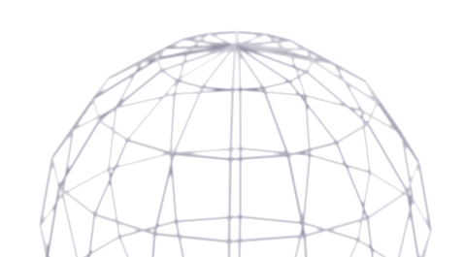
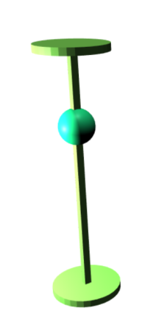
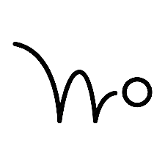
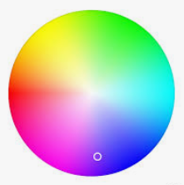

hue
mqtt
external control
mouse hover (3D)
mouse touch click (3D)
mouse touch hold (3D)
properties change
activate control
animation
color
light
3d slider

Slide 2
properties change
activate control
animation
color
single value
slider
function slider
states linear
states slider
multi slider
states interpolation
XY slider
multi slider

