Slide 1
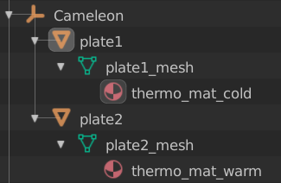
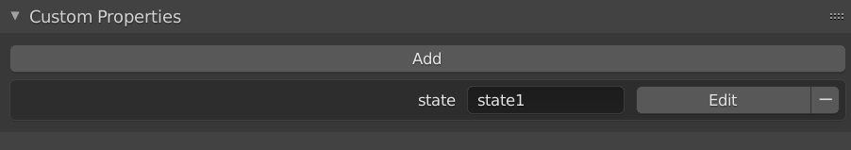
active state
child 1 = state 1
child 2 = state 2

Slide 2
dat.gui
callback
onChange
home_app.js
event three_param
three_app.js
mixer
setTime()

