Slide 1
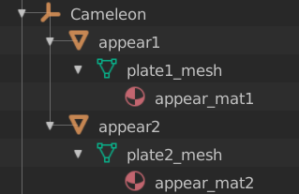
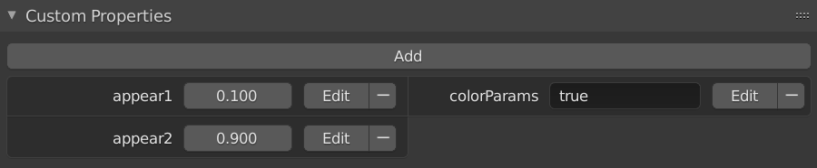
object name
child 1 = color 1
child 2 = color 2

Slide 2
dat.gui
callback
onChange
home_app.js
event three_param
three_app.js
mixer
setTime()

