Slide 1
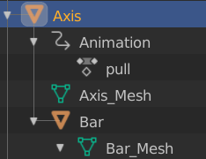
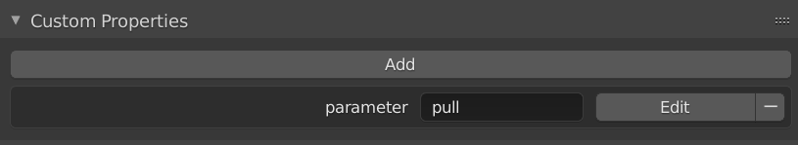
clip name

Slide 2
dat.gui
callback
onChange
home_app.js
event three_param
three_app.js
mixer
setTime()

