Slide 1
EC Smart Appliances Ontology project: status update
Date: 1 October 2014 DMS#: N/A Author: Frank den Hartog, Laura Daniele,
Jasper Roes Company: TNO For working group: SH TF For document: GWD050

Slide 2
Suggested actions
The authors propose that
HGI provides feedback to the EC Smart Appliances Ontology project team regarding their work done so far
HGI discusses with the project team how we can strengthen the collaboration, if needed
HGI considers using the ontology created by the project team as a basis for the HGI Device Model Template
2

Slide 3
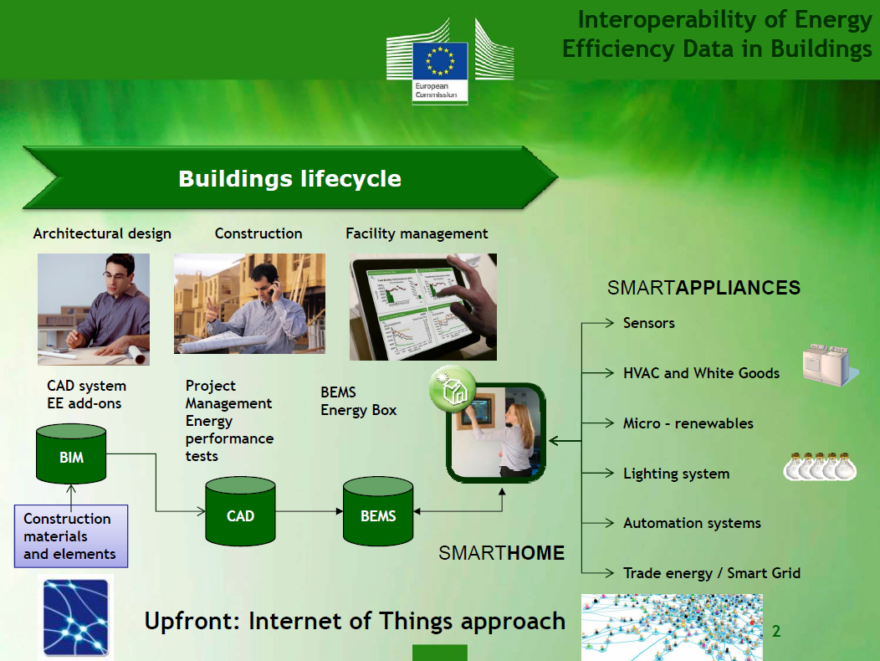
Slide from R. Segovia (EC)

Slide 4
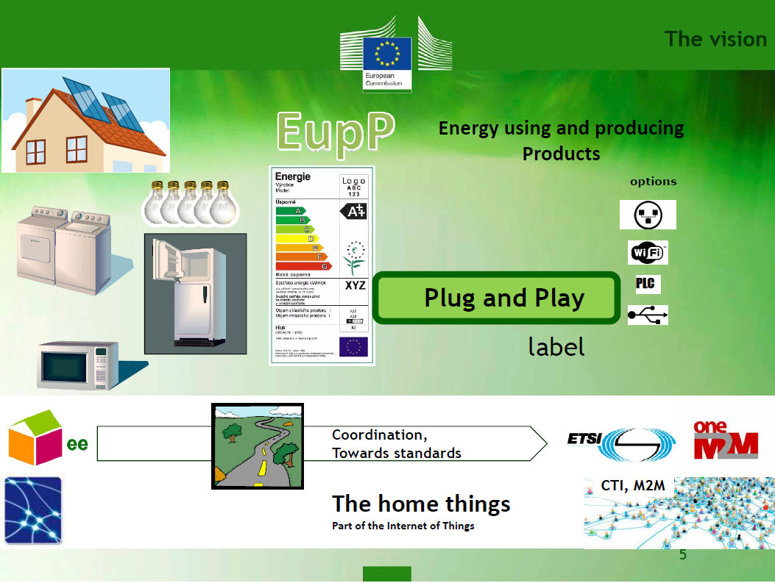
Slide from R. Segovia (EC)

Slide 5
The EC “Semantics of Smart Appliances” project
Goal: Support ETSI SMART M2M as an organization. Provide the material needed to define the relevant tools and data models for the collection of devices that helps the EU to reach its 2020 goals regarding the reduction of greenhouse gas emission and buildings’ energy consumption.
Tasks:
Take stock of existing semantic assets and use case assets
Perform a translation exercise of each model or use case to a reference ontology language and subsequently a mapping between these models
Propose a reference ontology and document it into ETSI M2M architecture
Timing: finished in February 2015
This is what we
now finished

Slide 6
Project execution
EC asked TNO to execute the project
Project is executed transparently; see:
LinkedIn group: http://www.linkedin.com/groups/Workshop-Stakeholders-on-Smart-Appliances-7450648
Website: https://sites.google.com/site/smartappliancesproject/
Public is continuously invited to provide the project team with feedback

Slide 7
Relevant deliverables
May 2014:
D-S1 First interim study report: Covering stock-taking activity of Task 1 and related semantic map. published
August 2014:
D-S2 Second interim study report: Translation of assets to OWL and mapping. Not exhaustive. published
D-O1 OWL-files of semantic assets in stable website . published
December 2014:
D-S3 Third interim study report: Unified ontology, and how it fits in ETSI M2M architecture
D-O2 Smart Appliances Unified Ontology, in stable website
February 2015:
D-S4: Final study report: combining and updating previous study reports
March 2015: 1-day Workshop

Slide 8

27 assets identified in the EC Invitation to Tender
From E2BA and the eeSemantics community:
FIEMSER Data Model for Monitoring & control network
eDiana (ARTEMIS) ontology for device discovery and interoperability
ENERsip M2M Communications Infrastructure Modelling Ontology
SmartCoDe EUP classification with respect to energy management
TIBUCON
SEEMPubS Ontology
SEIPF ontology
DEHEMS Digital Environment Home Energy Management System project
AIM*
Ebbits
SESAME Demonstrator
LinkSmart ontologies
Adapt4EE
MIRABEL Flex
eeSemantics EupP VoCamP
Hydra
From CECED,
EDI-SERVICE,
EDI-WHITE,
IRIS
PI
From Lighting Europe
CEN/TC 169
CIE Newsletter
International Lighting Vocabulary
buidlingSmart’s Industry Foundation Classes (IFC)
FIPA
Semantic Sensor Network Ontology (SSN)
CEN/CLC/ETSI Smart Grid CG M490
BACnet, KNX, LonWorks, and assets produced by Eu.bac and various CENELEC TCs
oBIX
SensorML

Slide 9
21 additional assets identified during project
ECHONET
Broadband Forum
HGI
OSGi
UPnP
Energy@Home
Agora
FAN
DomoML-env
OpenIoT
ZigBee Home Automation
ZigBee Light Link
OMA Lightweight M2M
DECT ULE
SEP2 (Zigbee, HomePlug, Wi-Fi)
Z-wave
Enocean
DLMS/COSEM
OMS
IETF CoAP
CENELEC-CEM, ‘Technical Report IEC 62746-2’, Draft version Technical Standard of CLC TC205 WG18

Slide 10
Why a reference ontology?
Explicitly specify
recurring core concepts in the smart appliances domain
the relationships between these concepts
mappings to other concepts used by different assets/standards/models.
The mappings allow translation from the reference ontology to specific assets, reducing the need to create translations between all individual assets.
With 48 assets, 48x47=2256 translations are required without the reference ontology.

Slide 11
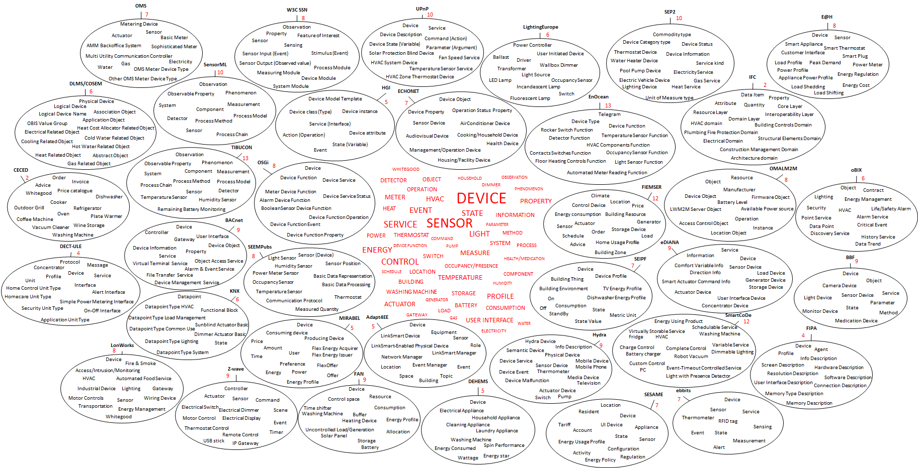
Visual representation of terminology overlap in 43 of these assets

Slide 12
Draft short list of assets from which reference ontology will be created
Selected NOT on the basis of market relevance
Model Acronym | Reference | URL
DECT ULE HAN FUN | HF-Overview, HF-Protocol, HF-Service, HF-Interface, HF-Profile, V1.00, 2014-23-1 | http://www.ulealliance.org/registration.aspx?f=11
ECHO NET | ECHONET Specifications Appendix “Detailed Requirements for ECHONET Device Objects” Release C, 31 May 2013 | http://www.echonet.gr.jp/english/spec/pdf_spec_app_c_e/SpecAppendixC_e.pdf
eDIANA | D2.2-A “Ontology for Device Awareness”, 30 November 2009 | http://s15723044.onlinehome-server.info/artemise/documents/D22A_Ontology_for_Device_Awareness_m10_IMSML.pdf
EnOcean EP | EnOcean Equipment Profiles (EEP), Version 2.6, 17 December 2013 | http://www.enocean-alliance.org/eep/
FAN FPAI | HEGRID AD1305 Interface description: Interface report, Version 1.0 (final), 7th January, 2014 | http://www.flexiblepower.org/downloads/
FIEMSER | D5 FIEMSER Data Model, February 2011 | http://www.fiemser.eu/wp-content/uploads/2011/12/D5_FIEMSER-data-model_m9_CSTmb_REVIEW.pdf
FIPA | FIPA Device Ontology Specification, SC00091E, 3 December 2002 | http://www.fipa.org/specs/fipa00091/SI00091E.pdf or http://www.fipa.org/specs/fipa00091/SI00091E.html
KNX | KNX System Specifications Interworking Datapoint Types, Version 1.07.00, 26 April 2012 | http://www.knx.org/media/docs/downloads/03%20-%20KNX%20Standard/KNX%20Standard%20Public%20Documents/03_07_02%20Datapoint%20Types%20v1.07.00%20AS.zip
MIRABEL | D7.5 “MIRABEL-ONE: Initial draft of the MIRABEL Standard, version1.0”, 22 December 2011 | http://wwwdb.inf.tu-dresden.de/miracle/publications/D7.5.pdf
OMA Light weight M2M | OMA Lightweight Machine-to-Machine Technical Specification Candidate version 1.0, 10 December 2013 | http://technical.openmobilealliance.org/Technical/release_program/docs/LightweightM2M/V1_0-20131210-C/OMA-TS-LightweightM2M-V1_0-20131210-C.pdf
OMS | Open Metering System Specification Vol.2 – Primary Communication Issue 4.0.2, and OMS-Data Point List –RELEASE A, Annex B to Volume 2: Primary Communication Issue 4.0.2, 27 January 2014 | http://oms-group.org/fileadmin/pdf/OMS-Spec_Vol2_Primary_v402.pdf , http://oms-group.org/fileadmin/pdf/OMS-Spec_Vol2_AnnexB_A031.pdf
OSGi DAL | RFC-196 OSGi Alliance Device Abstraction Layer, Draft, February 2014 | https://github.com/osgi/design/blob/master/rfcs/rfc0196/rfc-0196-DeviceAbstractionLayer.pdf
SEEMPubs | Deliverable D5.1 “Data Format Definition, version 1.0”, 30 September 2012 | http://seempubs.polito.it/images/stories/documents/WP5/D.5.1.pdf
PowerOnt | Dario Bonino, Fulvio Corno, Faisal Razzak “Enabling Machine Understandable Exchange of Energy Consumption Information in Smart Environments”, Energy and Buildings 43 (2011) 1392–1402 | http://dx.doi.org/10.1016/j.enbuild.2011.01.013
SEP2 | Zigbee Alliance / HomePlug Alliance Smart Energy Profile 2 Application Protocol Standard, ZigBee Public Document 13-0200-00, April 2013 | http://www.zigbee.org/Standards/ZigBeeSmartEnergy/ZigBeeSmartEnergy20Standard.aspx
Smart CoDE | Deliverable D1.1.2 “Model of local energy resource cluster”, 31 December 2012 | https://www.fp7-smartcode.eu/system/files/page/d-1.1.2.pdf
UPnP | UPnP Device Architecture 1.1, SolarProtectionBlind:1, HVAC:1, Lighting Controls:1 | http://upnp.org/specs/arch/UPnP-arch-DeviceArchitecture-v1.1.pdf , http://upnp.org/specs/ha/solarprotectionblind1/ , http://upnp.org/specs/ha/hvac/ , http://upnp.org/specs/ha/lighting/
W3C SSN | Semantic Sensor Network Ontology, | http://www.w3.org/2005/Incubator/ssn/ssnx/ssn
Z-Wave | Z-Wave Technical Basics Chapter 4 “Application Layer”, 1 June 2011 | http://www.domotiga.nl/attachments/download/1075/Z-Wave%20Technical%20Basics-small.pdf

Slide 13
Short listed assets are converted to OWL
Work done by hand rather than automatically
Only for the top classes
Tools exist to convert XML to OWL and vv, but lots of details checking needs to be done afterwards
Results can be found on https://sites.google.com/site/smartappliancesproject/ontologies
Comments are still welcome
Ontologies can be read with various tools, from simple web browsers, up to more advanced visualization tools such as Protégé (open source)

Slide 14
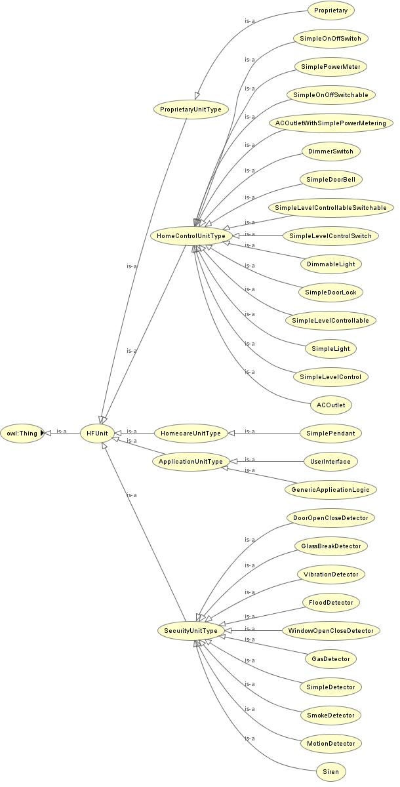
Example visualization (DECT ULE HAN FUN)

Slide 15
First conclusions regarding semantic coverage
3 main types of models can be distinguished, which have a focus on either:
Devices, sensors and their specification in terms of services, functions and states
Energy consumption information and profiles to optimize energy efficiency
Building-related semantic models
Assets fall typically in one of these categories and do not show much (linguistic) overlap with assets from other categories.

Slide 16
Draft proposal core concepts of the reference ontology
Device
Device category
Function
Function category
Service
Command
Parameter
Mode/Status
Energy profile
Energy
Power
Time/Duration
Building
Sensor
Actuator
Meter
Load
Storage
Generator
Unit of Measure

Slide 17
Initial mapping between the short-listed assets and the core concepts of a reference ontology
 | device | service | device cat. | function cat. | function | command | parameter | mode/status | energy profile | energy | power | time/duration | building | sensor | actuator | meter | load | storage | generator | unit of measure
DECT ULE | x | x |  | x | x | x | x |  |  |  | x | x |  | x | x | x
PowerOnt | x |  |  | x | x | x |  | x |  |  | x |  | x |  |  |  |  |  |  | x
ECHONET | x |  | x |  | x |  |  | x |  |  |  |  | x | x
eDIANA | x | x |  |  |  | x |  |  |  |  |  |  |  | x | x |  | x | x | x
EnOcean | x |  | x | x | x |  |  |  |  |  |  |  |  | x |  | x
FAN FPAI | x |  | x | x | x |  |  |  | x | x | x | x |  |  |  |  | x | x | x | x
FIEMSER | x |  |  |  |  |  |  | x |  |  |  |  | x | x | x |  | x | x | x
FIPA | x
KNX | x |  |  | x |  | x |  | x |  |  |  |  |  |  | x
MIRABEL | x |  |  |  |  |  |  |  | x | x | x | x |  |  |  |  | x | x | x | x
OMA M2M | x |  |  |  |  | x | x
OMS | x |  |  |  |  |  |  |  |  | x | x | x |  |  |  | x |  |  |  | x
OSGi DAL | x |  |  |  | x | x | x | x |  |  |  |  |  | x |  | x |  |  |  | x
SEEMpubs | x |  | x |  |  |  |  | x |  | x | x |  | x | x |  |  |  |  |  | x
SEP2 | x | x |  |  | x |  |  | x |  |  | x | x |  |  |  | x |  |  |  | x
SmartCoDE | x |  | x |  |  |  | x |  |  |  |  |  |  |  |  |  | x | x | x
UPnP | x | x |  |  |  | x | x | x
W3C SSN | x |  |  |  |  |  |  |  |  |  |  | x |  | x |  |  |  |  |  | x
Z-Wave | x |  | x | x | x | x |  |  |  |  |  |  |  | x | x

Slide 18
Future work
Collect comments from industry and fine-tune long list, short list, core concepts, etc. as needed
Create reference ontology
Integrate it into the ETSI M2M Architecture
After the official end of the project: Improve and maintain ontology within ETSI

