Slide 1
INDEPENDENT CASCA FDE PROOF OF WORK
I built the deployment room
I would have wanted as a banker.
A production-proven, governed SMB lending workflow inside NodeRoom.
Former JPMorgan commercial credit, healthcare / life-science and startup banking
Now building the agent systems I needed as an operator.
INDEPENDENT PROJECT · NOT AFFILIATED WITH OR ENDORSED BY CASCA
01

Slide 2
CASCA FDE DEPLOYMENT LAB
The hard problem is reconstructing the operating workflow—not adding a chatbot.
01
02
03
04
DOCUMENT STATE
DEPENDENCY
AUTHORITY
PROOF
What exists, what is missing, and what changed?
What blocks a complete credit file right now?
Which action belongs to the agent, banker, or credit officer?
Can the packet be reopened and independently checked?
Synthetic borrower data only. The workflow prepares and validates a human-review packet; it never makes the credit decision.
INDEPENDENT PROOF OF WORK · 2026-07-21
02

Slide 3
CASCA FDE DEPLOYMENT LAB
The Casca-inspired workflow lives inside NodeRoom—not beside it.
01
02
03
04
NODE ROOM
SMB LENDING PACK
GOVERNED TRANSACTION
OPTIONAL GRAPH READ MODEL
→
→
→
Canonical room, identity, collaboration, artifacts and approval history
Synthetic fixtures, document logic, critical path, calculations and validators
Pinned proposal → validation → human decision → CAS apply → receipt
Tenant-scoped blocker and path queries; never canonical application state
One product surface. One proposal lifecycle. One receipt format.
INDEPENDENT PROOF OF WORK · 2026-07-21
03

Slide 4
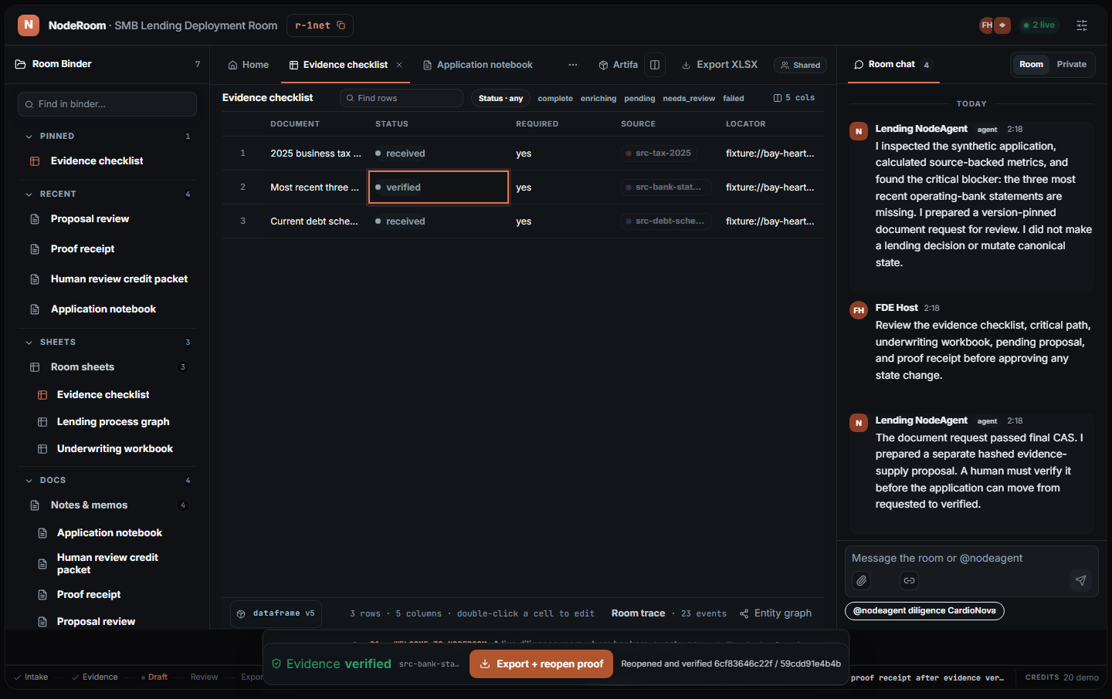
CASCA FDE DEPLOYMENT LAB
The browser journey completed the full governed transaction.
2
Sequential human approvals
v1 → v3
CAS-protected application versions
2 hashes
Export and packet reopened independently
No credit decision
Authority remains human.
INDEPENDENT PROOF OF WORK · 2026-07-21
04

Slide 5
CASCA FDE DEPLOYMENT LAB
Human credit authority is encoded into the transaction.
STATE
AGENT / SYSTEM
PROPOSAL
AUTHORITY
01
MISSING
Base version pinned
Request document
Human approval
02
REQUESTED
Source + digest supplied
Verify evidence
Human approval
03
VERIFIED
Packet regenerated atomically
Export + reopen
Independent proof
Every transition is reviewable, versioned, and receipt-backed—even when policy eventually automates a low-risk step.
INDEPENDENT PROOF OF WORK · 2026-07-21
05

Slide 6
CASCA FDE DEPLOYMENT LAB
Production proof found a defect that health checks missed.
FIRST ATTEMPT
REPAIRED RELEASE
Frontend and backend
served different deployments.
Verified served bundle
→ exact clean redeploy
→
The page was healthy. The production journey stalled.
The same browser journey then passed and persisted after reload.
FDE lesson: deployment is not complete until the user-visible workflow proves the exact frontend/backend binding.
INDEPENDENT PROOF OF WORK · 2026-07-21
06

Slide 7
CASCA FDE DEPLOYMENT LAB
The benchmark is dimensional—never a universal winner claim.
10 / 10
3× each
100%
0%
Locked runs passed
Model-backed repetitions
Document recall + blocker recall
False requirement rate
MEAN RUNTIME · MILLISECONDS
Manual
0 ms
1 run
Chat-only
3,328 ms
3 runs
Graph agent
7,009 ms
3 runs
Memory-enhanced
8,367 ms
3 runs
Billed provider cost was unavailable in the response, so the receipt records cost as n/a instead of estimating it.
INDEPENDENT PROOF OF WORK · 2026-07-21
07

Slide 8
CASCA FDE DEPLOYMENT LAB
The deployment separates configuration from reusable platform learning.
BANK-SPECIFIC
REUSABLE NOW
NEXT PLATFORM GAPS
•
Document checklist
•
Pinned proposals + CAS
•
Actual-byte browser upload
•
Product stages
•
Evidence lineage
•
Optional Neo4j read projection
•
Policy / exception rules
•
Decision-free packets
•
External bank connectors
•
Integration mapping
•
Export / reopen receipts
•
More held-out products
This is the FDE flywheel: map one customer deeply, ship one bounded workflow, then promote only the proven primitives into the platform.
INDEPENDENT PROOF OF WORK · 2026-07-21
08

Slide 9
WHY CASCA · WHY ME
Banking fluency expressed
as deployed software.
01 LIVED THE WORKFLOW
02 BUILT THE SYSTEM
03 CLOSED THE LOOP
Commercial credit, healthcare / life-science and startup banking
NodeRoom proposal, evidence, CAS, packet and proof lifecycle
Production browser proof exposed and repaired a real deployment split
Give me one real workflow. I’ll map it, ship it, and prove it.
PUBLIC APP · NODEROOM.LIVE · SOURCE + PROOF AVAILABLE
09

