Slide 1
NODESLIDE / 01
Build the story. Keep every decision editable.
NodeSlide treats a deck as a typed system: narrative, geometry, sources, comments, and changes stay connected from first brief to final room.
• Structured canvas
• Guarded edits
• Traceable claims
NODESLIDE · SOURCE-AWARE · EDITABLE
01
Notes:
Narrative role: NodeSlide / 01. Keep the spoken transition focused on “Build the story. Keep every decision editable.” Evidence note: Content is based on the supplied creation brief. Illustrative examples are not independently verified; replace them with measured evidence before external publication. NodeSlide sources [source_93ab71e30efa8578017c37e8da0fa12f] NodeSlide product brief Citation: Show how NodeSlide turns presentation work into a traceable, editable, reviewable system. Disclaimer: Internal working material

Slide 2
SCENARIO / 02
Keep source context attached as the story moves.
This golden scenario focuses on one design goal: keep copy, layout, citations, and feedback connected through drafting, review, revision, and handoff.
CONTEXT
01 Draft with source context
Qualitative workflow label — not a measured benchmark
02 Review on stable anchors
03 Hand off editable structure
NODESLIDE · SOURCE-AWARE · EDITABLE
02
Notes:
Narrative role: Scenario / 02. Keep the spoken transition focused on “Keep source context attached as the story moves.” Evidence note: Content is based on the supplied creation brief. Illustrative examples are not independently verified; replace them with measured evidence before external publication. NodeSlide sources [source_93ab71e30efa8578017c37e8da0fa12f] NodeSlide product brief Citation: Show how NodeSlide turns presentation work into a traceable, editable, reviewable system. Disclaimer: Internal working material [source_8a22baf6717d3e9cb4de18a8a81d6d82] Golden workflow scenario Citation: Qualitative product-workflow scenario for demonstrating NodeSlide; no measured customer benchmark is claimed. Disclaimer: Internal working material

Slide 3
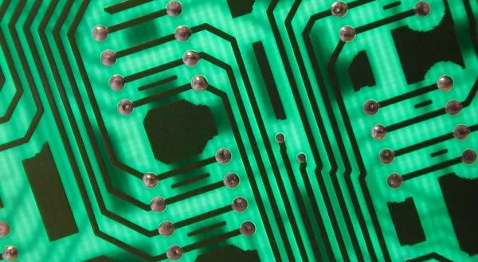
FOUNDATION / 03
Structure turns a visual artifact into an operating surface.
Slides and elements carry stable IDs, normalized geometry, source links, export capability, locks, and independent versions.
01 Stable IDs survive every view
02 Normalized boxes travel across renderers
Twechie · BY-SA 2.0 via Openverse
03 Locks protect intent
NODESLIDE · SOURCE-AWARE · EDITABLE
03
Notes:
Narrative role: Foundation / 03. Keep the spoken transition focused on “Structure turns a visual artifact into an operating surface.” Evidence note: Content is based on the supplied creation brief. Illustrative examples are not independently verified; replace them with measured evidence before external publication. NodeSlide sources [source_93ab71e30efa8578017c37e8da0fa12f] NodeSlide product brief Citation: Show how NodeSlide turns presentation work into a traceable, editable, reviewable system. Disclaimer: Internal working material [source_8a22baf6717d3e9cb4de18a8a81d6d82] Golden workflow scenario Citation: Qualitative product-workflow scenario for demonstrating NodeSlide; no measured customer benchmark is claimed. Disclaimer: Internal working material

Slide 4
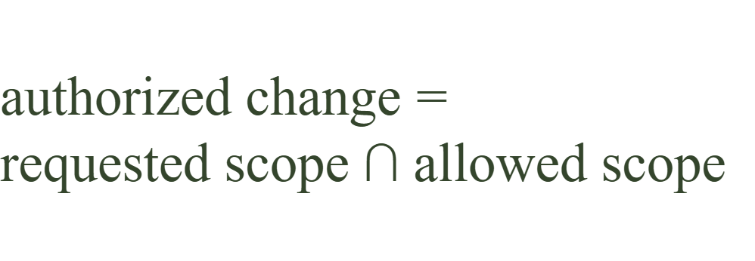
WORKFLOW / 04
Plan → propose → commit, with scope checked at every boundary.
The agent can reason broadly, but it may only write inside the explicit deck, slide, element, comment, or bounding-box scope.
01 Read context
02 Propose an inspectable patch
03 Validate and accept atomically
NODESLIDE · SOURCE-AWARE · EDITABLE
04
Notes:
Narrative role: Workflow / 04. Keep the spoken transition focused on “Plan → propose → commit, with scope checked at every boundary.” Evidence note: Content is based on the supplied creation brief. Illustrative examples are not independently verified; replace them with measured evidence before external publication. NodeSlide sources [source_93ab71e30efa8578017c37e8da0fa12f] NodeSlide product brief Citation: Show how NodeSlide turns presentation work into a traceable, editable, reviewable system. Disclaimer: Internal working material [source_8a22baf6717d3e9cb4de18a8a81d6d82] Golden workflow scenario Citation: Qualitative product-workflow scenario for demonstrating NodeSlide; no measured customer benchmark is claimed. Disclaimer: Internal working material

Slide 5
PROOF / 05
A beautiful deck still needs deterministic gates.
Structural, geometry, source, and export checks produce separate signals for basic validity, publishing safety, and a clean handoff.
3 gates
independent validation signals: ok, publishOk, cleanOk
01 ok · structurally valid
02 publishOk · safe to present
03 cleanOk · no warnings
NODESLIDE · SOURCE-AWARE · EDITABLE
05
Notes:
Narrative role: Proof / 05. Keep the spoken transition focused on “A beautiful deck still needs deterministic gates.” Evidence note: Content is based on the supplied creation brief. Illustrative examples are not independently verified; replace them with measured evidence before external publication. NodeSlide sources [source_93ab71e30efa8578017c37e8da0fa12f] NodeSlide product brief Citation: Show how NodeSlide turns presentation work into a traceable, editable, reviewable system. Disclaimer: Internal working material [source_8a22baf6717d3e9cb4de18a8a81d6d82] Golden workflow scenario Citation: Qualitative product-workflow scenario for demonstrating NodeSlide; no measured customer benchmark is claimed. Disclaimer: Internal working material

Slide 6
TRUST / 06
Comments become context. Patches remain choices.
A reviewer can anchor feedback to a deck, slide, element, or region; link the resolution to an accepted patch; and restore any prior snapshot.
01 Anchored discussion
02 Compare-and-set acceptance
03 Version recovery
NODESLIDE · SOURCE-AWARE · EDITABLE
06
Notes:
Narrative role: Trust / 06. Keep the spoken transition focused on “Comments become context. Patches remain choices.” Evidence note: Content is based on the supplied creation brief. Illustrative examples are not independently verified; replace them with measured evidence before external publication. NodeSlide sources [source_93ab71e30efa8578017c37e8da0fa12f] NodeSlide product brief Citation: Show how NodeSlide turns presentation work into a traceable, editable, reviewable system. Disclaimer: Internal working material

Slide 7
NEXT / 07
Move at presentation speed without giving up engineering-grade trust.
Start with a brief, shape the narrative together, and leave with a deck whose content, sources, changes, and exports are still yours.
• Create from brief
• Review every change
• Present with confidence
NODESLIDE · SOURCE-AWARE · EDITABLE
07
Notes:
Narrative role: Next / 07. Keep the spoken transition focused on “Move at presentation speed without giving up engineering-grade trust.” Evidence note: Content is based on the supplied creation brief. Illustrative examples are not independently verified; replace them with measured evidence before external publication. NodeSlide sources [source_93ab71e30efa8578017c37e8da0fa12f] NodeSlide product brief Citation: Show how NodeSlide turns presentation work into a traceable, editable, reviewable system. Disclaimer: Internal working material

