Slide 1
NARRATIVE FOUNDATIONS · HERO THESIS
Reviewability turns generation into a product decision
BREADTH
MOTION
PROOF
38
canonical visual artifacts
14-slide public narrative
One evidence-bounded thesis anchors the complete visual vocabulary.
SOURCE · atlas-v2-hero-thesis · deterministic builder v2
ULTRA V2 01
Notes:
Artifact 01: hero-thesis One evidence-bounded thesis anchors the complete visual vocabulary. Source: atlas-v2-hero-thesis Human preference: pending.

Slide 2
PROGRESSION · EVIDENCE SCROLLYTELLING
Evidence becomes a decision through five inspectable states
1
Source
3
Bind claim
5
Deck CI
2
Extract
4
Build visual
WEB · scroll scrub PPTX · five stepped states REDUCED MOTION · final state
The web version scrubs; PowerPoint shows the same numbered progression.
SOURCE · atlas-v2-evidence-scrollytelling · deterministic builder v2
ULTRA V2 02
Notes:
Artifact 21: evidence-scrollytelling The web version scrubs; PowerPoint shows the same numbered progression. Source: atlas-v2-evidence-scrollytelling Human preference: pending.

Slide 3
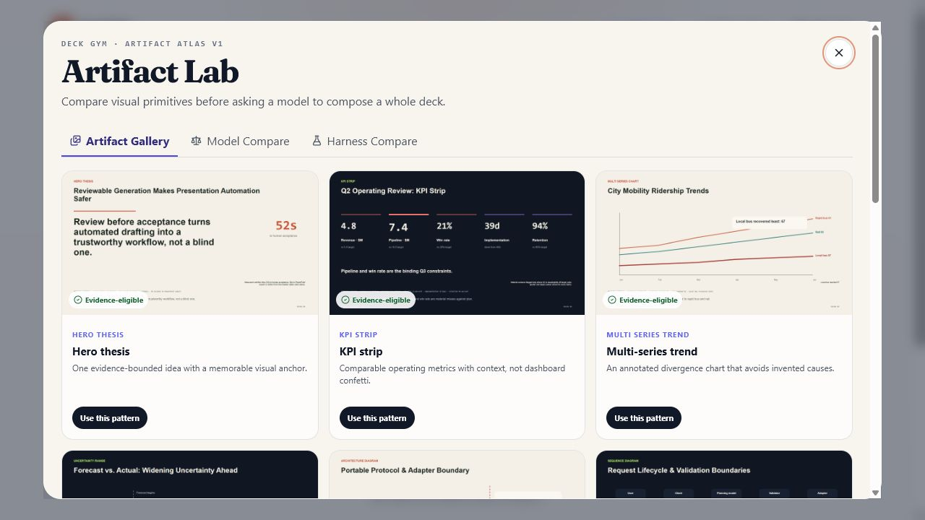
PRODUCT MEDIA · REAL SCREENSHOT CALLOUTS
The product proof is the interface people actually use
1
V1 gallery
12 patterns
2
model compare
keeps failures red
3
use pattern
starts a real workflow
A real NodeSlide capture occupies most of the slide with three exact callouts.
SOURCE · atlas-v2-real-screenshot-callouts · deterministic builder v2
ULTRA V2 03
Notes:
Artifact 24: real-screenshot-callouts A real NodeSlide capture occupies most of the slide with three exact callouts. Source: atlas-v2-real-screenshot-callouts Human preference: pending.

Slide 4
SYSTEMS · REQUEST SEQUENCE
Review custody is visible at every handoff
User
Client
Planner
Validator
Adapter
submit
bounded context
typed plan
issues / pass
accepted commit
versioned receipt
The happy path and failed-validation return path remain distinct.
SOURCE · atlas-v2-request-sequence · deterministic builder v2
ULTRA V2 04
Notes:
Artifact 14: request-sequence The happy path and failed-validation return path remain distinct. Source: atlas-v2-request-sequence Human preference: pending.

Slide 5
DATA · DENSE DASHBOARD FUNNEL
A dashboard can be dense without becoming a card graveyard
FROZEN ARENA · CANDIDATE FUNNEL
EXCEPTIONS
Briefs · 100
2 Arena candidates failed gates
Historical result; not current Atlas status
Candidates · 84
Valid renders · 83
DECISION QUEUE
Deck CI · 82
Review model-blind pairs
Prior human winner · 1
Approve public 14
Promote recipes only
A funnel, trend, exceptions, and decision queue share one controlled surface.
SOURCE · atlas-v2-dense-dashboard-funnel · deterministic builder v2
ULTRA V2 05
Notes:
Artifact 12: dense-dashboard-funnel A funnel, trend, exceptions, and decision queue share one controlled surface. Source: atlas-v2-dense-dashboard-funnel Human preference: pending.

Slide 6
DECISION EVALUATION · COST QUALITY FRONTIER
Routing improves when quality, cost, and latency are judged together
Eligible fraction →
OBSERVED FRONTIER
100%
Claude · 24/24 · $0.0086 · 8.2s
Bubble size
= latency
Kimi · 23/24 · $0.0013 · 17.6s
Y-axis shown from
90–100% eligible
95%
Gemma · 23/24 · $0 · 17.3s
Ensemble · not yet run
90%
$0
$0.004
$0.008
Observed cost per candidate →
The observed routes stay separate from the not-yet-run ensemble.
SOURCE · atlas-v2-cost-quality-frontier · deterministic builder v2
ULTRA V2 06
Notes:
Artifact 35: cost-quality-frontier The observed routes stay separate from the not-yet-run ensemble. Source: atlas-v2-cost-quality-frontier Human preference: pending.

Slide 7
SYSTEMS · SYSTEM ARCHITECTURE
The portable protocol keeps product logic above backend choice
Memory
Portable protocol
initialize · stage · commit
Adapter boundary
Client
Validation engine
Convex
TRUST BOUNDARY · persistence only
Postgres
Typed connectors and a visible trust boundary preserve system meaning.
SOURCE · atlas-v2-system-architecture · deterministic builder v2
ULTRA V2 07
Notes:
Artifact 13: system-architecture Typed connectors and a visible trust boundary preserve system meaning. Source: atlas-v2-system-architecture Human preference: pending.

Slide 8
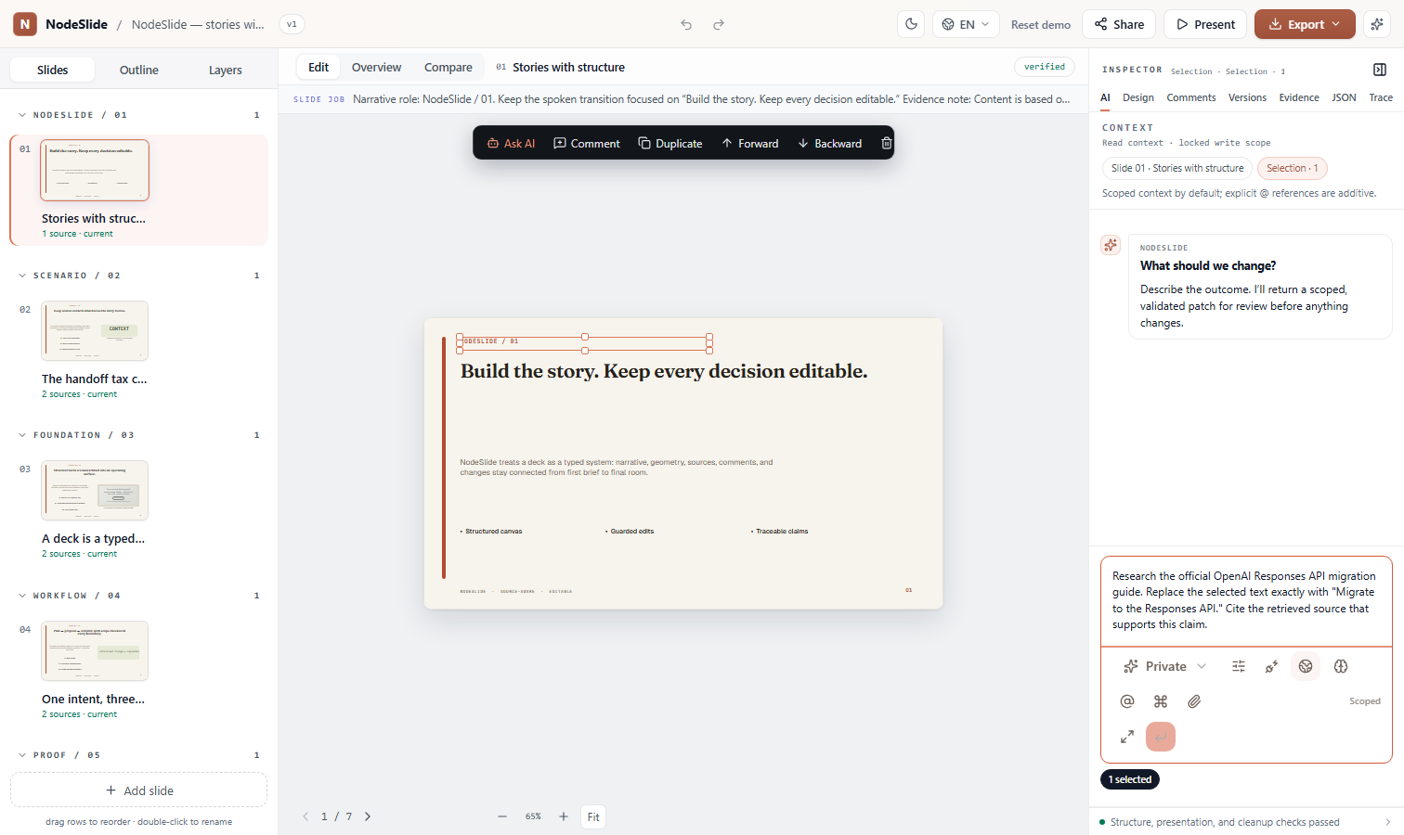
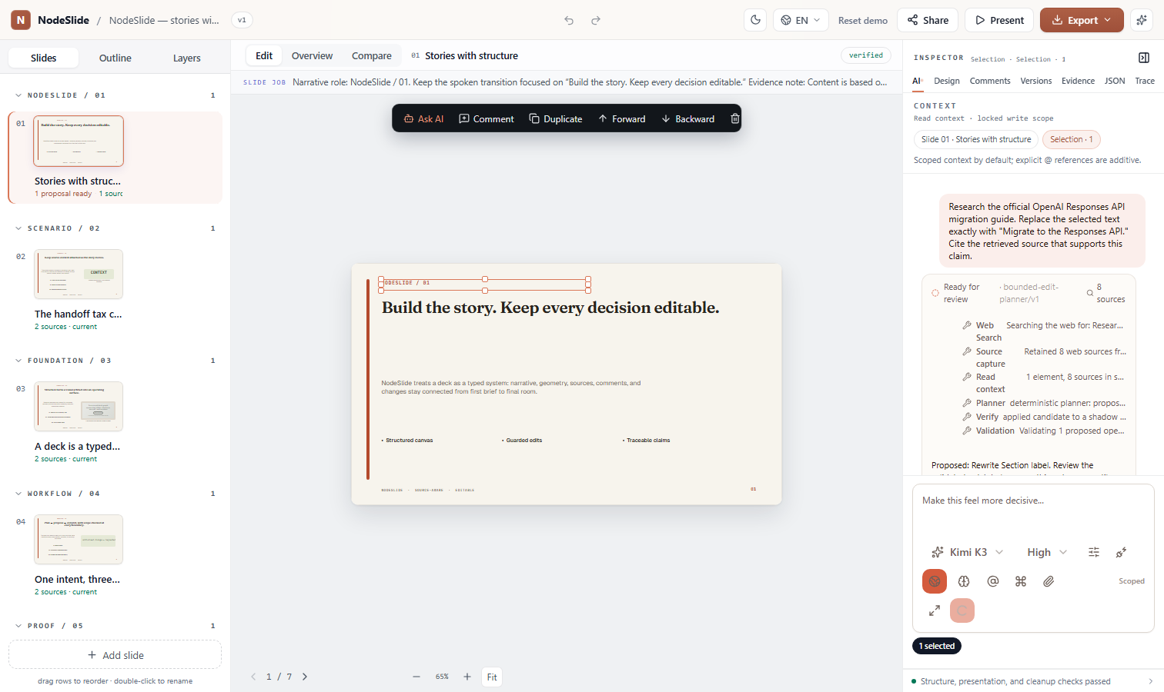
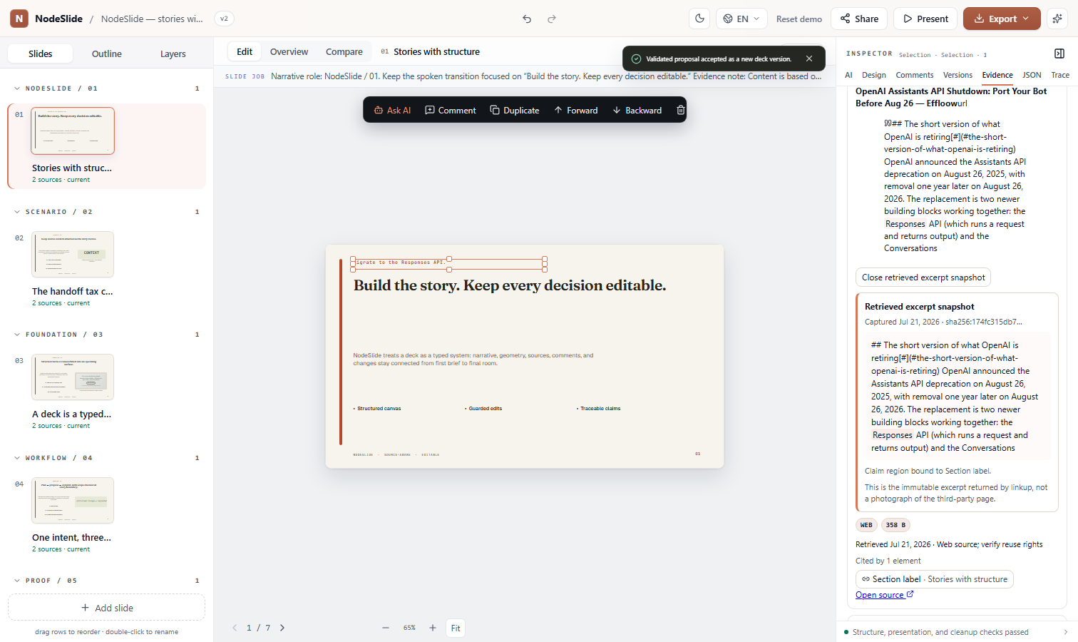
PRODUCT MEDIA · INTERACTION CLIP
One bounded interaction carries the story from selection to receipt
1 · consented request
3 · review proposal
5 · source-bound result
select
ask agent
handoff
canvas update
version +1
3 captured checkpoints · 5 declared workflow steps
Three captured product states anchor a five-step workflow and its PowerPoint fallback.
SOURCE · atlas-v2-interaction-clip · deterministic builder v2
ULTRA V2 08
Notes:
Artifact 25: interaction-clip Three captured product states anchor a five-step workflow and its PowerPoint fallback. Source: atlas-v2-interaction-clip Human preference: pending.

Slide 9
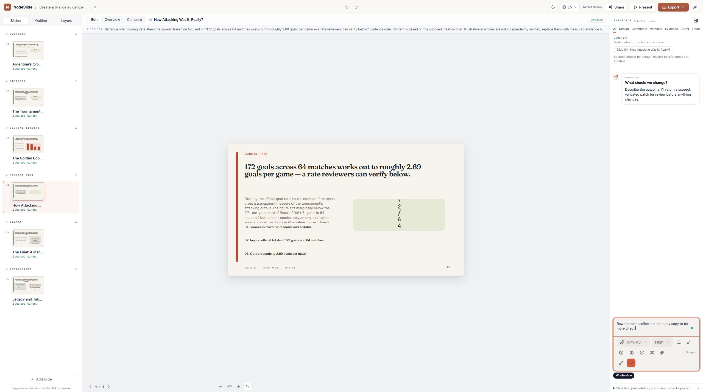
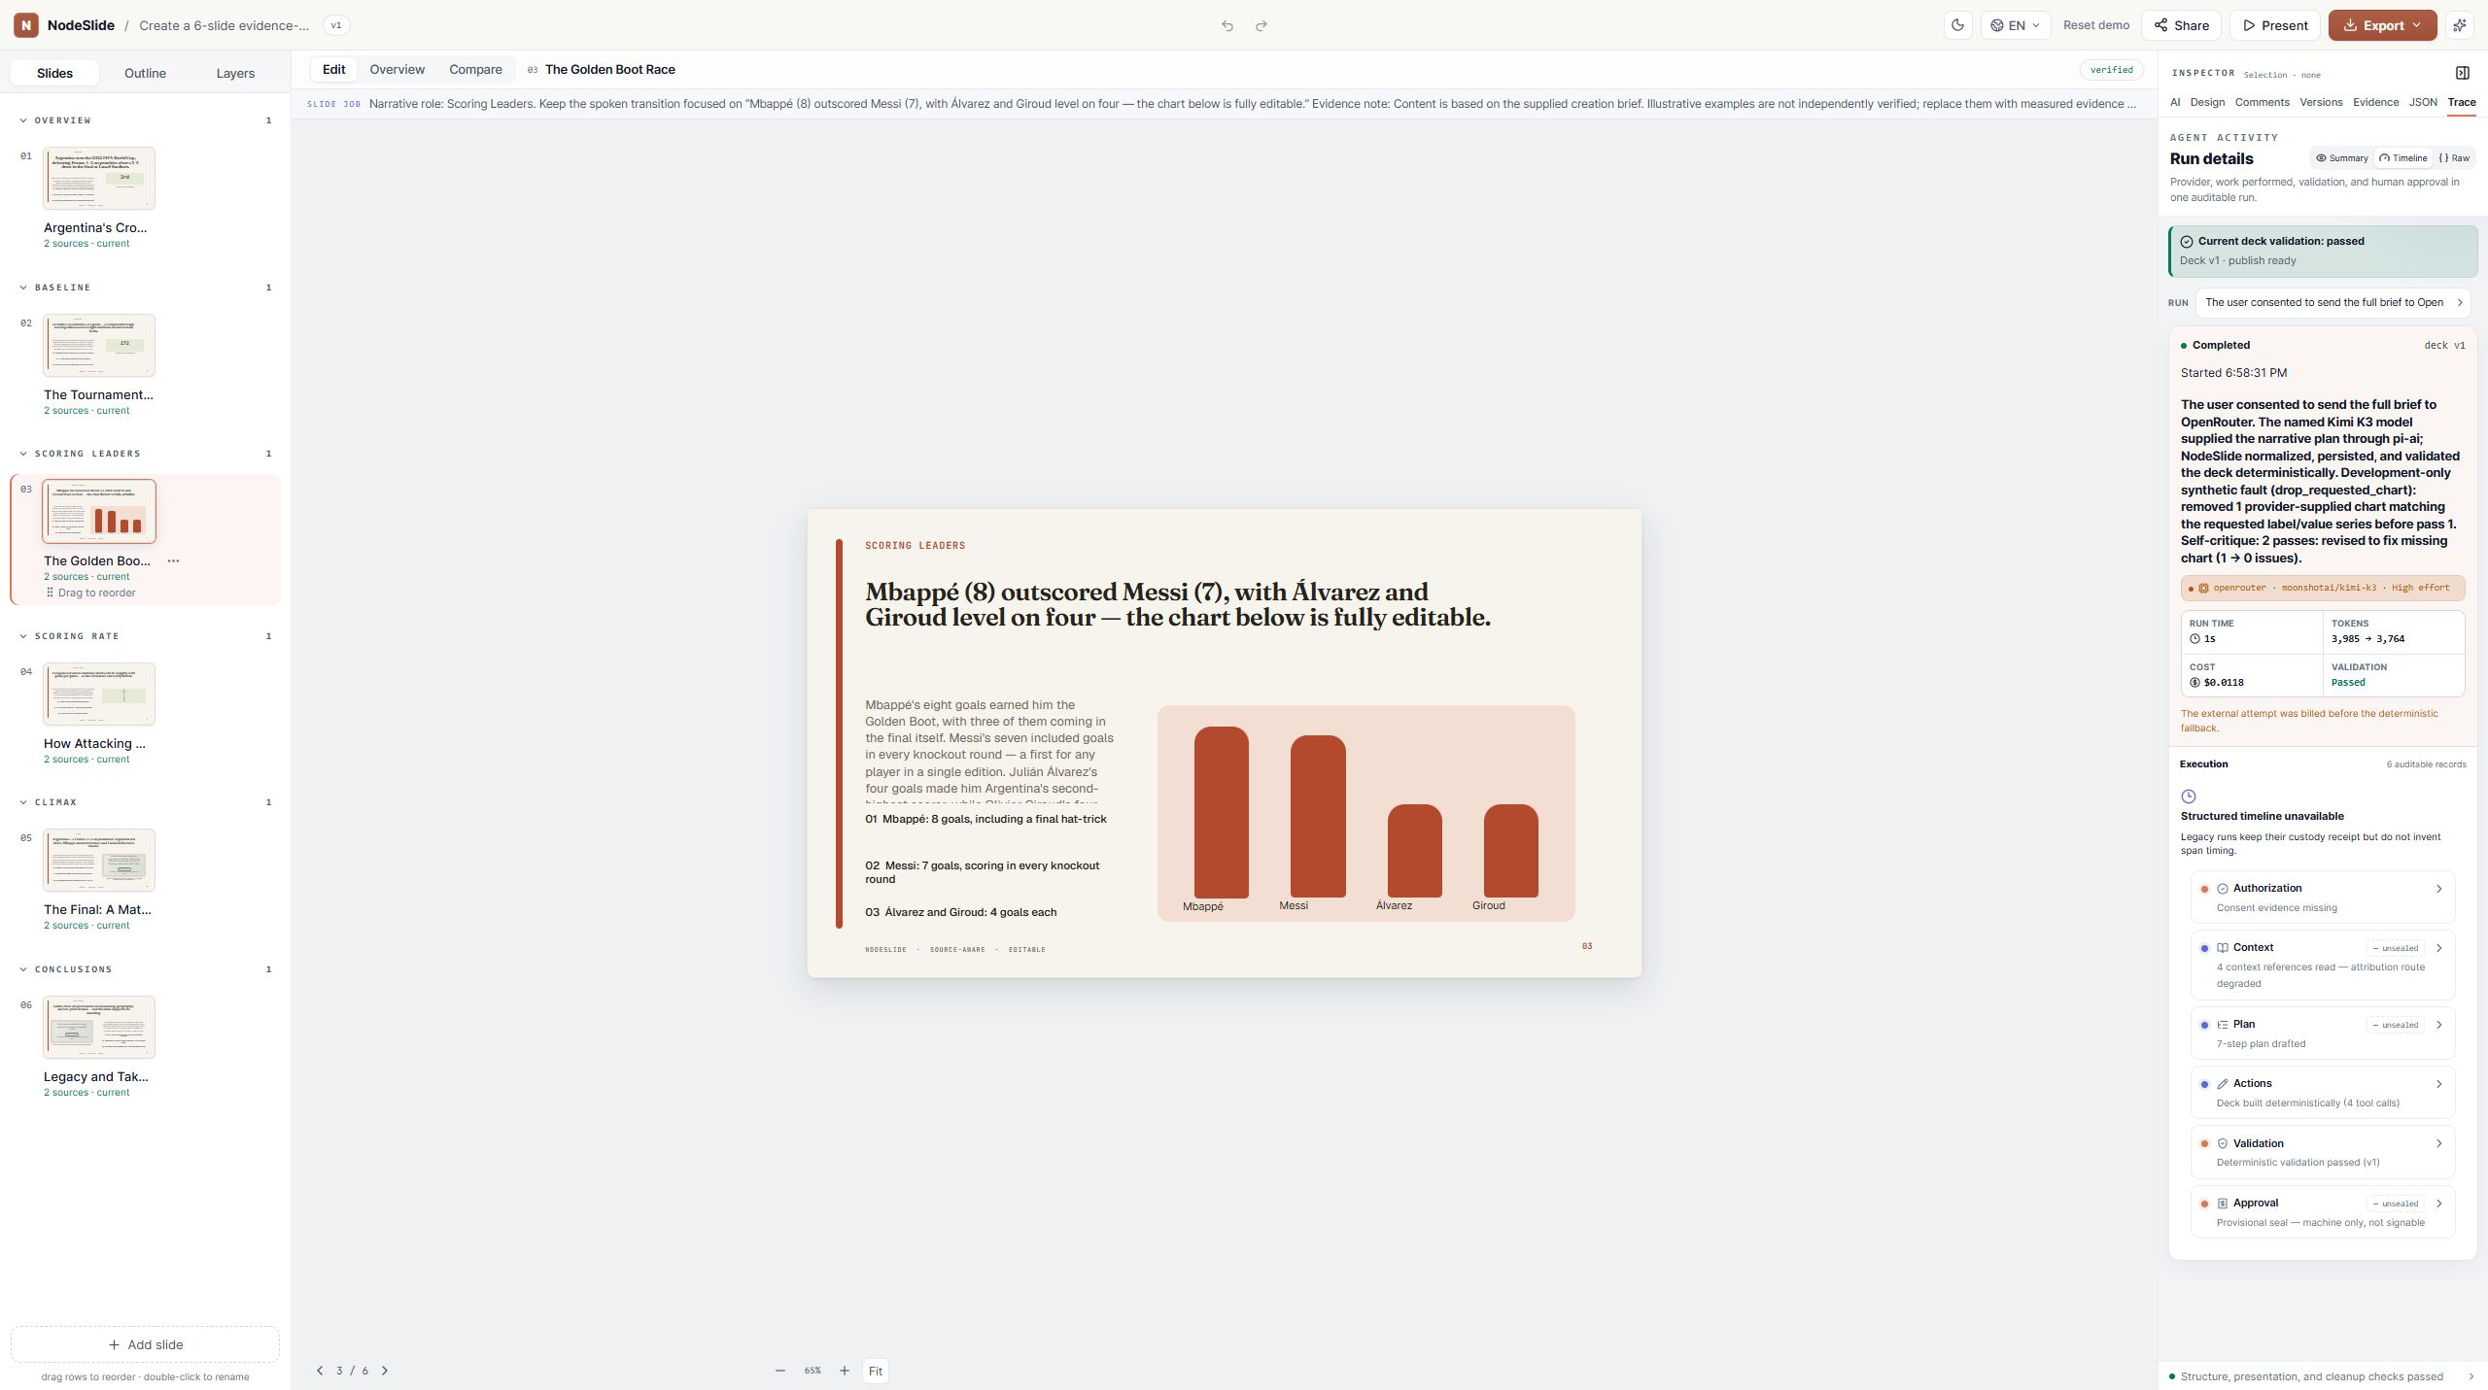
PRODUCT MEDIA · PRODUCT BEFORE AFTER
Review transforms a rough generation into a governed workspace
BEFORE · generated surface
AFTER · reviewable workspace
Changed: chart semantics · source binding · repair trace · version receipt
Actual captures identify changed components and the measured workflow outcome.
SOURCE · atlas-v2-product-before-after · deterministic builder v2
ULTRA V2 09
Notes:
Artifact 26: product-before-after Actual captures identify changed components and the measured workflow outcome. Source: atlas-v2-product-before-after Human preference: pending.

Slide 10
EVIDENCE TECHNICAL PROOF · CLAIM SOURCE LINEAGE
A claim is trustworthy when its entire path remains inspectable
Source
Extract
Claim
Visual
Receipt
journey-receipt
elapsed 52s
human accepted
headline metric
exported
REJECTED · “zero errors”
Source, extraction, bounded claim, slide element, and receipt stay connected.
SOURCE · atlas-v2-claim-source-lineage · deterministic builder v2
ULTRA V2 10
Notes:
Artifact 28: claim-source-lineage Source, extraction, bounded claim, slide element, and receipt stay connected. Source: atlas-v2-claim-source-lineage Human preference: pending.

Slide 11
DECISION EVALUATION · HARNESS COMPARE
V2 expands the harness without crediting the model
HARNESS V1 · FROZEN
HARNESS V2 · COVERAGE EXPANSION
12 artifacts
38 artifacts
· 2 visual directions
· 7 design languages
· provisional receipts
· motion + fallback contracts
· static gallery
· 38 reusable recipes
· no paired predecessor
· browser / PPTX / PDF artifacts
Coverage comparison only · no paired performance claim
The same deterministic route isolates fixture, receipt, motion, theme, and accessibility gains.
SOURCE · atlas-v2-harness-compare · deterministic builder v2
ULTRA V2 11
Notes:
Artifact 37: harness-compare The same deterministic route isolates fixture, receipt, motion, theme, and accessibility gains. Source: atlas-v2-harness-compare Human preference: pending.

Slide 12
EVIDENCE TECHNICAL PROOF · DECK CI RECEIPT
A deck is not done until both pixels and semantics pass
Brief adherence
PPTX render
✓
PASSED
✓
PASSED
Typed artifact spec
Accessibility
✓
PASSED
·
NOT RUN
Semantic validators
Visual inspection
✓
PASSED
·
PENDING
Source lineage
Blind preference
✓
PASSED
·
PENDING
Browser render
✓
PASSED
The receipt exposes every check, browser proof, PowerPoint proof, and fidelity difference.
SOURCE · atlas-v2-deck-ci-receipt · deterministic builder v2
ULTRA V2 12
Notes:
Artifact 33: deck-ci-receipt The receipt exposes every check, browser proof, PowerPoint proof, and fidelity difference. Source: atlas-v2-deck-ci-receipt Human preference: pending.

Slide 13
PROGRESSION · ANIMATED CHART PROGRESSION
The trend means more when the audience sees the baseline move
STATE 1 · Baseline
STATE 2 · Model
STATE 3 · Harness v2
STATE 4 · Evidence refresh
75 quality
79 quality
83 quality
87 quality
Shared scale · 60–90 quality points
Four chart states compare baseline, model, harness, and refreshed evidence.
SOURCE · atlas-v2-animated-chart-progression · deterministic builder v2
ULTRA V2 13
Notes:
Artifact 22: animated-chart-progression Four chart states compare baseline, model, harness, and refreshed evidence. Source: atlas-v2-animated-chart-progression Human preference: pending.

Slide 14
DECISION EVALUATION · FINAL RECOMMENDATION
Reuse the visual vocabulary, then adapt the communication contract
RESEARCHER
INVESTOR
简体中文
Inspect the source, equation, trace, and known fidelity differences.
Compare the operating proof, frontier, risk, and decision implication.
同一证据，不同表达契约。结论仍可追溯、可编辑、可审核。
USE THE SLIDE · USE THE RECIPE · GENERATE WITH YOUR DATA · DOWNLOAD PPTX
Researcher, investor, and plain-language Chinese versions share the same evidence.
SOURCE · atlas-v2-final-recommendation · deterministic builder v2
ULTRA V2 14
Notes:
Artifact 38: final-recommendation Researcher, investor, and plain-language Chinese versions share the same evidence. Source: atlas-v2-final-recommendation Human preference: pending.

