Slide 1
NARRATIVE FOUNDATIONS · HERO THESIS
Reviewability turns generation into a product decision
BREADTH
MOTION
PROOF
38
canonical visual artifacts
14-slide public narrative
One evidence-bounded thesis anchors the complete visual vocabulary.
SOURCE · atlas-v2-hero-thesis · deterministic builder v2
THEME 01
Notes:
Artifact 01: hero-thesis One evidence-bounded thesis anchors the complete visual vocabulary. Source: atlas-v2-hero-thesis Human preference: pending.

Slide 2
NARRATIVE FOUNDATIONS · HERO THESIS
Reviewability turns generation into a product decision
BREADTH
MOTION
PROOF
38
canonical visual artifacts
14-slide public narrative
One evidence-bounded thesis anchors the complete visual vocabulary.
SOURCE · atlas-v2-hero-thesis · deterministic builder v2
THEME 02
Notes:
Artifact 01: hero-thesis One evidence-bounded thesis anchors the complete visual vocabulary. Source: atlas-v2-hero-thesis Human preference: pending.

Slide 3
NARRATIVE FOUNDATIONS · HERO THESIS
Reviewability turns generation into a product decision
BREADTH
MOTION
PROOF
38
canonical visual artifacts
14-slide public narrative
One evidence-bounded thesis anchors the complete visual vocabulary.
SOURCE · atlas-v2-hero-thesis · deterministic builder v2
THEME 03
Notes:
Artifact 01: hero-thesis One evidence-bounded thesis anchors the complete visual vocabulary. Source: atlas-v2-hero-thesis Human preference: pending.

Slide 4
DATA · DENSE DASHBOARD FUNNEL
A dashboard can be dense without becoming a card graveyard
FROZEN ARENA · CANDIDATE FUNNEL
EXCEPTIONS
Briefs · 100
2 Arena candidates failed gates
Historical result; not current Atlas status
Candidates · 84
Valid renders · 83
DECISION QUEUE
Deck CI · 82
Review model-blind pairs
Prior human winner · 1
Approve public 14
Promote recipes only
A funnel, trend, exceptions, and decision queue share one controlled surface.
SOURCE · atlas-v2-dense-dashboard-funnel · deterministic builder v2
THEME 04
Notes:
Artifact 12: dense-dashboard-funnel A funnel, trend, exceptions, and decision queue share one controlled surface. Source: atlas-v2-dense-dashboard-funnel Human preference: pending.

Slide 5
DATA · DENSE DASHBOARD FUNNEL
A dashboard can be dense without becoming a card graveyard
FROZEN ARENA · CANDIDATE FUNNEL
EXCEPTIONS
Briefs · 100
2 Arena candidates failed gates
Historical result; not current Atlas status
Candidates · 84
Valid renders · 83
DECISION QUEUE
Deck CI · 82
Review model-blind pairs
Prior human winner · 1
Approve public 14
Promote recipes only
A funnel, trend, exceptions, and decision queue share one controlled surface.
SOURCE · atlas-v2-dense-dashboard-funnel · deterministic builder v2
THEME 05
Notes:
Artifact 12: dense-dashboard-funnel A funnel, trend, exceptions, and decision queue share one controlled surface. Source: atlas-v2-dense-dashboard-funnel Human preference: pending.

Slide 6
DATA · DENSE DASHBOARD FUNNEL
A dashboard can be dense without becoming a card graveyard
FROZEN ARENA · CANDIDATE FUNNEL
EXCEPTIONS
Briefs · 100
2 Arena candidates failed gates
Historical result; not current Atlas status
Candidates · 84
Valid renders · 83
DECISION QUEUE
Deck CI · 82
Review model-blind pairs
Prior human winner · 1
Approve public 14
Promote recipes only
A funnel, trend, exceptions, and decision queue share one controlled surface.
SOURCE · atlas-v2-dense-dashboard-funnel · deterministic builder v2
THEME 06
Notes:
Artifact 12: dense-dashboard-funnel A funnel, trend, exceptions, and decision queue share one controlled surface. Source: atlas-v2-dense-dashboard-funnel Human preference: pending.

Slide 7
SYSTEMS · SYSTEM ARCHITECTURE
The portable protocol keeps product logic above backend choice
Memory
Portable protocol
initialize · stage · commit
Adapter boundary
Client
Validation engine
Convex
TRUST BOUNDARY · persistence only
Postgres
Typed connectors and a visible trust boundary preserve system meaning.
SOURCE · atlas-v2-system-architecture · deterministic builder v2
THEME 07
Notes:
Artifact 13: system-architecture Typed connectors and a visible trust boundary preserve system meaning. Source: atlas-v2-system-architecture Human preference: pending.

Slide 8
SYSTEMS · SYSTEM ARCHITECTURE
The portable protocol keeps product logic above backend choice
Memory
Portable protocol
initialize · stage · commit
Adapter boundary
Client
Validation engine
Convex
TRUST BOUNDARY · persistence only
Postgres
Typed connectors and a visible trust boundary preserve system meaning.
SOURCE · atlas-v2-system-architecture · deterministic builder v2
THEME 08
Notes:
Artifact 13: system-architecture Typed connectors and a visible trust boundary preserve system meaning. Source: atlas-v2-system-architecture Human preference: pending.

Slide 9
SYSTEMS · SYSTEM ARCHITECTURE
The portable protocol keeps product logic above backend choice
Memory
Portable protocol
initialize · stage · commit
Adapter boundary
Client
Validation engine
Convex
TRUST BOUNDARY · persistence only
Postgres
Typed connectors and a visible trust boundary preserve system meaning.
SOURCE · atlas-v2-system-architecture · deterministic builder v2
THEME 09
Notes:
Artifact 13: system-architecture Typed connectors and a visible trust boundary preserve system meaning. Source: atlas-v2-system-architecture Human preference: pending.

Slide 10
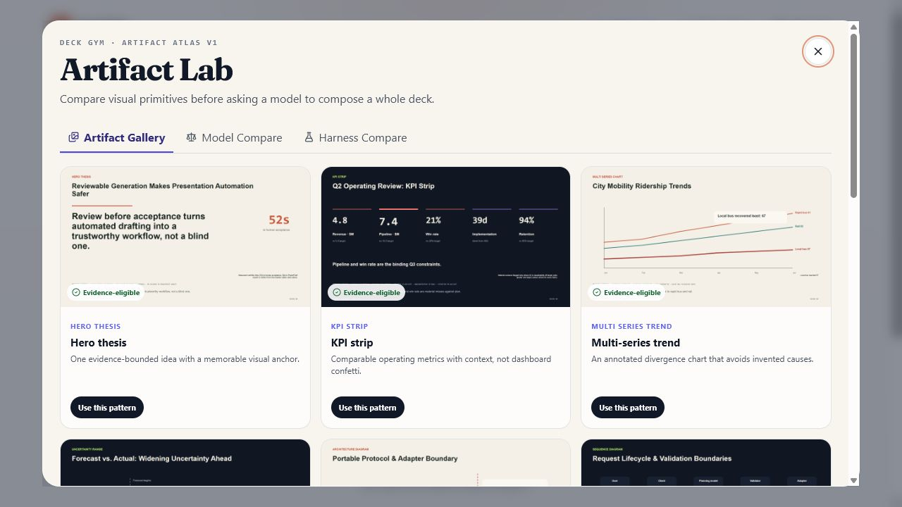
PRODUCT MEDIA · REAL SCREENSHOT CALLOUTS
The product proof is the interface people actually use
1
V1 gallery
12 patterns
2
model compare
keeps failures red
3
use pattern
starts a real workflow
A real NodeSlide capture occupies most of the slide with three exact callouts.
SOURCE · atlas-v2-real-screenshot-callouts · deterministic builder v2
THEME 10
Notes:
Artifact 24: real-screenshot-callouts A real NodeSlide capture occupies most of the slide with three exact callouts. Source: atlas-v2-real-screenshot-callouts Human preference: pending.

Slide 11
PRODUCT MEDIA · REAL SCREENSHOT CALLOUTS
The product proof is the interface people actually use
1
V1 gallery
12 patterns
2
model compare
keeps failures red
3
use pattern
starts a real workflow
A real NodeSlide capture occupies most of the slide with three exact callouts.
SOURCE · atlas-v2-real-screenshot-callouts · deterministic builder v2
THEME 11
Notes:
Artifact 24: real-screenshot-callouts A real NodeSlide capture occupies most of the slide with three exact callouts. Source: atlas-v2-real-screenshot-callouts Human preference: pending.

Slide 12
PRODUCT MEDIA · REAL SCREENSHOT CALLOUTS
The product proof is the interface people actually use
1
V1 gallery
12 patterns
2
model compare
keeps failures red
3
use pattern
starts a real workflow
A real NodeSlide capture occupies most of the slide with three exact callouts.
SOURCE · atlas-v2-real-screenshot-callouts · deterministic builder v2
THEME 12
Notes:
Artifact 24: real-screenshot-callouts A real NodeSlide capture occupies most of the slide with three exact callouts. Source: atlas-v2-real-screenshot-callouts Human preference: pending.

