Slide 1
PRODUCT-EVIDENCE.CLAIM-LINEAGE
1
A claim is evidence only when its whole path survives
Source
Extraction
Bounded claim
Slide element
Receipt
Atlas v3 shipped zero native chart parts
The topology gate that measured it
PRESENT · BOUND DIAGRAM

Slide 2
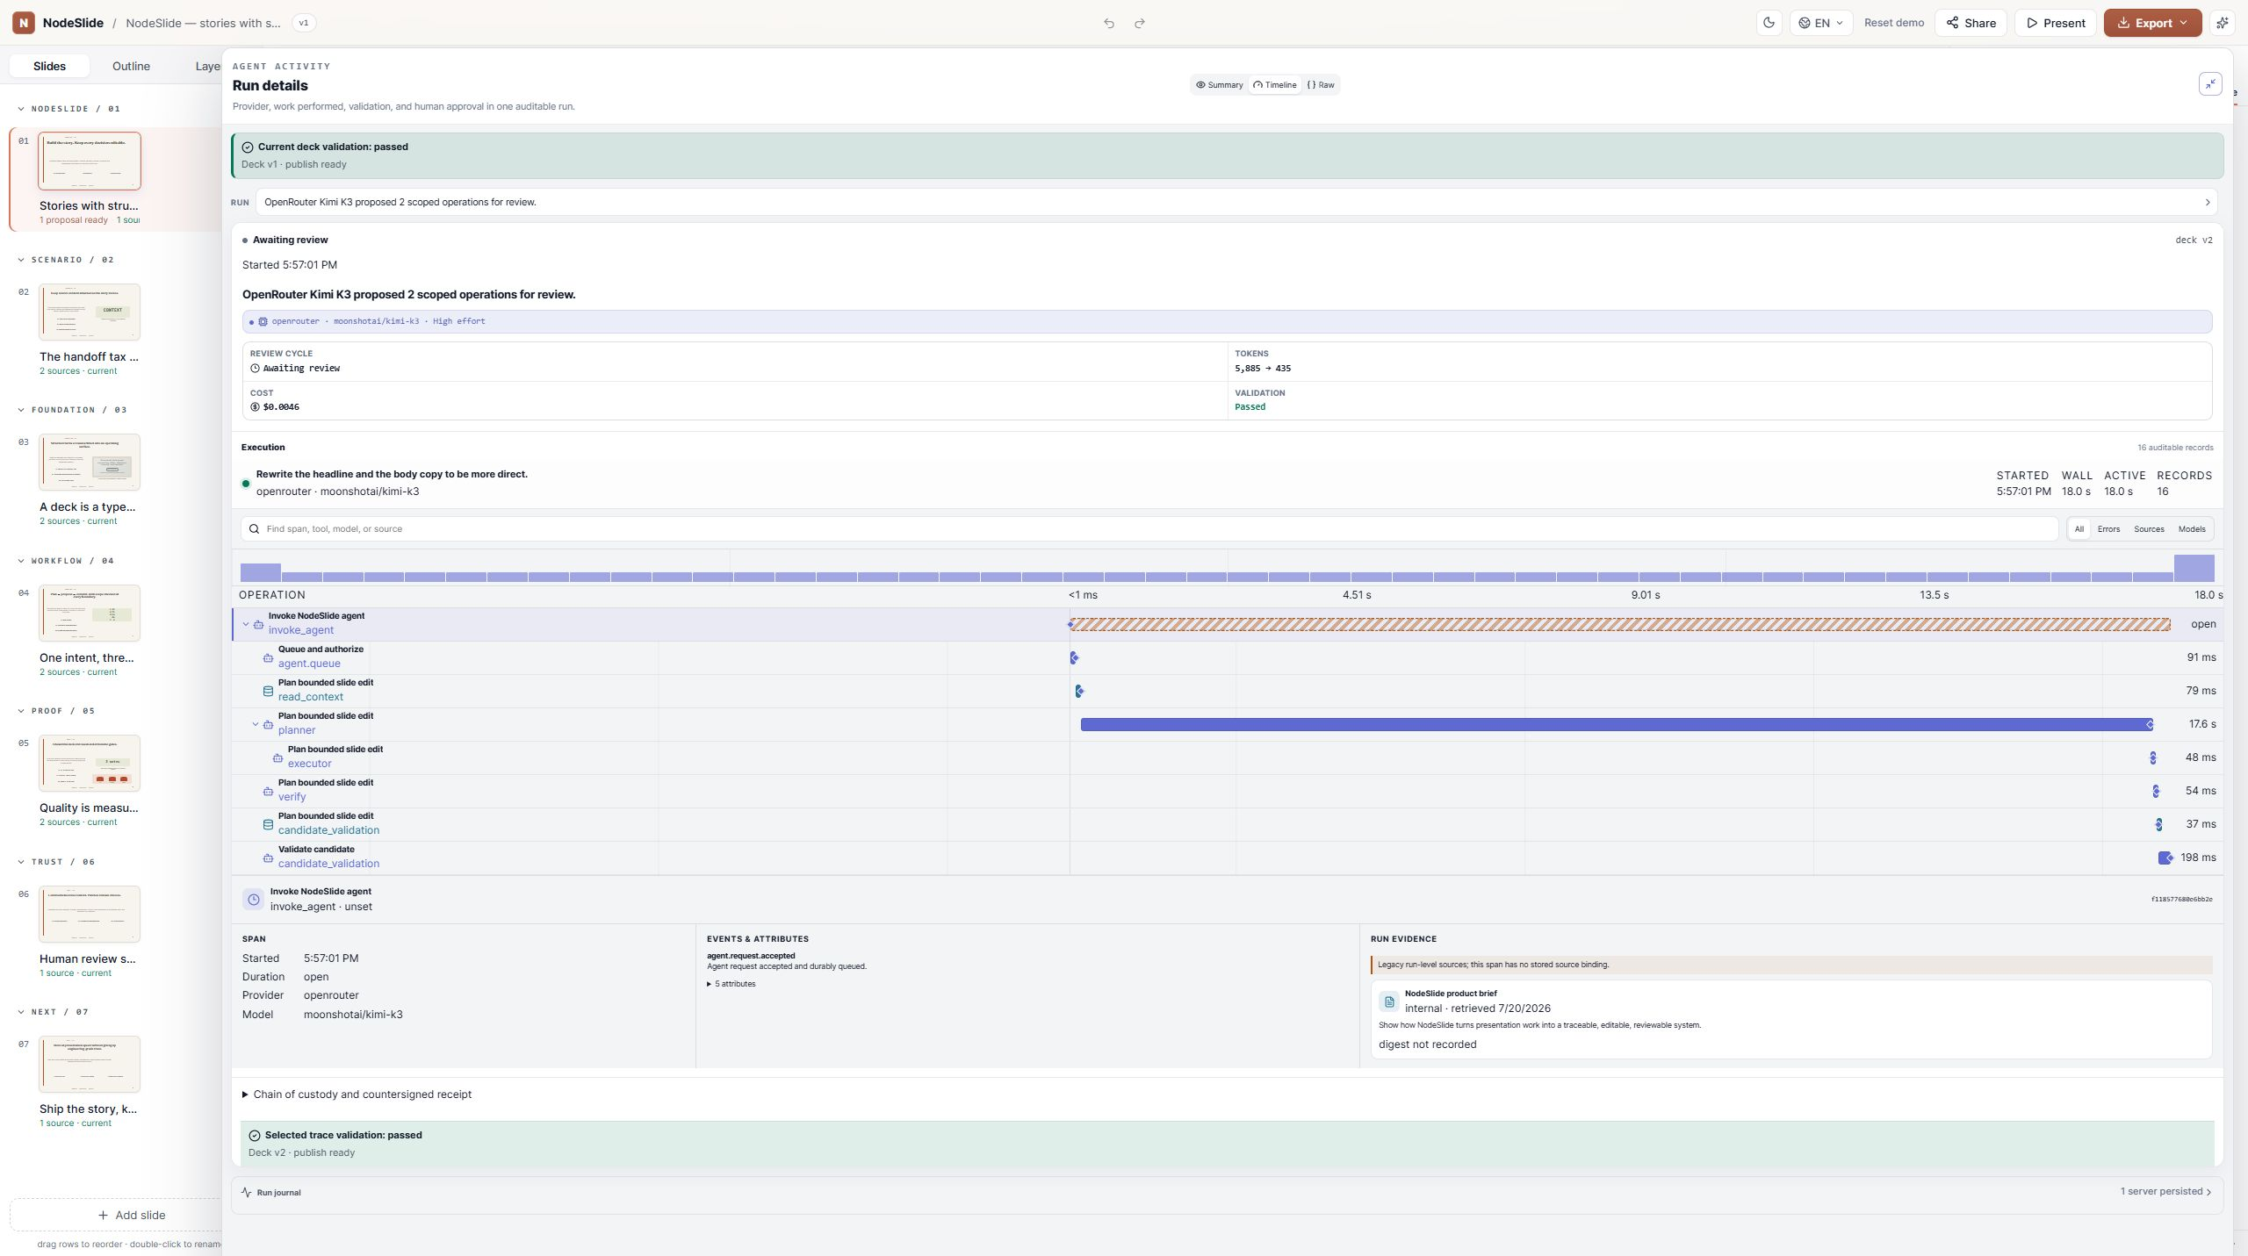
PRODUCT-EVIDENCE.CITATION-CARD
2
The time axis is a real OOXML object, cited to the spec
OOXML c:dateAx (ECMA-376 time axis)
PRESENT · EMBEDDED IMAGE

Slide 3
PRODUCT-EVIDENCE.DECK-CI-RECEIPT
3
A deck is done when pixels and semantics both pass
Cohort | browser | powerpoint | fidelity
topology gate | pass | pass | pass
citation gate | pass | pass | pass
motion gate | pass | pass | pass
Native builder CI run
PRESENT · TABLE GRID

Slide 4
TECHNICAL.CODE-AND-RESULT
4
Runtime claims ship with the code that produced them
const raw = await pptx.write("nodebuffer");
const a = await injectOmml(raw, equations);
const b = await injectConnectors(a, diagrams);
const out = await injectDateAxes(b, timelines);
Phase | Measured ms
pptx.write | 52.765
inject.omml | 0.175
inject.connectors | 12.153
inject.dateAxes | 0.235
inject.timing | 0.126
dedupe.media | 5.566
total | 71.02
sample size | 1
PRESENT · MEASURED RESULT

Slide 5
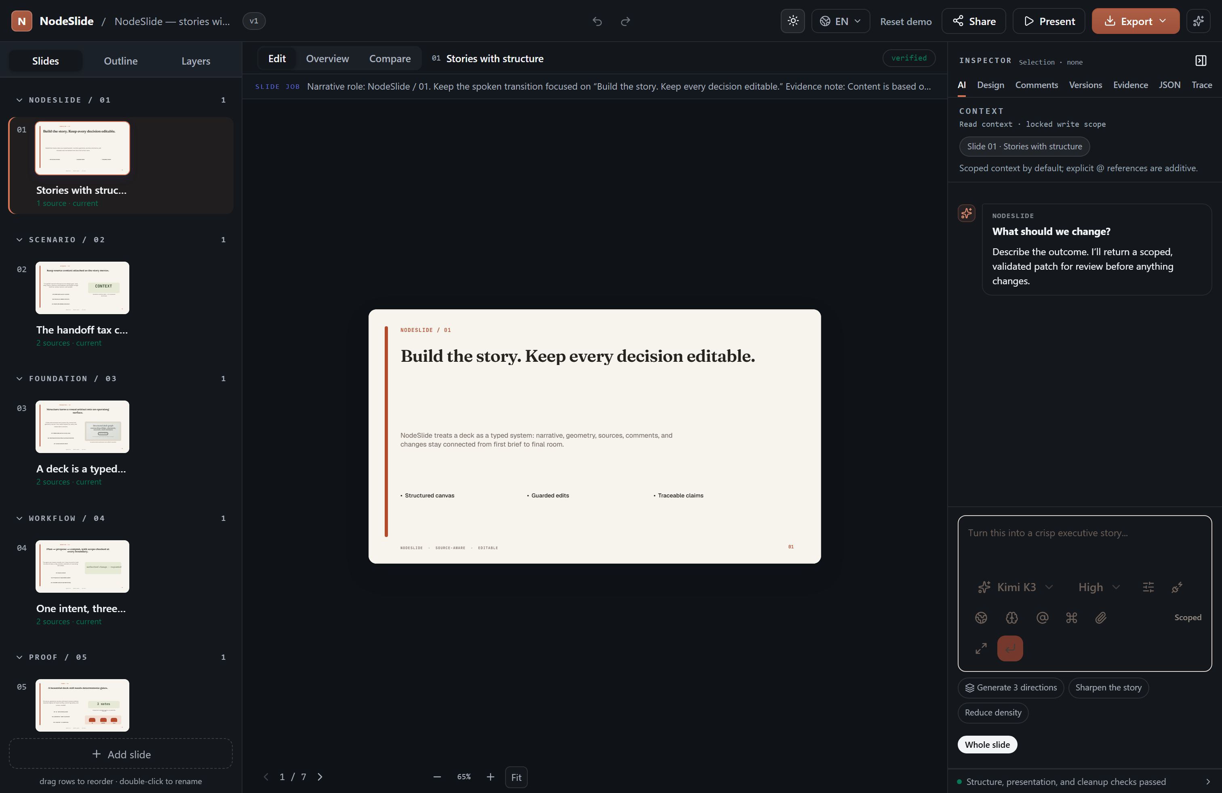
TECHNICAL.EVIDENCE-MEDIA
5
When the artifact cannot ship, the deck says so in the bytes
declared fallback · capability.pptx = poster-frame
Asset-bound capture. PowerPoint receives the captured image as a poster frame; no live region highlight.

