Slide 1
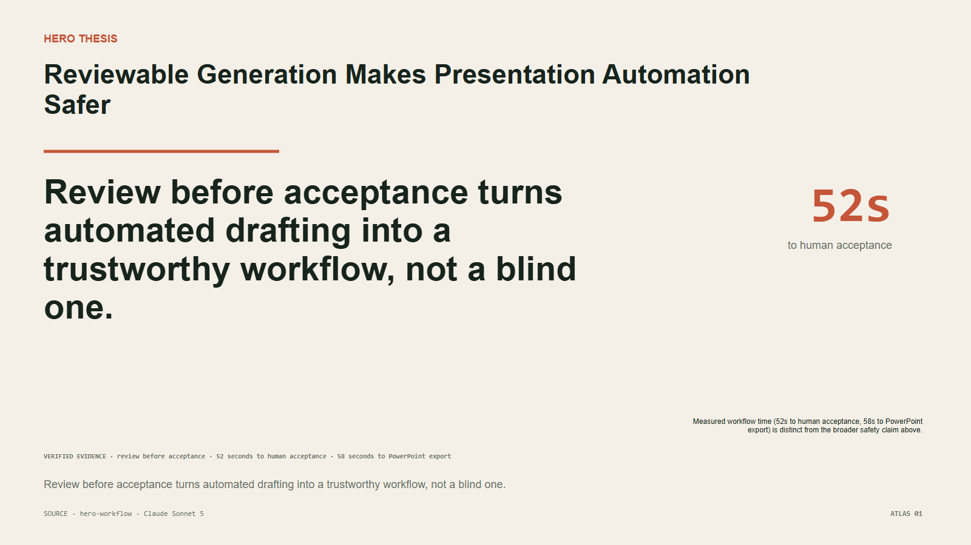
ATLAS 01 · HERO THESIS
Reviewable Generation Makes Presentation Automation Safer
Review before acceptance turns automated drafting into a trustworthy workflow, not a blind one.
Claude Sonnet 5
evidence editorial
native web
native PPTX
SOURCE · hero-workflow | machine provisional · human preference pending
NodeSlide Ultra Showcase RC1

Slide 2
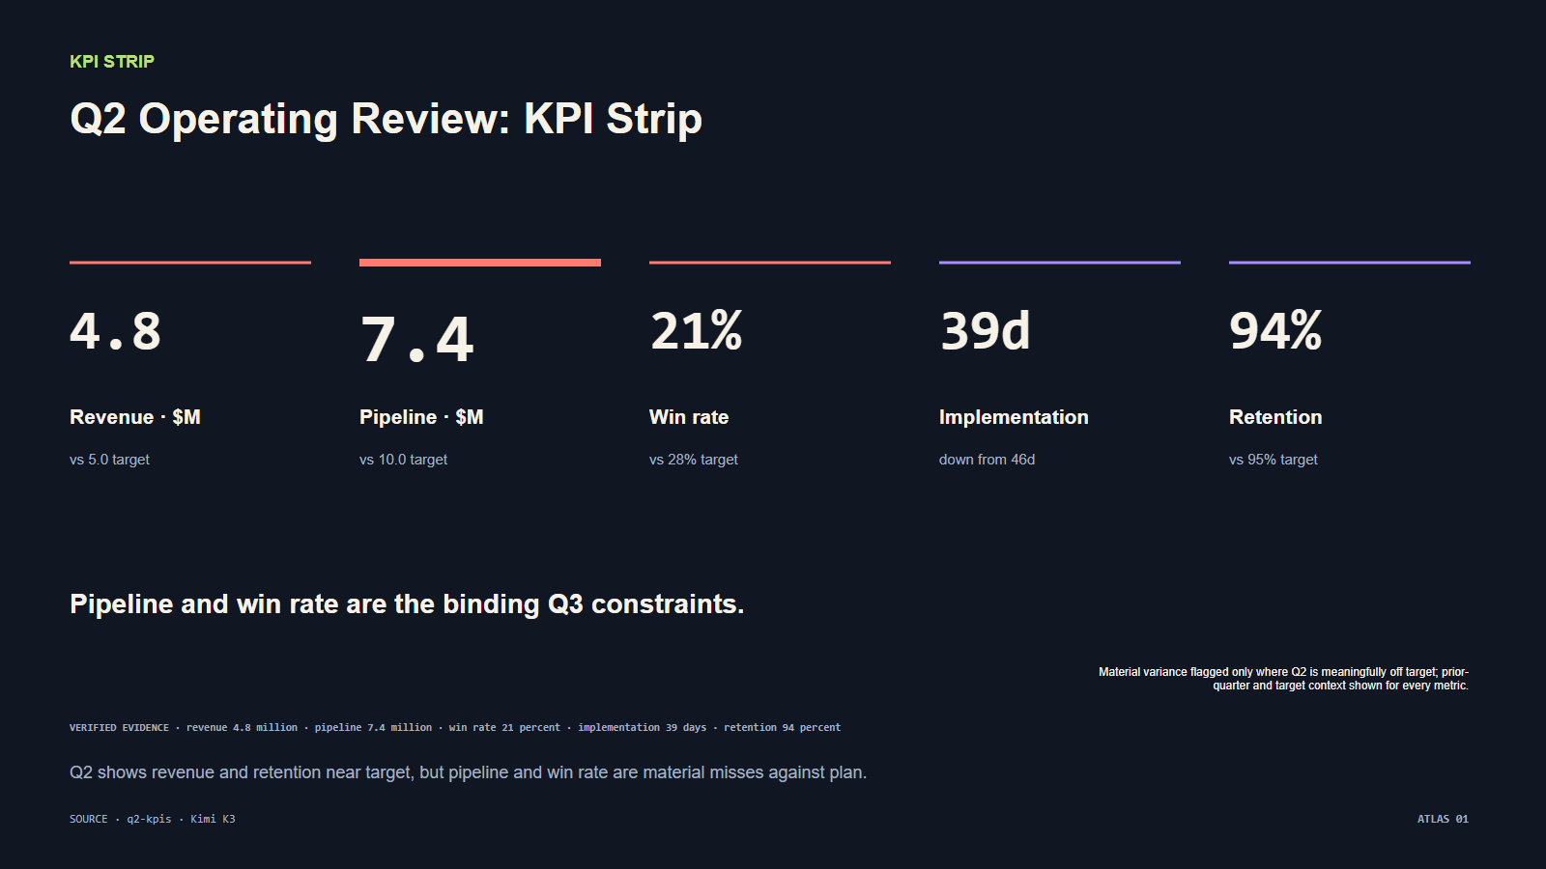
ATLAS 02 · KPI STRIP
Q2 Operating Review: KPI Strip
Kimi K3
expressive technical
native web
native PPTX
Q2 shows revenue and retention near target, but pipeline and win rate are material misses against plan.
SOURCE · q2-kpis | machine provisional · human preference pending
NodeSlide Ultra Showcase RC1

Slide 3
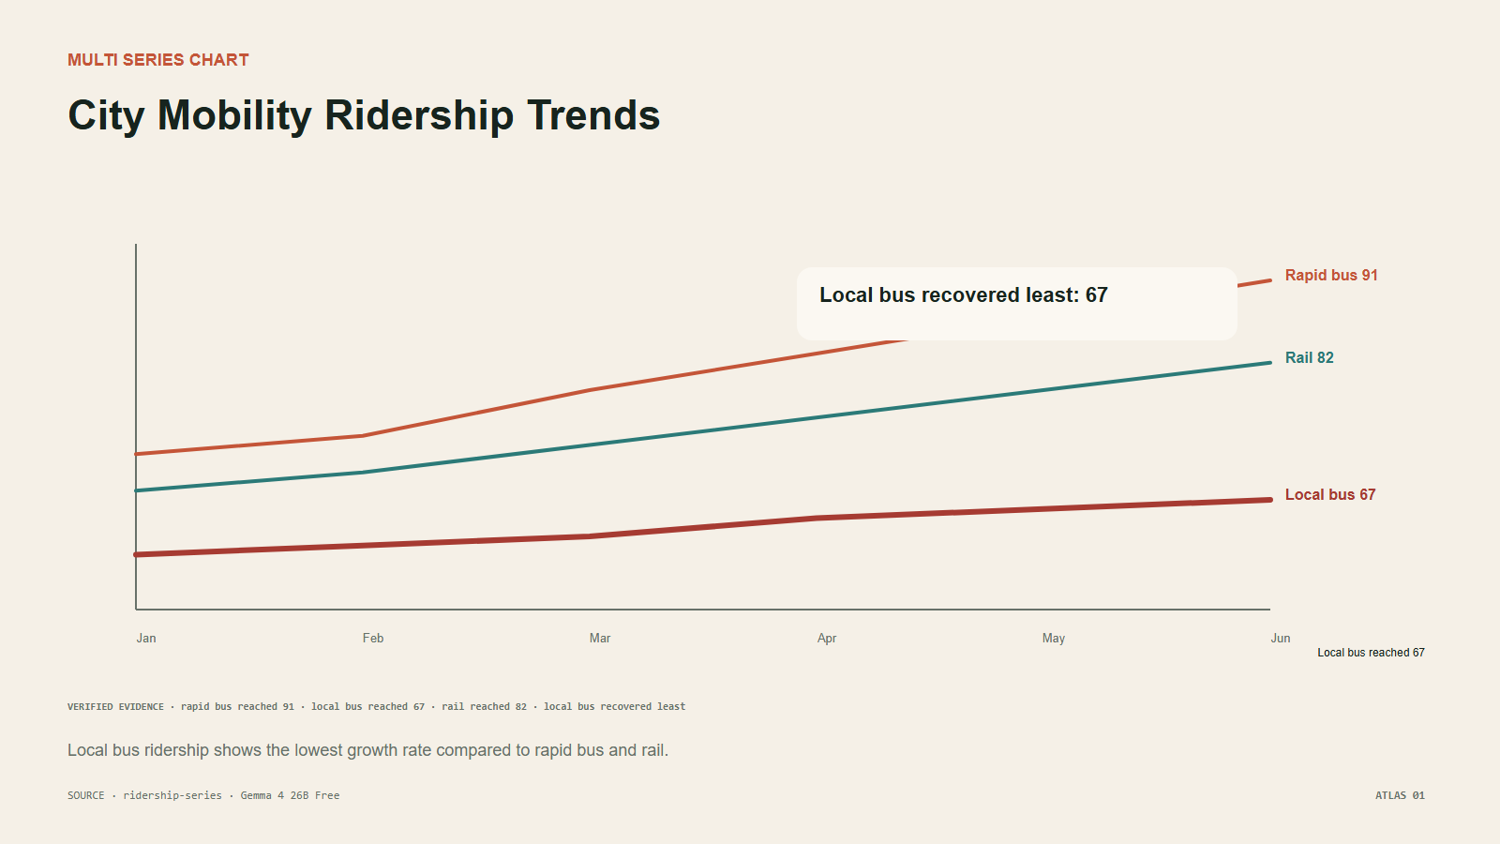
ATLAS 03 · MULTI SERIES CHART
City Mobility Ridership Trends
Local bus ridership shows the lowest growth rate compared to rapid bus and rail.
Gemma
4
Free
evidence editorial
native web
native PPTX
3
SOURCE · ridership-series | machine provisional · human preference pending
NodeSlide Ultra Showcase RC1

Slide 4
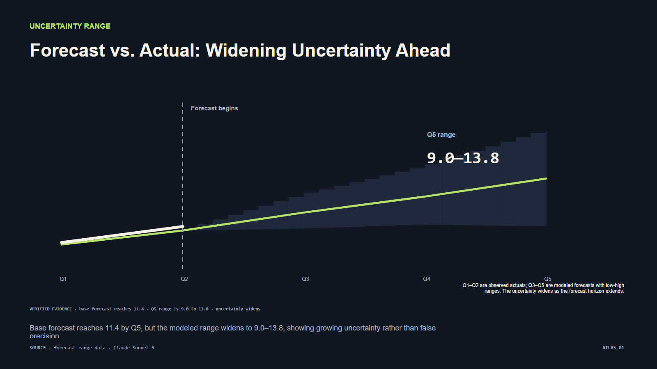
ATLAS 04 · UNCERTAINTY RANGE
Forecast vs. Actual: Widening Uncertainty Ahead
Base forecast reaches 11.4 by Q5, but the modeled range widens to 9.0–13.8, showing growing uncertainty rather than false precision.
Claude Sonnet 5
expressive technical
native web
native PPTX
SOURCE · forecast-range-data | machine provisional · human preference pending
NodeSlide Ultra Showcase RC1

Slide 5
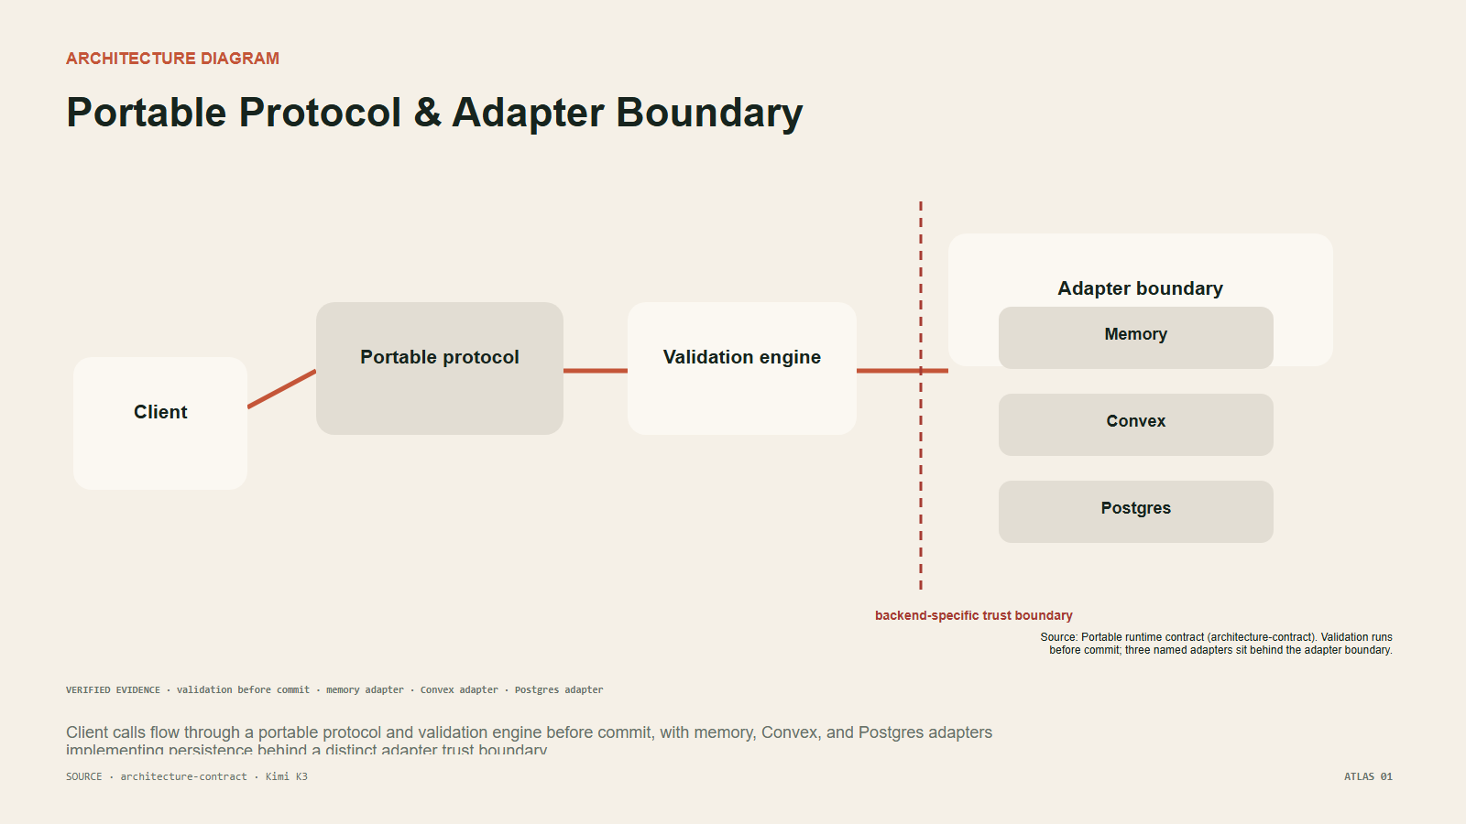
ATLAS 05 · ARCHITECTURE DIAGRAM
Portable Protocol & Adapter Boundary
Kimi K3
evidence editorial
native web
native PPTX
Client calls flow through a portable protocol and validation engine before commit, with memory, Convex, and Postgres adapters implementing persistence behind a distinct adapter trust boundary.
SOURCE · architecture-contract | machine provisional · human preference pending
NodeSlide Ultra Showcase RC1

Slide 6
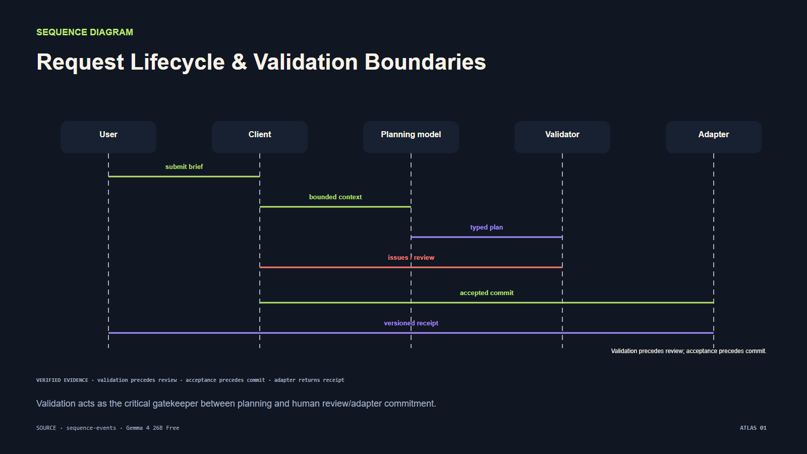
ATLAS 06 · SEQUENCE DIAGRAM
Request Lifecycle & Validation Boundaries
Validation acts as the critical gatekeeper between planning and human review/adapter commitment.
Gemma
4
Free
expressive technical
native web
native PPTX
6
SOURCE · sequence-events | machine provisional · human preference pending
NodeSlide Ultra Showcase RC1

Slide 7
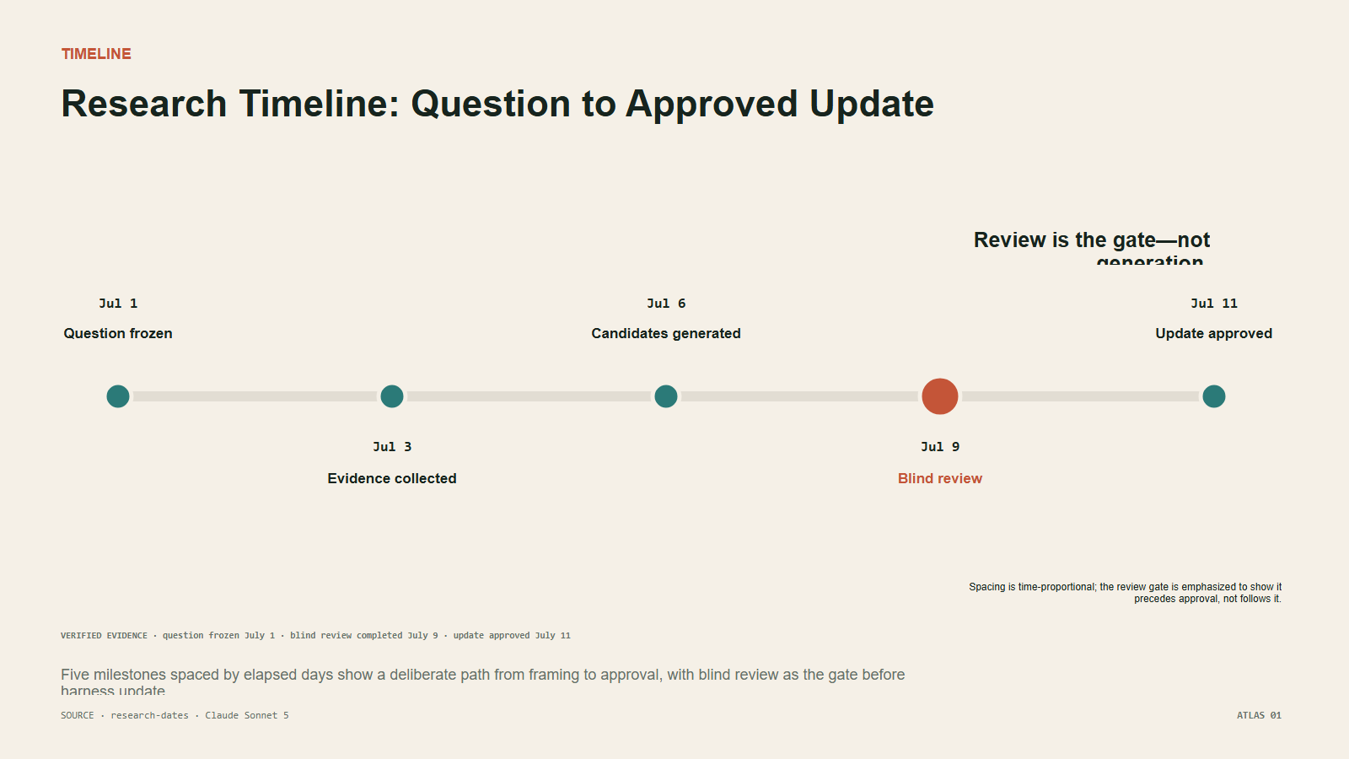
ATLAS 07 · TIMELINE
Research Timeline: Question to Approved Update
Five milestones spaced by elapsed days show a deliberate path from framing to approval, with blind review as the gate before harness update.
Claude Sonnet 5
evidence editorial
native web
native PPTX
SOURCE · research-dates | machine provisional · human preference pending
NodeSlide Ultra Showcase RC1

Slide 8
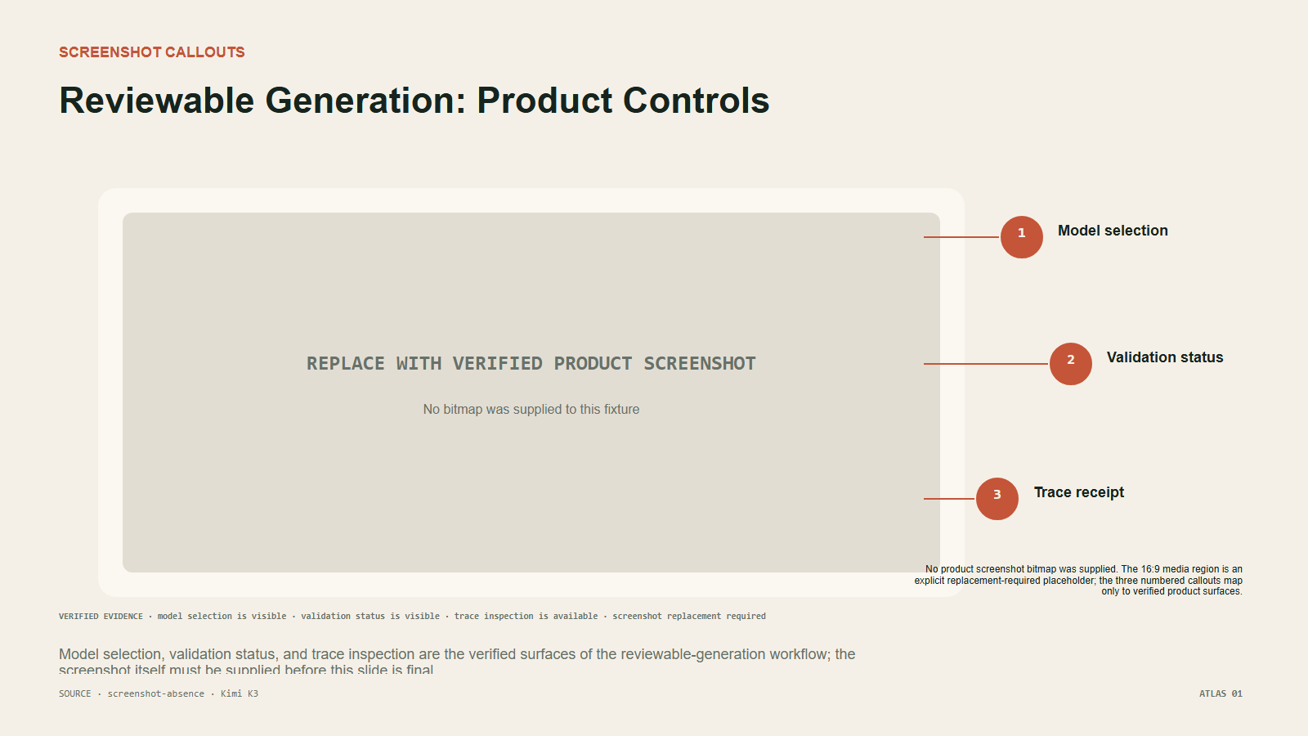
ATLAS 08 · SCREENSHOT CALLOUTS
Reviewable Generation: Product Controls
Kimi K3
evidence editorial
native web
grouped-editable PPTX
Model selection, validation status, and trace inspection are the verified surfaces of the reviewable-generation workflow; the screenshot itself must be supplied before this slide is final.
SOURCE · screenshot-absence | machine provisional · human preference pending
NodeSlide Ultra Showcase RC1

Slide 9
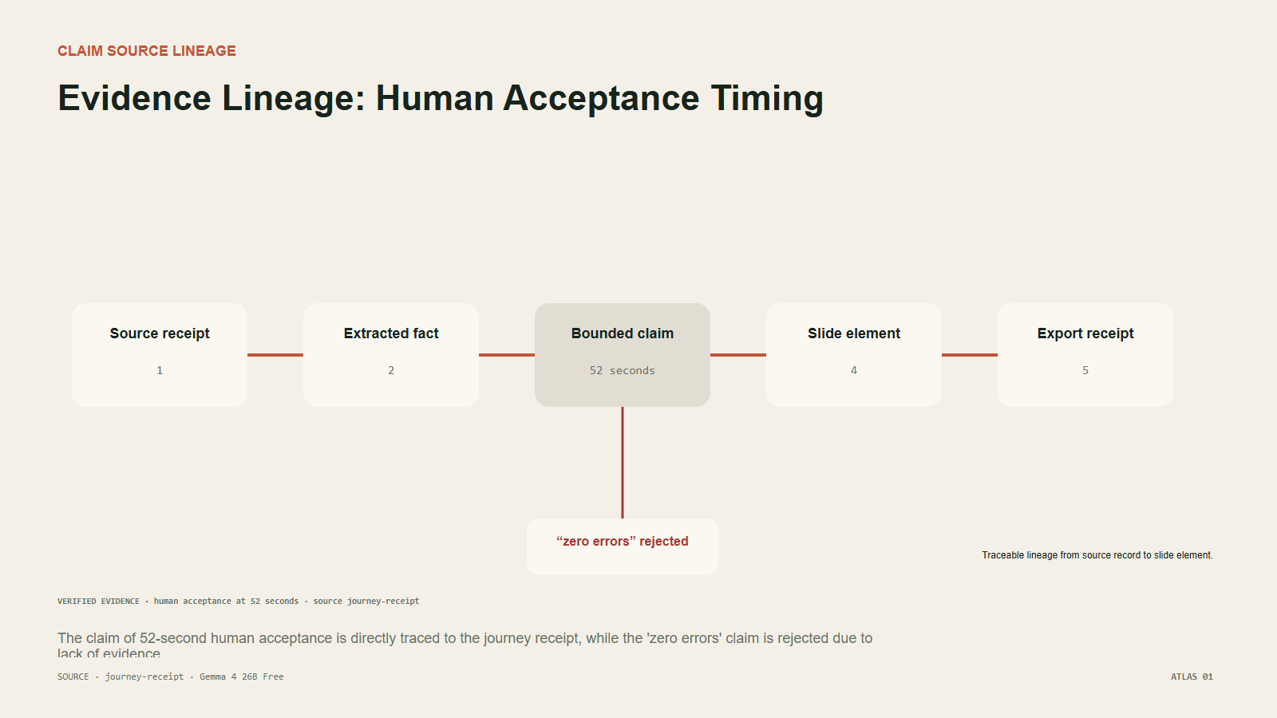
ATLAS 09 · CLAIM SOURCE LINEAGE
Evidence Lineage: Human Acceptance Timing
The claim of 52-second human acceptance is directly traced to the journey receipt, while the 'zero errors' claim is rejected due to lack of evidence.
Gemma
4
Free
evidence editorial
native web
native PPTX
9
SOURCE · journey-receipt | machine provisional · human preference pending
NodeSlide Ultra Showcase RC1

Slide 10
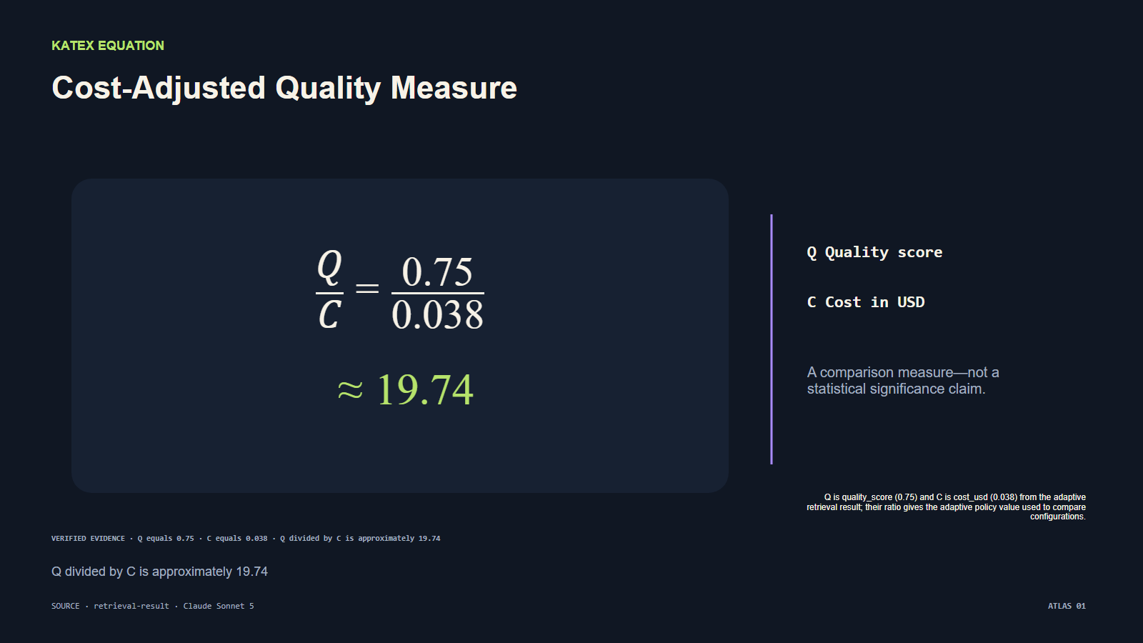
ATLAS 10 · KATEX EQUATION
Cost-Adjusted Quality Measure
Q divided by C is approximately 19.74
Claude Sonnet 5
expressive technical
native web
grouped-editable PPTX
SOURCE · retrieval-result | machine provisional · human preference pending
NodeSlide Ultra Showcase RC1

Slide 11
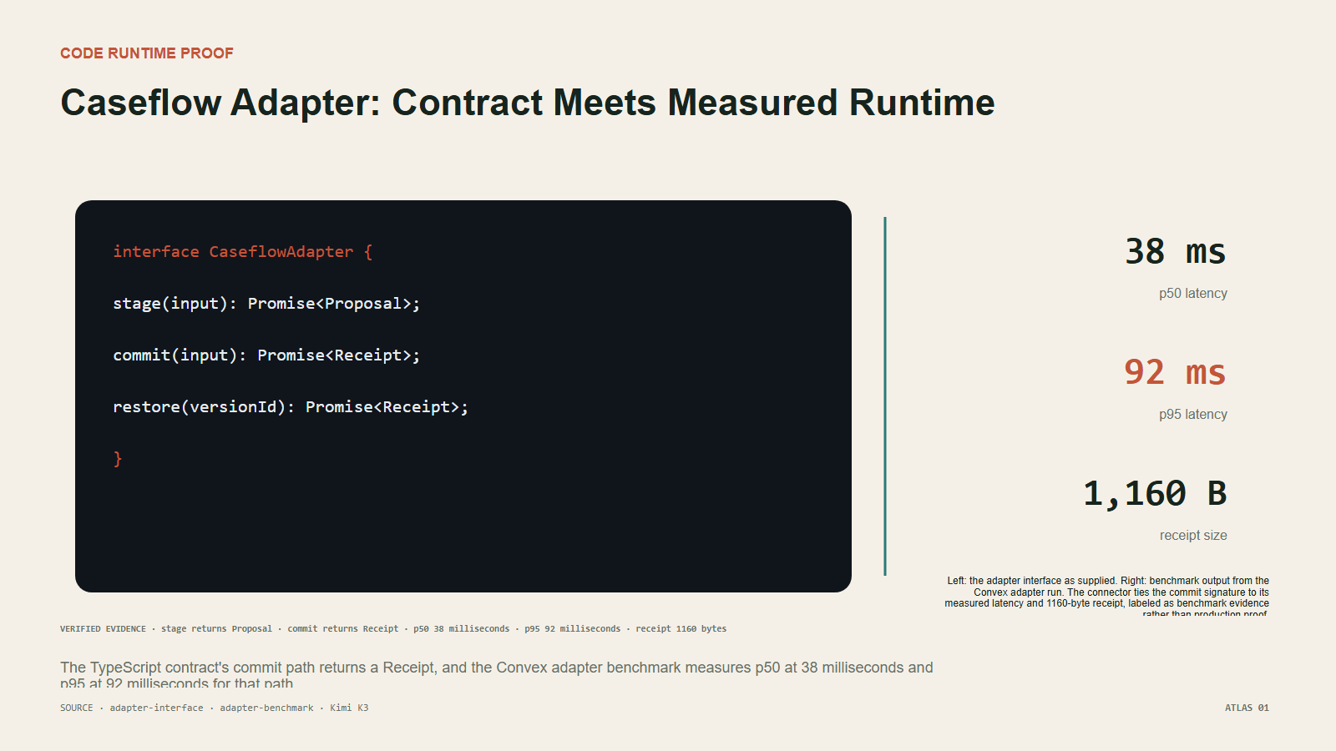
ATLAS 11 · CODE RUNTIME PROOF
Caseflow Adapter: Contract Meets Measured Runtime
Kimi K3
evidence editorial
native web
grouped-editable PPTX
The TypeScript contract's commit path returns a Receipt, and the Convex adapter benchmark measures p50 at 38 milliseconds and p95 at 92 milliseconds for that path.
SOURCE · adapter-interface · adapter-benchmark | machine provisional · human preference pending
NodeSlide Ultra Showcase RC1

Slide 12
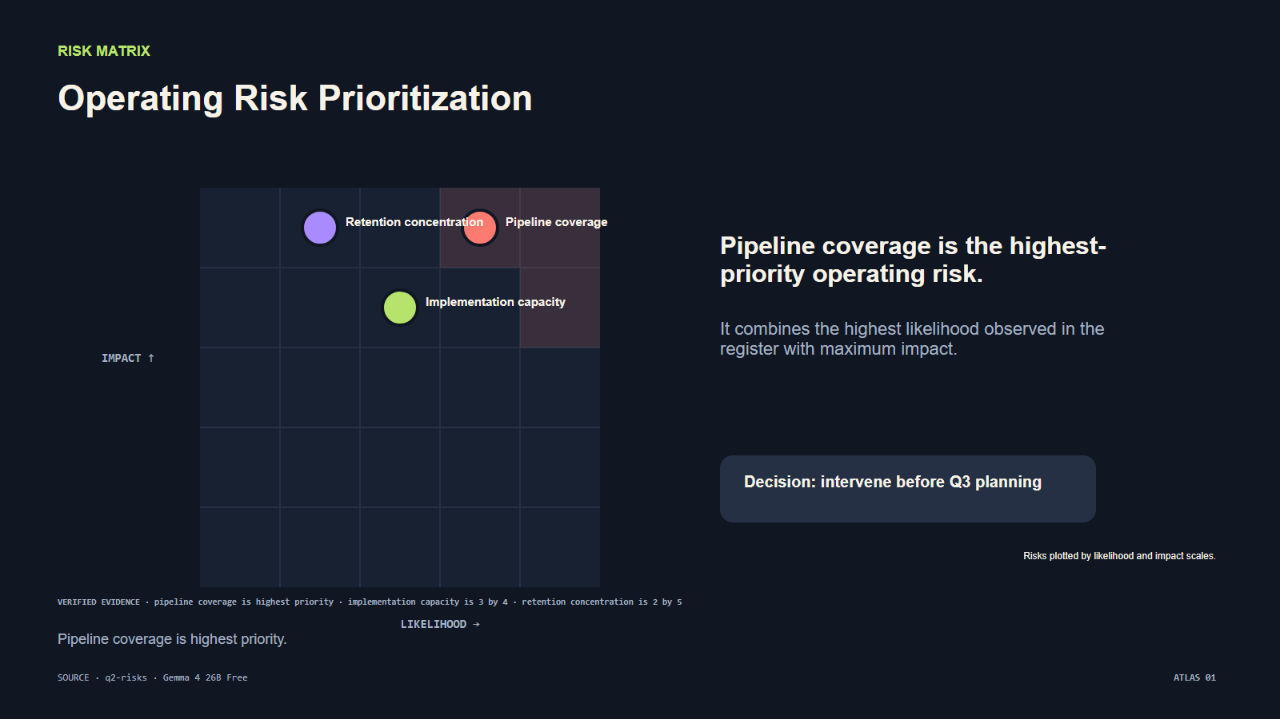
ATLAS 12 · RISK MATRIX
Operating Risk Prioritization
Pipeline coverage is highest priority.
Gemma
4
Free
expressive technical
native web
native PPTX
12
SOURCE · q2-risks | machine provisional · human preference pending
NodeSlide Ultra Showcase RC1

