Slide 1
NARRATIVE.HERO-THESIS
1
Reviewability turns generation into a product decision
One evidence-bounded thesis anchors the complete visual vocabulary.

Slide 2
NARRATIVE.SECTION-OPENER
2
A museum needs chapters, not a wall of thumbnails
Seven chapters organize artifacts by the job they perform for an audience.

Slide 3
NARRATIVE.BIG-METRIC
3
82 of 84 candidates cleared browser and PowerPoint proof
The headline metric stays tied to the frozen Arena receipt instead of becoming marketing shorthand.

Slide 4
NARRATIVE.QUOTE
4
The useful promise is editable evidence, not instant polish
A customer-voice treatment demonstrates editorial rhythm without inventing a customer.

Slide 5

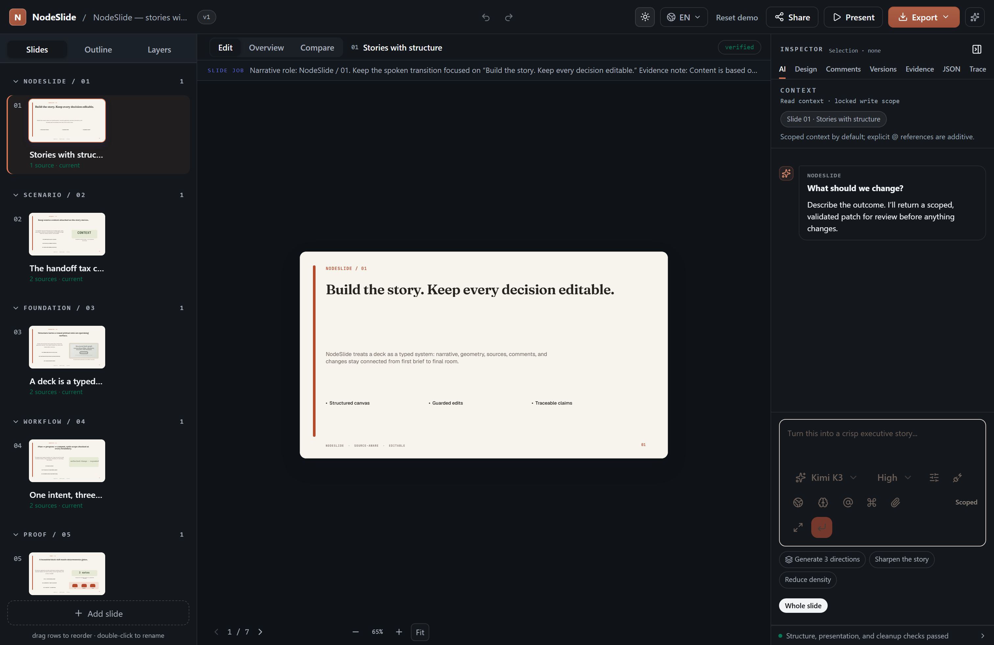
PROGRESSION.BEFORE-AFTER
5
The harness removes clutter before it adds decoration
Before · light
After · dark

Slide 6
DATA.KPI-STRIP
6
The operating verdict should scan in under five seconds

Slide 7
DATA.MULTI-SERIES
7
Direct labels make divergence visible without inventing a cause

Slide 8
DATA.UNCERTAINTY-RANGE
8
A forecast is more credible when its range is impossible to miss

Slide 9
DATA.WATERFALL
9
Harness gains come from several small controls, not one magic prompt

Slide 10
DATA.DISTRIBUTION
10
The best route sits on a frontier, not at one universal optimum

Slide 11
DATA.TABLE
11
Dense tables stay readable when hierarchy does the filtering
Series | Archetypes | Distinct artifacts | Native objects | Declared fallback
Narrative | 4 | 4 | 4 | 0
Data | 9 | 9 | 9 | 0
Systems | 6 | 6 | 6 | 0
Progression | 5 | 5 | 3 | 2
Product evidence | 7 | 7 | 7 | 0
Technical | 4 | 4 | 4 | 0
Decision | 3 | 3 | 3 | 0

Slide 12
DATA.FUNNEL
12
A dashboard can be dense without becoming a card graveyard

Slide 13
SYSTEMS.ARCHITECTURE
13
The portable protocol keeps product logic above backend choice
brief
planner
artifact-compiler
ooxml-emitter
deck-ci

Slide 14
SYSTEMS.SEQUENCE
14
Review custody is visible at every handoff
author
agent
reviewer
countersign

Slide 15
SYSTEMS.NODE-EDGE-GRAPH
15
Better receipts reinforce trust; unchecked complexity pushes back
receipt
trust
reuse
signal
complexity

Slide 16
SYSTEMS.NODE-EDGE-GRAPH
16
Every visual can retain the path from source to slide
Source A
Source B
Source C
Claims
Rejections
Charts
Diagrams
Proof

Slide 17
SYSTEMS.HIERARCHY
17
Routing should spend capability only where the task needs it
routing-budget
high-capability
low-cost
kimi-k3
gemma-4

Slide 18
SYSTEMS.NODE-EDGE-GRAPH
18
NodeKit connects the stack while NodeSlide proves the journey
Hub
Americas
EMEA
APAC
Edge

Slide 19
PROGRESSION.TIMELINE
19
Human approval remains the gate between experiment and harness change

Slide 20
PROGRESSION.ROADMAP
20
The next release sequence exposes dependencies and confidence

Slide 21
PROGRESSION.SCROLLYTELLING
21
Evidence becomes a decision through five inspectable states
1. source
2. capture
3. fact
4. claim
5. slide-element
5-step build sequence (transition: scrub) — each state reveals on advance over the pinned visual.

Slide 22
PROGRESSION.SCROLLYTELLING
22
The trend means more when the audience sees the baseline move
1. baseline-series — 62
2. plan-delta — 68
3. measured-delta — 74
4. variance-band — 80
5. final-series — 86
5-step build sequence (transition: step) — each state reveals on advance over the pinned visual.

Slide 23
MEDIA.IMAGE
23
A visual story can lead with atmosphere and still preserve proof

Slide 24
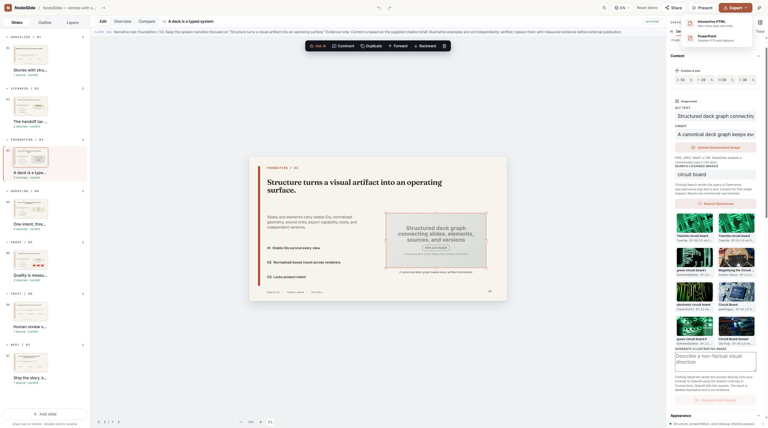
PRODUCT-EVIDENCE.SCREENSHOT-CALLOUTS
24
The product proof is the interface people actually use
1. Capability menu
2. Blocked export path

Slide 25
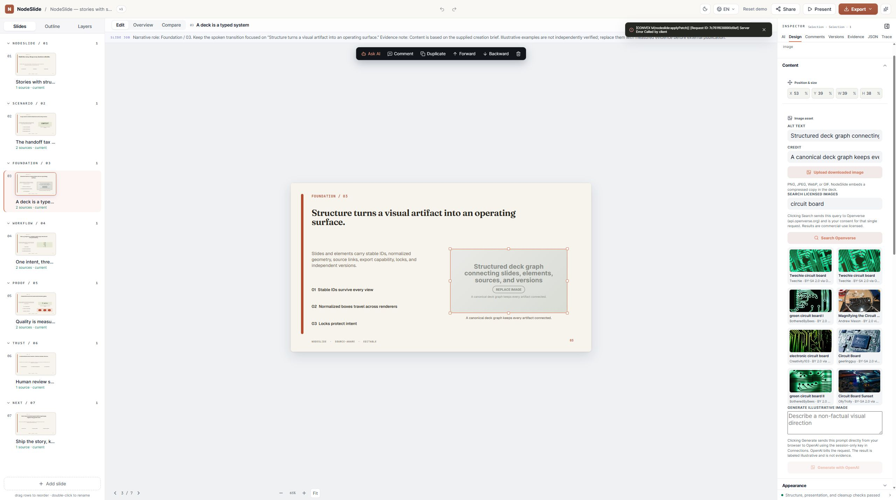
PRODUCT-EVIDENCE.INTERACTION-CLIP
25
One bounded interaction carries the story from selection to receipt
Declared poster frame — a still is not an interaction clip.

Slide 26
PROGRESSION.BEFORE-AFTER
26
Review transforms a rough generation into a governed workspace
Before · light
After · dark

Slide 27
MEDIA.IMAGE
27
The canvas can move from whole system to exact evidence

Slide 28
PRODUCT-EVIDENCE.CLAIM-LINEAGE
28
A claim is trustworthy when its entire path remains inspectable
capture
extracted-fact
claim
slide-element
Atlas v3 shipped zero native chart parts
The topology gate that measured it

Slide 29
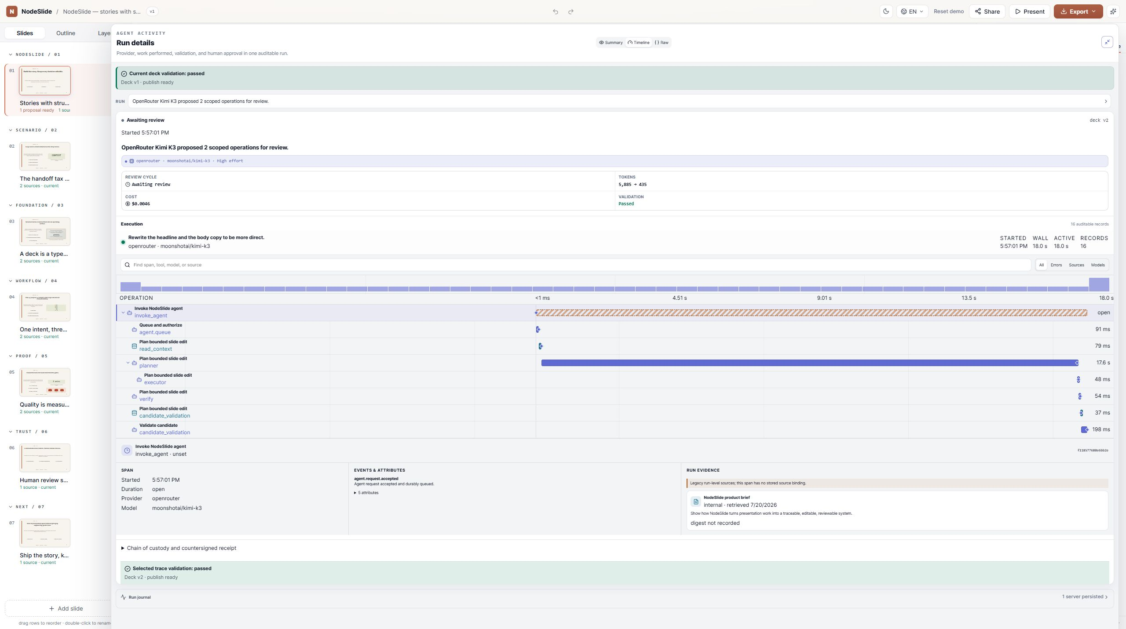
PRODUCT-EVIDENCE.CITATION-CARD
29
Citation quality depends on the exact source region
OOXML c:dateAx (ECMA-376 time axis)

Slide 30
TECHNICAL.CODE-AND-RESULT
30
Runtime claims require a reproducible benchmark receipt
const raw = await pptx.write("nodebuffer");
const a = await injectOmml(raw, equations);
const b = await injectConnectors(a, diagrams);
const out = await injectDateAxes(b, timelines);
Phase | Measured ms
pptx.write | 206.925
inject.omml | 23.338
inject.connectors | 22.25
inject.dateAxes | 18.479
inject.timing | 15.56
dedupe.media | 31.689
total | 318.241
sample size | 1

Slide 31
TECHNICAL.TRACE-WATERFALL
31
Trace anatomy is illustrative until trace and span IDs are bound
pptx.write
206.925ms
inject.omml
23.338ms
inject.connectors
22.25ms
inject.dateAxes
18.479ms
inject.timing
15.56ms
dedupe.media
31.689ms
Measured build spans (build-measurements.json)

Slide 32
TECHNICAL.EQUATION
32
The score is only useful when every symbol maps to evidence
$$\frac{Q}{1 + α·C + β·L}$$

Slide 33
PRODUCT-EVIDENCE.DECK-CI-RECEIPT
33
A deck is not done until both pixels and semantics pass
Field | Value
artifact | deck-ci-receipt
kind | generic
Native builder CI run

Slide 34
DECISION.RISK-MATRIX
34
Pipeline coverage is the risk that deserves action first

Slide 35
DECISION.COST-QUALITY
35
Routing improves when quality, cost, and latency are judged together

Slide 36
SYSTEMS.COMPARISON-MATRIX
36
Different models fail differently under the same contract
Cohort | quality | cost | latency
claude | 1 | 0.00862 | 8.19
kimi | 0.958 | 0.0013 | 17.62
gemma | 0.958 | 0 | 17.27
nemotron | — | — | —
gpt-oss | — | — | —
ensemble | — | — | —

Slide 37
SYSTEMS.COMPARISON-MATRIX
37
V2 expands the harness without crediting the model
Cohort | artifactCoverage
v1 | 12
v2 | 38

Slide 38
DECISION.RECOMMENDATION
38
Reuse the visual vocabulary, then adapt the communication contract
Researcher, investor, and plain-language Chinese versions share the same evidence.

