Slide 1
OPENING / 01
Empty directory. Figured-out agent application.
One neutral starter connects lifecycle, responsive UI, browser proof, and receipts.
• One base; no preset
• Local proof: 9.989 s
• 64 tests; 0 audit issues
NODEKIT · FIGURED OUT · PROOF-CARRYING
01
Notes:
NodeKit now starts domain-blank while preserving one stable product grammar. Evidence: proof/factory-acceptance.json and the 64-test local suite.

Slide 2
STAKES / 02
The product path must stay the proof path.
Generation is cheap. Trust breaks when demo, evaluation, browser, and production run different implementations.
01 One compiled definition serves every gate
02 Receipts bind the exact candidate
03 Failed gates remain visible
NODEKIT · FIGURED OUT · PROOF-CARRYING
02
Notes:
The controlling invariant is same-path execution: local, benchmark, browser, and production may vary inputs, but not substitute a parallel agent implementation.

Slide 3
EVIDENCE / 03
One neutral application passed the full factory path in 9.989 seconds.
From an empty directory, NodeKit installed, compiled, checked, demonstrated, evaluated, browser-tested, and proof-bound one domain-blank app.
9.989 s
01 Domain-blank base: passed
deterministic empty-directory factory acceptance
02 Candidate and config: bound
03 Local benchmark, not production latency
NODEKIT · FIGURED OUT · PROOF-CARRYING
03
Notes:
Measured by proof/factory-acceptance.json on 2026-07-21. The duration is deterministic local factory acceptance, not hosted latency.

Slide 4
PRODUCT BOUNDARY / 04
Domain behavior moved out of the default and into reference applications.
The starter is blank in domain and figured out in behavior. Research, lending, and RL examples now prove extension points without defining the base product.
neutral base → domain pack → reference app
01 One neutral primary create command
02 Domain packs own specialized behavior
03 Reference apps remain inspectable
NODEKIT · FIGURED OUT · PROOF-CARRYING
04
Notes:
The primary nodekit create path rejects legacy presets. Specialized projects are created explicitly as reference applications.

Slide 5
PORTABLE CORE / 05
Caseflow makes generated work safe before any backend is chosen.
The portable core owns lifecycle transitions, optimistic concurrency, explicit next-action ownership, safe failure, and content-addressed completion receipts.
case → run → stage → artifact → proposal → approval → receipt
01 Memory adapter passes conformance
02 Stale proposals conflict, never clobber
03 Completion emits an immutable receipt
NODEKIT · FIGURED OUT · PROOF-CARRYING
05
Notes:
Evidence: src/lib/caseflow.mjs, src/lib/caseflow-conformance.mjs, and test/caseflow.test.mjs.

Slide 6
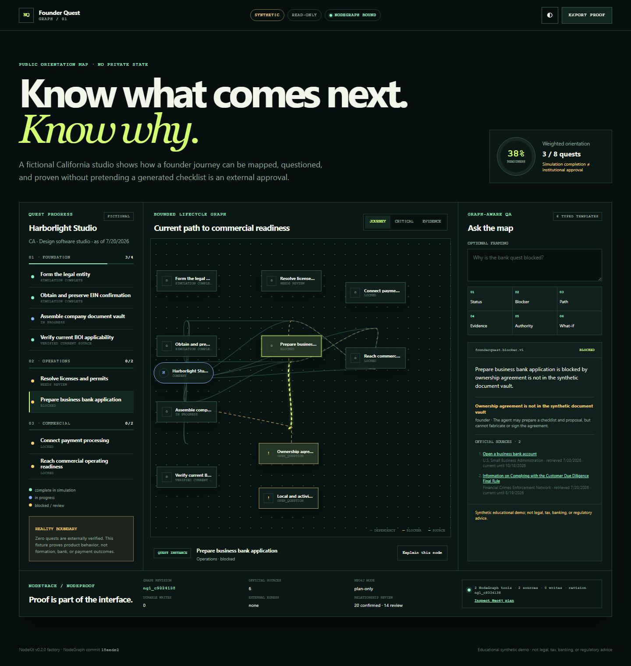
REFERENCE PROOF / 06
Real products remain evidence, not starter defaults.
The retained Founder Quest reference shows that a domain product can keep its own artifact surface and proof while the shared NodeKit grammar stays neutral.
01 Domain-specific UI stays in the app
02 Shared lifecycle stays portable
Reference screenshot; domain proof is not starter behavior.
03 Production claims remain receipt-bound
NODEKIT · FIGURED OUT · PROOF-CARRYING
06
Notes:
The inherited Founder Quest screenshot remains reference evidence. It is not presented as part of the neutral starter.

Slide 7
BACKEND STRATEGY / 07
Convex is the golden adapter, not the semantic definition.
NodeKit owns portable Caseflow semantics. Convex supplies the first-class reactive implementation; future Postgres and Supabase adapters must pass the same observable conformance.
portable protocol → provider adapter → native acceleration
01 Memory conformance: passing
02 Convex extraction: gated by reuse
03 No premature all-in-one component
NODEKIT · FIGURED OUT · PROOF-CARRYING
07
Notes:
Sources: docs/BACKEND_PORTABILITY.md, docs/CONVEX_CASEFLOW_EXTRACTION.md, https://docs.convex.dev/components/authoring, and https://docs.convex.dev/agents/workflows.

Slide 8
DECISION / 08
Ship the stable grammar. Extract infrastructure after repetition.
The neutral factory, responsive experience, portable Caseflow, and ProofLoop candidate binding are ready to review as one coherent change.
intent ↔ artifact ↔ decision ↔ receipt
01 Create one neutral application
02 Review proposals before apply
03 Bind completion to proof
NODEKIT · FIGURED OUT · PROOF-CARRYING
08
Notes:
Next gate: adopt the portable Caseflow lifecycle in three materially different consumers before publishing a bounded Convex component.

