Slide 1
NODESLIDE / OPENUI PHASE 0
LIVE LOCAL RUN
OpenUI makes the visual
decision visible before
the slide changes
A bounded adoption proof: structured visual materials → validated SlideLang proposal → human acceptance.
LOCAL PROOF · 2026-07-16
01

Slide 2
Four incompatible units need a transformation ladder—not one axis
The OpenUI component keeps every scenario claim in its own unit and makes the non-chart decision explicit.
01
REPLICATION
02
EQUIVALENT CAPACITY
03
INDIVIDUAL ACCELERATION
04
SYSTEM OUTCOME
200K copies
50K coder
equivalents
30× speed
4× research
progress
→
→
→
copies
coder equivalents
individual speed multiplier
overall progress multiplier
USER-PROVIDED SCENARIO FIXTURE · UNVERIFIED
NO SHARED AXIS · MIXED UNITS
LOCAL PROOF · 2026-07-16
02

Slide 3
Selection crosses one governed boundary at a time
OpenUI is the decision surface. SlideLang and Convex remain the document and authority layers.
01
02
03
04
OPENUI LANG
VISUAL MATERIAL SPEC
SLIDELANG PROPOSAL
HUMAN ACCEPT
Render an allowlisted
visual decision
Validate units, labels,
and provenance
Compile one editable
add-slide operation
CAS + candidate receipt
advance v1 → v2
Fail closed: mixed-unit chart · fabricated source · stale deck version · duplicate slide id
LOCAL PROOF · 2026-07-16
03

Slide 4
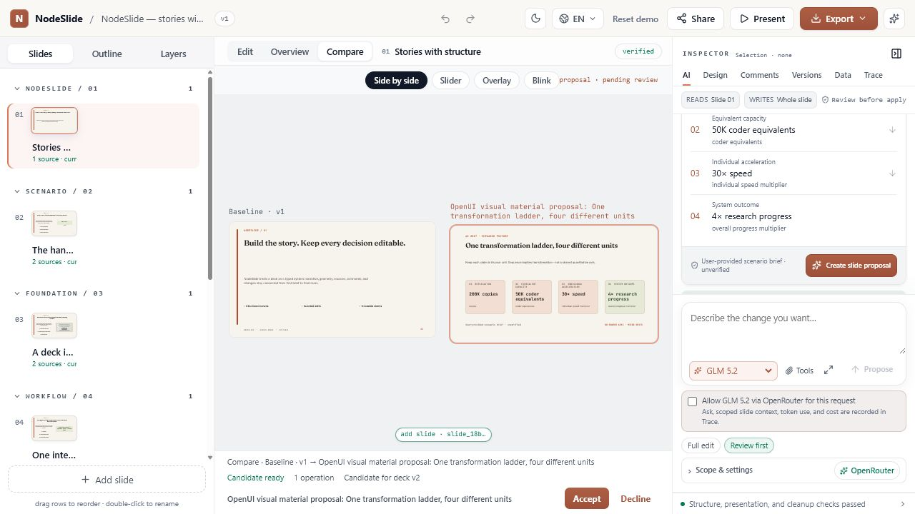
The live interaction proved the boundary—not just the render
Disposable local workspace · exact candidate preview corrected during dogfood
15 / 15
OpenUI + agent contract tests passed
v1 → v2
Pending proposal stayed unapplied until Accept
1 operation
Editable add-slide patch
with a candidate validation receipt
LOCAL PROOF · 2026-07-16
04

Slide 5
RELEASE BAR
Adopt Phase 0 now.
Keep the boundary.
01 OPENUI
02 SLIDELANG
03 HUMAN REVIEW
Bounded component library + visible provenance
Editable output + exact candidate validation
No mutation before explicit Accept
NEXT · SOURCE BINDING + SERVER-GENERATED OPENUI
05

