Slide 1
Exam 1 Topics

Slide 2
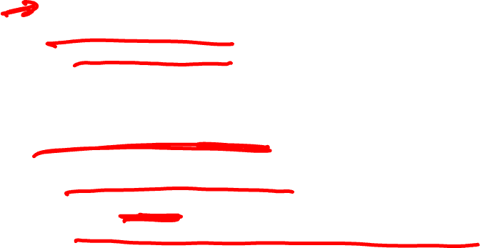
Topics
Formal languages (Lecture 2 plus chapters)
Regular languages
Regular expressions
DFAs
Use of regular languages in programming languages
Context-free languages
Context-free grammars
Derivation, parse, ambiguity
Use of CFGs in programming languages
Expression grammars, precedence, and associativity

Slide 3

Topics
Parsing (Lecture 3 plus chapters)
LL Parsing (Lectures 3 and 4 plus chapters)
Recursive-descent parsing, recursive-descent routines
LL(1) grammars
LL(1) parsing tables
FIRST, FOLLOW, PREDICT
LL(1) conflicts

Slide 4

Topics
Logic programming concepts (Lecture 5 plus chapters
Declarative programming
Horn clause, resolution principle
Prolog (Lectures 5, 6, and 7 plus chapters)
Prolog concepts: search tree, rule ordering, unification, backtracking, backward chaining
Prolog programming: lists and recursion, arithmetic, backtracking cut, negation-by-failure, generate-and-test

Slide 5

Topics
Binding and scoping (Lecture 8 plus reading)
Object lifetime
Combined view of memory
Stack management
Scoping (in languages where functions are third-class values)
Static and dynamic links
Static (lexical) scoping
Dynamic scoping

Slide 6
Topics
Attribute grammars
Attributes
Attribute rules
Decorated parse trees
Bottom-up (i.e., S-attributed) grammars

Slide 7
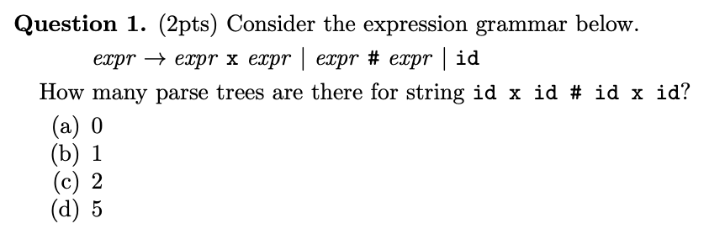
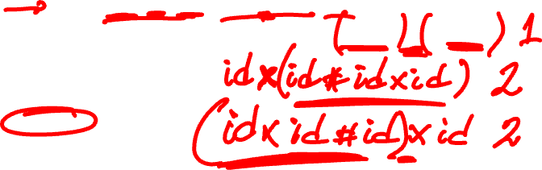
Quiz 1

Slide 8
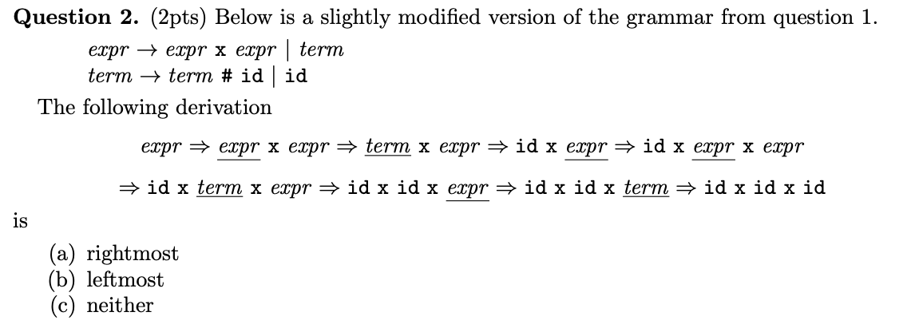

Quiz 1

Slide 9
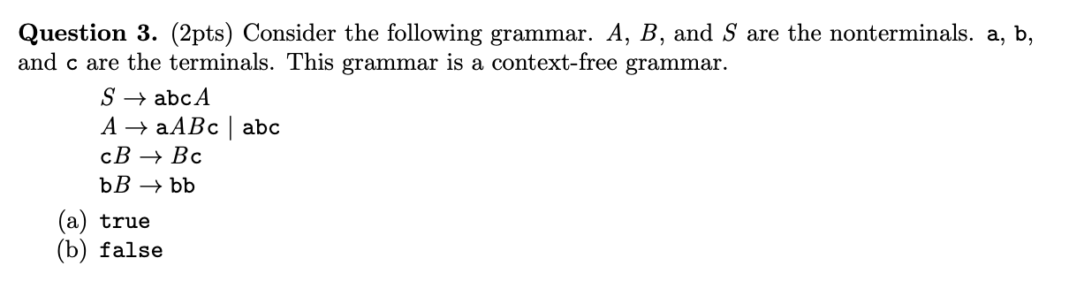

Quiz 1

Slide 10
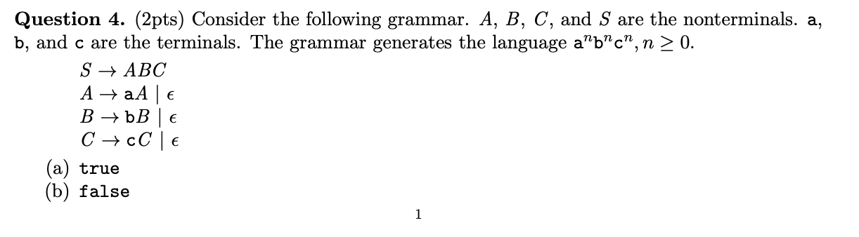

Quiz 1

Slide 11
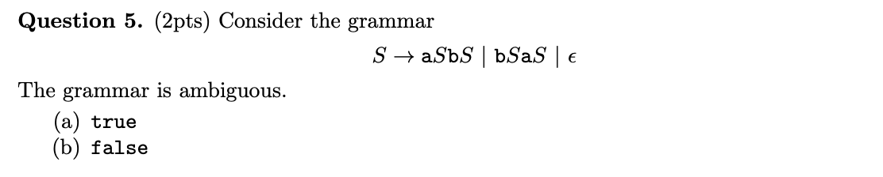

Quiz 1

Slide 12
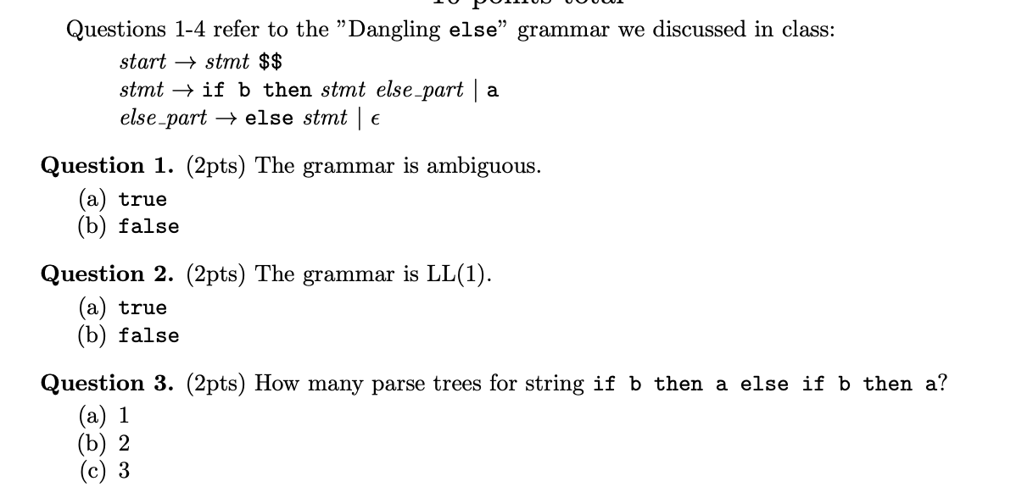
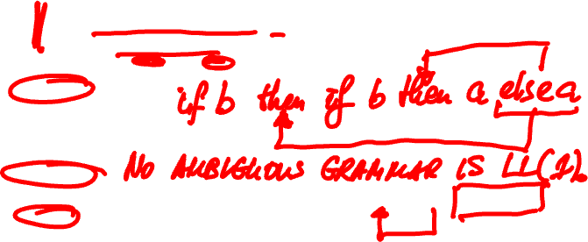
Quiz 2

Slide 13
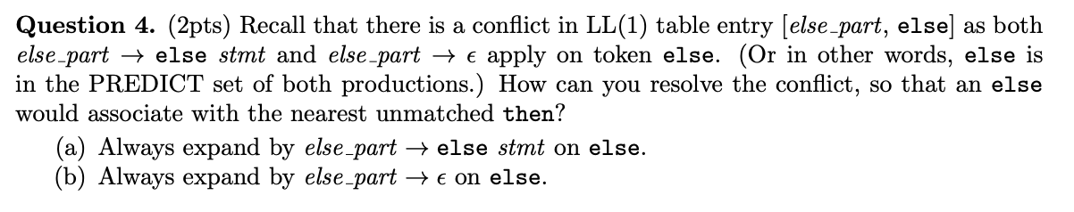
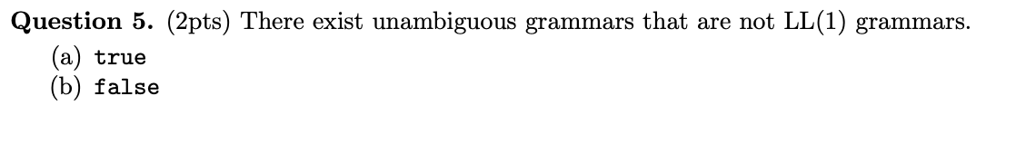
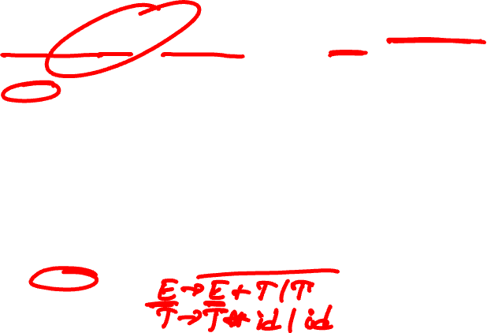
Quiz 2

Slide 14
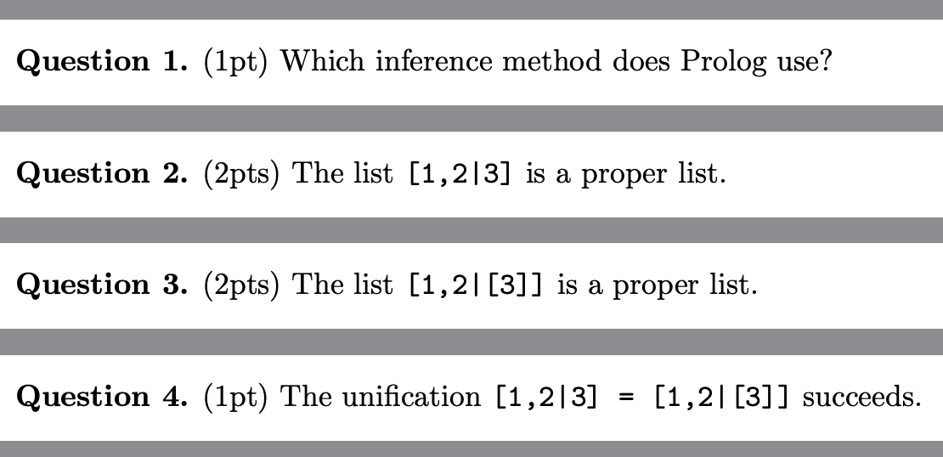
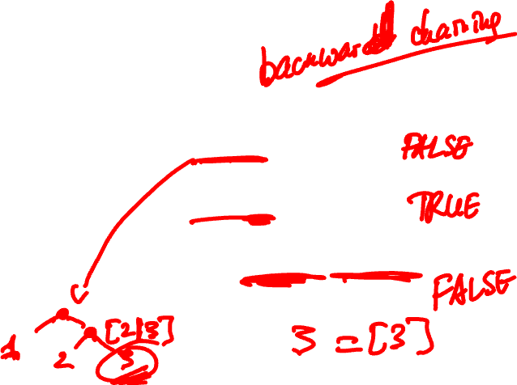
Quiz 3

Slide 15
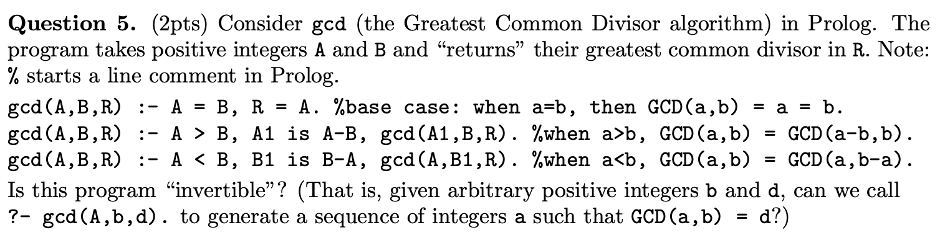
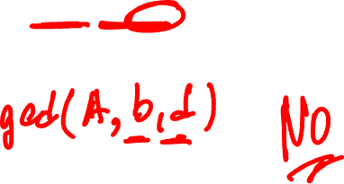
Quiz 3

Slide 16
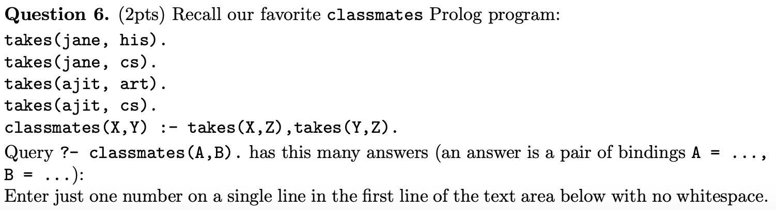

Quiz 3

Slide 17
