Slide 1
Functional Programming with Scheme
Read: Scott, Chapter 11.1-11.3

Slide 2
Lecture Outline
Functional programming languages
Scheme
S-expressions and lists
cons, car, cdr
Defining functions
Examples of recursive functions
Shallow vs. deep recursion
Equality testing

Slide 3
Racket/PLT Scheme/DrScheme
Download Racket (was PLT Scheme (was DrScheme))
http://racket-lang.org/
Run DrRacket
Languages => Choose Language => Other Languages => Legacy Languages: R5RS
One additional textbook/tutorial:
Teach Yourself Scheme in Fixnum Days by Dorai Sitaram:
https://ds26gte.github.io/tyscheme/index.html

Slide 4
First, Imperative Languages
The concept of assignment is central
X:=5; Y:=10; Z:=X+Y; W:=f(Z);
Side effects on memory
Program semantics (i.e., how the program works): state-transition semantics
A program is a sequence of assignment statements with effect on memory (i.e., state)
C := 0;
for I := 1 step 1 until N do
t := a[I]*b[I];
C := C + t;
Notes:
Let us look at imperative languages.
What are the defining characteristics of imperative languages?

Slide 5
Imperative Languages
Functions (also called “procedures”, “subroutines”, or routines) have side effects:
Roughly:
A function call affects visible state; i.e., a function call may change state in a way that affects execution of other functions; in general, function call cannot be replaced by result
Also, result of a function call depends on visible state; i.e., function call is not independent of the context of the call
Notes:
In imperative languages we use terms procedure, or subroutine,
not function. For obvious reasons ☺.

Slide 6
Imperative Languages
Functions are, traditionally, not first-class values
A first-class value is one that can be passed as argument to functions, and returned as result from functions
In a language with assignments, it can be assigned into a variable or structure
Are functions in C first-class values?
As languages become more multi-paradigm, imperative languages increasingly support functions as first-class values (JS, R, Python, Java 8, C++11)

Slide 7
Functional Languages
Program semantics: reduction semantics
A program is a set of function definitions and their application to arguments
Def IP = (Insert +) º (ApplyToAll *) º Transpose
IP <<1,2,3>,<6,5,4>> is
(Insert +) ((ApplyToAll *) (Transpose
<<1,2,3>,<6,5,4>>))
(Insert +) ((ApplyToAll *) <<1,6>,<2,5>,<3,4>>)
(Insert +) <6,10,12>
28
Function composition

Slide 8
Functional Languages
In pure functional languages, there is no notion of assignment, no notion of state
Variables are bound to values only through parameter associations
No side effects!
Referential transparency
Roughly:
Result of function application is independent of context where the function application occurs; function application can be replaced by result

Slide 9
Functional Languages
Functions are first-class values
Can be returned as value of a function application
Can be passed as an argument
In a language with assignment, can be assigned into variables and structures
Unnamed functions exist as values

Slide 10
Lecture Outline
Functional programming languages
Scheme
S-expressions and lists
cons, car, cdr
Defining functions
Examples of recursive functions
Shallow vs. deep recursion
Equality testing

Slide 11
Lisp and Scheme
Lisp is the second oldest high-level programming language!
Simple syntax
Program code and data have same syntactic form
The S-expression
Function application written in prefix form
(e1 e2 e3 … ek) means
Evaluate e1 to a function value
Evaluate each of e2,…,ek to values
Apply the function to these values
(+ 1 3) evaluates to 4

Slide 12
History
Lisp
1950’s
John McCarthy
Scheme
1975
Guy Steele
Gerald Sussman
Common Lisp
dynamic scoping
lexical scoping
functions as first-class values

Slide 13
Why Scheme?
Simple syntax! Great to introduce core functional programming concepts
Reduction semantics
Lists and recursion
Higher order functions
Evaluation order
Parametric polymorphism
Later we’ll see Haskell and new concepts
Algebraic data types and pattern matching
Lazy evaluation
Type inference

Slide 14
S-expressions
S-expr ::= Name | Number | ( { S-expr } )
Name is a symbolic constant (a string of chars which starts off with anything that can’t start a Number)
Number is an integer or real number
List of zero or more S-expr’s
E.g., (a (b c) (d)) is a list S-expr
a
b
c
( )
( )
d
( )
Notes:
Syntax is given in Extended Backus Naur Form (EBNF).
An S-expr is a Name (a symbolic constant) or a Number (a numerical constant), or a list of zero or more S-expr’s.
Note the underlined ( and ). Parens are tokens in the language, and are underlined to differentiate with ( ) used as metasymbols in EBNF.
{ S-expr } denotes “one or more occurrences of S-expr” in EBNF.

Slide 15
List Functions
car and cdr
Given a list, they decompose it into first element, rest-of-list portions
E.g., car of (a (b c) (d)) is a
E.g., cdr of (a (b c) (d)) is ((b c)(d))
cons
Given an element and a list, cons builds a new list with the element as its car and the list as its cdr
cons of a and (b) is (a b)
() is the empty list
Notes:
IBM 704 had support for splitting a word.
CAR stands for Content of the Address Register
CDR stands for Content of the Data Register

Slide 16
Quoting
‘ or quote prevents the Scheme
interpreter from evaluating the argument
(quote (+ 3 4)) yields (+ 3 4)
‘(+ 3 4) yields (+ 3 4)
Whereas (+ 3 4) yields 7
Why do we need quote?

Slide 17
Questions
((a) b (c d))
a ()
(car ‘(a b c)) yields ?
(car ‘((a) b (c d))) yields ?
(cdr ‘(a b c)) yields ?
(cdr ‘((a) b (c d))) yields ?
Can compose these operators in a short-hand manner. Can
reach arbitrary list element by composition of car’s and cdr’s.
(car (cdr (cdr ‘((a) b (c d)) )))
can also be written
(caddr ‘((a) b (c d)) )
(car (cdr (cdr ‘((a) b (c d)) ))) =
(car (cdr ‘( b (c d))) = (car ‘((c d))) = (c d)
b
c
d ()
()
Notes:
Does this look familiar?
(car ‘(a b c)) yields a
(car ‘((a) b (c d))) yields (a)
(cdr ‘(a b c)) gives (b c)
(cdr ‘((a) b (c d))) gives (b (c d))

Slide 18
Questions
Recall cons
E.g., (cons ‘a ‘(b c)) yields (a b c)
(cons ‘d ‘(e)) yields ?
(cons ‘(a b) ‘(c d)) yields ?
(cons ‘(a b c) ‘((a) b (c d))) yields ?
Notes:
(cons ‘(a b c) ‘((a) b (c d))) yields ((a b c) (a) b (c d))
(cons ‘d ‘(e)) yields (d e)
(cons ‘(a b) ‘(c d)) yields ((a b) c d)

Slide 19
Type Predicates
Note the quote: it prevents evaluation of the argument
(symbol? ‘sam) yields #t (symbol? 1) yields #f
(number? ‘sam) yields #f (number? 1) yields #t
(list? ‘(a b)) yields #t (list? ‘a) yields #f
(null? ‘()) yields #t (null? ‘(a b)) yields #f
(zero? 0) yields #t (zero? 1) yields #f
Can compose these.
(zero? (- 3 3)) yields #t Note that since this
language is fully parenthesized, there are no precedence
problems in expressions!

Slide 20
Question
What is the typing discipline in Scheme?
Static or dynamic?
Answer: Dynamic typing. Variables are bound to values of different types at runtime. All type checking done at runtime.

Slide 21
Lecture Outline
Functional Programming Languages
Scheme
S-expressions and lists
cons, car, cdr
Defining functions
Examples of recursive functions
Shallow vs. deep recursion
Equality testing

Slide 22
Scheme: Defining Funcitons
Fcn-def ::= (define (Fcn-name {Param}) S-expr)
Fcn-name should be a new name for a function.
Param should be variable(s) that appear in the
S-expr which is the function body.
Fcn-def ::= (define Fcn-name Fcn-value)
Fcn-value ::= (lambda ( {Param} ) S-expr)
where Param variables are expected to appear in the S-expr; called a lambda expression.

Slide 23
Examples
(define (zerocheck? x) (if (= x 0) #t #f) )
If-expr ::= ( if S-expr0 S-expr1 S-expr2 )
where S-expr0 must evaluate to a boolean value; if that
value is #t, then the If-expr yields the result of S-expr1,
otherwise it yields the result of S-expr2.
(zerocheck? 1) yields #f,
(zerocheck? (* 1 0)) yields #t
Notes:
a
b

Slide 24
Examples
(define (atom? object)
(not (pair? object)) )
Here pair? is a built-in type predicate. It yields #t
if the argument is a non-trivial S-expr (i.e., something
one can take the cdr of). It yields #f otherwise.
not is the built-in logical operator.
What does atom? do?
Notes:
a
b

Slide 25
Examples
(define square (lambda (n) (* n n)))
Associates the Fcn-name square with the function value (lambda (n) (* n n))
Lambda calculus is a formal theory of functions
Set of functions definable using lambda calculus (Church 1941) is same as set of functions computable as Turing Machines (Turing 1930’s)

Slide 26
Trace of Evaluation
(define (atom? object)
(not (pair? object)) )
(atom? `(a))
-obtain function value corresponding to atom?
-evaluate `(a) obtaining (a)
-evaluate (not (pair? ‘(a)))
-obtain function value corresponding to not
-evaluate (pair? ‘(a))
-obtain function value corresponding to pair?
-evaluate ‘(a) obtaining (a)
-return value #t
-return #f
-return #f

Slide 27
Read-Eval-Print Loop (REPL)
Scheme interpreter runs read-eval-print loop
Read input from user
A function application
Evaluate input
(e1 e2 e3 … ek)
Evaluate e1 to obtain a function
Evaluate e2, … , ek to values
Execute function body using values from previous step as parameter values
Return value
Print return value

Slide 28
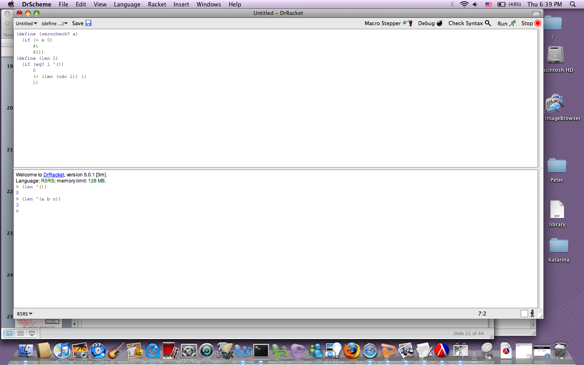

Slide 29
Conditional Execution
(if e1 e2 e3)
(cond (e1 h1) (e2 h2) … (en-1 hn-1) (else hn))
Cond is like if – then – else if construct
(define (zerocheck? x)
(cond ((= x 0) #t) (else #f)))
OR
(define (zchk? x)
(cond ((number? x) (zero? x))
(else #f)))

Slide 30
Recursive Functions
(define (len x)
(cond ((null? x) 0) (else (+ 1 (len (cdr x))))))
(len `(1 2)) should yield 2.
Trace: (len `(1 2)) -- top level call
x = (1 2)
(len `(2)) -- recursive call 1
x = (2)
(len `()) -- recursive call 2
x = ()
returns 0 -- return for call 2
returns (+ 1 0) = 1 --return for call 1
returns (+ 1 1) = 2 -- return for top level call
(len ‘((a) b (c d))) yields what?
len is a shallow
recursive function

Slide 31
Recursive Functions
(define (app x y)
(cond ((null? x) y)
((null? y) x)
(else
(cons (car x)
(app (cdr x) y)))))
What does app do?
(app ‘() ‘()) yields ?
(app ‘() ‘(1 4 5)) yields ?
(app ‘(5 9) ‘(a (4) 6)) yields ?
app is a shallow
recursive function
Notes:
(app ‘() ‘()) yields ()
(app ‘() ‘(1 4 5)) yields (1 4 5)
(app ‘(5 9) ‘(a (4) 6)) yields (5 9 a 9 (4) 6)

Slide 32
Exercise
(define (len x)
(cond ((null? x) 0) (else (+ 1 (len (cdr x))))))
Write a version of len that uses if instead of cond
Write a function countlists that counts the number
of list elements in a list. E.g.,
(countlists ‘(a)) yields 0
(countlists ‘(a (b c (d)) (e))) yields 2
Recall (list? l) returns true if l is a list, false otherwise

Slide 33
Recursive Functions
(define (fun x)
(cond ((null? x) 0)
((atom? x) 1)
(else (+ (fun (car x)) (fun (cdr x)))) ))
fun is a deep
recursive function
What does fun do?

Slide 34
fun counts atoms in a list
(define (atomcount x)
(cond ((null? x) 0)
((atom? x) 1)
(else (+ (atomcount (car x)) (atomcount (cdr x)))) ))
(atomcount ‘(a)) yields 1
(atomcount ‘(1 (2 (3)) (5)) ) yields 4
Trace: (atomcount ‘(1 (2 (3)) )
1> (+ (atomcount 1) (atomcount ‘( (2 (3)) ) ))
2> (+ (atomcount ‘(2 (3)) ) (atomcount ‘( ) ) )
3> (+ (atomcount 2) (atomcount ‘((3)) )
4> (+ (atomcount ‘(3)) (atomcount ‘( )) )
5> (+ (atomcount 3) (atomcount ‘( )))
atomcount is a deep
recursive function
0
1
Notes:
???

Slide 35
Exercise
Write a function flatten that flattens a list
(flatten ‘(1 (2 (3)))) yields (1 2 3)

Slide 36
Lecture Outline
Functional Programming Languages
Scheme
S-expressions and lists
cons, car, cdr
Defining functions
Examples of recursive functions
Shallow vs. deep recursion
Equality testing

Slide 37
Equality Testing
eq?
Built-in predicate that can check atoms for equal values
Does not work on lists in the way you might expect!
eql?
Our predicate that works on lists
(define (eql? x y)
(or (and (atom? x) (atom? y) (eq? x y))
(and (not (atom? x)) (not (atom? y))
(eql? (car x) (car y))
(eql? (cdr x) (cdr y)) )))
equal?
Built-in predicate that works on lists

Slide 38
Examples
(eql? ‘(a) ‘(a)) yields what?
(eql? ‘a ‘b) yields what?
(eql? ‘b ‘b) yields what?
(eql? ‘((a)) ‘(a)) yields what?
(eq? ‘a ‘a) yields what?
(eq? ‘(a) ‘(a)) yields what?

Slide 39
Models for Variables
Value model for variables
A variable is a location that holds a value
I.e., a named container for a value
a := b
Reference model for variables
A variable is a reference to a value
Every variable is an l-value
Requires dereference when r-value needed (usually, but not always implicit)
l-value (the location)
r-value (the value held in that location)

Slide 40
Models for Variables: Example
b := 2;
c := b;
a := b + c;
Value model for variables
b := 2 b:
c := b c:
a := b+c a:
Reference model for variables
b := 2 b
c := b c
a := b+c a
2
2
4
2
4

Slide 41
Equality Testing: How does eq? work?
Scheme uses the reference model for variables!
(define (f x y) (list x y))
Call (f ‘a ‘a) yields (a a)
x refers to atom a and y refers to atom a.
eq? checks that x and y both point to the
same place.
Call (f ‘(a) ‘(a)) yields (‘(a) ‘(a))
x and y do not refer to the same list.
x
y
a
A cons cell
x
y
a
( )
Notes:
note that ( ) or nil is an atom!
nil is actually a polymorphic constant as it stands both the empty list and is an atom as well.
also, note that x and y don’t point to the same list at all so that the eq? comparison will fail.
in the atom: a case, x and y both point to the cell which points to a, so they have the same contents and compare eq.
safest thing to do is to use eql? on all comparisons! this tests that 2 S-exprs are isomorphic, which is what we usually mean by equal.

Slide 42
Models for Variables
C/C++, Pascal, Fortran
Value model
Java
Mixed model: value model for simple types, reference model for class types
JS, Python, R, etc.
Reference model
Scheme
Reference model! eq? is “reference equality” (akin of Java’s ==), equal? is value equality

Slide 43
The End

