Slide 1
Dynamic Languages
Read: Scott, Chapter 14 (optional)

Slide 2
Lecture Outline
Scripting programming languages
Dynamic programming languages
Taking stock: PL design choices
Python

Slide 3
Scripting Languages
E.g., Tcl, awk
Originate in the 1970’s from UNIX (shell scripts)
Purpose
To process text files with ease
To launch components and combine (or “glue”) these components into an application
Characteristics
Ease of use, flexibility, rapid prototyping: hence, scripting languages are dynamically typed
Extensive support for text processing

Slide 4
References
Following slides are based on
“The Rise of Dynamic Languages” talk by Jan Vitek
“The Essence of JavaScript”, ECOOP’10 paper by Shriram Krishnamurthi et al.
“The Eval that Men Do”, ECOOP’11 paper by Gregor Richards et al.

Slide 5
2 Decades of Dynamic Languages
Visual Basic dyn 1991
Python dyn 1991
Lua dyn 1993
R dyn 1993
Java stat+dyn 1995
JavaScript dyn 1995
Ruby dyn 1995
PHP dyn 1995
C# stat+dyn 2001
Scala stat 2002
F# stat 2003
Clojure dyn 2007
Julia dyn 2009
Last decade or so:
Go stat ~2009
Rust stat 2010
Swift stat 2014
TypeScript stat+dyn

Slide 6
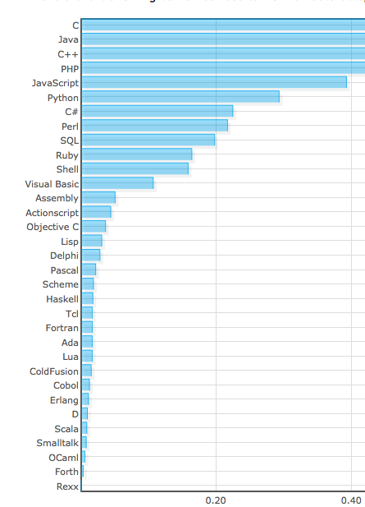
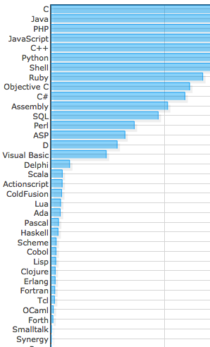
2011:
2013:

Slide 7
Characteristics
Dynamic typing, also known as Duck typing
Type checking amounts to running the “Duck test” at runtime:
“If it walks like a duck and swims like a duck and quacks like a duck, then it is a duck.” --- paraphrased from J. W. Riley
fun F( x ) {
x.quack();
}

Slide 8
Other Characteristics
Reference model, garbage collected
Reflective! (i.e., eval is a prominent feature)
Use of eval ranges “from sensible to stupid” (ref. “The Eval that Men Do” by Richards et al.)
eval is evil. Avoid it.
eval has aliases. Don’t use them.
--- Douglas Crockford

Slide 9
Other Characteristics
Use of eval ranges “from sensible to stupid” (ref. “The Eval that Men Do” by Richards et al.)
var flashVersion = parse();
flash2Installed = flashVersion == 2;
flash3Installed = flashVersion == 3;
… // same for versions 4 to 11
for (var i = 2; i <= maxVersion; i++)
if (eval(“flash”+i+”Installed”)==true)
actualVersion = i;
Notes:
Source of code: a real website, heute.de.

Slide 10
The Eval that Men Do

Slide 11
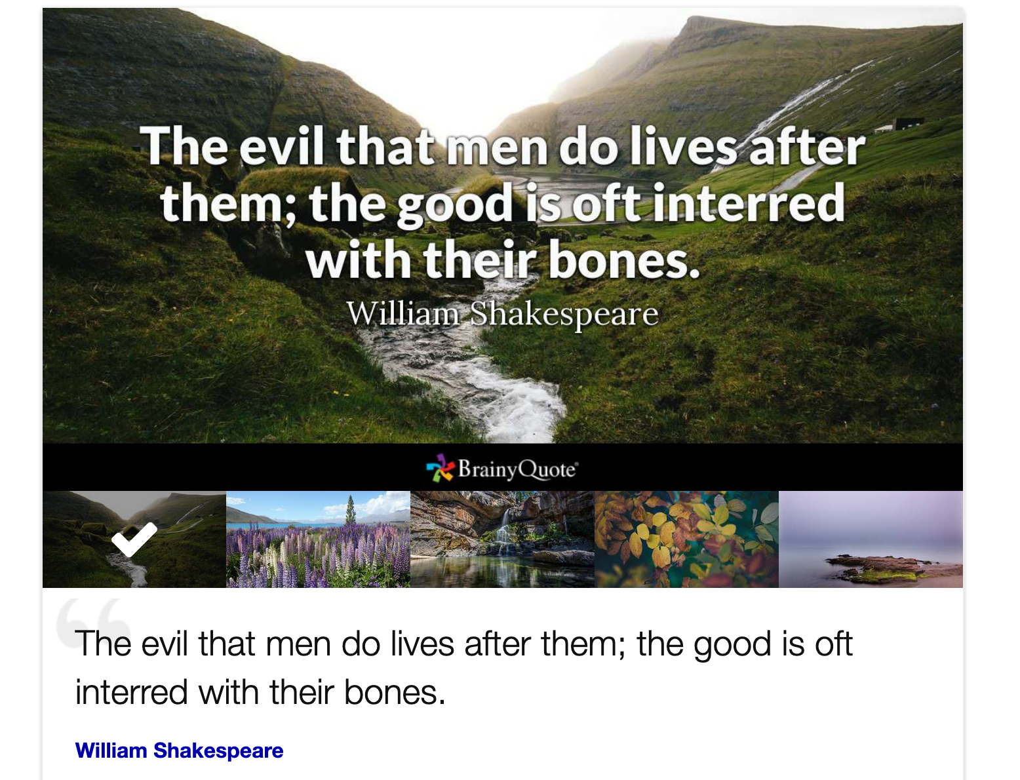
The Eval That Men Do

Slide 12
Other Characteristics
High-level data structures, libraries
Lightweight syntax
Delay error reporting, error-oblivious
Very difficult to trace and fix errors
Performance challenged
C interpreters ~2-5 times slower than Java
Java interpreters ~16-43 times slower than Java

Slide 13
A bit on JavaScript
95% of all web sites use JavaScript
Single-threaded
Reference model, garbage collected
Reflective! (i.e., eval is a prominent feature)
High-level data structures, libraries
Lightweight syntax
Error-oblivious

Slide 14
Objects and Fields in JavaScript
Objects have fields (field are also known as properties)
Field lookup
x[“f”], x.f
{ “f” : 7 }[“g”] JavaScript is error-oblivious, in the above example, it returns undefined, and continues!
Field update
x[“f”] = 2, x.f = 2
{ “f” : 0 }[“g”] = 10 results in
{ “f” : 0, “g” : 10 }

Slide 15
Objects and Fields in JavaScript
Field delete
delete x.f
delete { “f” : 7, “g” : 0 }[“g”]

Slide 16
Arrays Are Objects
function sum(arr){
var r = 0; for (var i=0; i<arr[“length”]; i=i+1){
r = r + arr[i]
};
return r
};
sum([1,2,3]) yields what?
var a = [1,2,3,4];
delete a[“3”];
sum(a) yields what?
Notes:
The first one yields 6 as we expect.
But arrays are really objects, so as with objects, we can delete a field.
So when we delete a[“3”], a[“3”] strangely stays there and strangely,
JS does not update the length of the array… sum(a) yields undefined.

Slide 17
Functions Are Objects
f = function(x) { return x+1 }
f.y = 90
f(f.y) yields what?
Other unexpected behavior…
with statement
eval
Notes:
f(f.y) yields 91.

Slide 18
Wat?
https://www.destroyallsoftware.com/talks/wat

Slide 19
Lecture Outline
Scripting programming languages
Dynamic programming languages
Taking stock: PL design choices
Python

Slide 20
Taking Stock: Design Choices
Semantics/
Basic Operation
Datatypes
Control-flow
Scheme | Booleans, Numbers, Symbols, Lists | Conditional flow, Recursion | Reduction/ Function application
Java | Primitive types, Classes (library, and user-defined) | Conditional flow, Iteration | State-transition/ Assignment statement
C++ | Primitive types, struct types, pointer types, array types, Classes | Conditional flow, Iteration | State-transition/ Assignment statement

Slide 21
Taking Stock: Design Choices
Semantics/ Basic Operation
Datatypes
Control-flow
Haskell | ADTs, Type Classes | Conditional flow, Recursion | Reduction/ Function application
Python

Slide 22
Taking Stock: Design Choices
Parameter
Passing
Mechanism
Variable Model
Scoping
Typing
Scheme
Java
C++
Reference
model
By value
Static, nested
function
definitions
Dynamic,
type-safe
Value model
for simple types,
reference model
for class types
By sharing
Static
Static and
dynamic,
type-safe
Value model
By value and
by reference
Static
Static,
type-unsafe

Slide 23
Taking Stock: Design Choices
Parameter
Passing
Mechanism
Variable Model
Scoping
Typing
Haskell
Python
Reference
model
By name (lazy
evaluation)
Static, nested
function
definitions
Static,
type-safe

Slide 24
Python
Designed by Guido van Rossum at CWI Amsterdam in 1991
Multi-paradigm programming language
All characteristics of dynamic languages
It has “functional” features
E.g. higher-order functions, map and reduce on lists, list comprehensions
It has “object-oriented” features
E.g., iterators, array slicing operations, reflection, exceptions, (multiple) inheritance, dynamic loading

Slide 25
Python: Syntax and Scoping
Scott
Variable belongs to block where it is written, unless explicitly imported.
What is the output of this program?
m=1; j=3
def outer():
def middle(k):
def inner():
m=4 # new local m
print (m,j,k)
inner()
return m,j,k # 3 element tuple
m=2; # new local m
return middle(j) # old (global) j
print (outer())
print (m,j)

Slide 26
Python: Syntax and Scoping
Scott
Variable belongs to block where it is written, unless explicitly imported.
What is the output of this program?
m=1; j=3
def outer():
def middle(k):
def inner():
global m # from main program, not outer
m=4
print (m,j,k)
inner()
return m,j,k # 3 element tuple
m=2; # new local m
return middle(j) # old (global) j
print (outer())
print (m,j)
What’s printed if we removed
the red “global m” statement?
then remove the blue assignment?

Slide 27
Python: Syntax and Scoping
What is the output of this program?
m=1;
def outer():
def middle():
def inner():
return m;
inner()
return inner # middle returns a closure
m=2 # { inner() { return m; }, m->2 }
return middle()
fun = outer() # fun is a reference to closure
print (fun())

Slide 28
Scoping: Static Scoping Rules
Blocks (scopes) are defined by indentation
There are no variable declarations
A variable belongs to block where it is written
“Closest enclosing scope” rule applies
Lookup proceeds from inner to outer blocks
‘global’ overrides rule for access to outermost scope
Functions are first class values
Static scoping entails closures and unlimited extent

Slide 29
Datatypes
Numbers (+, *, **, pow, etc) - immutable
Collections
Sequences
Strings are immutable!
Lists
Tuples are immutable!
Mappings
Dictionaries
Files

Slide 30
Datatypes
So, what model for variables does Python use?
Reference model for variables
Equality
== equal in value (structural equality, value equality)
(Same in Scala, == redirects to equals!)
is same object (reference equality)
None acts like null in C, a placeholder for an actual value

Slide 31
Control Flow
Short-circuit evaluation of boolean expressions
Constructs for conditional control flow and iteration: if, while, for
for x in [“spam”, “eggs”, “ham”]:
print x #iterates over list elements
s = “lumberjack”
for y in s: print y #iterates over chars
Use of iterators defines the “Python style”

Slide 32
Functions
Two forms of function definition. First class values
def incr(x): return x+1 #function incr
#list of 2 functions
incrs = [lambda x: x+1, lambda x: x+2]
Polymorphism
#what datatypes can this function be used on?
def intersect(seq1, seq2):
res = [ ]
for x in seq1: #iterates over elements in seq1
if x in seq2: #checks if element is in seq2
res.append(x) #if so, adds element to list
return res
print intersect([1,2,3],[2,4,6]) #[2]
print intersect( (1,2,3,4), (4,3,5)) #[3,4]
print intersect( (1,2,3), [1,2,3]) #[1, 2, 3]
print intersect({1:'a',2:'b',3:'c'}, {1:'a',4:'d'}) #[1]
print intersect({1:'a',2:'b',3:'c'}, {4:'a',5:'b'}) #[]
#clearly the intersection is on the keys, not the values!

Slide 33
Functions
What is the parameter passing mechanism in Python?
Call by value
But each value is a reference!
So we say that parameter passing is call by sharing
Be careful: if we pass a reference to a mutable object, callee may change argument object

Slide 34
Taking Stock: Python
Datatypes?
Control flow?
Basic operation?
Variable model?
Parameter passing mechanism?
Scoping?
Are functions first-class values?
Typing?
Notes:
Supports high-level datatypes: lists, strings, dictionaries, sets, etc.
Control-flow: conditionals, iteration, the Python style.
Basic operation: assignment
Variable model: reference model
Parameter passing: call by sharing
Scoping: static, with functions as first class values.
Python implements closures, just like Scheme!

