Slide 1
Final Exam Review

Slide 2
Final Exam is Cumulative
Programming Language Syntax (Ch. 2.1-2.3.3)
Logic Programming and Prolog (Ch. 12)
Scoping (Ch. 3.1-3.3)
Programming Language Semantics (Sc. Ch. 4.1-4.3)
Functional programming (Ch. 11)
Scheme and Haskell, map/fold questions
Lambda calculus (Ch. 11 Companion)
Data abstraction: Types (Ch. 7, 8)
Control abstraction: Parameter Passing (Ch. 9.1-9.3)
Object-oriented languages (10.1-10.2)
Concurrency (13.1). “What can go wrong?” questions
Dynamic languages (Ch. 14 optional)
Comparative Programming Languages

Slide 3
Exam 1 Topics
Formal languages (Lecture 2 plus chapters)
Regular languages
Regular expressions
DFAs
Use of regular languages in programming languages
Context-free languages
Context-free grammars
Derivation, parse, ambiguity
Use of CFGs in programming languages
Expression grammars, precedence, and associativity

Slide 4
Exam 1 Topics
Parsing (Lecture 3 plus chapters)
LL Parsing (Lectures 3 and 4 plus chapters)
Recursive-descent parsing, recursive-descent routines
LL(1) grammars
LL(1) parsing tables
FIRST, FOLLOW, PREDICT
LL(1) conflicts

Slide 5
Exam 1 Topics
Logic programming concepts (Lecture 5 plus chapters
Declarative programming
Horn clause, resolution principle
Prolog (Lectures 5, 6, and 7 plus chapters)
Prolog concepts: search tree, rule ordering, unification, backtracking, backward chaining
Prolog programming: lists and recursion, arithmetic, backtracking cut, negation-by-failure, generate-and-test

Slide 6
Exam 1 Topics
Binding and scoping (Lecture 8 plus reading)
Object lifetime
Combined view of memory
Stack management
Scoping (in languages where functions are third-class values)
Static and dynamic links
Static (lexical) scoping
Dynamic scoping

Slide 7
Exam 1 Topics
Attribute grammars
Attributes
Attribute rules
Decorated parse trees
Bottom-up (i.e., S-attributed) grammars

Slide 8
Exam 2 Topics
Scheme (Lectures 12 and 13, plus chapters)
S-expression syntax
Lists and recursion
Shallow and deep recursion
Equality
Higher-order functions
map, foldl, and foldr
Programming with map, foldl, and foldr
Tail recursion

Slide 9
Exam 2 Topics
Scheme (Lecture 14, plus chapters)
Binding with let, let*, letrec
Scoping in Scheme
Closures and closure bindings

Slide 10
Exam 2 Topics
Scoping, revisited (Lecture 15, plus chapters)
Static scoping
Reference environment
Functions as third-class values vs.
Functions as first-class values
Dynamic scoping
With shallow binding
With deep binding

Slide 11
Exam 2 Topics
Lambda calculus (Lectures 15 and 16)
Syntax and semantics
Free and bound variables
Substitution
Rules of the Lambda calculus
Alpha-conversion
Beta-reduction
Normal forms
Reduction strategies
Normal order
Applicative order

Slide 12
Topics
Haskell (Lectures 19 and 20)
Basic syntax
Algebraic data types
Pattern matching
Lazy evaluation
Types and type inference
Basics of type classes and Maybe monad

Slide 13
Topics
Data abstraction and types (Lecture 21)
Types and type systems
Type equivalence
Types in C

Slide 14
Topics
Parameter passing mechanisms (Lecture 22)
Call by value
Call by reference
Call by value-result
Call by name
Call by sharing

Slide 15
Topics
Object-oriented languages and polymorphism (Lecture 23)
Subtype polymorphism
Parametric polymorphism
Explicit parametric polymorphism
Implicit parametric polymorphism

Slide 16
Topics
Concurrency in Java (Lecture 24)
Threads and tasks
Synchronized blocks
Concurrency errors
Data races
Atomicity violations

Slide 17
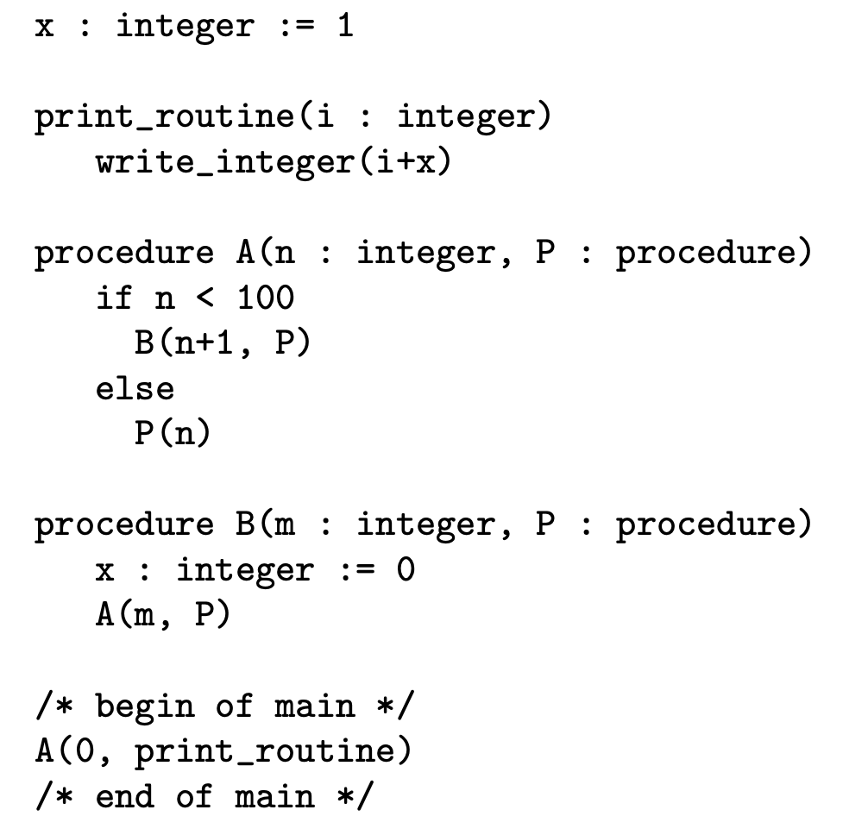
Practice Problems (Quiz 6)
Dyn. with shallow binding: 100
Dyn. with deep binding: 101

Slide 18
Practice Problems (Quiz 6)
Consider the problem of figuring out whether two trees (lists in Scheme) have the same fringe, that is, the same leaves, in the same order, regardless of structure. E.g., ((1 2) 3) and (1 (2 3)) have the same fringe. What is a straight-forward way to solve this problem?
Flatten, then compare

Slide 19
Practice Problems (Quiz 7)
type Name = String
data Expr = Var Name
| Val Bool
| And Expr Expr
| Or Expr Expr
| Not Expr
| Let Name Expr Expr
Fill in the type signature of find:
-- Looks up variable n in binding environment env.
-- Returns first binding or throws Exception if no binding of n.
-- Ex: find "x" [("x",True),("x",False),("y",True)] returns True
find :: _________________________________
find n env = head [ bool | (var,bool) <- env, var == n ]
Name -> [(Name,Bool)] -> Bool

Slide 20
Practice Problems (Quiz 7)
Fill in the Or and Let arms of eval:
-- Purpose: evaluates expression e in binding environment env
-- Returns the boolean value of e or throws an Exception
-- Ex.: eval (Var "x") [("x",True),("x",False)] returns True
eval :: Expr -> [(Name,Bool)] -> Bool
eval e env =
case e of
Var n -> find n env
Val b -> b
And e1 e2 -> (eval e1 env) && (eval e2 env)
Or e1 e2 -> ______________________________
Not e1 -> not (eval e1 env)
Let n e1 e2 -> _____________________________
(eval e1 env) || (eval e2 env)
eval e2 ((n,(eval e1 env)):env)

Slide 21
Practice Problems
In programming languages types and type checking
Prevent runtime errors
Abstract data organization and implementation
Document variables and subroutines
All of the above

Slide 22
Practice Problems
Let A denote all syntactically valid programs. Let S denote all syntactically valid programs that execute without forbidden errors. Let T denote all programs accepted by certain type-safe static type system. Which one best describes the relation between T, S and A?

Slide 23
Cont.
A: All programs
S: All programs that run without forbidden errors
T: All programs accepted by a
type-safe static type system

Slide 24
Practice Problems
Again, let S denote all syntactically valid programs that execute without forbidden errors. Let T’ denote all programs accepted by certain type-unsafe static type system.

Slide 25
Cont.
A: All programs
S: All programs that run without forbidden errors
T’: All programs accepted by a
type-unsafe static type system

Slide 26
Practice Problems
int w[10]() is an invalid declaration in C. Why?
true
false
In C, functions are third-class values. Thus, we cannot
pass a function as argument, return a function as a
result, or assign a function value to a variable, or structure.

Slide 27
Practice Problems
w in declaration int (*w[10])() is
A function
An array
A pointer

Slide 28
Practice Problems (Quiz 8)
A is a 3-dimensional array of ints: int [0..1,0..1,0..1] A.
The elements are ordered in memory as: A[0,0,0],A[1,0,0],A[0,1,0],A[1,1,0],A[0,0,1], A[1,0,1],A[0,1,1],A[1,1,1]
This is
Column-major order
Row-major order
Neither

Slide 29
Practice Problems (Quiz 8)
typedef struct { int *i; char c; } huge_record;
void const_is_shallow(
const huge_record* const r) {
int *x = r->i; // or just *(r->i) = 0;
*x = 0;
}
Is this a compile time error?
No.

Slide 30
Practice Problems (Quiz 8)
By value: 1, 1
By reference: 2, 2
By value-result: 2, 3
By name: 2, 4
Notes:
By value-result, we assume 2 things. First, addresses (l-values) are recalculated at procedure exit. Second, parameter write-out happens from left to right.

Slide 31
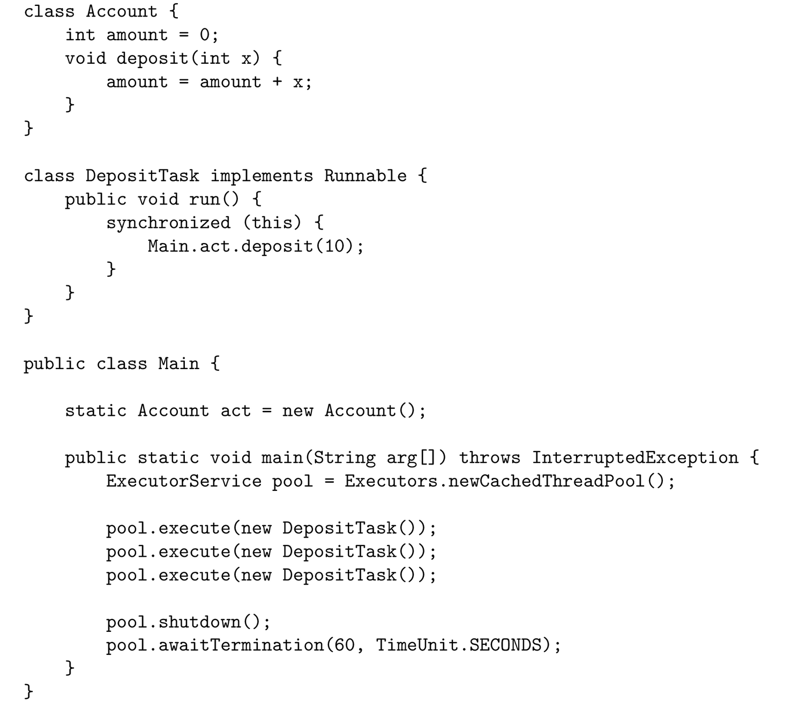
Practice Problems (Quiz 9)
Question 1. What are the possible values for
act.amount in the end?
10,20,30 (will accept 0,10,20,30 as well)
Question 2. Field amount in Account has
(d) package visibility

Slide 32
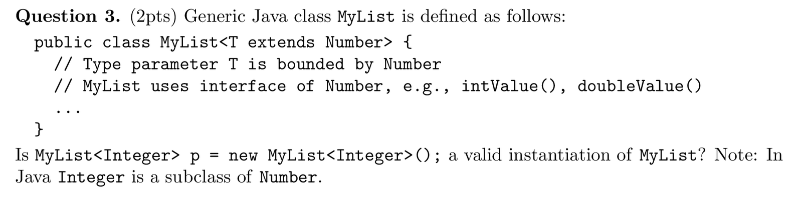
Practice Problems (Quiz 9)
(a) Yes
(b) No

Slide 33
Practice Problems (Quiz 9)
Question 4. Consider the C++ code:
bar x;
bar y = x;
At y = x C++ calls
(b) copy constructor bar::bar(bar&)

Slide 34
Practice Problems (Quiz 9)
Question 5. Consider the C++ code:
bar x, y;
y = x;
At y = x C++ calls
(a) assignment operator bar::operator=(bar&)

Slide 35
Practice Problems (Quiz 9)
Question 6. Now suppose this was Java code:
bar x, y;
y = x;
At y = x Java calls
(b) neither

