Slide 1
Lecture Outline
Notion of binding time
Object lifetime and storage management
An aside: Stack Smashing 101
Slides courtesy of RPISEC/MBE
Scoping
Static scoping
Dynamic scoping

Slide 2
Stack Frames
In x86-64 RBP is fp and RSP is sp. Define the stack frame for the currently executing function
local variables
pointer to previous frame
return address
note: for 64bit, each 'slot' is 8 bytes
RSP ->
0x1337
"ABCDEFGH
0123456\0"
0x7fff10203040
0x400134
<- local var
<- local var
void foo() {
long long x = 0x1337;
char str[16];
strcpy(str, "ABCDEFGH0123456");
}
<- caller frame RBP
RBP ->
<- return address

Slide 3
What is corruption?
So what happens if a programer makes a simple mistake:
char foo[64];
int money = 0;
gets(foo);

Slide 4
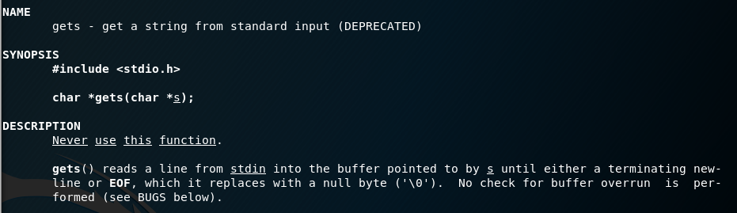
gets()?
DO NOT EVER USE
scanf("%s", ...) as well
So what happens if we give this program a bunch of A’s? With gets we can give as many A’s as we want!

Slide 5
Stack Smashing 101
Lower Memory
Higher Memory
main() has a
stack frame
- Contains local variables
- Pointer to previous frame
- Return address
-
-
-
-
-
-
-
-
0x00
0x7fff01020304
0x40051f
Start of
char foo[64]
End of foo
money = 0
Not supposed to touch
Base pointer
RETURN ADDRESS

Slide 6
Stack Smashing 101
As gets() continues to read input, we fill up the 64 bytes allocated for buffer foo
Lower Memory
Higher Memory
0x4141414141414141
0x4141414141414141
0x4141414141414141
0x4141414141414141
0x4141414141414141
0x4141414141414141
0x4141414141414141
0x4141414141414141
0x00
0x7fff01020304
0x40051f
Start of
char foo[64]
End of foo
money = 0
Not supposed to touch
Base pointer
RETURN ADDRESS

Slide 7
Stack Smashing 101
As gets() continues to read input, we fill up the 64 bytes allocated for foo
Go far enough, it corrupts important data!
Lower Memory
Higher Memory
0x4141414141414141
0x4141414141414141
0x4141414141414141
0x4141414141414141
0x4141414141414141
0x4141414141414141
0x4141414141414141
0x4141414141414141
0x41
0x7fff01020304
0x40051f
Start of
char foo[64]
End of foo
money = 0
Not supposed to touch
Base pointer
RETURN ADDRESS

Slide 8
Stack Smashing 101
We can give ourselves money
If we want to set money to 0x1337beef we need to know:
Most x86 machines are little endian (little byte goes first)
Meaning the byte order for numbers is "backwards" in memory
0x01020304 would be
0x04 | 0x03 | 0x02 | 0x01

Slide 9
Stack Smashing 201
What else can we corrupt?
What happens if you corrupt further? When does it segfault?
What was that about a return address?

Slide 10
Stack Smashing 201
When func() is called, runtime stores the return address on the stack (i.e., the address of the instruction that immediately follows call func in main)
int func() {
puts("Hello World");
return 17;
}
int main() {
int res = func();
return 0;
}

Slide 11
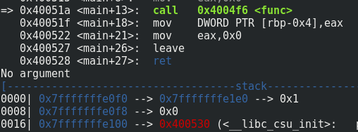
Stack Smashing 201
Before the call:

Slide 12
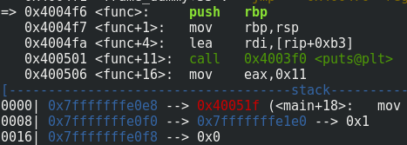
Stack Smashing 201
Before the call: After the call:
Return address points back to where it left off in main

Slide 13
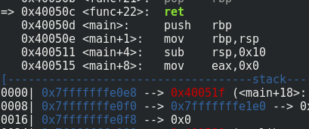
Stack Smashing 201
Returning just takes whatever is on the top of the stack, and jumps there, equivalently: pop rip
About to return:

Slide 14
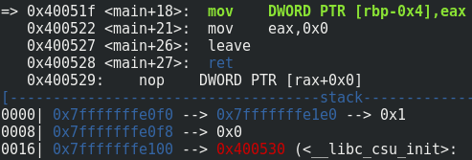
Stack Smashing 201
Returning just takes whatever is on the top of the stack, and jumps there, equivalently: pop rip
About to return: Returned back to main:

Slide 15
Stack Smashing 201
Returning just takes whatever is on the top of the stack, and jumps there, equivalently: pop rip
About to return: Returned back to main:
What if we change this???
?!?!?!?

Slide 16
Stack Smashing 201
Lower Memory
Higher Memory
Without corruption:
At the end of the function, it returns
0x40051f is popped off the stack and stored in rip
Control goes to that address
We want to change this
0x4141414141414141
0x4141414141414141
0x4141414141414141
0x4141414141414141
0x4141414141414141
0x4141414141414141
0x4141414141414141
0x4141414141414141
0x00
0x7fff01020304
0x40051f
Start of
char foo[64]
End of foo
money = 0
Base pointer
RETURN ADDRESS

Slide 17
Stack Smashing 201
Lower Memory
Higher Memory
Corrupted:
At the end of the function, it returns
0x4141414141414141 is popped off the stack and stored in rip
Control goes to that address
but it's invalid memory...
Segmentation fault
0x4141414141414141
0x4141414141414141
0x4141414141414141
0x4141414141414141
0x4141414141414141
0x4141414141414141
0x4141414141414141
0x4141414141414141
0x4141414141414141
0x4141414141414141
0x4141414141414141
Start of
char foo[64]
End of foo
money = 0
Base pointer
RETURN ADDRESS

