Slide 1
Customer Services Presentation
MODA GEEK PLUS

Slide 2
INTRODUCTION
THE PURPOSE OF THIS PRESENTATION IS TO MAKE KNOWN THE OPINIONS OF OUR CUSTOMERS TO IMPROVE OUR SERVICE AND ALSO THAT WE ARE WITHIN THE PARAMETERS OF THE 4PS.

Slide 3
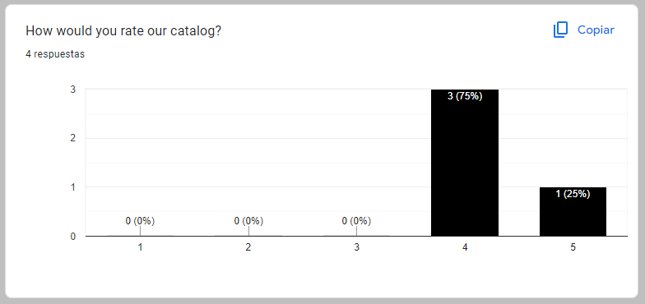
HERE WE OBSERVE THAT MOST OF OUR CUSTOMERS HAVE A GOOD ACCEPTANCE OF OUR CATALOG BUT WE MUST IMPROVE TO HAVE A 100% ACCEPTANCE RATE TO ATTRACT MORE POTENTIAL CUSTOMERS.

Slide 4
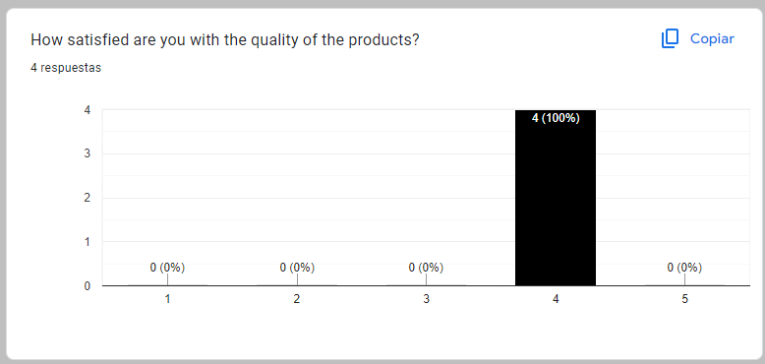
SIMILARLY, HERE WE CAN SEE THAT THE QUALITY OF OUR PRODUCTS IS GOOD BUT WE ARE NOT REACHING 100%, THIS MEANS THAT WE CAN STILL IMPROVE THE QUALITY AND THIS IS ACHIEVED BY CHANGING THE PRODUCT OR SUPPLIER THAT OFFERS US A BETTER QUALITY AND BETTER COST TO OFFER A BETTER PRODUCT TO THE CUSTOMER.

Slide 5
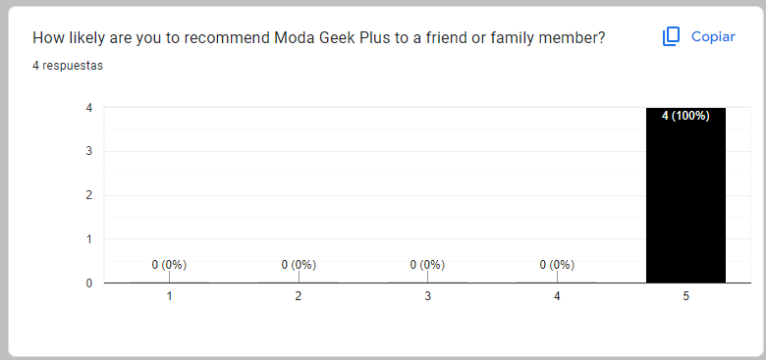
HERE WE SHOW THE RATE OF RECOMMENDATION AND WE CAN SEE THAT IT IS 100% THIS IS VERY GOOD NEWS BECAUSE THEY RECOMMEND US TO FAMILY AND FRIENDS IN THIS WAY WE COULD ENCOURAGE CUSTOMERS FOR THEIR LOYALTY AND RECOMMENDATIONS.

Slide 6
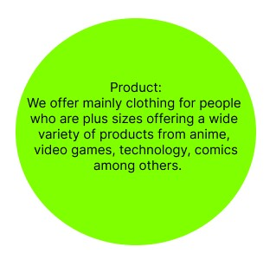
AS YOU CAN SEE OUR MAIN MARKET IS TO OFFER EXTRA SIZES SINCE IT IS A MARKET LITTLE EXPLOITED, WE OFFER VARIETY TO OUR CUSTOMERS MAKING THEM FEEL SPECIAL SINCE WE THINK ABOUT THEM.

Slide 7
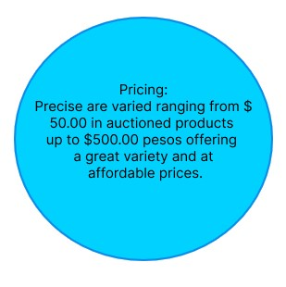
TO OFFER ACCESSIBLE PRODUCTS AND GOOD QUALITY IS OUR MISSION BECAUSE OFFERING PRODUCTS OF GOOD QUALITY AND PRICE IS WHAT WILL HELP US TO OBTAIN BETTER INCOME BUT ABOVE ALL TO ATTRACT MORE CUSTOMERS AND WITH TO GAIN THEIR TRUST AND LOYALTY.

Slide 8
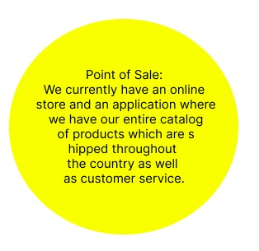
KNOWING THAT AT THIS MOMENT OUR STORE IS 100% ONLINE HELPS US TO IMPROVE OUR CUSTOMER SERVICE SO THAT IN THE FUTURE WHEN PHYSICAL STORES CAN BE SET UP WE WILL BE WELL ESTABLISHED AND IT WILL BE EASIER FOR OUR CUSTOMERS TO RECOGNIZE US.

Slide 9
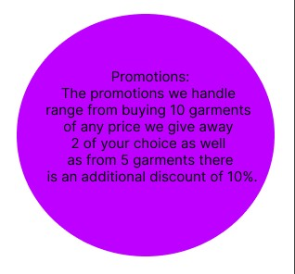
OFFERING PROMOTIONS IS IMPORTANT BECAUSE WITH IT WE CAN MAKE MORE SALES BUT ALSO MAKE MORE CUSTOMERS CONSUME OUR PRODUCT AND THE EASIEST WAY TO GET THOSE PROMOTIONS IS THROUGH SOCIAL NETWORKS.

Slide 10
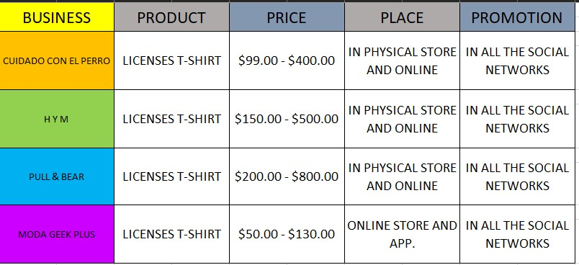
FINALLY, WE CAN SEE THAT WE HAVE GREAT COMPETITION AS THESE STORES OFFER PHYSICAL AND ONLINE STORES. STILL, THE DIFFERENCE IS THAT THEY DO NOT OFFER THE PRODUCTS THAT WE DO OFFER TO OUR SECTOR OF CUSTOMERS THIS GIVES US AN ADVANTAGE. STILL, ALSO THIS HELPS US TO IMPROVE TO POSITION OURSELVES AS PIONEERS IN OFFERING EXTRA SIZES.

