Slide 1

PESITO Inc.

Slide 2

Getting tired of wasting your money in nothing?

Slide 3

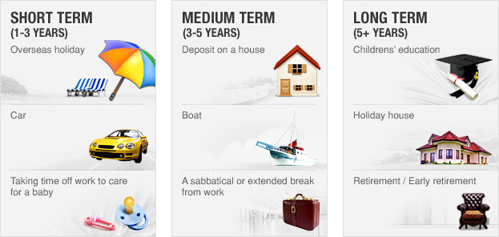
GOALS

Slide 4

Why use our application?

