Slide 1
Early Repair
Ticket Complete / Pending Guide
Home Service Network

Slide 2
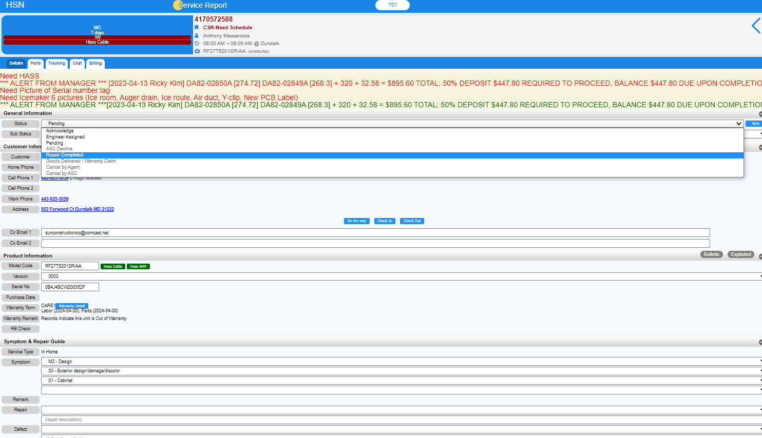


< Complete >
Click Repair completed
Click “Status”
Click “Repair Complete”

Slide 3
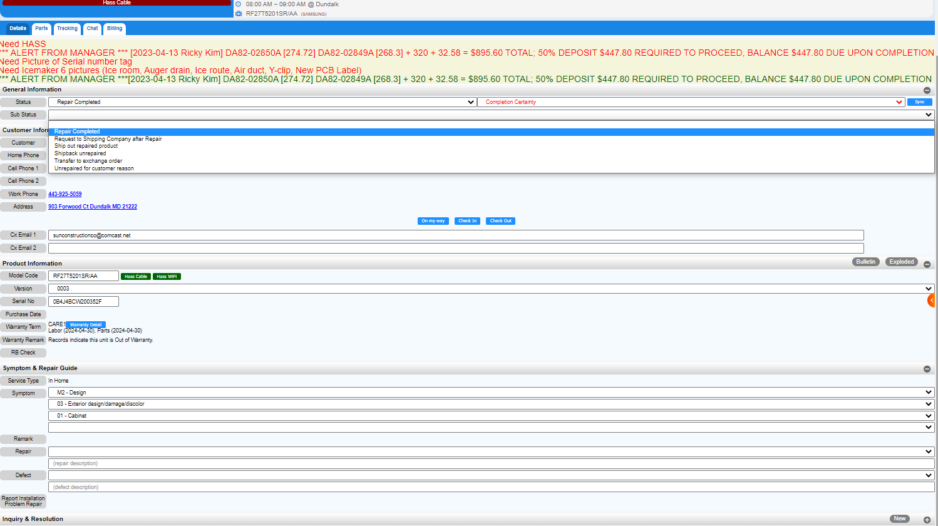
Click Repair completed
Click “Sub Status”
Click “Repair Complete”

Slide 4
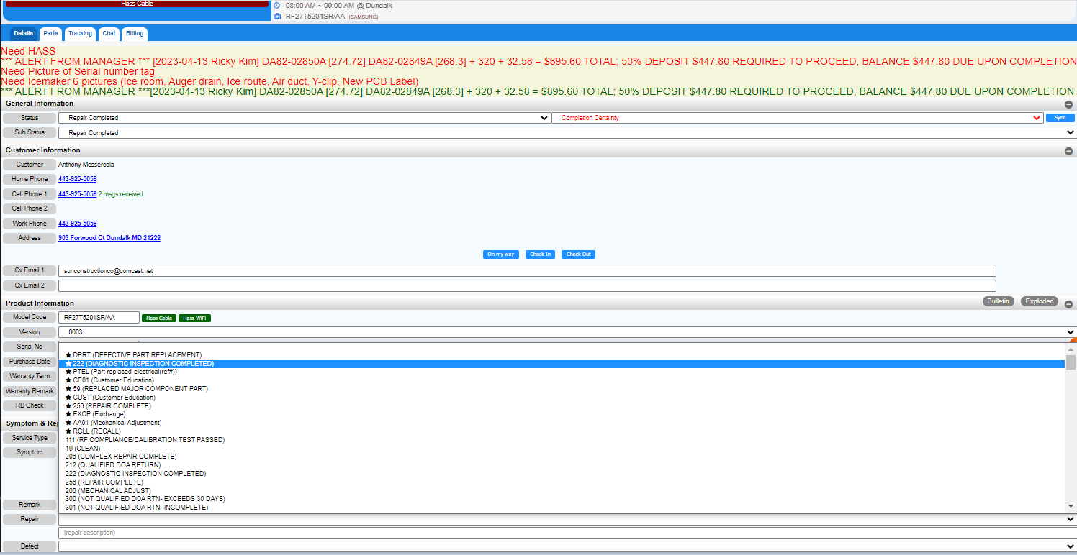
Select a repair code.
The most commonly used code is the one with emphasis before the code

Slide 5
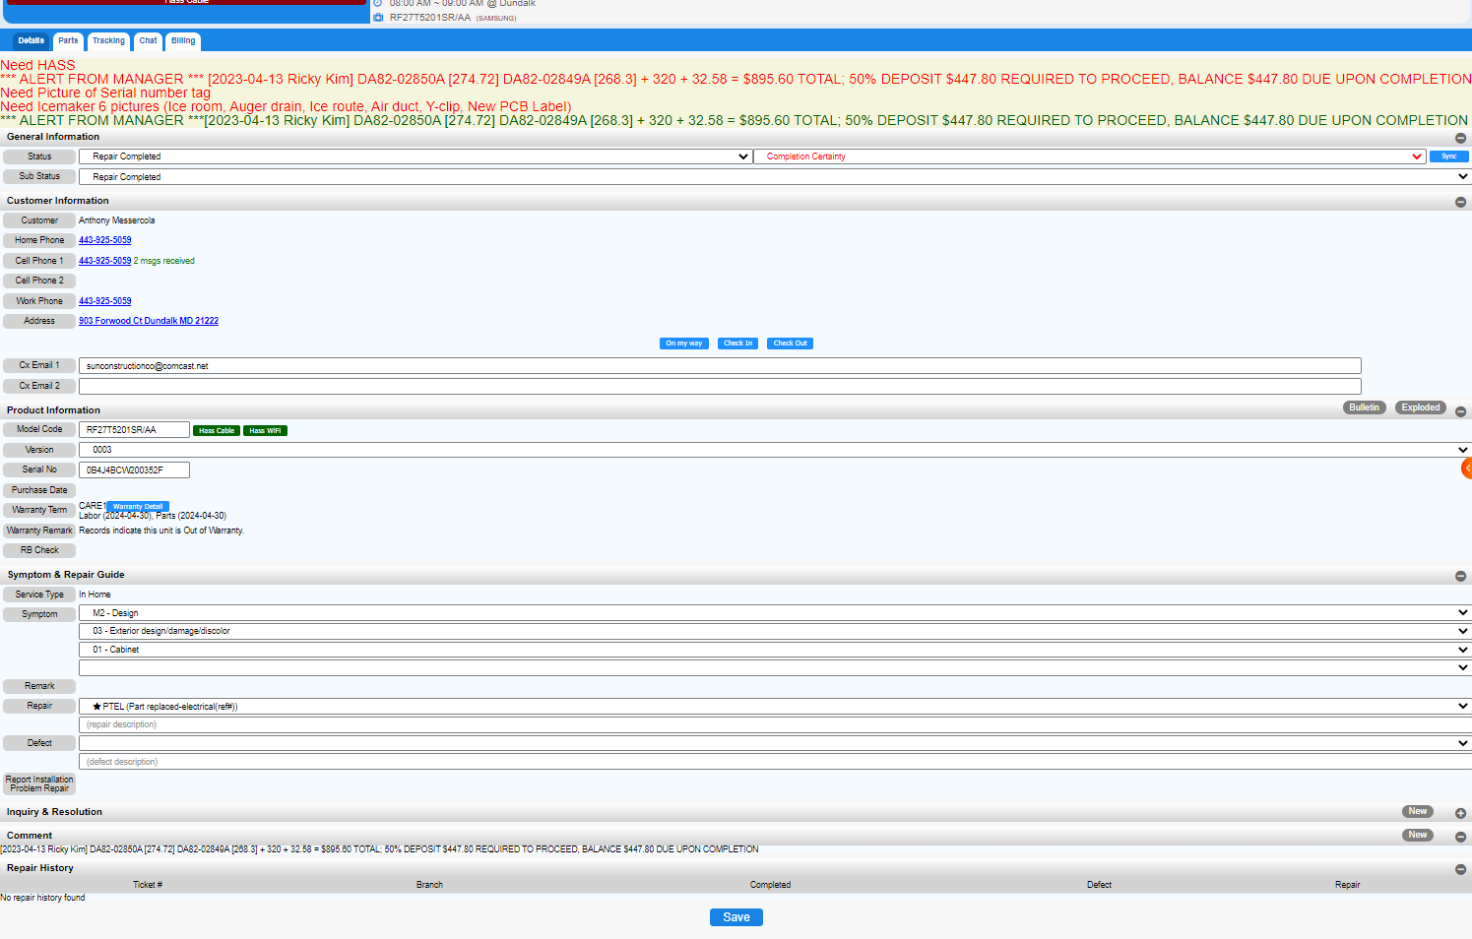

Description of repair reason type in

Slide 6
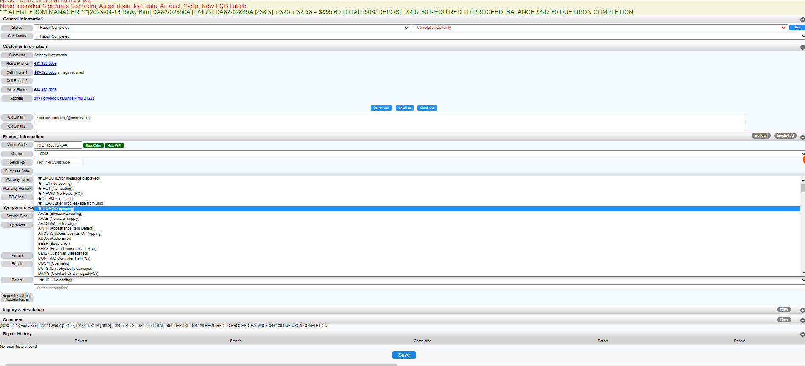
Select a defect code.
The most commonly used code is the one with emphasis before the code

Slide 7
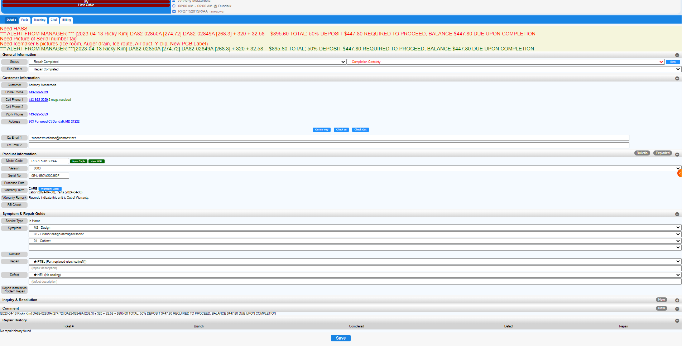
Description of defect reason type in

Slide 8
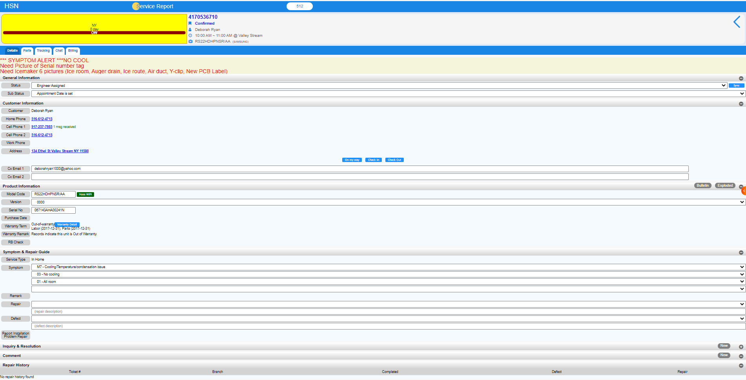
Click on the detail
Click Repair completed

Slide 9
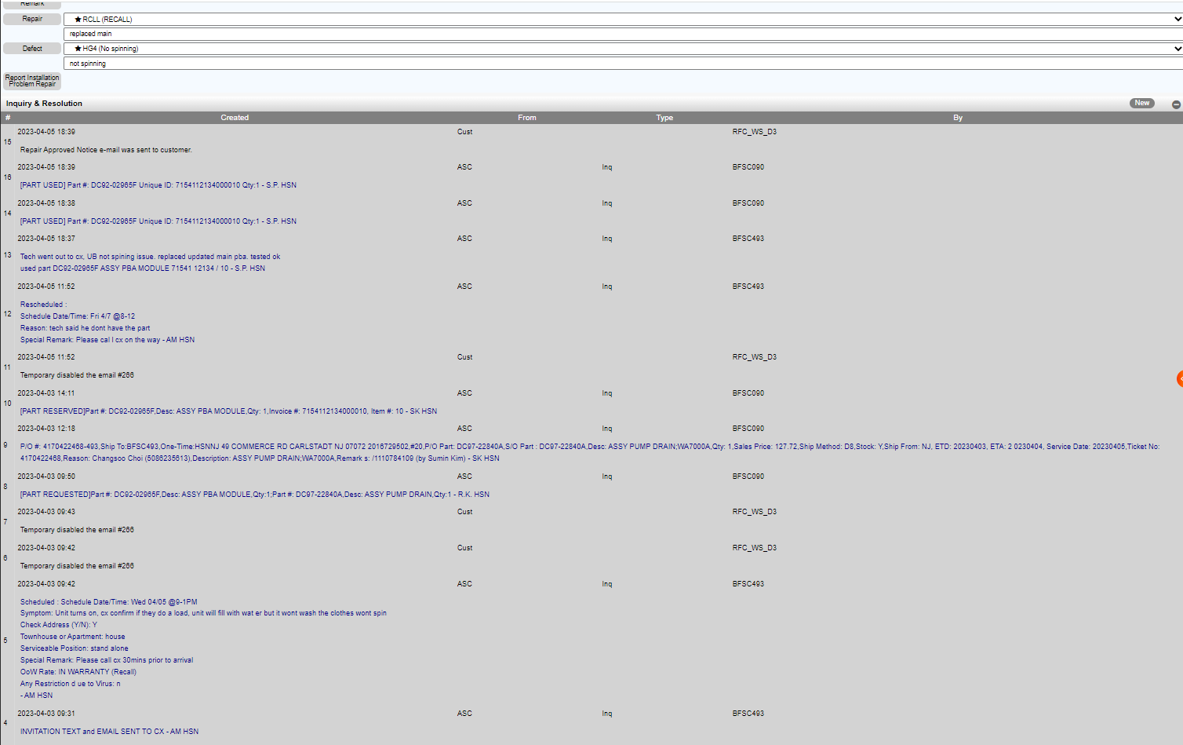
Check the note in the inquiry before you complete it

Slide 10
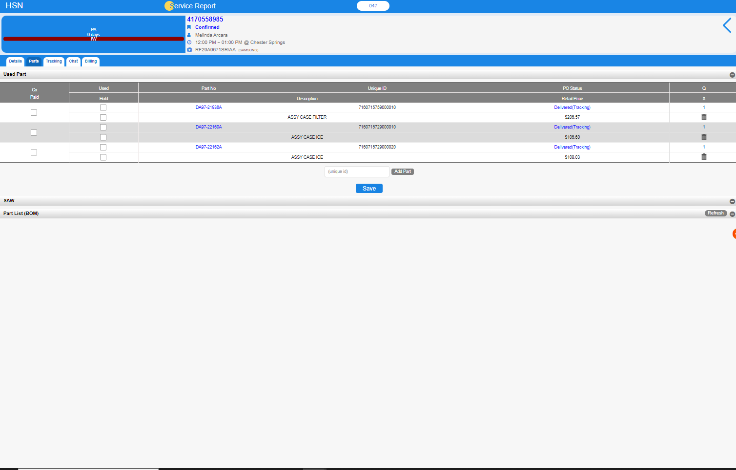

Click on the part
If you not used, delete part
Check the part in the inquiry before you complete it.
If you used, leave it

Slide 11
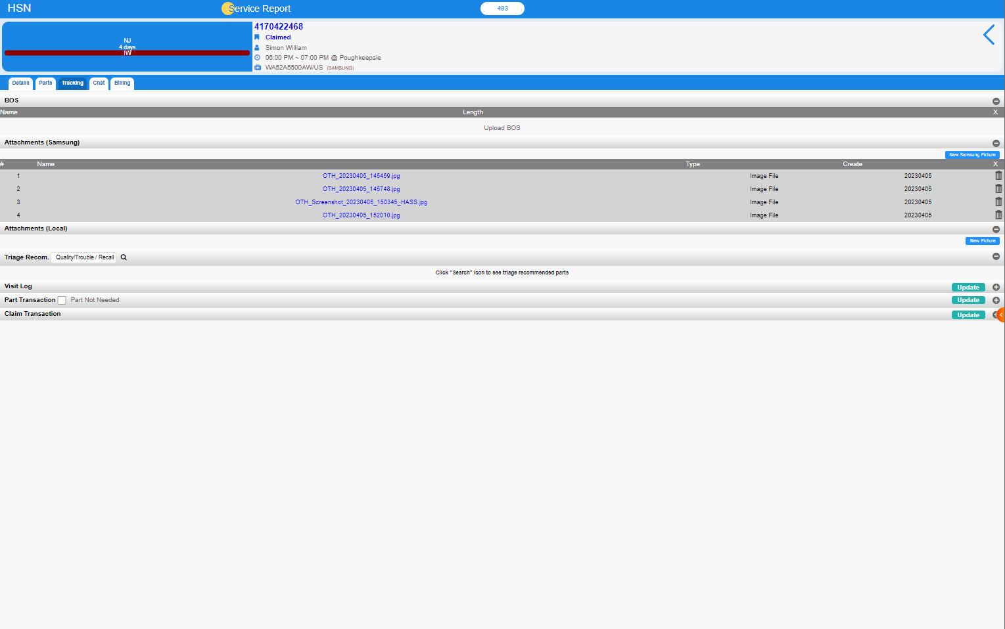
Click on the Tracking
Check the picture in the inquiry before you complete it

Slide 12
Before you press the Save button, check all the information of notes, parts, and photos and make a save

Slide 13
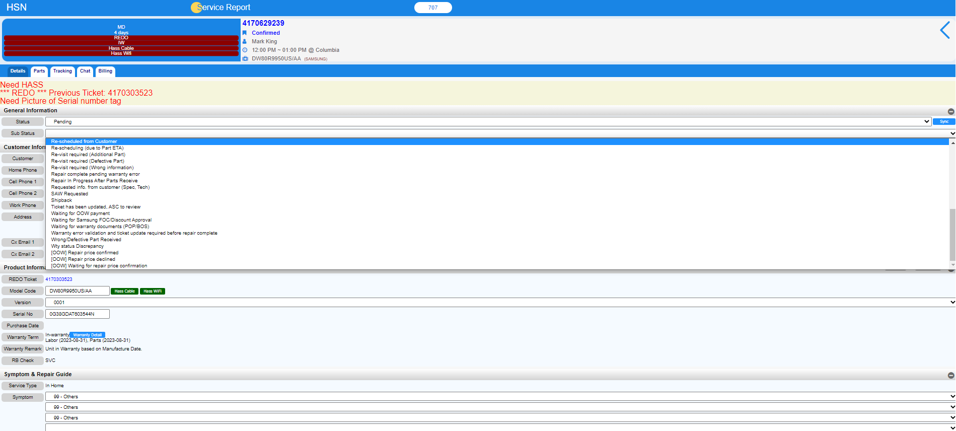
< Pending >
Input Status as “Pending”
If tech has to go back to Cx, Input the reason as “Re-scheduled from Customer”
If tech can’t complete the ticket, Input the reason as
“ Waiting for warranty documents (POP/BOS)”

Slide 14
If you have any question,
Please do not hesitate to contact the Triage team
Home Service Network

