Slide 1
Early Repair
Ticket Complete / Pending Guide
Home Service Network

Slide 2
Flowchart
Flowchart Reviewed by: Albert Shin
Technician selects ‘COMPLETED’ on ER Mobile
or
Technician updates Visit Log status to ‘READY TO COMPLETE’
Technician finishes the Repair Job
Ticket is now marked as:
READY TO COMPLETE
Immediately, the Ticket status gets Automatically updated to COMPLETED
If Ticket age is 9 days or more
If Ticket age is less than 9 days
Ticket remains marked as ‘READY TO COMPLETE’ until Aging reaches 8 days
Ticket status gets Automatically updated to COMPLETED the morning of the 9th day
*IMPORTANT: Not all Tickets will successfully be Completed automatically. Inquiry will make a record if the Auto Complete fails. Managers MUST review Failed Auto Complete tickets and manually Complete those tickets every morning. You can check Failed Auto Complete Tickets by going to ER > Ticket > Follow-Up Dashboard OR, on Ticket list, search by Repair Status.

Slide 3
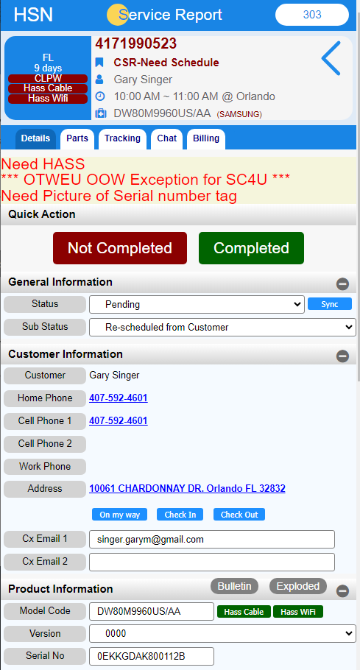
How to Complete (ER Mobile)
1. Once you are done with the repair and you want to Complete the ticket, all you need to do now is click on this big green ‘Completed’ button
2. You will no longer be able to select ‘Repair Completed’ through the dropdown menu.
If the ticket has Aged 8 days or older, the ticket will end up Completing itself as soon as you press the Completed button.
If you press the Completed button, but the ticket has not Aged 8+ days, it will remain open and Complete itself the morning of the 9th day.

Slide 4
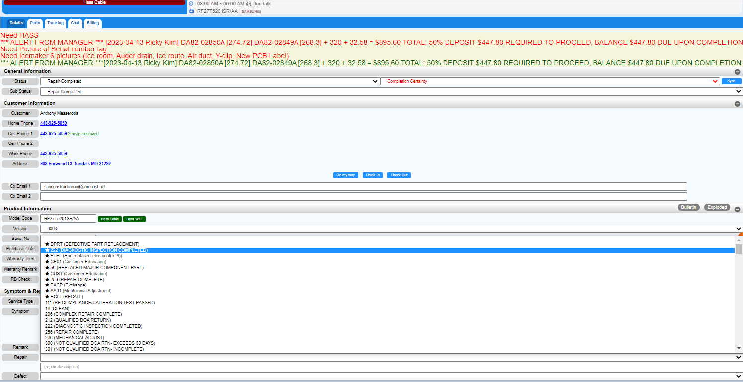


Select a repair code.
The most commonly used code is the one with emphasis before the code

Slide 5
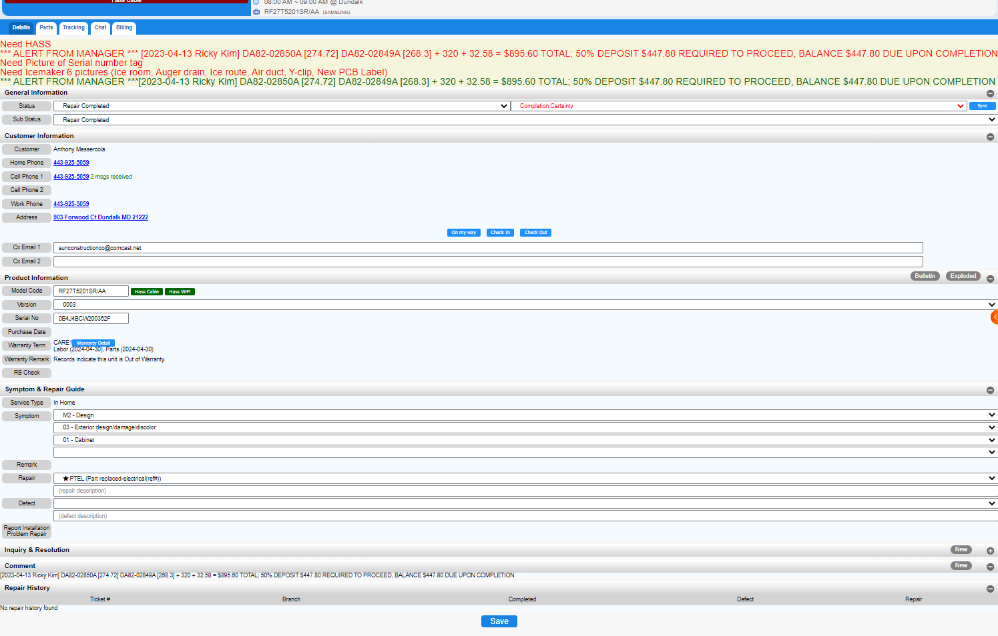

Description of repair reason type in

Slide 6
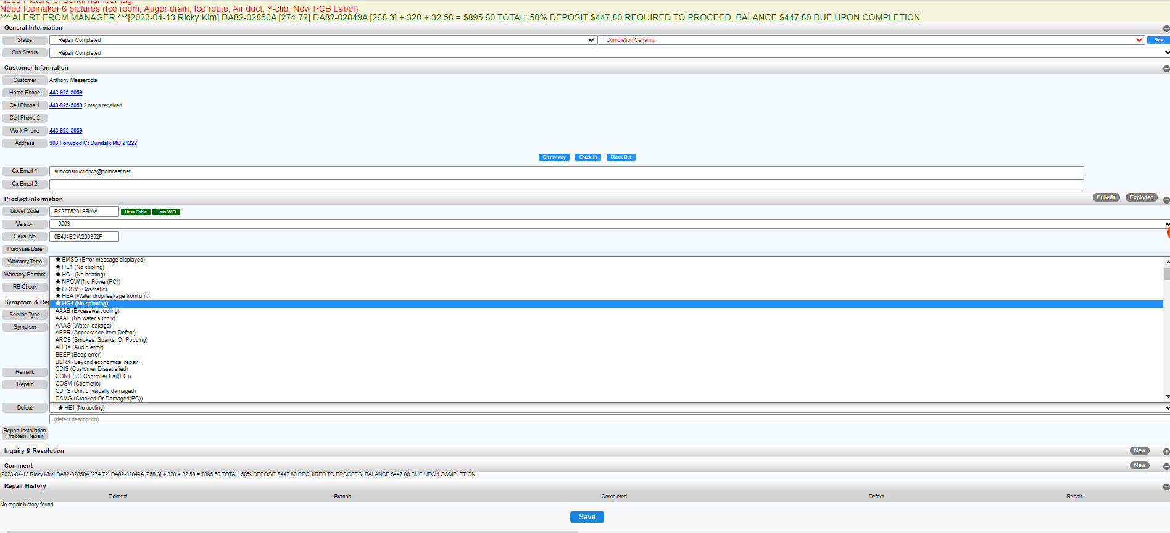
Select a defect code.
The most commonly used code is the one with emphasis before the code

Slide 7
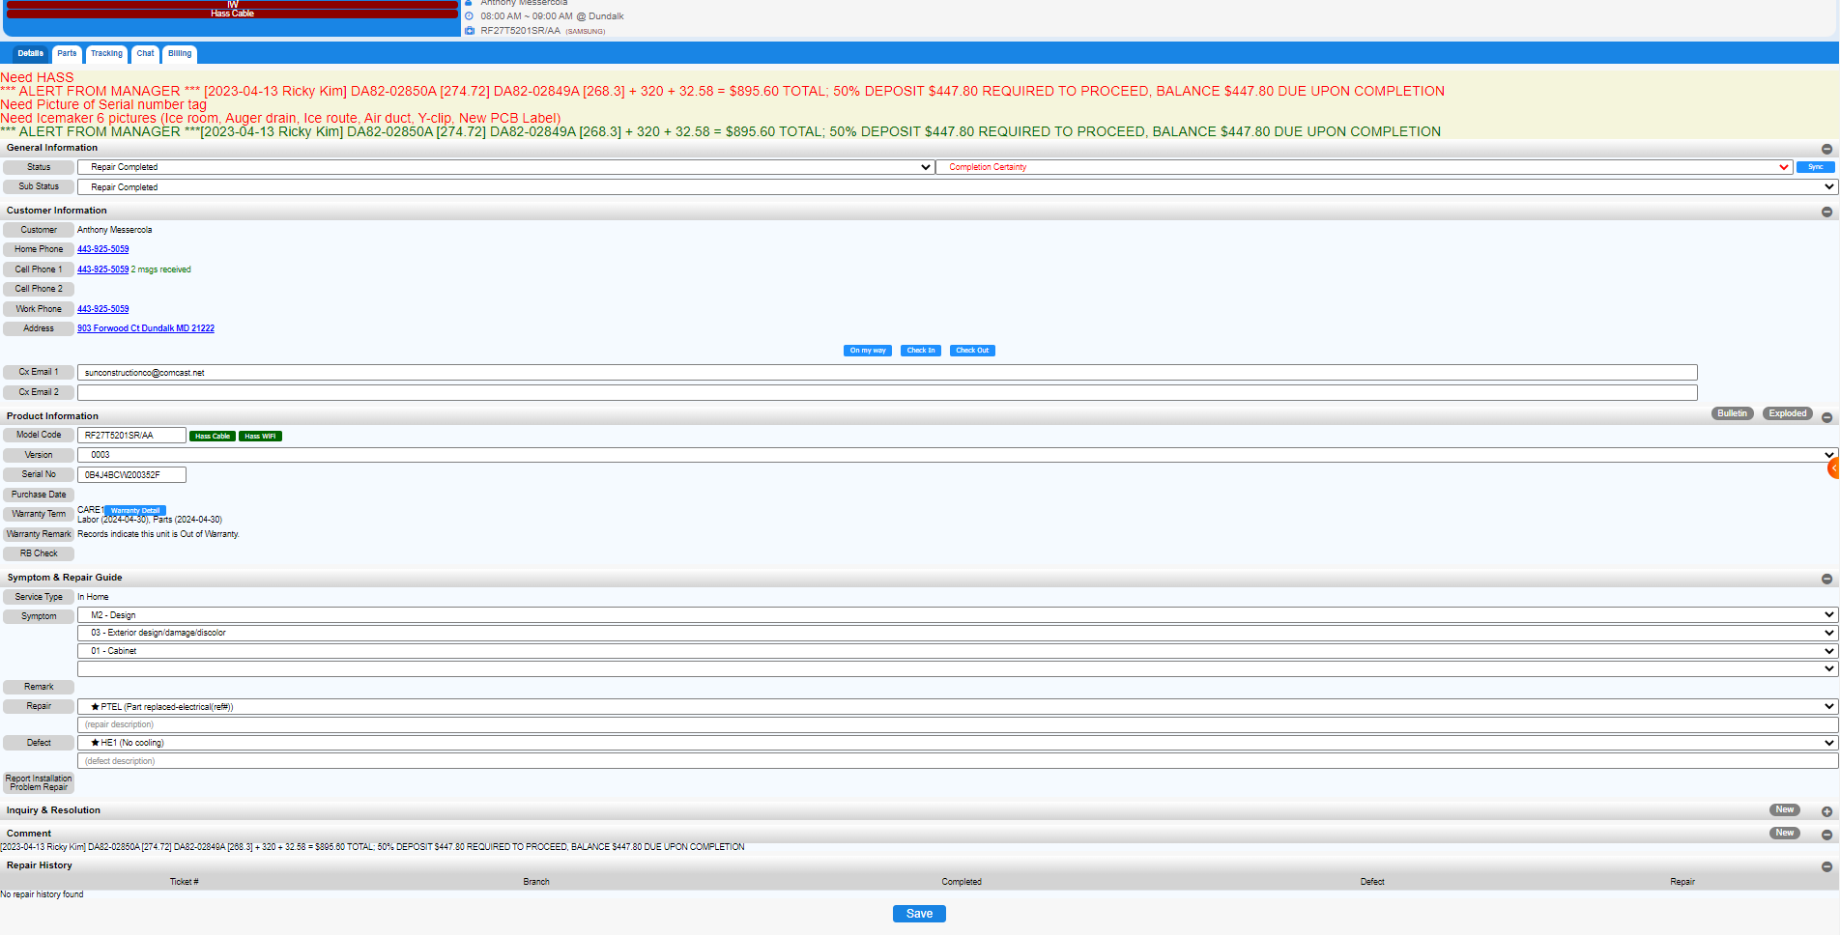
Description of defect reason type in

Slide 8
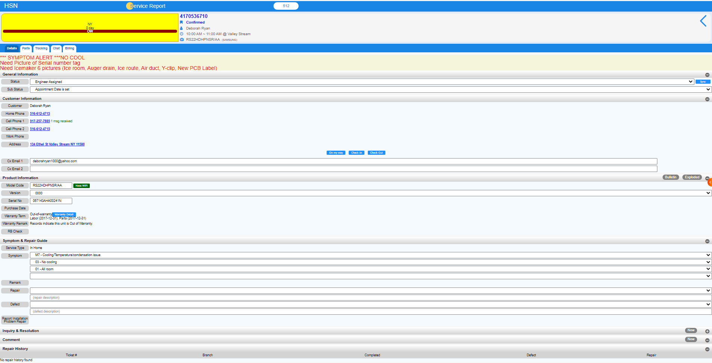
Click on the detail
Click Inquiry

Slide 9
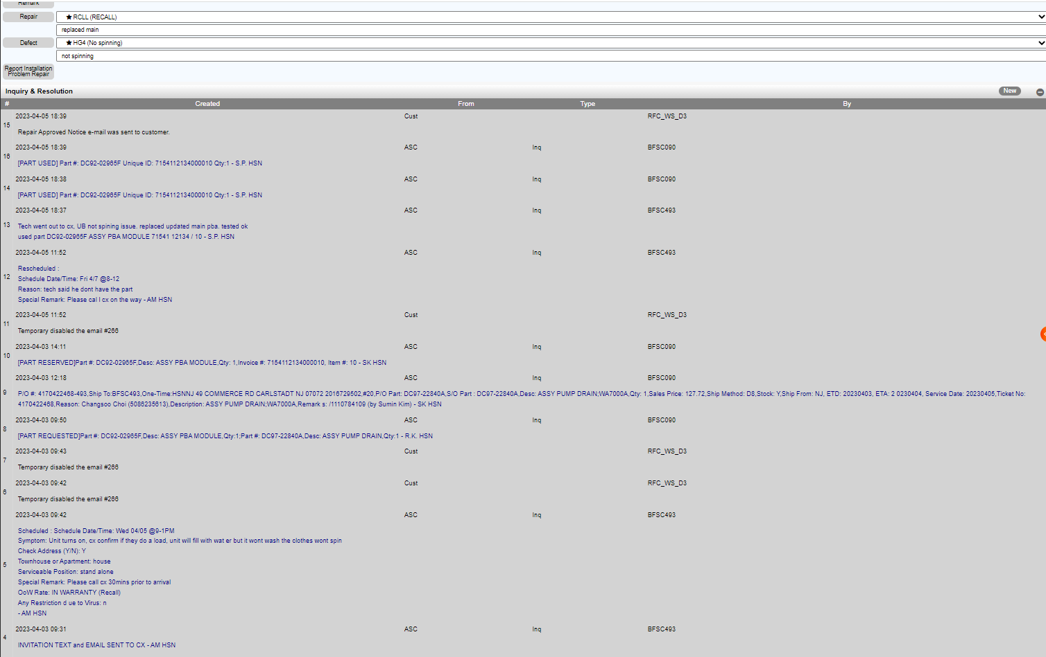
Check the note in the inquiry before you complete it

Slide 10
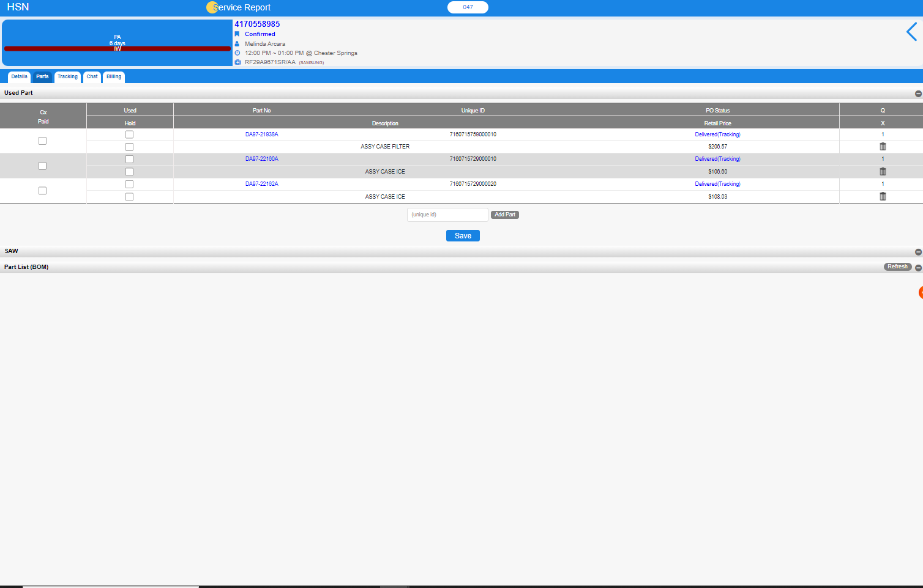

Click on the part
If you not used, delete part
Check the part in the inquiry before you complete it.
If you used, leave it

Slide 11
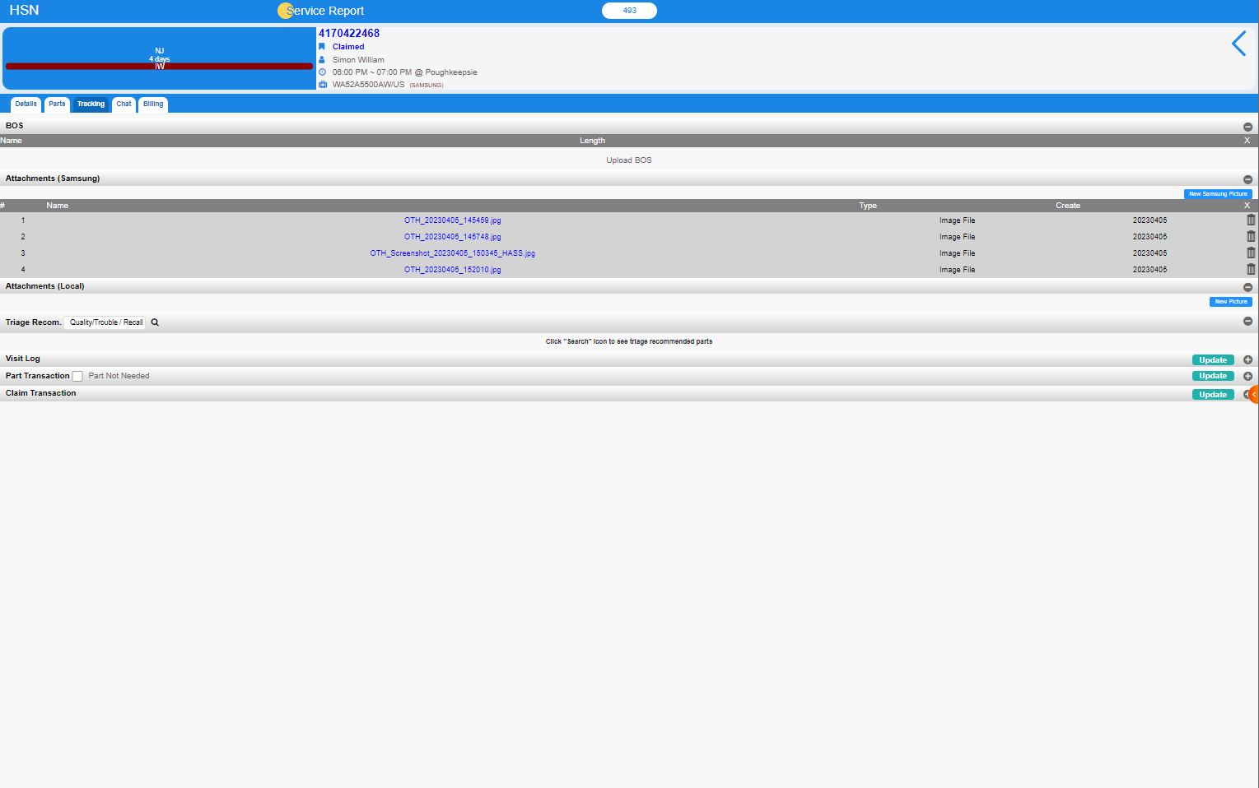
Click on the Tracking
Check the picture in the inquiry before you complete it

Slide 12
Before you press the Save button, check all the information of notes, parts, and photos and make a save

Slide 13
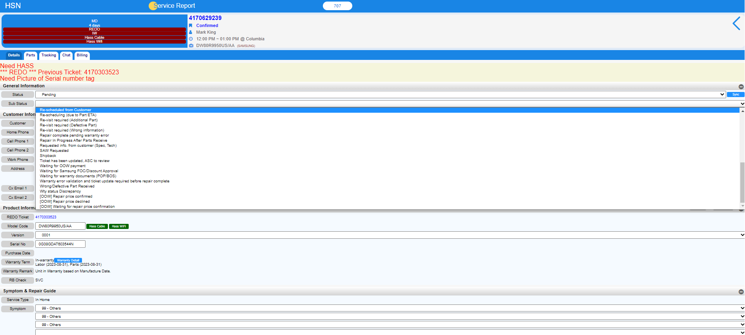
< Pending >
Input Status as “Pending”
If tech has to go back to Cx, Input the reason as “Re-scheduled from Customer”
If tech can’t complete the ticket, Input the reason as
“ Waiting for warranty documents (POP/BOS)”

Slide 14
If you have any question,
Please do not hesitate to contact the Triage team
Home Service Network

