Slide 1
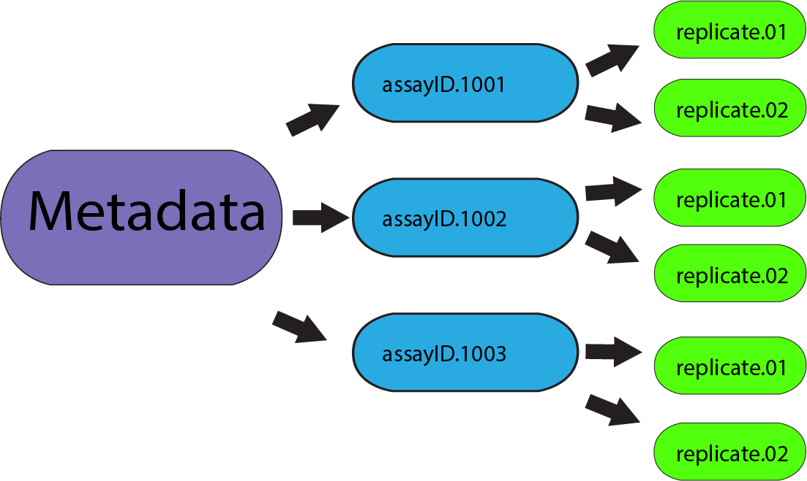
metadata
Everything same through children (eg experiment layouts and replicates)
- Saved to file; filename = barcode string
assay
- Everything same through children
- different ID’s can have different layouts
- Saved to file, must contain a unique-key that maps it back to metadata file
Replicates
- Not saved to file, added during printing of barcode
Metadata file contains plate-level general information reusable through assay’s
assayID’s contain strains used in plates
Plates have a replicateID
Concat a string representation of all three together to generate a barcode to label on a plate
V2IG4 - ecoli12 - 01

