Slide 1
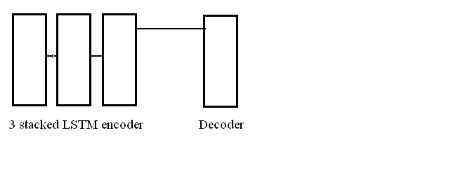
Seq to Seq LSTM Model

Slide 2
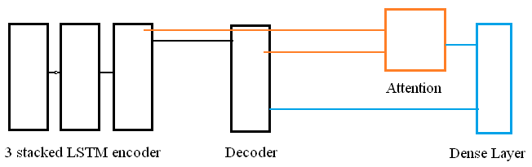
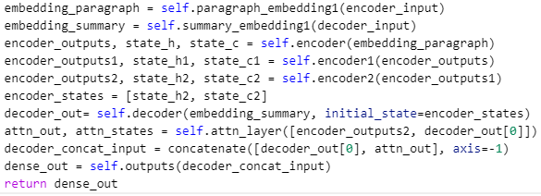
Seq to Seq LSTM Model

Slide 3
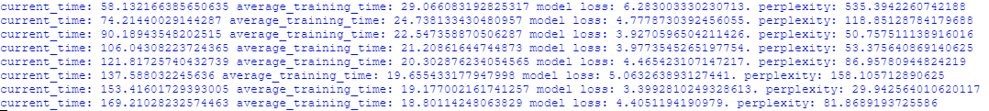
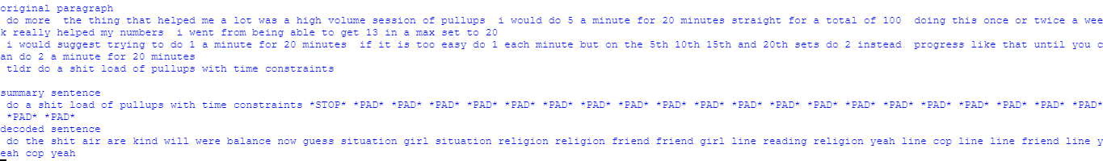
Results

Slide 4
Discussion
Can use beam search algorithm instead of using the random from k maximum probabilities to decode the summary.

