Slide 1
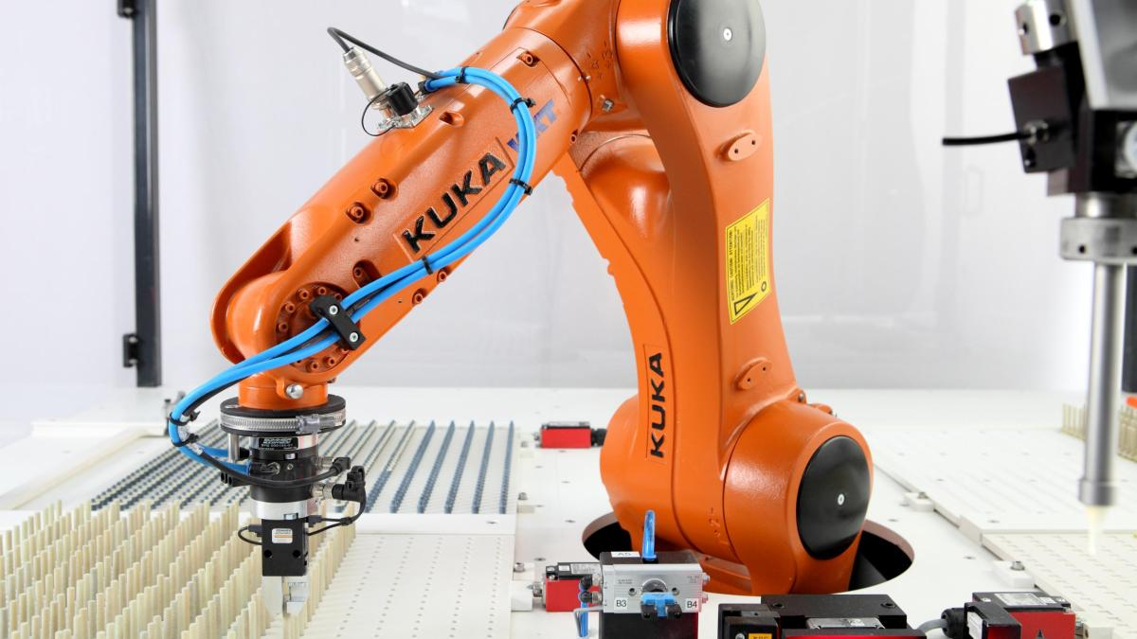
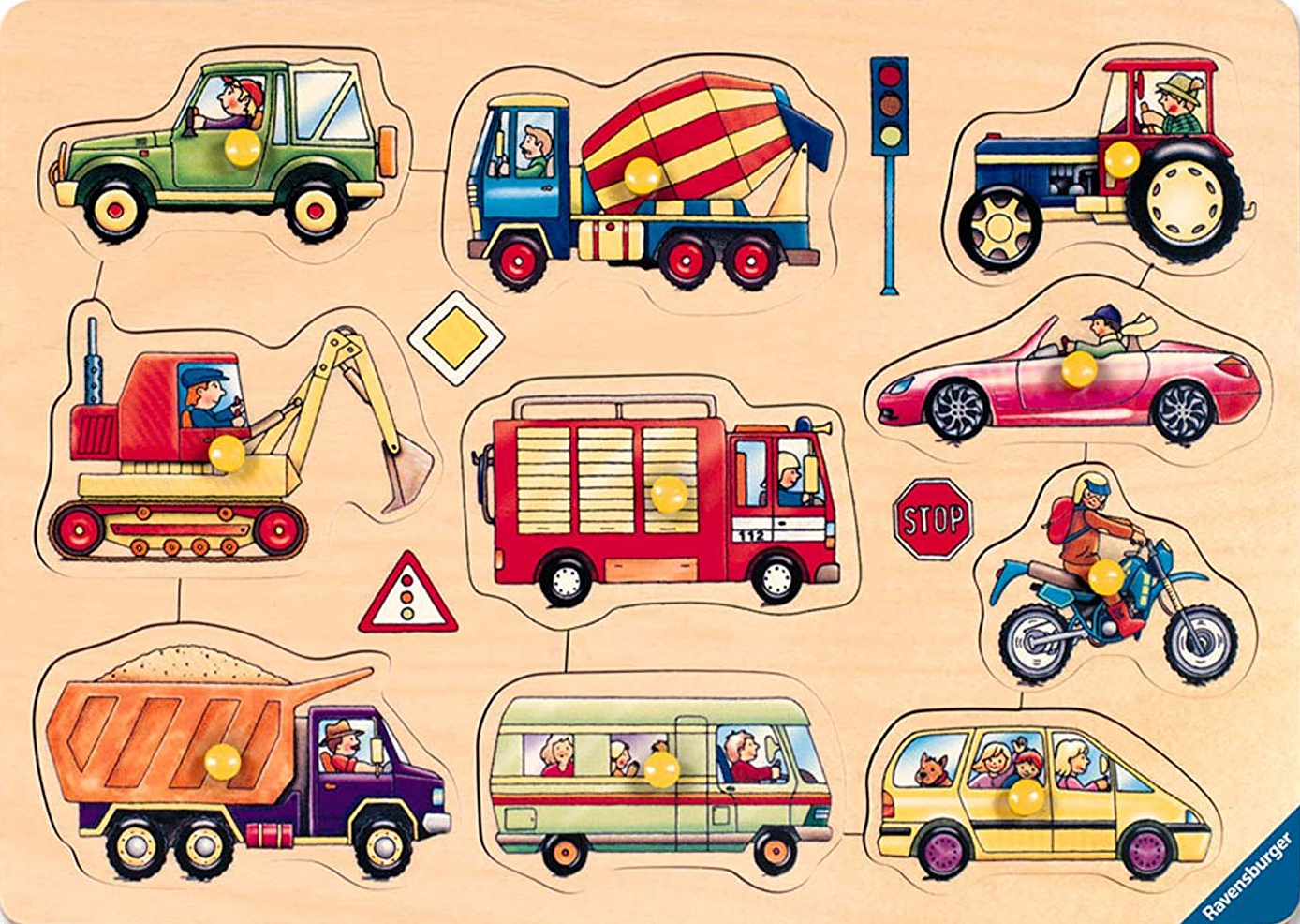
Initial project presentation
[1]
[2]
Car puzzle solving using a Kuka robot
Master IT-Engineering
Robotics – Prof. Dr. Ulrich Hoffmann and Hermann Höhne
Brüst, Jakob – Gömpel, Piet, - Röschmann, Niels – Tyagi Anurag
2019-04-30

Slide 2
Table of content
Introduction
Structure
Milestones
Introduction
Goals
Current situation
Structure
Project approach
Deliverables
Material and Costs
Milestones
Bibliography

Slide 3
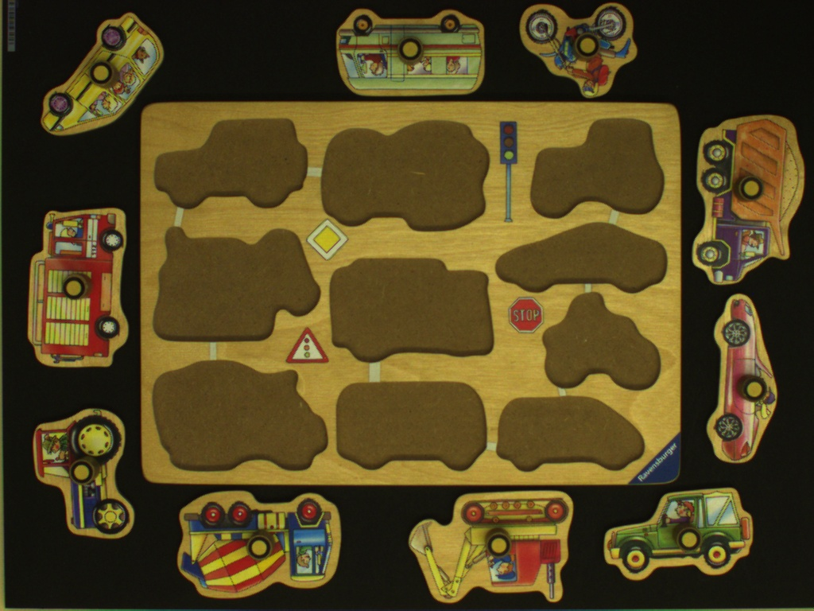
Goals
Introduction
How to get the pieces to the correct place?
Programm a industrial robot

Slide 4
Current situation
Introduction
Picture of robot

Slide 5
Project approach
Struture
Dynamic car puzzle solver
Kuka motion control
Image processing
Define operational space
Control movements
Control gripper rotation
Edge detection of puzzle
Calculation of rotation
Send motion commands
Marriage and error fixing
Final solver

Slide 6


Deliverables
Struture
[4]
.pdf
.py
Final project documentation
Software
[3]
Final presentation/demonstration
Video clip

Slide 7

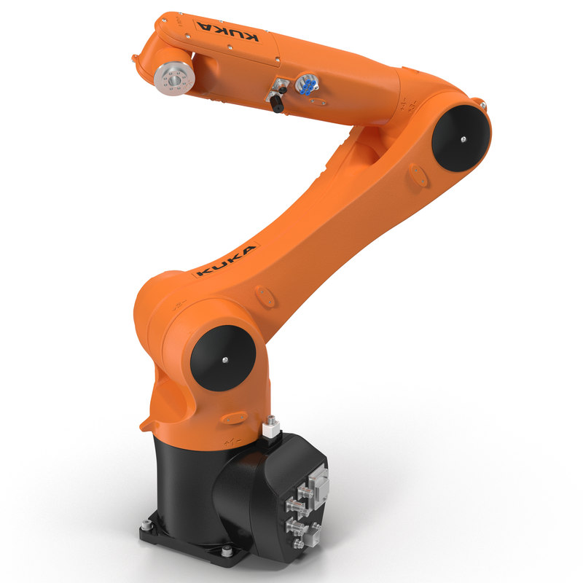



Material and costs
Struture
[8]
[2]
[5]
[9]
[6]
[7]

Slide 8
Milestones
Milestones
Milestone 1
Initial project presentation
2019-04-30
Milestone 5
Final presentation
2019-07-09
Milestone 2
Deﬁne basic principles 2019-05-14
Milestone 4
Working prototype
2019-06-25
Milestone 3
Implement/Test basic principles 2019-06-04

Slide 9
Bibliography
Introduction
Structure
Milestones
[1] - https://www.welt.de/img/wirtschaft/mobile139410507/5031358457-ci16x9-w1200/KUKA-Roboter-fuer-Wams -Wirtschaft-Kontak.jpg
[2] - https://images-na.ssl-images-amazon.com/images/I/81AlPD1WLyL._SL1500_.jpg
[3] - https://thumbs.dreamstime.com/z/videorahmen-film-kino-medien-d%C3%BCnne-linie-ikone-des-spielers-lineares -vektorsymbol-99227086.jpg
[4] - https://t4.ftcdn.net/jpg/00/36/49/45/500_F_36494561_5LXhPVnoiKL6Kc08mkChbfyeImyW82Z4.jpg
[5] - https://static.turbosquid.com/Preview/2015/05/29__08_34_09/KukaRobotKR10R1100Rigged3dmodel02.jpg 4e9d544a-294d-4965-9ff8-8ac9642a33b5Original.jpg
[6] - https://www.kuka.com/-/media/kuka-corporate/images/products/software/kuka-workvisualgrafik-intro.jpg
[7] - https://image.freepik.com/freie-ikonen/kamera-skizzieren_318-8404.jpg
[8] - https://python.rs/pylogo.png
[9] - https://upload.wikimedia.org/wikipedia/commons/5/53/OpenCV_Logo_with_text.png
(all downloaded at 2019-04-28)

