Slide 1
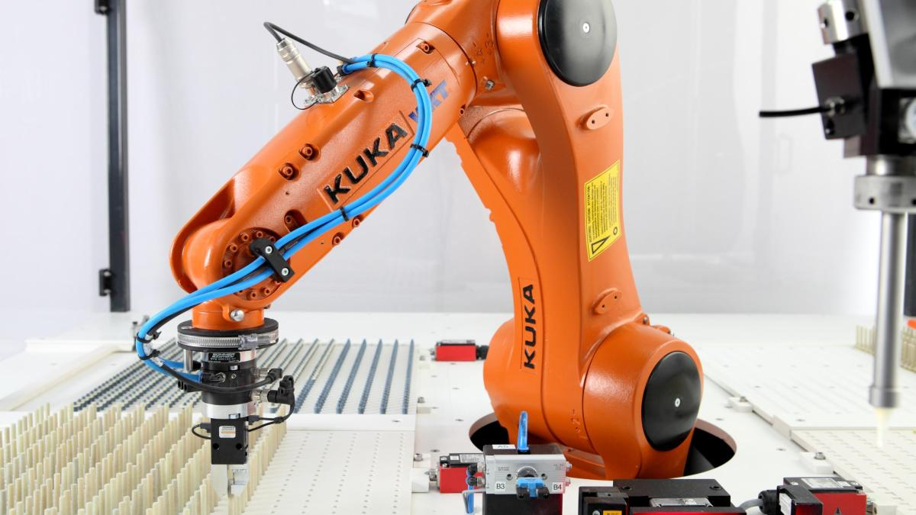
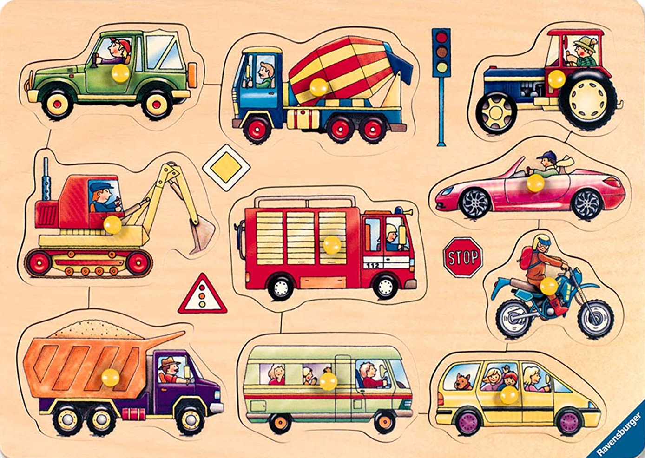
Initial project presentation
[1]
[2]
Car puzzle solving using a Kuka robot
Master IT-Engineering
Robotics – Prof. Dr. Ulrich Hoffmann and Hermann Höhne
Brüst, Jakob – Gömpel, Piet, - Röschmann, Niels – Tyagi Anurag
2019-04-30

Slide 2
Table of content
Introduction
Structure
Milestones
Introduction
Goals
Current situation
Structure
Project approach
Deliverables
Material and Costs
Milestones
Timing
Schedule
Milestones
Bibliography

Slide 3
Goals
Introduction
Control Kuka industrial robot
Solve car puzzle automatically and dynamical

Slide 4
Current situation
Introduction

Slide 5
Project approach
Struture

Slide 6
Deliverables
Struture

Slide 7
Material and costs
Struture

Slide 8
Milestones
Milestones

Slide 9
Bibliography
Introduction
Structure
Milestones
[1] - https://www.welt.de/img/wirtschaft/mobile139410507/5031358457-ci16x9-w1200/KUKA-Roboter-fuer-Wams-Wirtschaft-Kontak.jpg (download 2019-04-28)
[2] - https://images-na.ssl-images-amazon.com/images/I/81AlPD1WLyL._SL1500_.jpg (download at 2019-04-28)

