Slide 1
CUSTOMER DATA
ANALYSIS
Power BI Project Presentation
Understanding customer behavior, product demand, revenue and payment preferences
Dataset: customers_cleaned (1).csv • 99,457 transaction rows
Project explanation and task-by-task guide

Slide 2
Project overview
The goal is to turn transaction records into useful business insights.
Compare shopping behavior by gender and age group.
Measure items sold and revenue generated.
Identify high-performing product categories and malls.
Understand cash, credit-card and debit-card usage.
Present findings and practical recommendations.
TRANSACTIONS
ATTRIBUTES
99,457
10
UNITS SOLD
CATEGORIES
298,712
8
Period: Jan 2021 – Mar 2023
10 malls • Customer ages 18–69
02

Slide 3
Dataset and attribute information
Each row represents one recorded transaction.
invoice_no
Unique invoice / transaction ID
quantity
Number of items purchased
customer_id
Customer identifier
price
Unit price in Turkish lira (TL)
gender
Female or Male
payment_method
Cash, Credit Card or Debit Card
age
Customer age in years
invoice_date
Date of transaction
category
Product category
shopping_mall
Mall where purchase occurred
Quality check: no missing values or fully duplicated rows were found in the uploaded CSV.
03

Slide 4
Core calculations (DAX)
Select Modeling → New measure for each formula.
Total Transactions
Total Quantity
Total Transactions = DISTINCTCOUNT(customers_cleaned[invoice_no])
Total Quantity = SUM(customers_cleaned[quantity])
Total Revenue
Average Transaction Value
Total Revenue = SUMX(customers_cleaned, customers_cleaned[quantity] * customers_cleaned[price])
Average Transaction Value = DIVIDE([Total Revenue], [Total Transactions], 0)
Replace customers_cleaned if your actual Power BI table name is different.
05

Slide 5
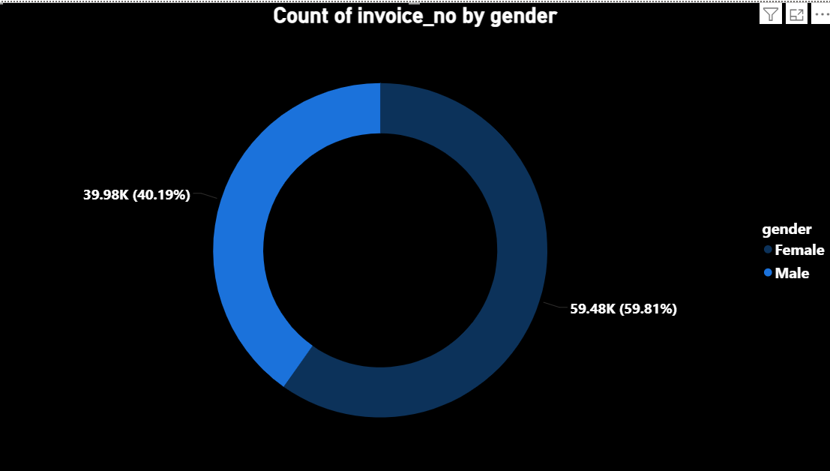
Task 1: Shopping distribution by gender
How is the shopping distribution according to Gender?
Female: 59,482 (59.8%)
Male: 39,975 (40.2%).
Female customers represent the larger share of recorded transactions.
.
06

Slide 6
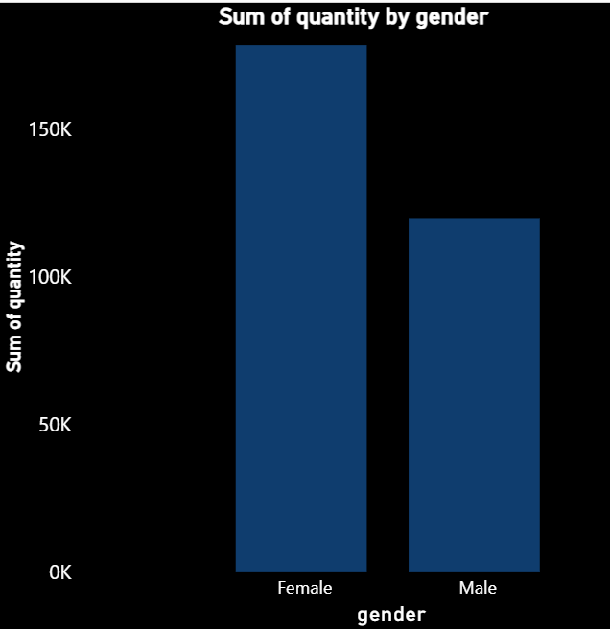
Task 2: Products sold by gender
Which gender purchased the greatest number of items?
Female: 178,659 units
Male: 120,053 units.
07

Slide 7
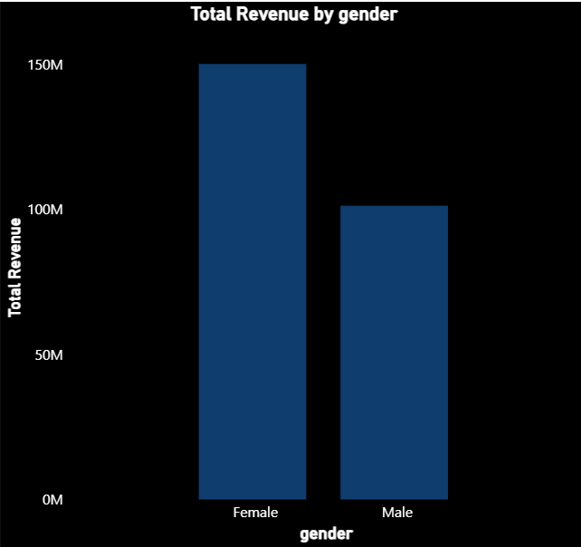
Task 3: Revenue by gender
Which gender generated more sales revenue?
Female: TL 150.21M
Male: TL 101.30M.
Female customers generate more total revenue, alongside more transactions.
08

Slide 8
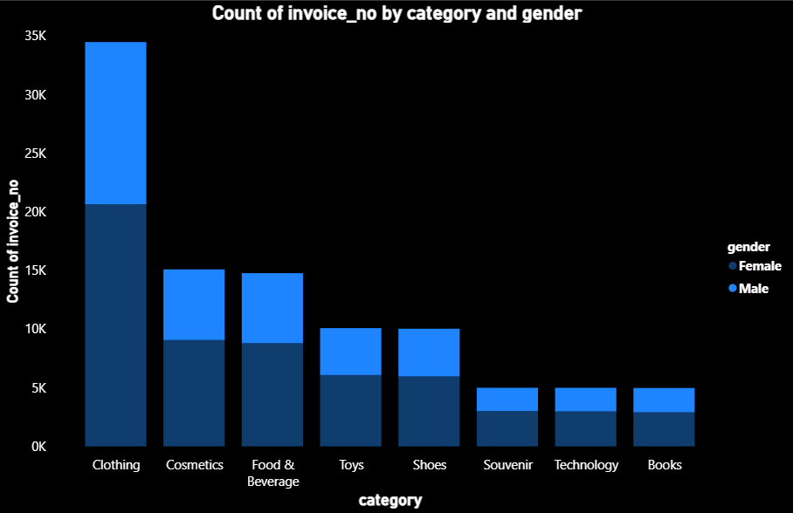
Task 4: Purchase categories and gender
How do product categories compare across genders?
Clothing is largest by transaction count: 34,487.
Female clothing revenue is higher than male clothing revenue.
09

Slide 9
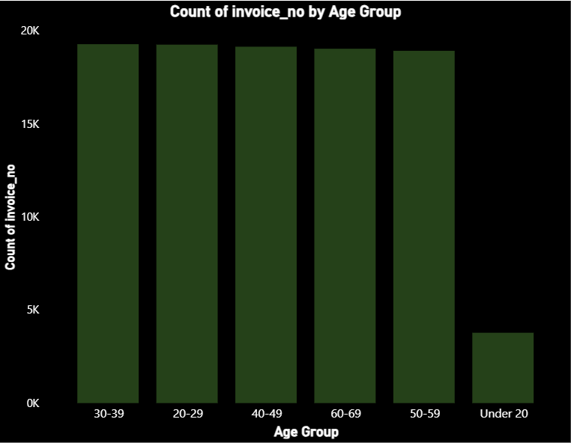
Task 5: Shopping distribution by age
How many transactions belong to each age group?
Age 30–39 has the most transactions: 19,287.
Groups 20–69 are otherwise relatively similar.
10

Slide 10
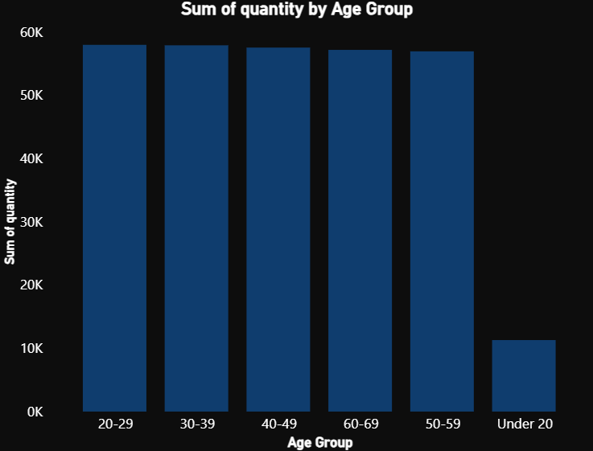
Task 6: Products sold by age group
Which age group purchased the most units?
Age 20–29 purchased 57,949 units,
closely followed by 30–39 with 57,875.
BUSINESS SUGGESTION
Compare units with revenue and average transaction value to see whether high-volume groups also make high-value purchases.
11

Slide 11
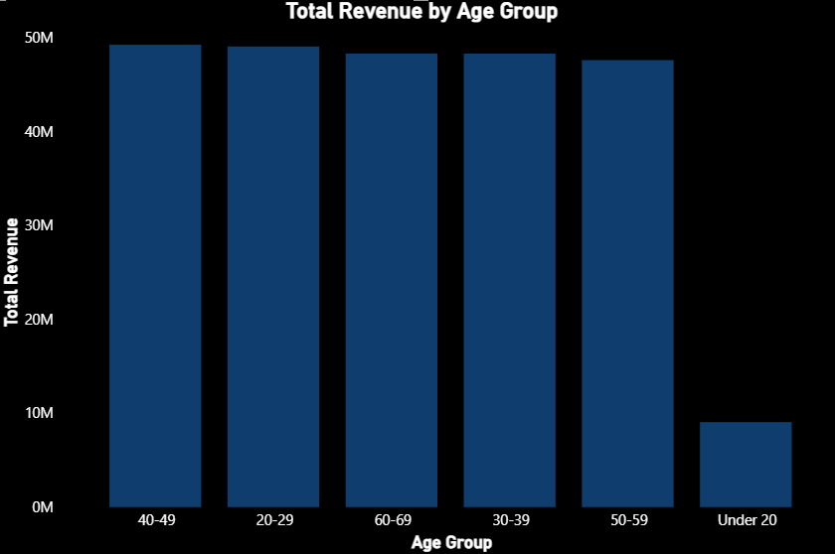
Task 7: Revenue by age group
Which age group generated the highest revenue?
Age 40–49 leads with TL 49.23M.
Under 20 contributes TL 9.05M.
12

Slide 12
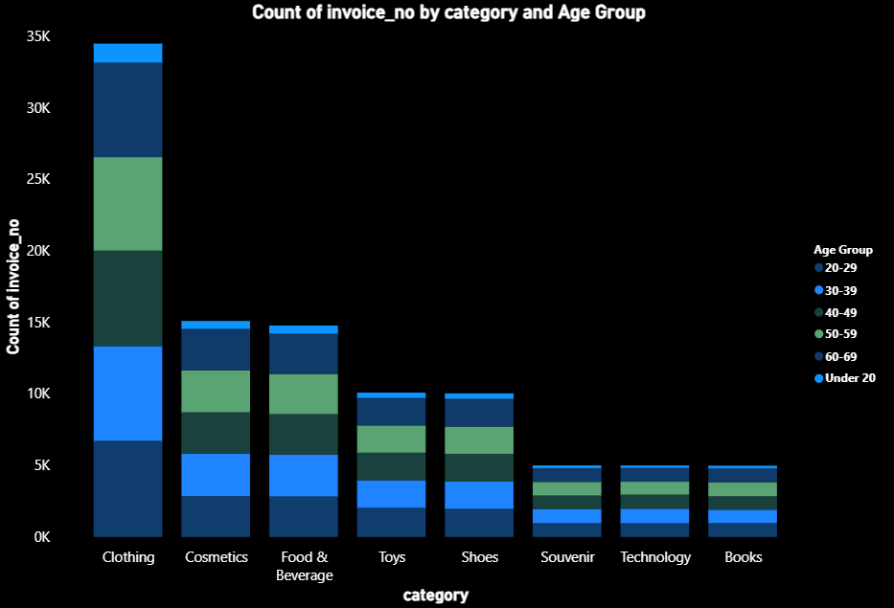
Task 8: Purchase categories and age
Which categories are purchased by different age groups?
Use the chart to identify each age group's highest-count or highest-revenue categories
validate patterns in your report.
.
13

Slide 13
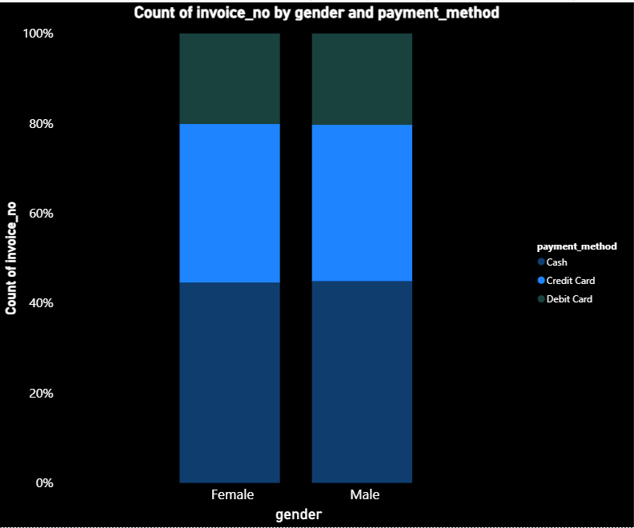
Task 9: Payment method relationships
Does payment method vary by gender, age, category or mall?
Cash is the most common method for both genders.
Compare proportions across groups, not only raw counts.
14

Slide 14
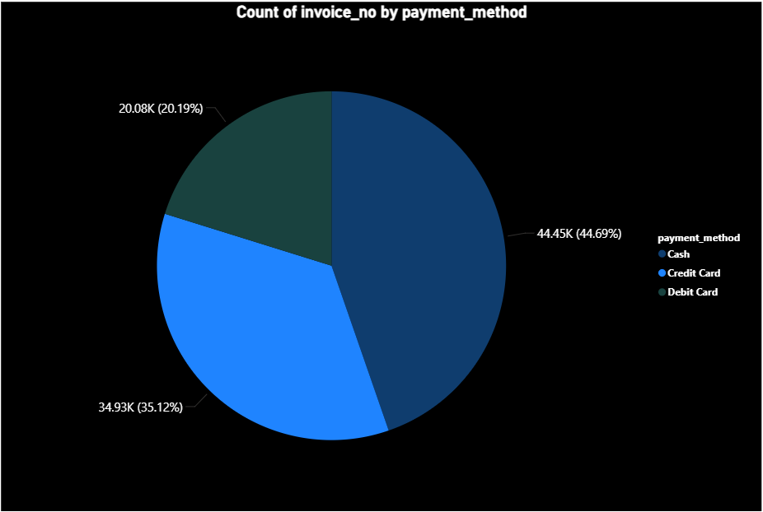
Task 10: Overall payment distribution
Which payment method is used most often overall?
Cash: 44,447 (44.7%)
Credit Card: 34,931 (35.1%)
Debit Card: 20,079 (20.2%).
Cash is the leading method.
15

Slide 15
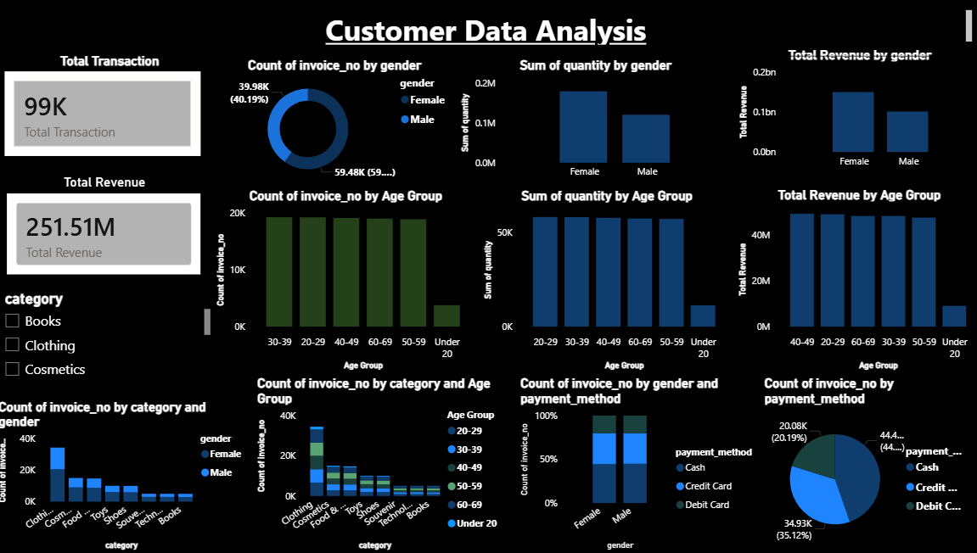
Dashboard
CUSTOMER DATA ANALYSIS
Transactions
Units sold
Revenue
Avg. transaction
99,457
298,712
TL 251.51M
TL 2,528.79
Gender
Category revenue
Age revenue
Insert matching Power BI visual
Insert matching Power BI visual
Insert matching Power BI visual
Payment method
Mall revenue
Monthly trend
Insert matching Power BI visual
Insert matching Power BI visual
Insert matching Power BI visual
Slicers: Gender • Age Group • Category • Payment Method • Mall • Date
18

Slide 16
CONCLUSION
The dataset contains 99,457 transactions across 10 malls.
Gender, age, category and payment visuals reveal shopping patterns.
KPI cards and slicers make the report easier to explore.
Recommendations should be tested against margins, inventory and future sales.
THANK YOU

