Slide 1
TRANSMISSION MEDIA
Name :- Honey Hari
Roll no :- 0133CS161084

Slide 2
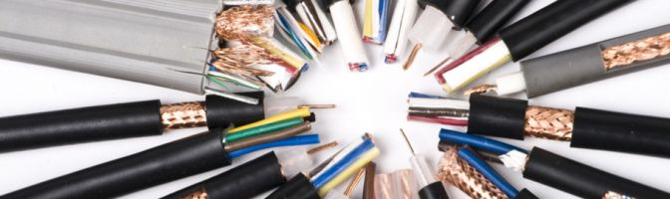
GUIDED MEDIA

Slide 3
GUIDED MEDIA :- In guided media , communication devices are directly connnected with each other by using some physical media like wires.It is also called Bounded Media.
Example :- Some examples of bounded media for communication are as follows:
Twisted Pair
Coaxial cable
Fiber Optics

Slide 4
Twisted Pair Cable
Twisted pair cables as the names implies, consists of a pair of cables twisted together, which has been utilized in telecommunication field for a long time.
The twisting can avoid noise from outside sources and crosstalk on multi-pair cables, so this cable is best suited for carrying signals.

Slide 5
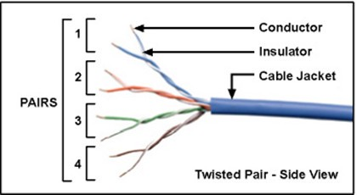
Twisted Pair Cable

Slide 6
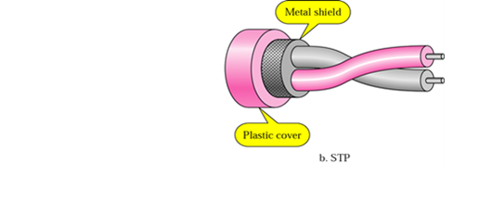
Twisted pair cable can be divided into two types: unshielded twisted-pair (UTP) and shielded twisted-pair (STP).
Shielded Twisted Pair :- The pair is wrapped with metalic foil to insulate the pair from electromagnetic interference .
It is more expensive and harder to work.

Slide 7
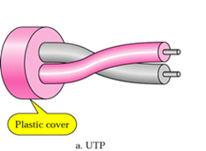
Unshielded Twisted Pair (UTP) :-
Each wire is insulated with plastic wrap but the pair is encased in an outer covering.

Slide 8
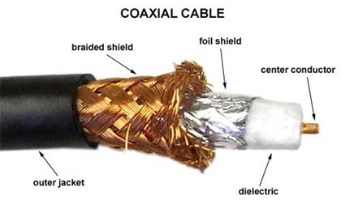

Slide 9
Coaxial Cable :- Coaxial cable consists of copper wire covered by an insulating material.
The insulated copper wire is covered by copper mesh.
The mesh protect the data signals from interference by external electromagnetic waves.
Coaxial cables are used by the cable TV network and Telephone companies.

Slide 10
Compare co-axial cable & twisted pair cable
A major twisted pair and coaxial cable difference is related to shielding.

Slide 11
coaxial cables are more expensive, they support longer cable lengths because they are better shielded.
This superior shielding prevents crosstalk and other disruptions in traffic.
In comparisons between coaxial vs twisted pair, coaxial cables are able to transmit over 80 times the amount of data as a twisted pair cable. Because of this, coaxial cables are almost always used for high-speed communication, including internet, cable and telecommunications services.

Slide 12
Twisted pair cables still remain in use throughout by telecommunications companies as they are the oldest type of cable.
They are still extremely affordable and fast to install, and an organization may not experience much latency if it uses twisted pair cables throughout its internal network.
They connect with the RJ45 connector

Slide 13
Twisted pair cabling is better suited when cost and installation are an issue and if EMI and crosstalk are not too much of a problem.
The biggest advantage of twisted cables is in installation, as it is often thinner than coaxial cables and as they are thinner, they can not support very long runs

Slide 14
CONCLUSION

Slide 15
Twisted pair cable Coaxial cable
Transmission of signals takes place in the electrical form over the metallic conducting wires.
In this medium the noise immunity is low.
Twisted pair cable can be affected due to external magnetic field.
Transmisson of signals takes place in the electrical form over the inner conductor of the cable.
Coaxial having higher noise immunity than twisted pair cable.
Coaxial cable is less affected due to external magnetic field.

Slide 16
Twisted pair cable Coaxial cable
Cheapest medium.
Low Bandwidth.
Attenuation is very high.
Installation is easy.
Moderate Expensive.
Moderately high bandwidth.
Attenuation is low.
Installation is fairly easy.

Slide 17
Thank you

