Slide 1
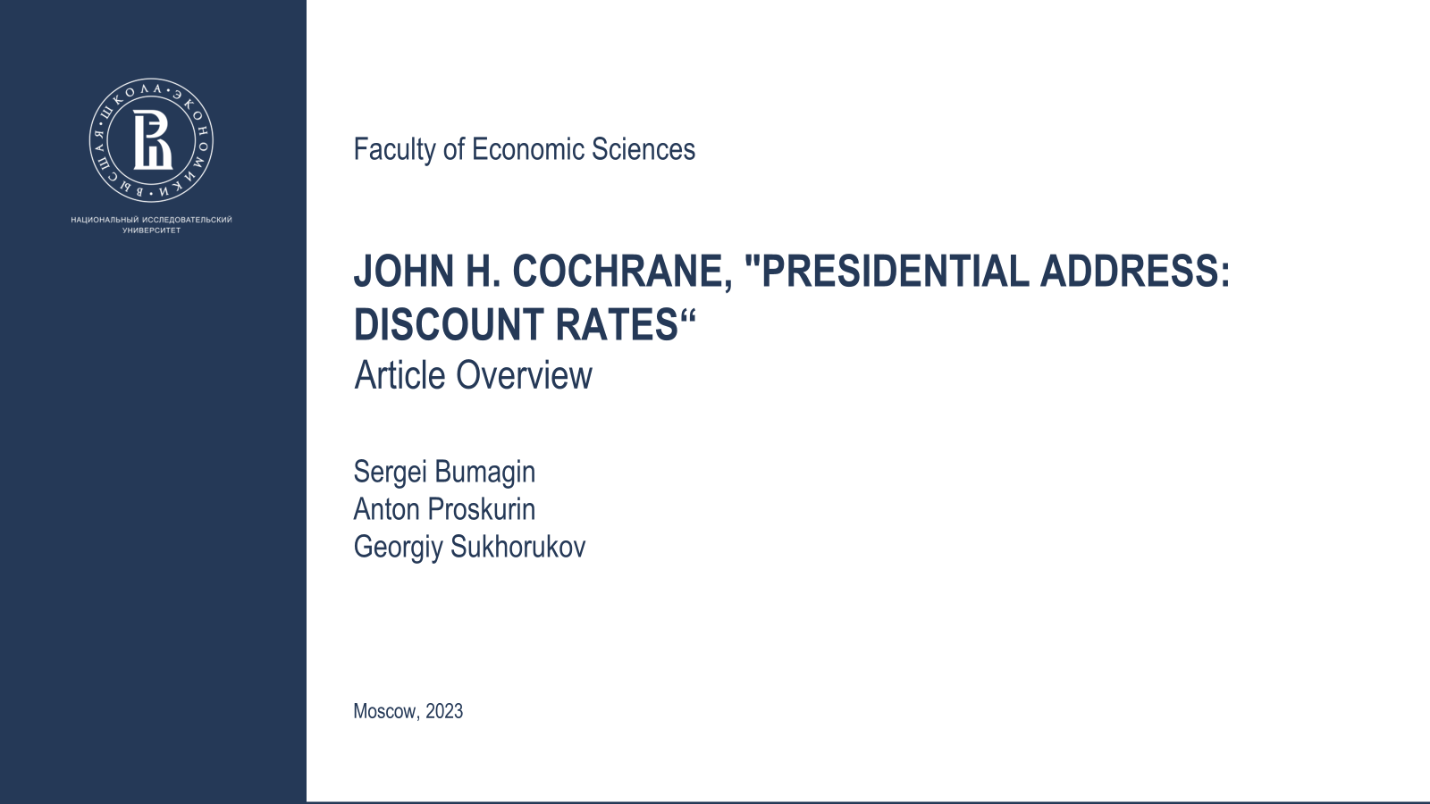

Slide 2
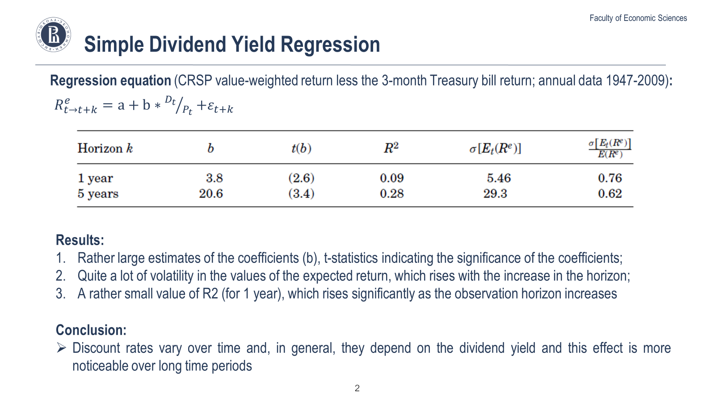

Slide 3
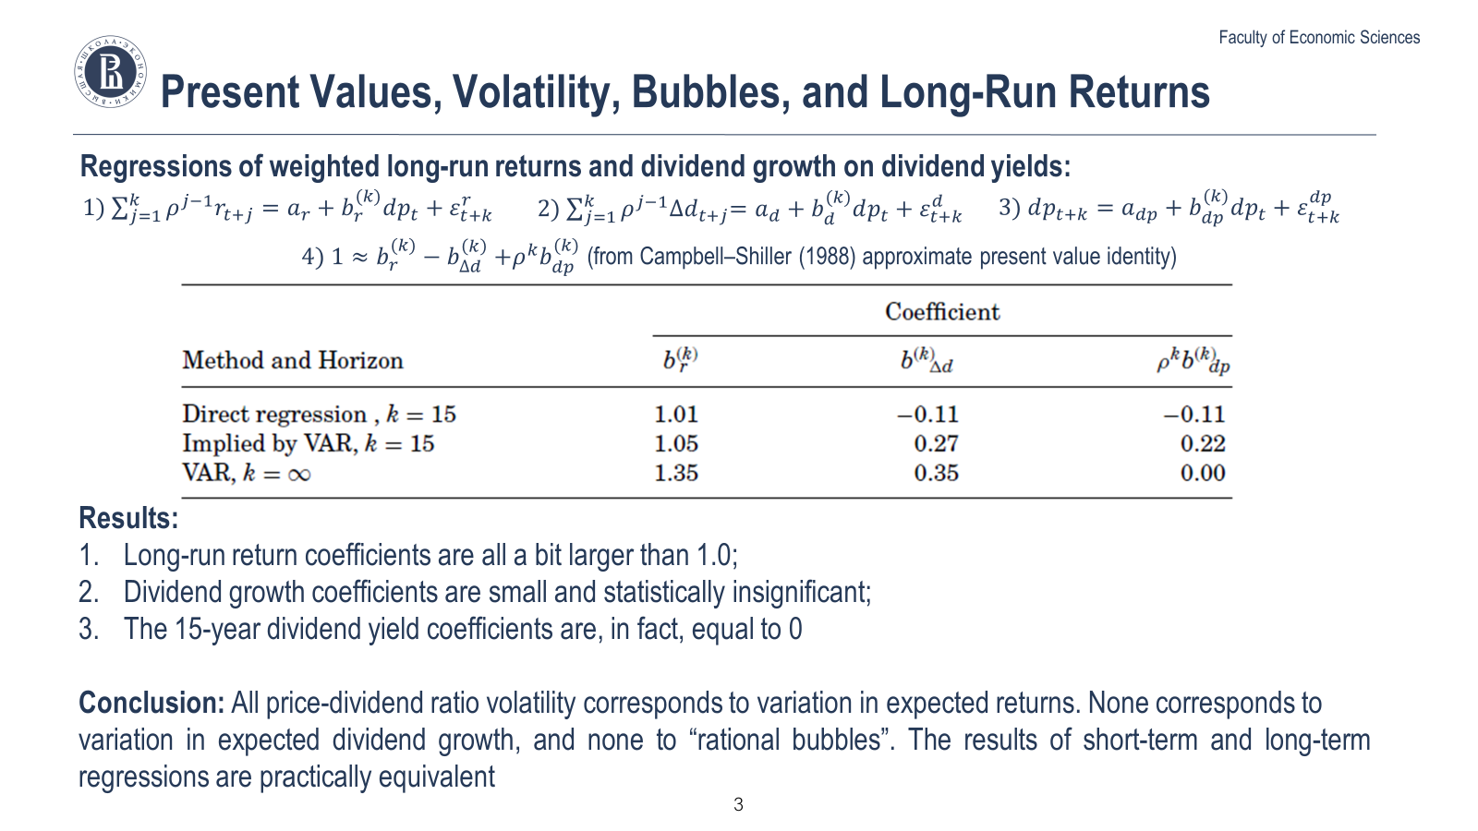

Slide 4
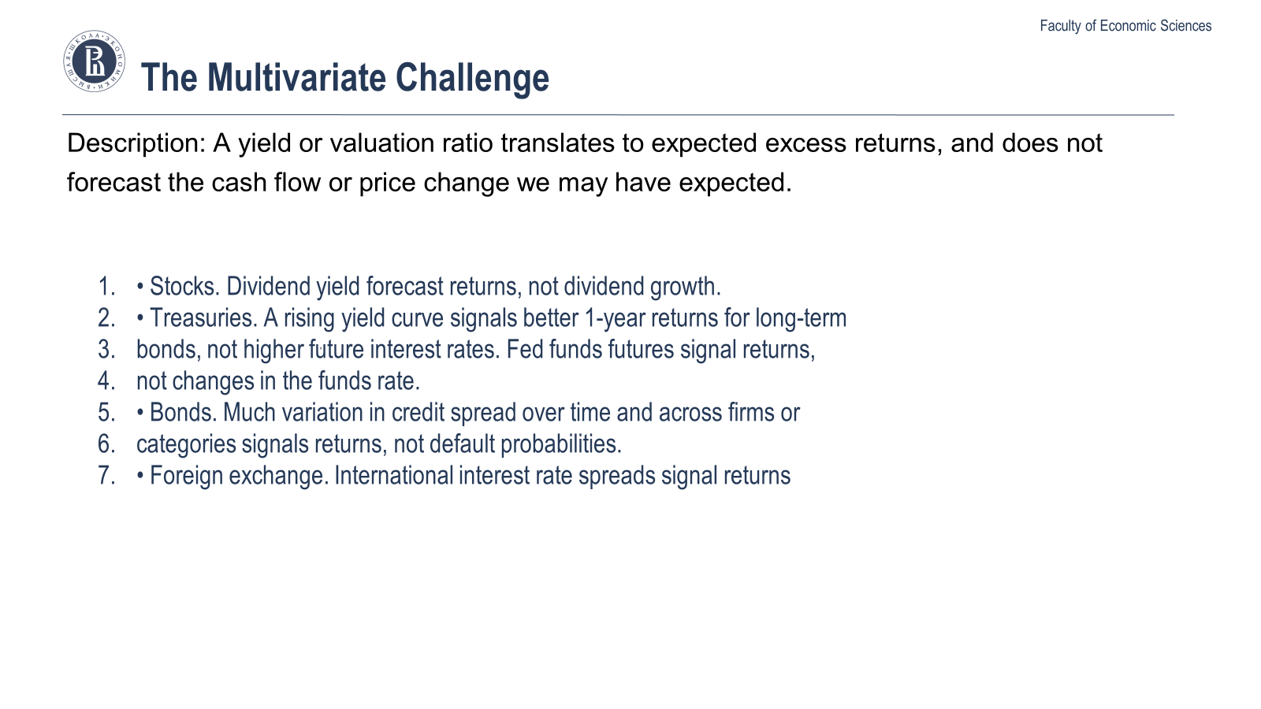
Pervasive Phenomenon
Description: A yield or valuation ratio translates to expected excess returns, and does not
forecast the cash flow or price change we may have expected.
• Stocks. Dividend yield forecast returns, not dividend growth.6
• Treasuries. A rising yield curve signals better 1-year returns for long-term
bonds, not higher future interest rates. Fed funds futures signal returns,
not changes in the funds rate.7
• Bonds. Much variation in credit spread over time and across firms or
categories signals returns, not default probabilities.8
• Foreign exchange. International interest rate spreads signal returns, not
.

Slide 5
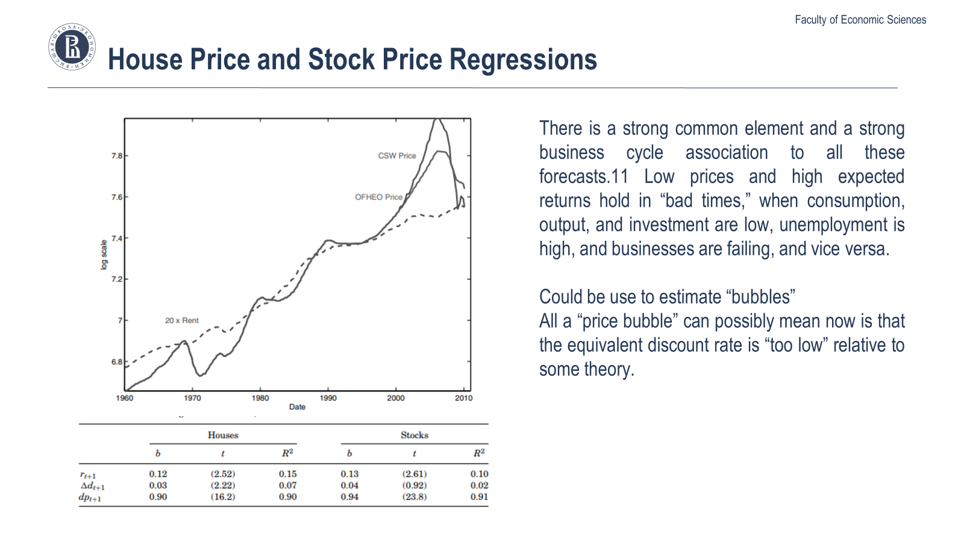
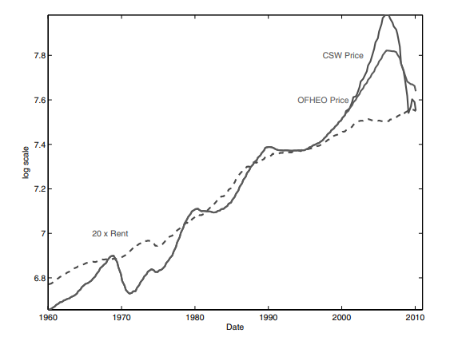
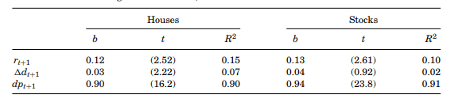
House Price and Stock Price Regressions
There is a strong common element and a strong business cycle association to all these forecasts.11 Low prices and high expected returns hold in “bad times,” when consumption, output, and investment are low, unemployment is high, and businesses are failing, and vice versa.
Could be use to estimate “bubbles”
All a “price bubble” can possibly mean now is that the equivalent discount rate is “too low” relative to some theory.

Slide 6
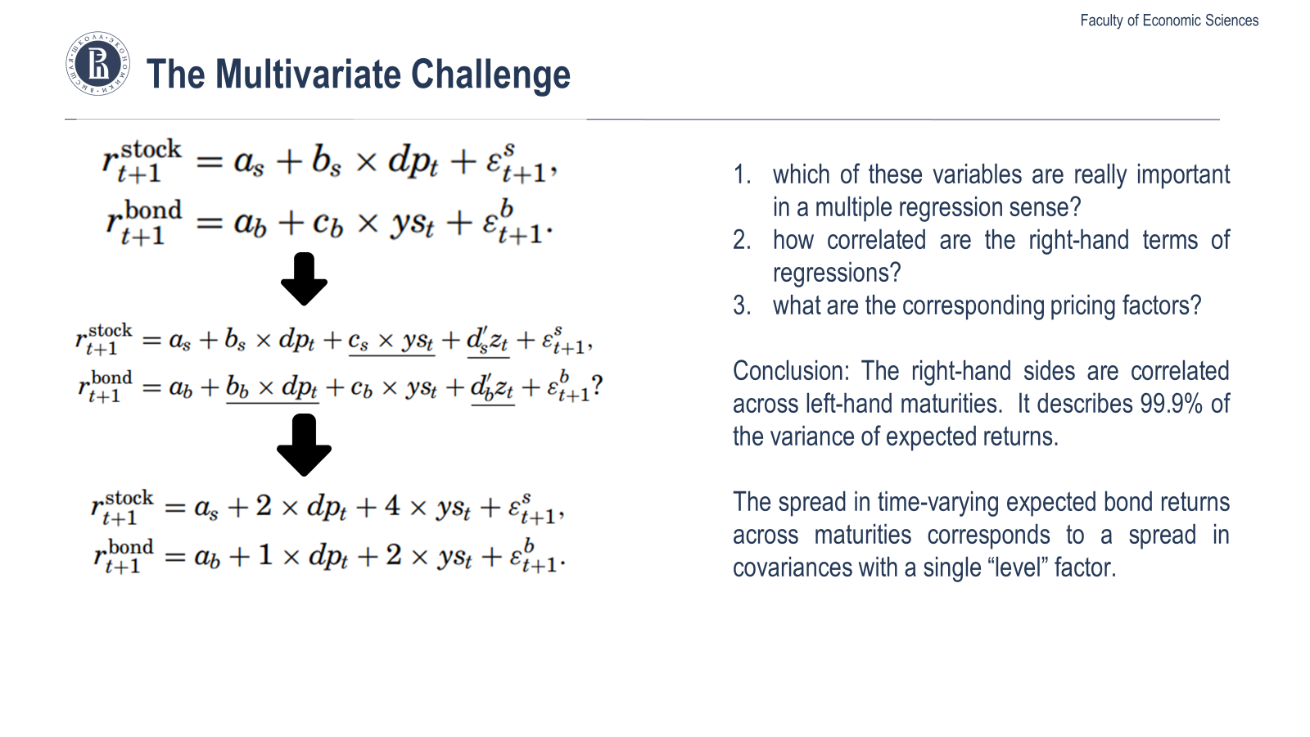

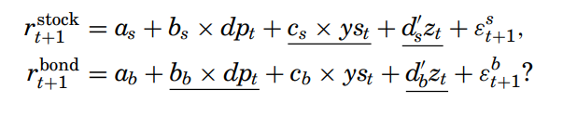
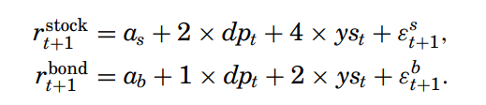

The Multivariate Challenge
which of these variables are really important in a multiple regression sense?
how correlated are the right-hand terms of regressions?
what are the corresponding pricing factors?
Furthermore, the right-hand sides are almost perfectly correlated across left-hand maturities.12 A single common factor describes 99.9% of the variance of expected returns as in (8). Finally, the spread in time-varying expected bond returns across maturities corresponds to a spread in covariances with a single “level” factor. The market prices of slope, curvature, and expected-return factor risks are zero.

Slide 7
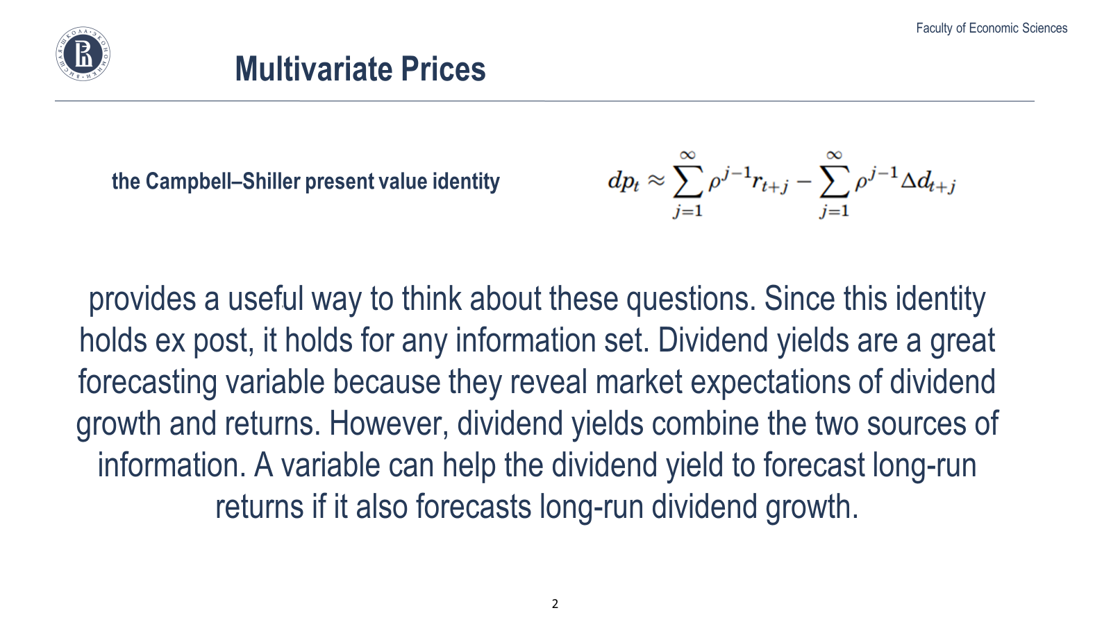

Multivariate Prices
the Campbell–Shiller present value identity
provides a useful way to think about these questions. Since this identity holds ex post, it holds for any information set. Dividend yields are a great forecasting variable because they reveal market expectations of dividend growth and returns. However, dividend yields combine the two sources of information. A variable can help the dividend yield to forecast long-run returns if it also forecasts long-run dividend growth.

Slide 8
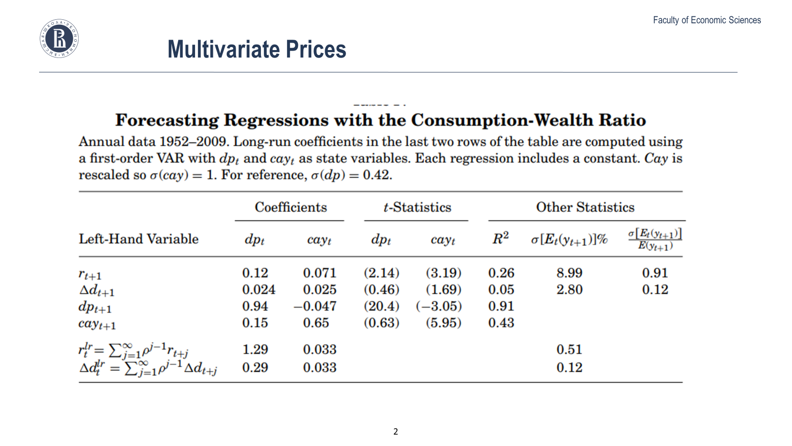
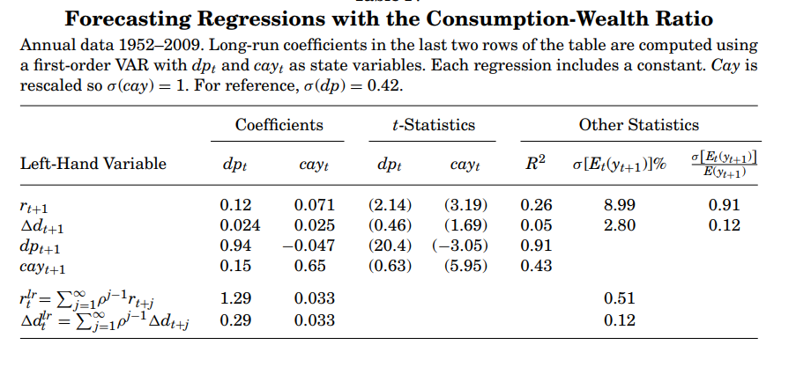
Multivariate Prices

Slide 9
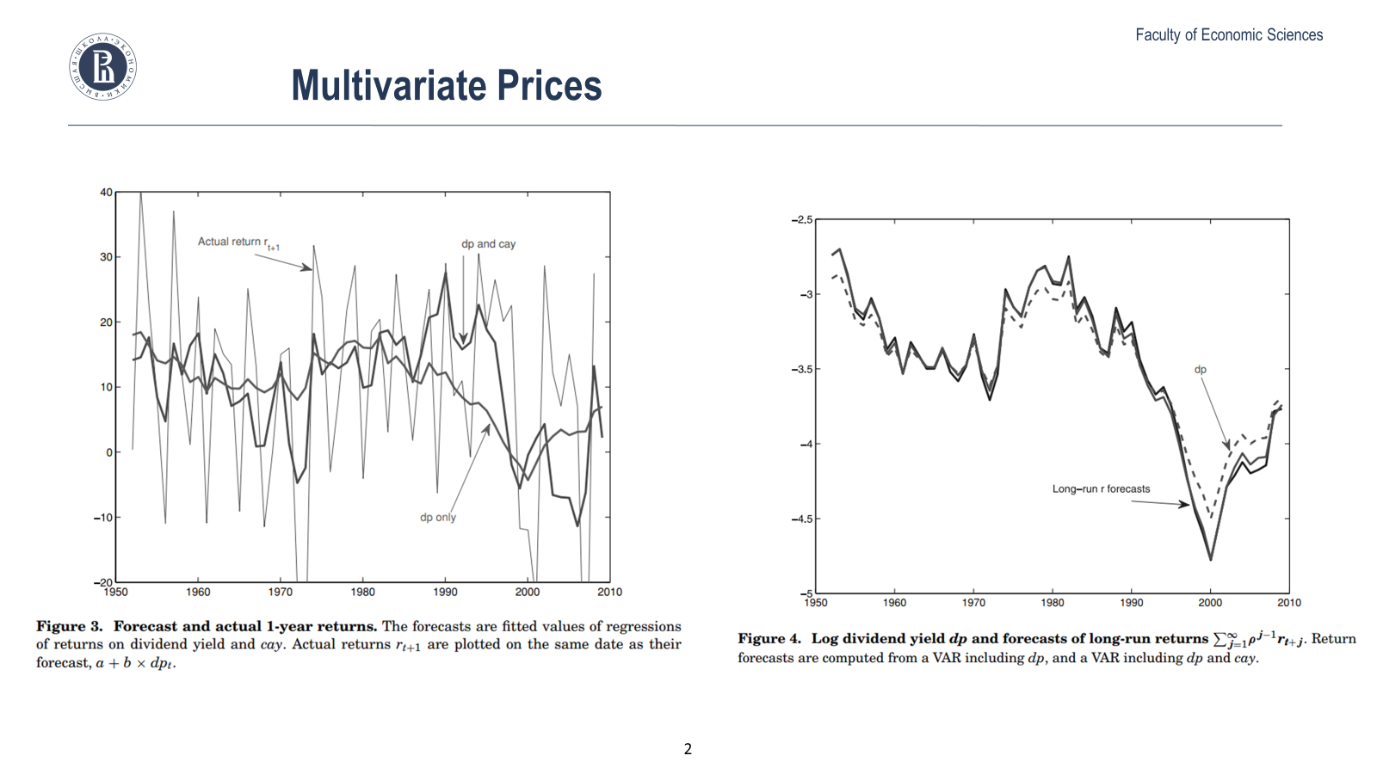
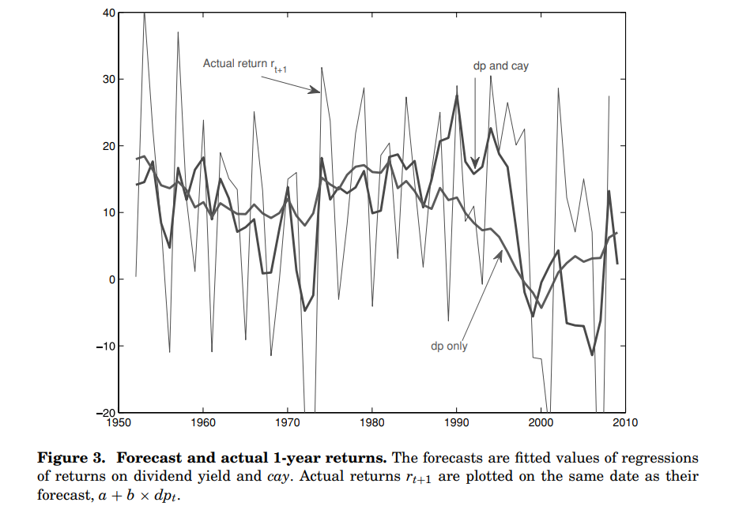
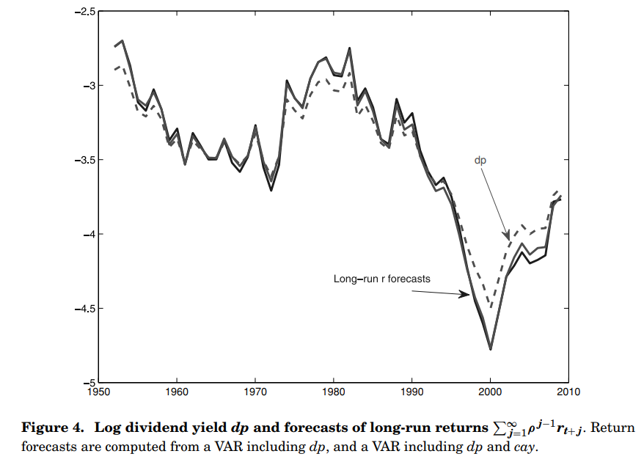
Multivariate Prices

Slide 10
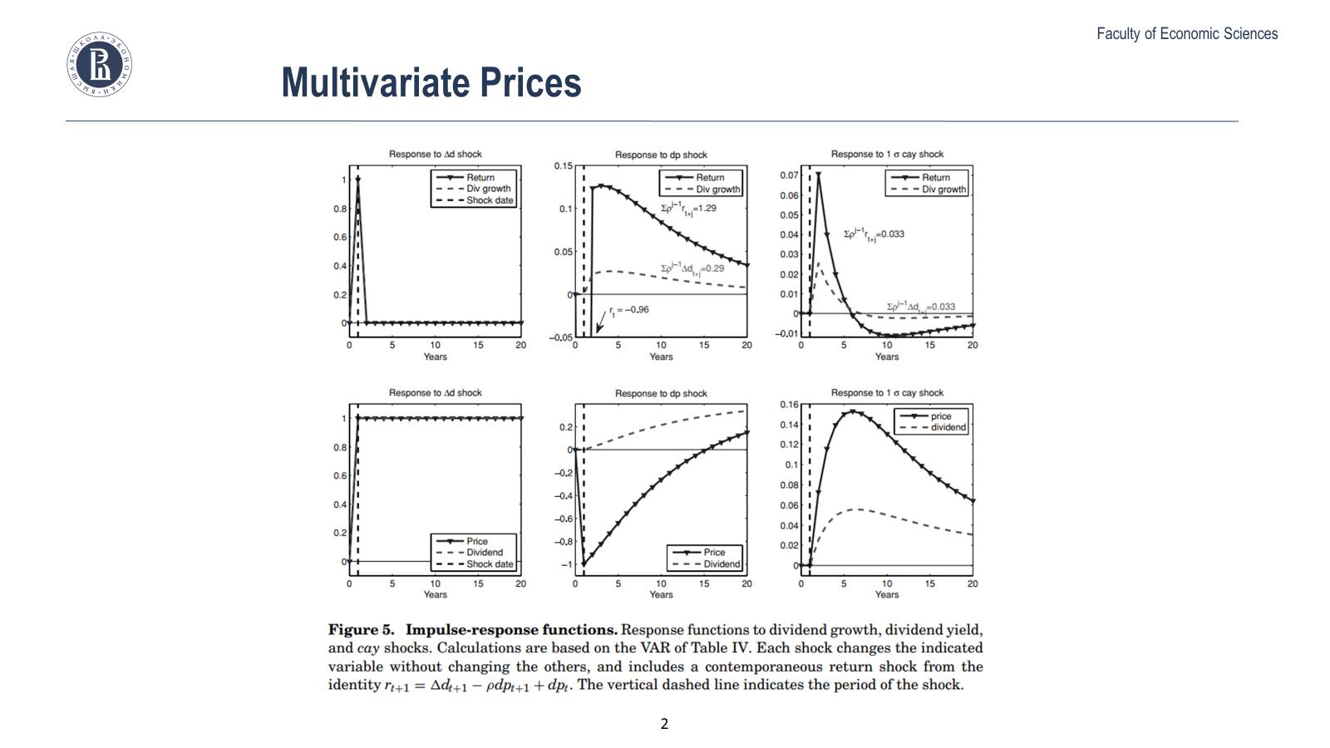
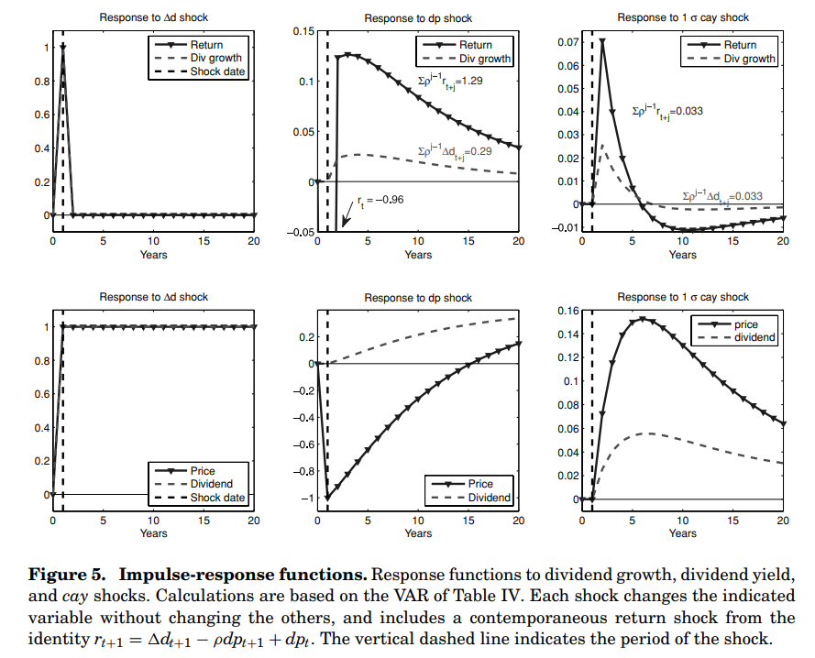
Multivariate Prices

Slide 11


