Slide 1
FantomCMS
(Content Management System)
Jeremy Criquet
Cole Grim
Joshua Leihe
Matthew Isaac Lean
Jono Yang
December 5th 2014

Slide 2
The project: Create a web content management system that...
Uses the Fantom programming language
Supports single page application design
Things we learned
The Fantom language
The scrum process

Slide 3
Things that worked well for us
Technologies we used
Working in the group room (Tree House)
GIT branches
Team building activities
F4 (IDE)
Fantom
Java
Javascript
MongoDB
GitHub
Things that we had trouble with
Time management
Lack of Fantom documentation

Slide 4
Things We Liked
Things We Didn’t Like
Making an amazing project
Getting the majority of our “ambitious” project complete
Working together
Learning new things
Free Pizza!
Sifting through partial Fantom documentation
Doing RAC reviews
Incomplete Javascript implementation for Fantom

Slide 5
Tasks we completed
A home app that displays the available apps
Full backend infrastructure for the system
A state model that allows for easy navigation using the single page application paradigm
A working database that fits our modular design
A users app that controls who has access to which apps
A pages app that displays pages that have been statically stored in the database
A gallery app for viewing multimedia on the site

Slide 6
Tasks we completed (continued)
A layouts app that controls how the entire site is laid out
A themes app that controls the various colors and patterns on the site
An image extension to improve image functionality
And now, we present the UI of the CMS!

Slide 7
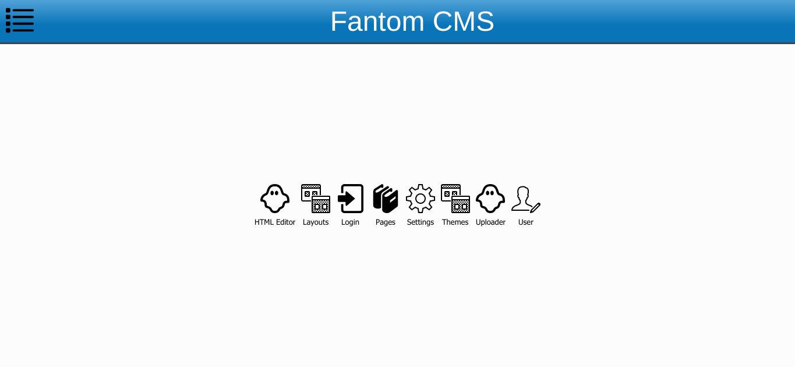
Home page where all the apps are displayed

Slide 8
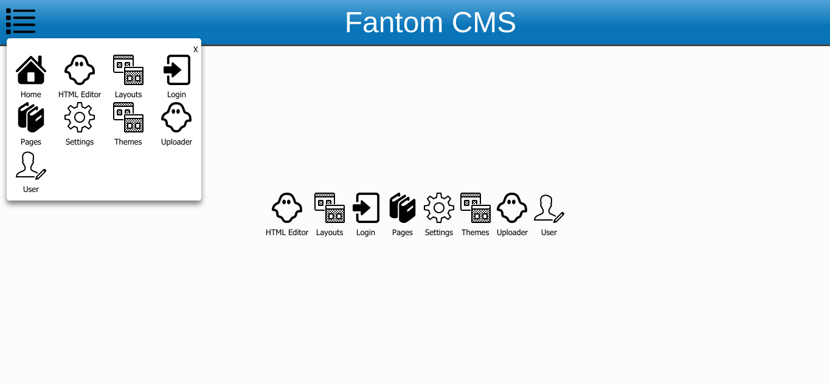
App drawer which is visible on every page.

Slide 9
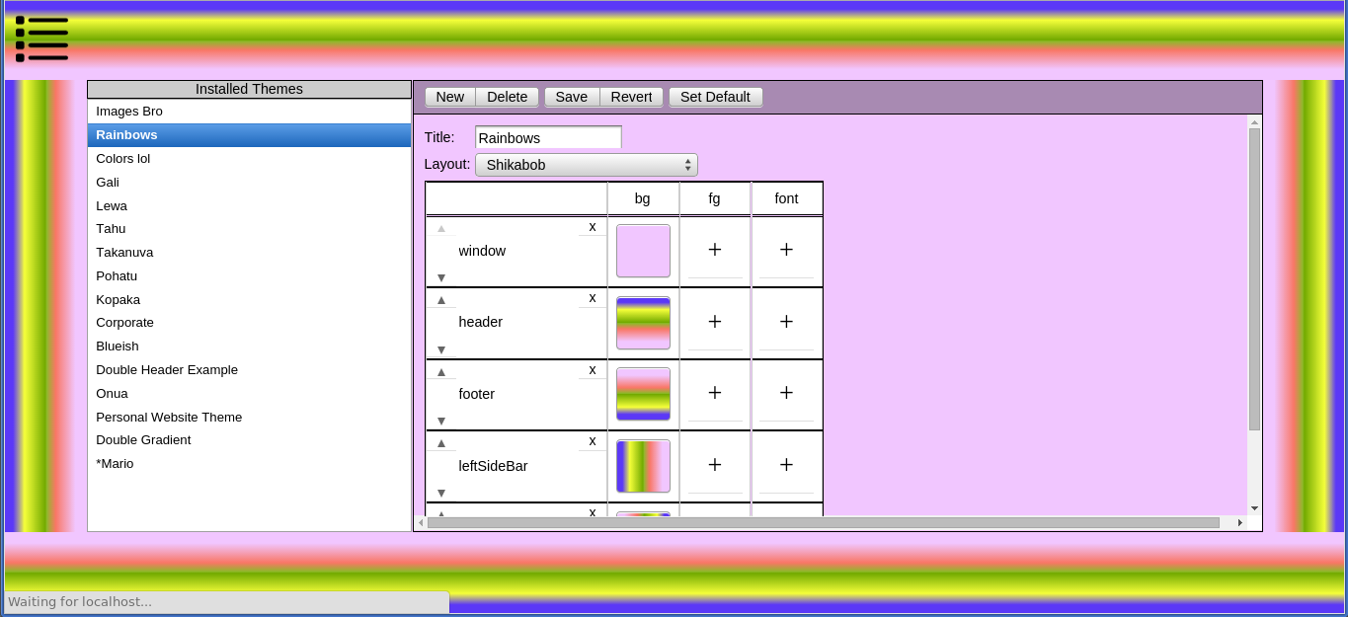
Themes! This allows you to control how the entire site looks.

Slide 10
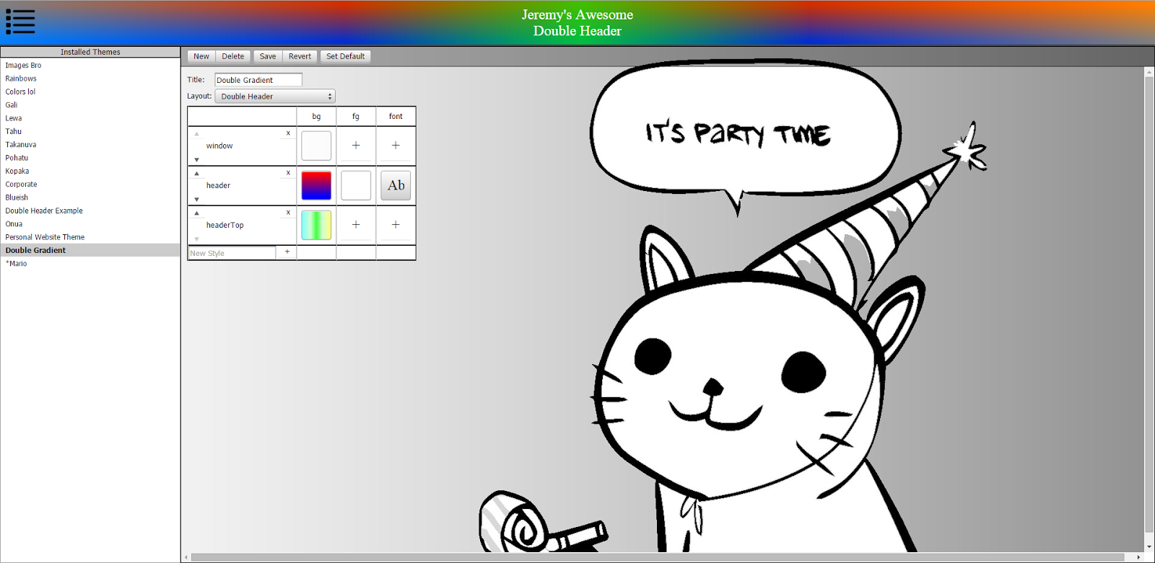
More Themes!
Themes! This allows you to control how the entire site looks.

Slide 11
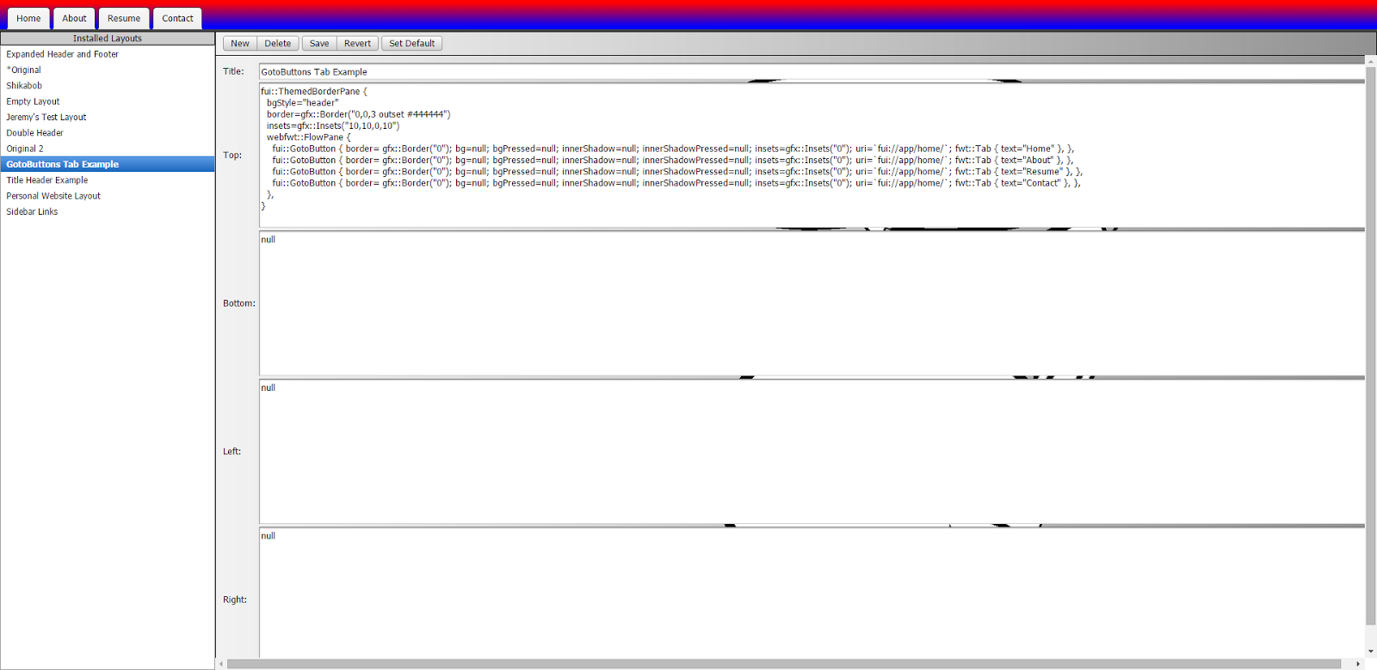
Layouts

Slide 12
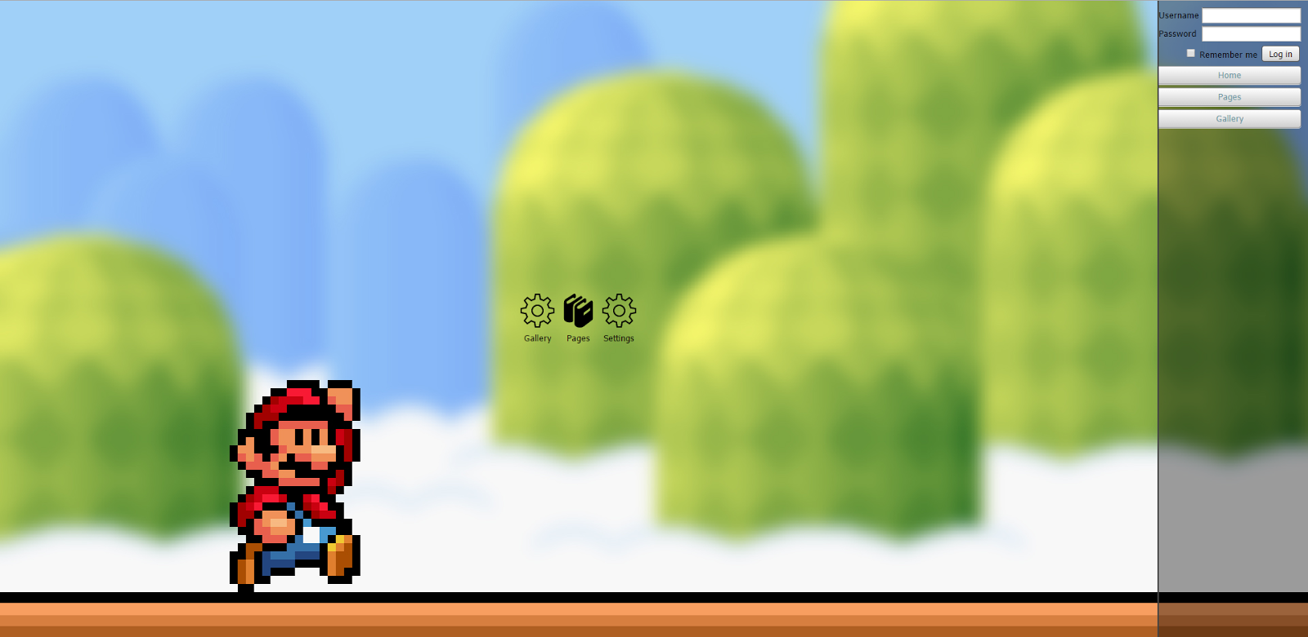
Login widget.
Without logging in, you have access to a limited number of apps
Login bar. Without logging in you have access to a limited number of apps

Slide 13
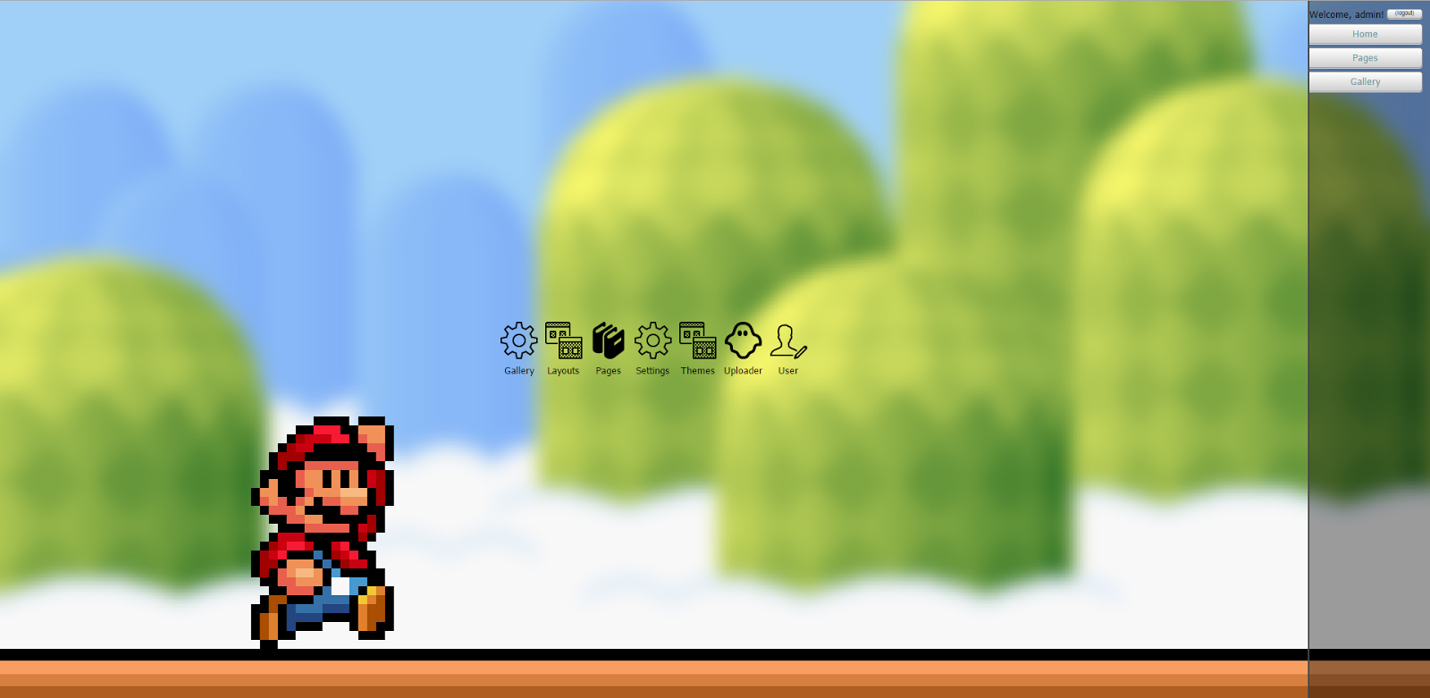
Login bar. Without logging in you have access to a limited number of apps

Slide 14
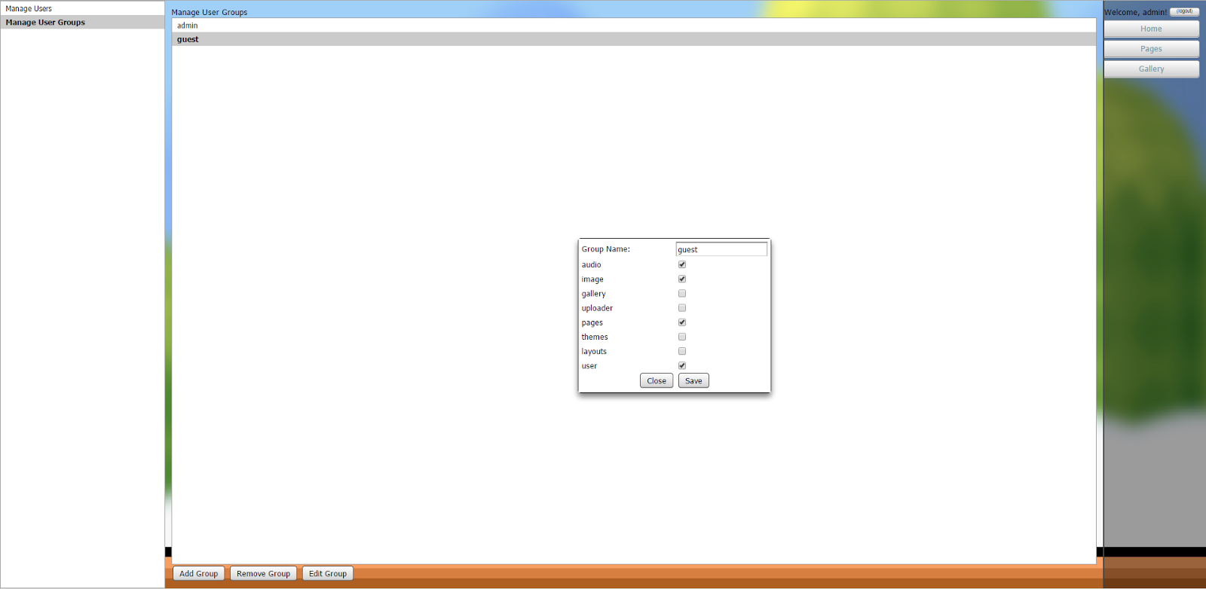
Login bar. Without logging in you have access to a limited number of apps
Set up users and user groups in User app.
You also can set user permissions.

Slide 15
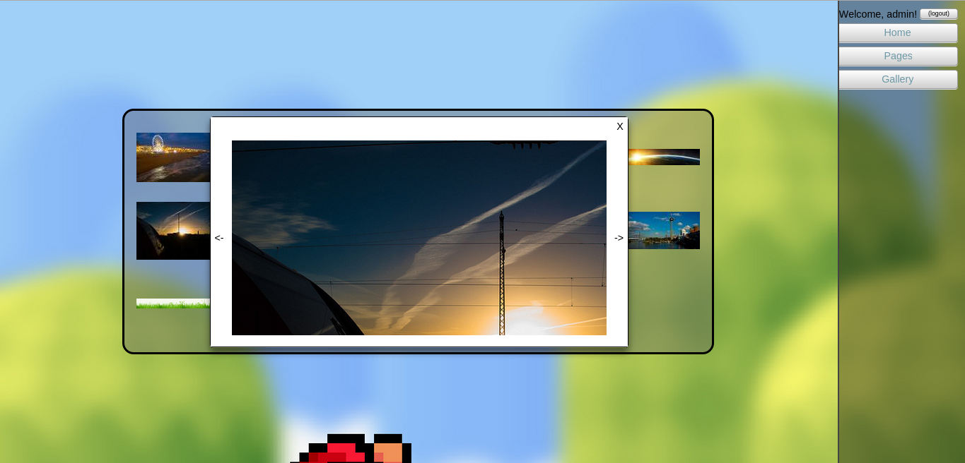
Gallery App

Slide 16
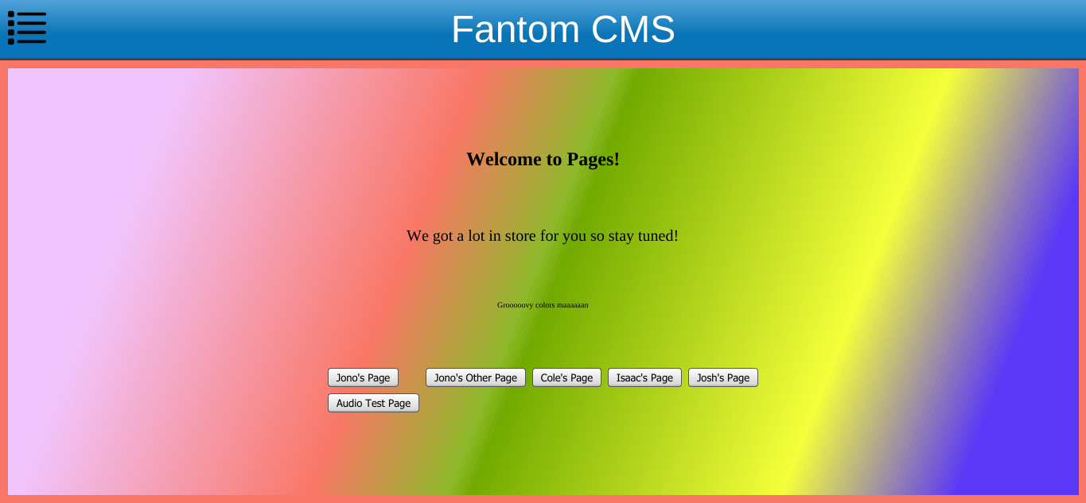
Pages. Here sample pages are loaded from the database

Slide 17
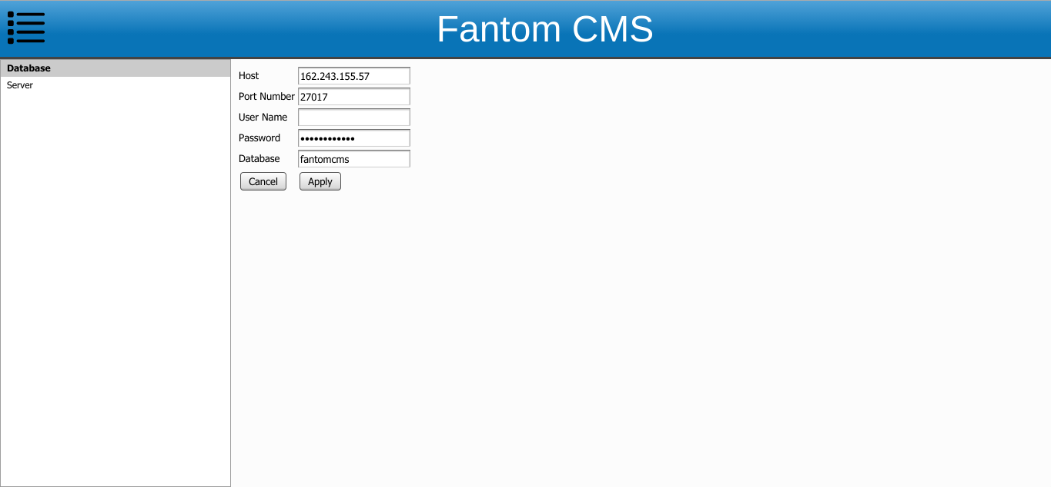
Database settings

Slide 18
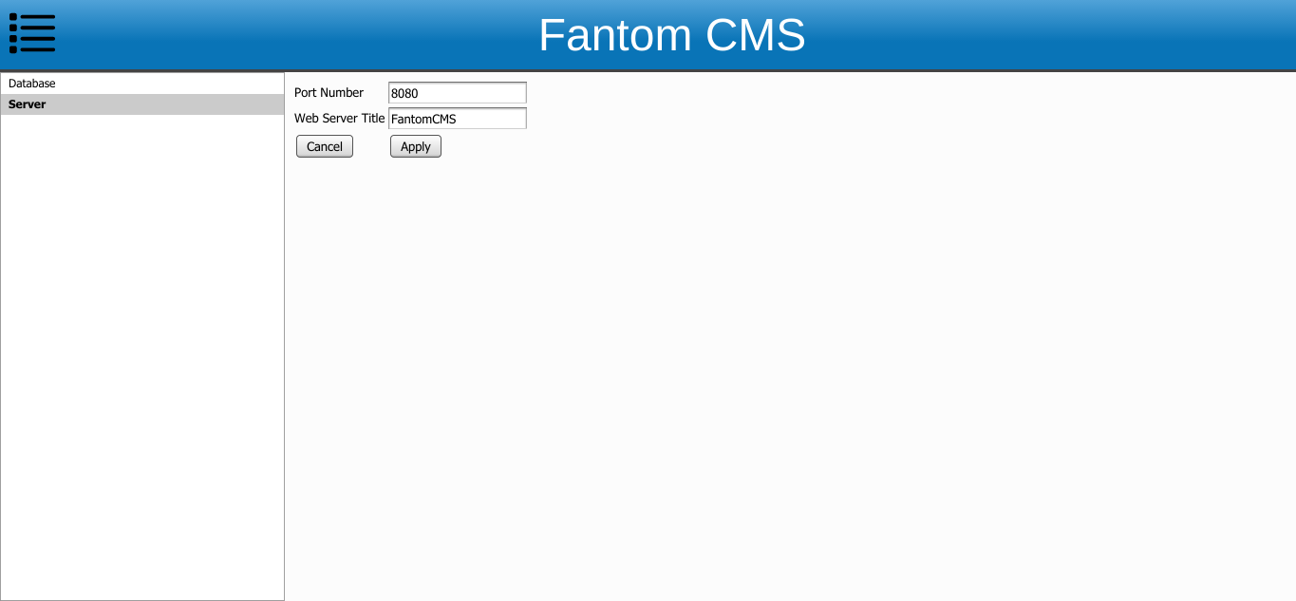
Server settings

Slide 19
Questions?

