Slide 1
FantomCMS
(Content Management System)
Jeremy Criquet
Cole Grim
Joshua Leihe
Matthew Isaac Lean
Jono Yang
December 5th 2014

Slide 2
The project: Create a web content management system that
Uses the Fantom programming language
Supports single page application design
Things we learned
The Fantom language
The scrum process

Slide 3
Things that worked well for us
Working in the group room (Tree House)
Team building activities
Things that we had trouble with
Time management
Lack of Fantom documentation

Slide 4
Technologies we used
Javascript
Fantom
Java
F4 (IDE)
MongoDB
GitHub

Slide 5
Tasks we completed
Full backend infrastructure for the system
A state model that allows for easy navigation using the single page application paradigm
A working database
A themes app that controls how the entire site is laid out and what colors and patterns are shown
A users app that controls who has access to which apps
A pages app that displays pages that have been statically stored in the database

Slide 6
Tasks we completed (continued)
A homepage that displays the available apps
A gallery app for viewing multimedia on the site
An audio extension that can play music from the database
And now, we present the UI of the CMS!

Slide 7
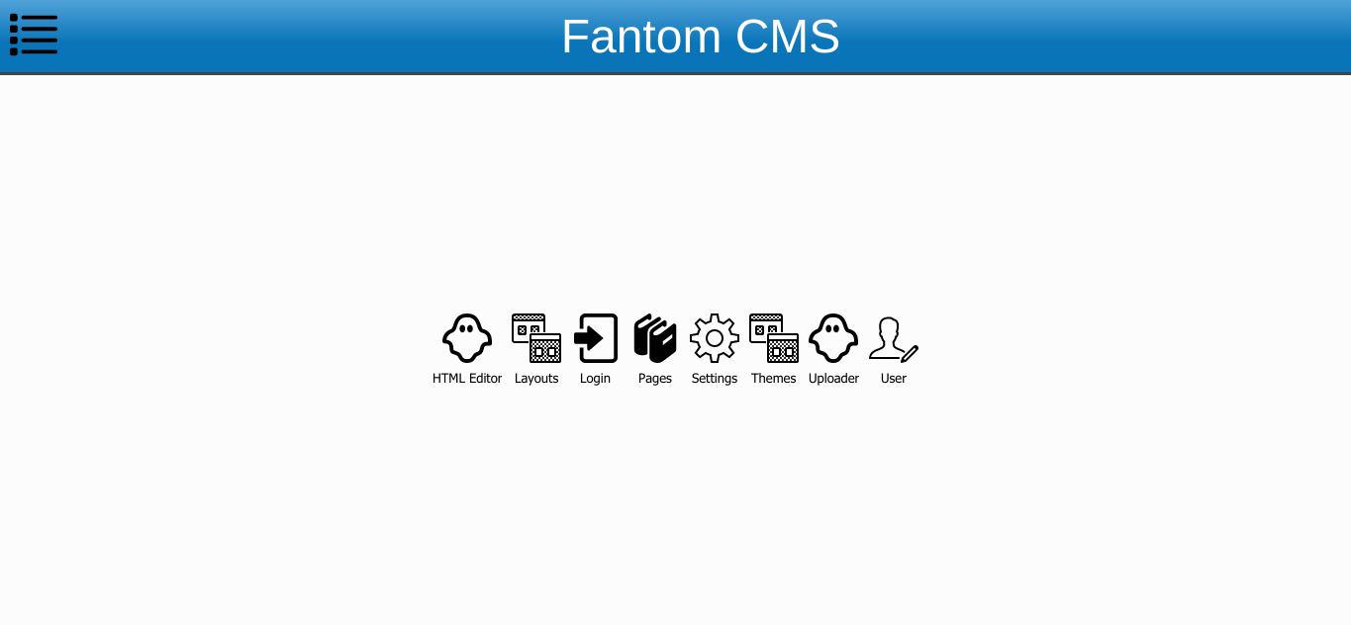
Home page where all the apps are displayed

Slide 8
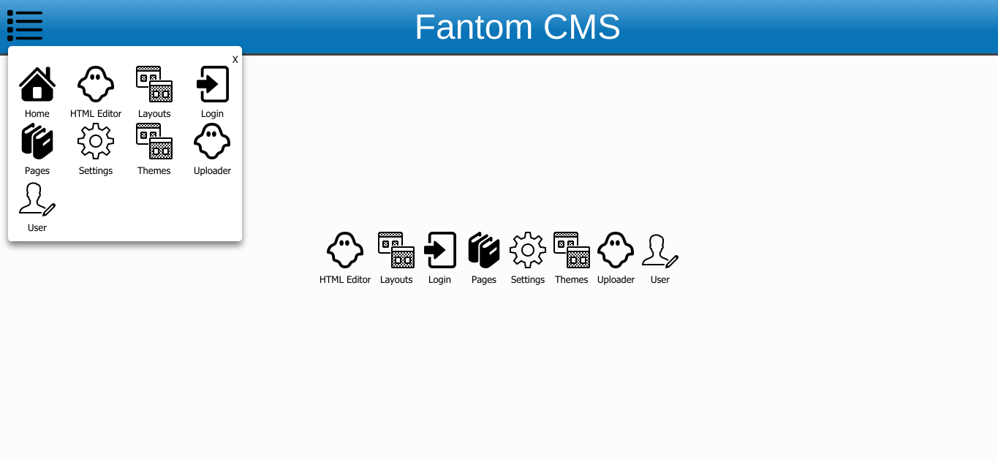
Menu which is visible on every page.

Slide 9
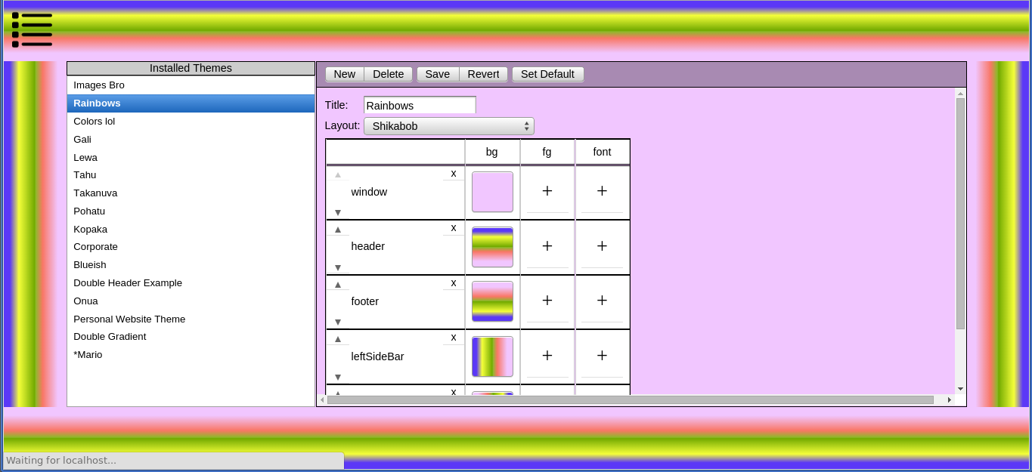
Themes! This allows you to control how the entire site looks.

Slide 10
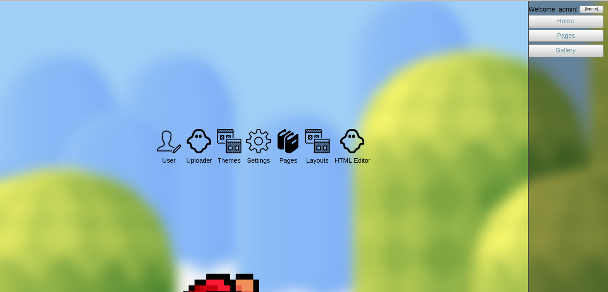
Login bar. Without logging in you have access to a limited number of apps

Slide 11
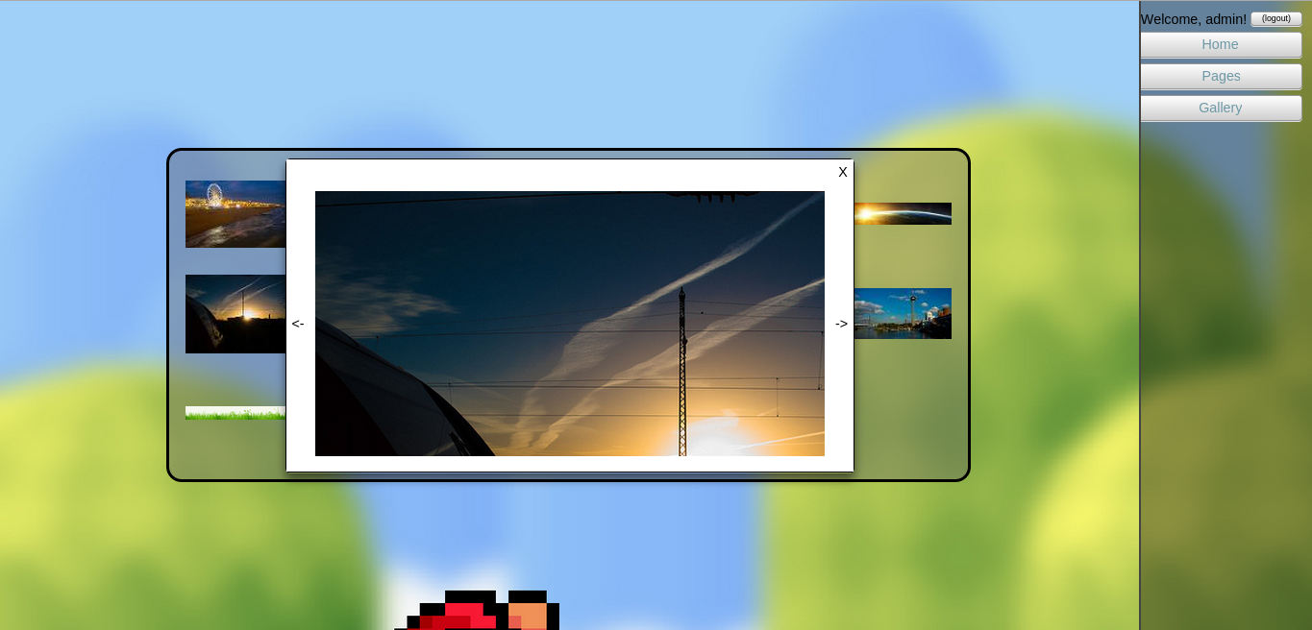
Gallery App

Slide 12
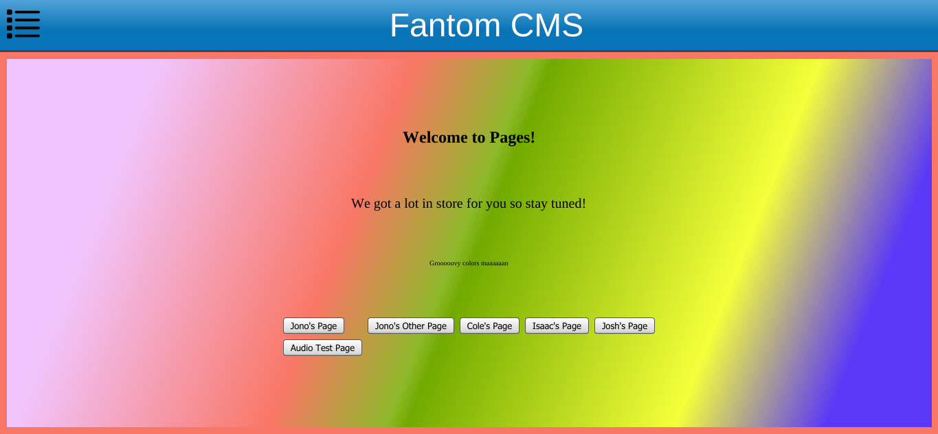
Pages. Here sample pages are loaded from the database

Slide 13
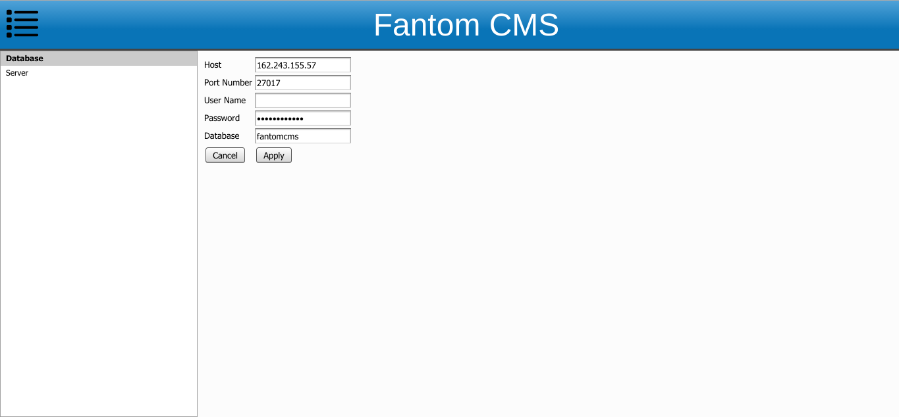
Database settings

Slide 14
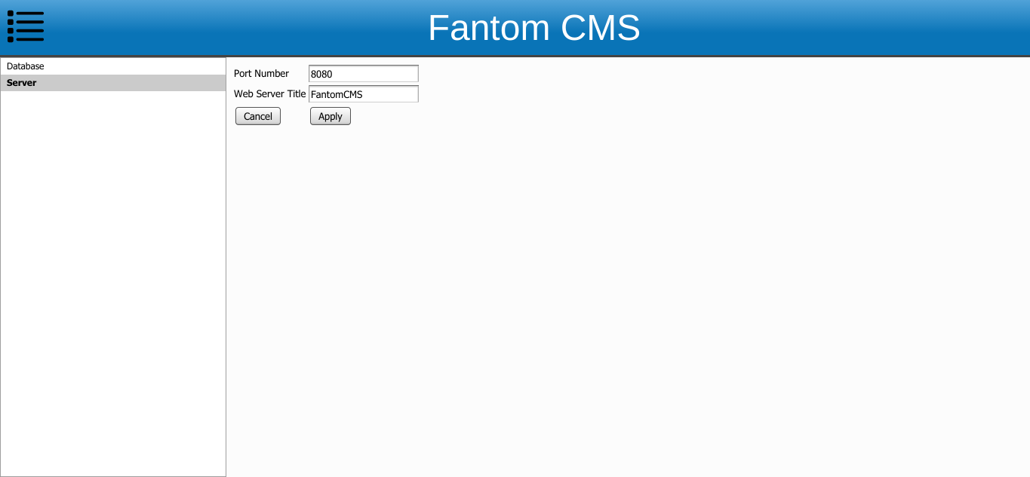
Server settings

Slide 15
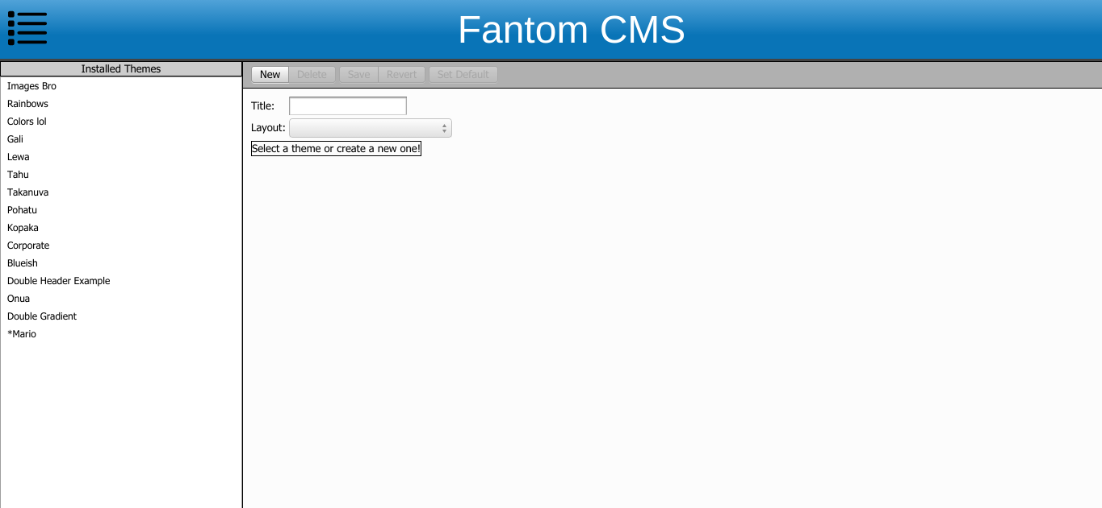
Layouts

Slide 16
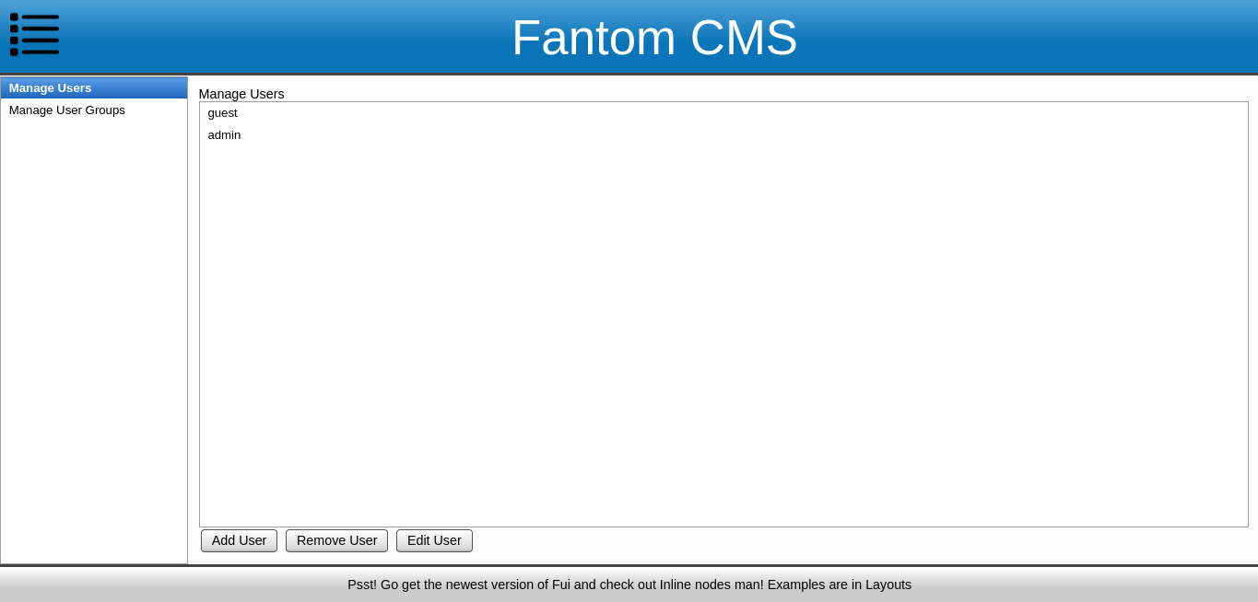
User management page

Slide 17
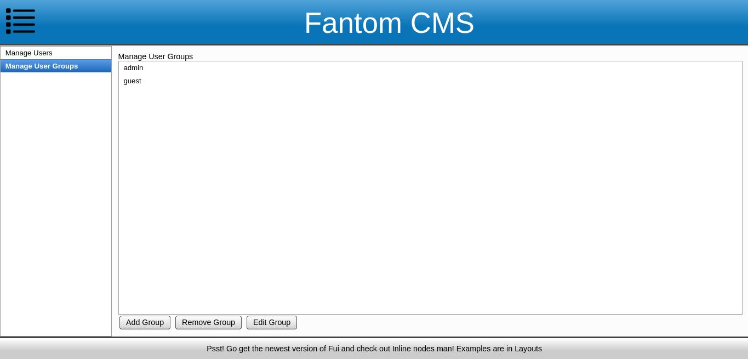
User groups page

Slide 18
Questions?

