Slide 1
Pollinator

Slide 2
Issues Addressed
ACCURACY
-Detailed modeling of complex HVAC systems (packaged and non-packaged air terminals with OpenStudio). -Multiple geometry variables of building height, shading, glazing ratios.
-Core and perimeter zones.
SPEED
-Running instances of Grasshopper on the Cloud.
-Running simulations parametrically to fully explore a parameter space.
VIZAULIZATION
-Online visualizer for the complete parameter space.
-For detailed viewing of individual schemes, zones are colored based on energy and comfort.
-3D models that fully communicate what geometry has been simulated.

Slide 3
The Process
TAKE OFF - Parametric GH definition is set up and variables defined.
POLLINATION – GH definitions with different input variables copied to the web and run in parallel
REGURGITATION – Output variables and images output to the json file.
EVAPORATION – Parameter space is browsed through and key situations are selected, downloaded and observed in more detail in the Rhino environment

Slide 4
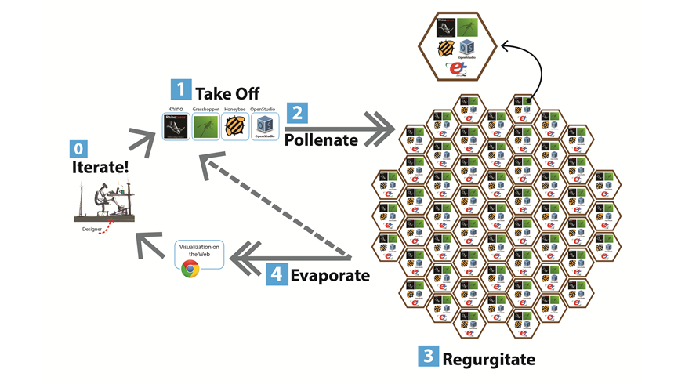

Slide 5
Future Work
Streamlining of the existing process (automating the launch with components)
Driving the visualization of the parameter space with search functions.
A download button to take the best scenarios and visualize the hourly data and 3D visualization within grasshopper and next to other design considerations.
3D visualizations in the web with 3D data output to json files.
A wider variety of more advanced systems available for simulation

