Slide 1

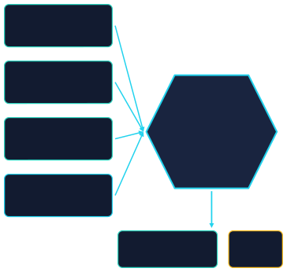

PS-019
CYBERSECURITY / PRIVACY ENGINEERING
AIORI 3 - HACKATHON
customers.csv
Personal-Data Discovery & Privacy Evidence Inventory
employees.csv
Discovery
Engine
rules + evidence
transactions.csv
An Explainable, Rule-BasedApproachtoPersonal-DataDiscovery
and Metadata Gap Identification
SQLite database
Team Name: PrivSight
Team Members: Yogesh Asnora, Honey Verma, Naitik Gupta
Institution: Invertis University
Evidence
inventory
Gap
report
Synthetic demonstration data only
PS-019 | Personal-Data Discovery & Privacy Evidence Inventory
1

Slide 2






Executive Summary
Scattered data
Organisations keepinformation across
Hard to find manually
Spotting candidate personal-data fields by hand is slow and error-prone.
Incomplete metadata
Declaredpurpose andretention
many files and databases.
information may be missing.
Our prototype automates field discovery and produces an evidence inventory.
Input
Discover
Map
Report
Review
CSV files and a structured SQLite database
Configurable rules flag candidate personal-data fields
Findings are matched to declared purpose and retention
Evidence inventory and metadata gap report (CSV / JSON)
Humans interpret evidence and make the decisions
Human reviewers stay responsible for interpretation and decisions.
PS-019 | Personal-Data Discovery & Privacy Evidence Inventory
2

Slide 3






Understanding the Problem
1
Personal data
2
Data discovery
3
Business purpose
Information that relates to an identifiable person, such as a name, email address or phone number.
Finding where such information may be stored across files and databases.
The reason the organisation says it holds a field (declared, e.g. "order communication").
4
Retention metadata
5
Evidence inventory
6
Metadata gap
How long the organisation says it keeps a field (declared, e.g. "24 months").
A single table of flagged fields with the technical evidence for each flag.
A flagged field whose declared purpose or retention information is missing or blank.
The system finds CANDIDATE fields and records technical evidence. A candidate is not a final legal determination.
PS-019 | Personal-Data Discovery & Privacy Evidence Inventory
3

Slide 4


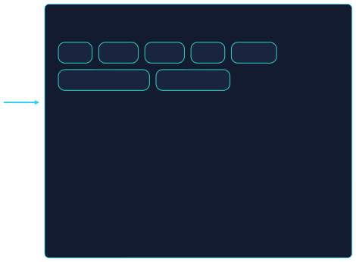




Real-World Scenario (Hypothetical)
Fictional company "Example Retail Co." - all data is synthetic
HYPOTHETICAL / SYNTHETIC
customers.csv
The challenge
name,email,phone, city
name
email
phone
city
salary
employees.csv
account_number
blood_group
name, salary, blood_group
• • • •
Which columns may hold personal data? What purpose is declared for each? What retention period is declared? Which of these answers are missing?
transactions.csv
account_number,amount, date
SQLite database
customers,employees, transactions tables
PS-019 | Personal-Data Discovery & Privacy Evidence Inventory
4

Slide 5












Why Manual Review Is Difficult
Distributed sources
Inconsistent field names
Names can mislead
Data lives in several files and databases, so one review means many places.
cust_mail, email_addr and EmailID may all mean the same thing.
A column called "email_status" may not contain email addresses at all.
Repeated inspection
Missing metadata
Reviewers need evidence
Large datasets need repeated manual checks as data changes.
Purpose and retention may be blank, and nobody notices.
A flag without a reason is hard to trust or challenge.
We do not claim measured time or cost savings; none have been benchmarked.
Takeaway: reviewers need consistent, explainable evidence - not just a list of column names.
PS-019 | Personal-Data Discovery & Privacy Evidence Inventory
5

Slide 6




Objectives and Scope
In scope
Out of scope
•Scan a structured SQL database
•Detect candidates across five configurable classes
•Use explainable rules and confidence scoring
•Map findings to declared purpose and retention
•Flag missing metadata
•Generate CSV and JSON reports
•Evaluate predictions against manually labelled ground truth
• • • •
•Scan syntheticCSV files
Automatic legalcompliance decisions
Automatic lawful-basis determination Universal data-flow discovery Guaranteed identification of every personal-data field
Production-scale scanning claims (unless actually tested)
•
PS-019 | Personal-Data Discovery & Privacy Evidence Inventory
6

Slide 7










Five Personal-Data Classes
Identity
Contact
Location
Financial
Sensitive / Health
EXAMPLE FIELDS
EXAMPLE FIELDS
EXAMPLE FIELDS
EXAMPLE FIELDS
EXAMPLE FIELDS
name, fullname, identity-
email, phone
city,postalcode, coordinates
salary,account-related,
bloodgroup,health-related fields
related fields
transaction financial info
DETECTION SIGNAL
DETECTION SIGNAL
DETECTION SIGNAL
DETECTION SIGNAL
DETECTION SIGNAL
Headertermsplus name-like values
Email-likeorphone-like value patterns
Headertermsplus place-like values
Headerterms plus numeric
Knownvaluesets such as A+, O+
or account-like values
WHY HUMAN REVIEW
WHY HUMAN REVIEW
Flags such as email_status look similar but may not hold addresses.
WHY HUMAN REVIEW
WHY HUMAN REVIEW
WHY HUMAN REVIEW
Namesalsoappear in non-
Acity alonemayidentify
Amountsmaynotrelate to
Highest-impactclass; needs
personal contexts (company, product).
little; context decides.
an individual.
careful handling.
Classification depends on the configured rules and the available evidence. Signals shown are illustrative.
PS-019 | Personal-Data Discovery & Privacy Evidence Inventory
7

Slide 8
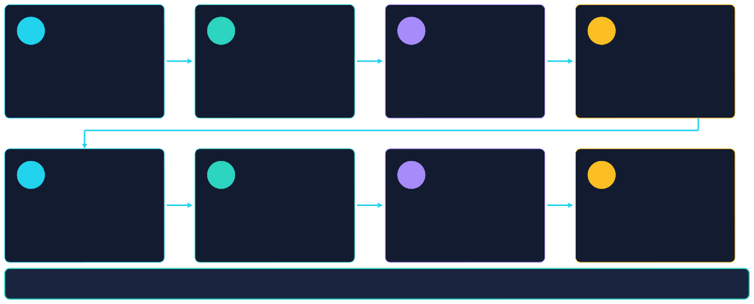
Proposed Solution: End-to-End Workflow
A rule-based Personal Data Discovery and Privacy Evidence Inventory tool
1
Read sources
2
Inspect
3
Apply rules
4
Score
CSV and SQL
schemas and values
configurable detection
evidence and confidence
5
Flag uncertain
6
Map metadata
7
Report
8
Evaluate
candidates for review
purpose and retention
inventory and gap reports
predictions vs ground truth
Every flagged field carries evidence, a confidence level and a review flag.
PS-019 | Personal-Data Discovery & Privacy Evidence Inventory
8

Slide 9
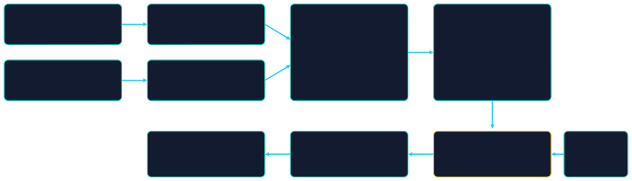


System Architecture
synthetic inputs
CSV files
CSV Scanner
Python | Pandas
Shared Detection Engine
Candidate Findings
SQLite database
SQL Scanner
SQLAlchemy | SQLite
structured source
Gap Report + Exports
Evidence Inventory
Metadata Mapper
Metadata
CSV / JSON
CSV / JSON
source_type + source_name + field_name
Registry
Ground Truth
data/ground_truth.csv
Evaluation Module
per-class precision / recall
Scanner Predictions
FastAPI + HTML / CSS / JavaScript
from candidate findings
optionalAPI-basedUI - notbuilt
IMPLEMENTED
IN PROGRESS
PLANNED / OPTIONAL
Status follows the project brief; confirm against the repository before presenting. Pytest covers the scanner.
PS-019 | Personal-Data Discovery & Privacy Evidence Inventory
9

Slide 10




Data Sources and Synthetic Dataset
VERIFY BEFORE PRESENTING
Source
customers.csv employees.csv transactions.csv customers
employees transactions data/ground_truth.csv
Type
CSV
CSV
CSV
SQLite table SQLite table SQLite table Labels
Records
150
120
175
100
80
120
84 labelled fields
Why synthetic data?
• • •
No real person is exposed during development Safe to share, demo and record
Known contents make manual labelling possible
Sample schema and row (fake values)
customer_id
name
email
city
C-0001
Test User One
user1@example.com
Sampletown
ILLUSTRATIVE EXAMPLE
PS-019 | Personal-Data Discovery & Privacy Evidence Inventory
10

Slide 11









How the Detection Engine Works
Normalize
Apply rules
Gather evidence
Score confidence
Generate finding
Normalized column name
Data type
% non-null matching
Value patterns
Lowercaseand cleaned,so
Numeric, text or date narrows what a field can be.
Regular expressions test whether values look like emails, phones, etc.
Share of non-empty values that match a pattern.
"Email_Addr" and "email" compare well.
Rules live in backend/config/rules.json (configurable)
Column email
city blood_group
Values seen email-like strings city names
A+, O+, ...
Result
Contact candidate
Location candidate Sensitive / Health candidate
A name or pattern match is evidence for review - not proof of legal classification.
PS-019 | Personal-Data Discovery & Privacy Evidence Inventory
11

Slide 12



Confidence Scoring and False Positives
Why score confidence? Similar-looking columns can mean different things.
CONCEPTUAL EXAMPLE
Column
Why it is tricky
Handling
Anatomy of a finding
Field
customers.csv / email
email
Name and values both match
Strong candidate
Evidence
name match + value pattern
email_status
May be verification status, not an address
Review required
Confidence
High (example level)
phone_verified
Likely a boolean flag
Review required
Review required
No
registration_date
Ambiguous: may or may not be personal
Review required
Explanation
Header and 100% of non-null values matched email-like pattern
Exact scoring formula and thresholds: extract from the scanner source; this diagram is conceptual.
PS-019 | Personal-Data Discovery & Privacy Evidence Inventory
12

Slide 13



Metadata Mapping
source_type
+
source_name
+
field_name
=
match key
Declared attributes: Purpose | Retention period | Metadata owner | Notice version | Notes
Complete example
ILLUSTRATIVE EXAMPLE
Incomplete example
ILLUSTRATIVE EXAMPLE
Attribute
Key
Purpose Retention Owner
Notice version
Value
csv + customers.csv + email Order communication
24 months
Customer Ops
v1.0
Attribute
Key
Purpose Retention Owner
Notice version
Value
csv + customers.csv + phone Customer support
(blank)
(blank)
v1.0
Metadata records what the organisation has DECLARED. Its existence in a registry file does not make it independently verified.
PS-019 | Personal-Data Discovery & Privacy Evidence Inventory
13

Slide 14



The Evidence Inventory
Confidence
ILLUSTRATIVE EXAMPLE
Source
Field
Class
Evidence / reason
Declared purpose
Retention
Review
Gap status
customers.csv
email
Contact
High
Name + email-like values
Order communication
24 months
No
None
customers.csv
phone
Contact
High
Name + phone-like values
Customer support
(blank)
Yes
Retention gap
customers.csv
email_status
Contact
Low
Name matches; values not email- like
Verification flag
12 months
Yes
None
employees.csv
sa lary
Finan cial
Medium
Name match; numeric values
(blank)
(blank)
Yes
Purpose + retention
One consolidated view
Reason for each flag
Machine-readable
Reviewersseefindingsanddeclared metadata
Evidencemakeseachfinding easy to confirm or
analysis.
CSVandJSONexportsfeed other tools or later
side by side.
challenge.
PS-019 | Personal-Data Discovery & Privacy Evidence Inventory
14

Slide 15






Metadata Gap Detection
ILLUSTRATIVE EXAMPLE
Case 1
Case 2
Case 3
Case 4
Purpose + retention present
No metadata gap for these two fields
Purpose missing or blank Purpose gap
Retention missing or blank Retention gap
Both missing
Purpose + retention gap
Expected gap-report fields
Source / field
Class
Gap status
• • • •
source_type, source_name field_name, detected_class purpose gap / retention gap gap status and review note
customers.csv / phone
Contact
Retention gap
employees.csv / salary
Financial
Purpose + retention gap
employees.csv / blood_group
Sensitive/Health
Purpose gap
Illustrative; confirm against reports/evidence_gaps.csv.
A metadata gap is a technical observation. It is not, by itself, proof of legal non-compliance.
PS-019 | Personal-Data Discovery & Privacy Evidence Inventory
15

Slide 16






Technical Stack Explained
Core processing
Python
IMPLEMENTED
Database
SQLite
IMPLEMENTED
Output
IMPLEMENTED
CSVand JSON
Scannerlogicand orchestration.
Localstructureddemo database.
Inventoriesandgap reports.
Pandas
SQLAlchemy
ReadsCSVsandhandles tabular data.
Connectstoandinspects SQL tables.
API and interface
FastAPI
API layer, if built.
PLANNED
Python re
Regular-expression pattern matching.
Validation and testing
Pydantic
IMPLEMENTED
JSON config
HTML / CSS / JS
Editabledetection rules, no code changes.
Lightweight UI, if built.
Validatesfindings and metadata structures.
Pytest
Unitandregression tests.
Workflow
IMPLEMENTED
Git and GitHub
Version control.
PS-019 | Personal-Data Discovery & Privacy Evidence Inventory
16

Slide 17





Evaluation Methodology
Ground truth
manual labels
Scannerpredictions
Match
Compare labels
Calculate
metrics per class
source + field
True Positive (TP)
False Positive (FP)
False Negative (FN)
Scanner flagsa fieldAND the label says it
Scannerflagsafieldbut the label says it does
Thelabelsaysitbelongs,but the scanner
belongs to that class.
not belong.
missed it.
Precision = TP / (TP + FP) Recall = TP / (TP + FN)
High precision: fewer incorrect flags.
High recall: more real positives found.
•Both matter; improving one can lower the other.
Computed separately for each of the five classes.
PS-019 | Personal-Data Discovery & Privacy Evidence Inventory
17

Slide 18



Evaluation Results
EVALUATION PENDING
Class
Identity
Contact
Location Financial Sensitive / Health
TP
FP
FN
Precision
Recall
Labelled positives
[ ] [ ] [ ] [ ] [ ]
[ ] [ ] [ ] [ ] [ ]
[ ] [ ] [ ] [ ] [ ]
[ ] [ ] [ ] [ ] [ ]
[ ] [ ] [ ] [ ] [ ]
[ ] [ ] [ ] [ ] [ ]
No results are shown yet
Caveats to state
Fillthistablefrom the latestverified evaluation run. No percentages,
• •
Small labelledsample (84 fields per the brief)
confusion matrices or accuracy claims are invented here.
Class imbalance can distort per-class metrics
PS-019 | Personal-Data Discovery & Privacy Evidence Inventory
18

Slide 19







Testing and Reliability
VERIFY BEFORE PRESENTING
36
detector tests reported as passing
Rule matching
Pattern matching
Right rule fires for the right column.
Regexes accept valid and reject invalid values.
False-positive handling
Confidence levels
Ambiguous names like email_status behave as expected.
Evidence maps to the expected level.
Source:existingdevelopmentreport.Re-run pytest to confirm before presenting.
Missing metadata
Regression protection
Blank purpose or retention is reported.
Later changes do not break earlier behaviour.
Passing unit tests show the code behaves as designed. They do not prove real-world accuracy.
PS-019 | Personal-Data Discovery & Privacy Evidence Inventory
19

Slide 20





Security, Privacy, and Limitations
Limitations
Prototype design
Needed for real deployment
• •
Synthetic demonstration data only
Core rule-based scanner needs no external LLM API
Sample values should be masked or omitted from reports where appropriate
•
Detection depends on configured rules and data quality
Unknown formats, ambiguous fields and unseen patterns may be missed
Declared metadata is not verified
Human review remains necessary
• • • • •
Access control
Audit logging
Secure storage Sensitive-output handling Appropriate security testing
•
•
• •
Not claimed: production security, legal compliance, or guaranteed detection of all personal data.
PS-019 | Personal-Data Discovery & Privacy Evidence Inventory
20

Slide 21

Demonstration Walkthrough
VERIFY BEFORE PRESENTING
# 1 2 3 4 5 6 7
Action
Show input CSVs and SQLite database Run the scanner (command below) Show candidate fields and evidence Show the metadata registry
Open reports/evidence_inventory.csv Open reports/evidence_gaps.csv Show evaluation output (if verified)
What to say
All data here is synthetic.
One command scans CSV and SQL sources.
Each finding has a class, confidence and reason.
This is what the organisation declared.
Findings and declared metadata in one table.
Blank purpose or retention is a technical gap, not a legal verdict. Ground truth vs predictions, per-class precision and recall.
$ python backend\scanner\run_scan.py
PS-019 | Personal-Data Discovery & Privacy Evidence Inventory
21

Slide 22










Expected Impact and Benefits
INTENDED BENEFITS - NOT MEASURED
Faster first pass
More consistent
Visible gaps
Explainable
Repeatable
Quicker initial field discovery than purely manual inspection, subject to validation.
The same configurable rules apply every run.
Missing declared metadata is surfaced, not overlooked.
Each flag carries evidence privacy teams can inspect.
Technical evaluation can be re-run as rules change.
These are intended benefits. None have been measured yet.
PS-019 | Personal-Data Discovery & Privacy Evidence Inventory
22

Slide 23





Technical Summary and Stack
Area Inputs Detection Evidence Metadata Outputs Evaluation Boundary
Summary
Synthetic CSV files and a SQLite database Rule-based, JSON-configured, five classes Confidence level, explanation, review flag source_type + source_name + field_name mapping Evidence inventory and gap report (CSV / JSON) Ground-truth precision / recall per class (pending) Supports human review; no legal determination
Stack
Python
Pandas
SQLAlchemy
SQLite
Python re
JSON
Pydantic
Pytest
Git / GitHub
FastAPI
HTML / CSS / JS
Discover the data. Explain the evidence. Highlight the gaps. Keep humans in control.
PS-019 | Personal-Data Discovery & Privacy Evidence Inventory
31

