Slide 1
PROJECT - 2 REPORT
ON
Empowering Business Insights
HONEY PATHANIA DR. AMARJEET KAUR
2026422 (UNI. ROLL NO.) (PROJECT SUPERVISOR)
207010 (CLASS ROLL NO.)

Slide 2
Table of CONTENTS
Introduction To Project
Objective & Scope
Hardware & Software Requirements
Technology Used
Methodology used
Data Flow Diagram
Screenshots Of Project Output
Effective Learning Outcomes
Bibliography

Slide 3
INTRODUCTION TO PROJECT
The Empowering Business Insights project aims to develop an interactive data visualization solution using Power BI to analyze the sales data of a fictional superstore.
The dashboard will provide insights into various aspects of sales performance, including revenue, profit, product categories, customer segments, and geographical trends.
Power BI, stakeholders will be able to make data-driven decisions to optimize sales strategies, improve operational efficiency, and maximize profitability.

Slide 4
Objective & scope
OBJECTIVE:
To create an intuitive and user-friendly dashboard interface for visualizing sales data.
To analyze sales performance metrics such as revenue, profit, and margins across different dimensions.
To identify trends, patterns, and outliers in sales data to uncover actionable insights.
To segment customers based on their purchasing behavior and demographics for targeted marketing.
To provide geographical analysis of sales data to identify high-potential markets and regions.

Slide 5
OBJECTIVE & SCOPE
SCOPE:
A high-level summary of key sales metrics and KPIs.
Visualizations depicting revenue trends over time and by product category.
Insights into profit margins, cost analysis, and contribution to overall profit.
Analysis of top-selling products, product categories, and inventory management.
Geographic maps showing sales distribution, regional performance, and market penetration.
Tools for users to perform custom analysis, create custom reports, and share insights with others.

Slide 6
software & hardware requirements
HARDWARE REQUIREMENTS:
Processor: i3 Onwards
Ram: 1gb, 2gb, 4gb, 8gb
Hard disk: 50GB
Monitor
Keyboard

Slide 7
software & hardware requirements
SOFTWARE REQUIREMENTS:
Operating system: windows 8.1, Linux, Mac IOS
TOOLS: Power BI, Microsoft Excel, Tableau
Database: excel file, CSV file etc

Slide 8
Technology used
Power BI Desktop
For designing and developing the interactive dashboard and Writing DAX Queries for manipulating the dataset.
Microsoft Excel
For data preparation, cleaning, and transformation.

Slide 9
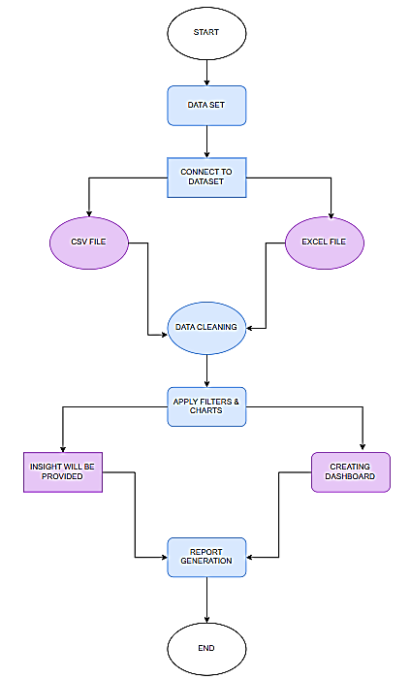
DATA FLOW DIAGRAM

Slide 10
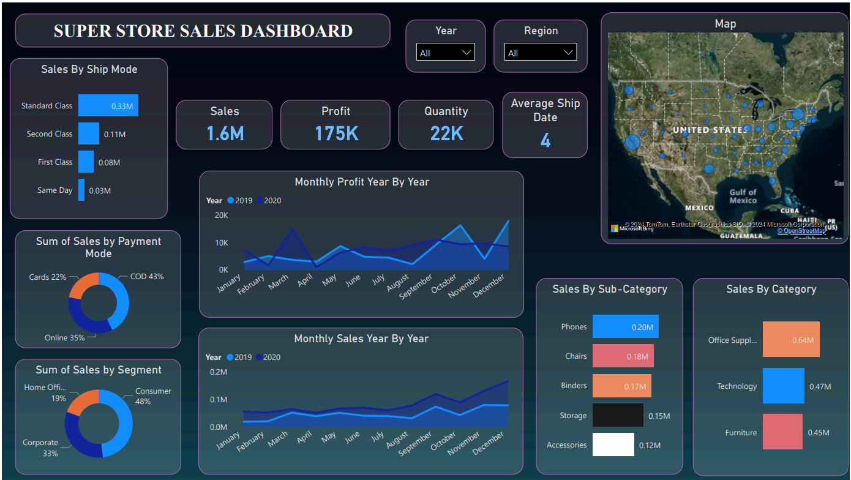
SCREENSHOT OF THE PROJECT
FIG. 1.1 WHOLE PROJECT SUMMARY IN ONE FRAME
FIG. 1.1 WITHOUT ANY ENTRY

Slide 11
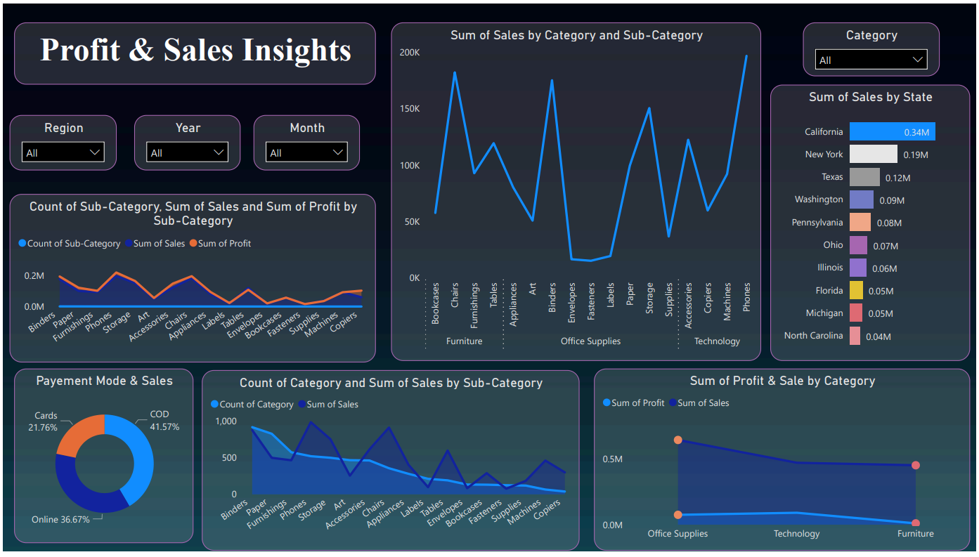
SCREENSHOT OF THE PROJECT
FIG. 1.2 PROFIT & SALES INSIGHTS

Slide 12
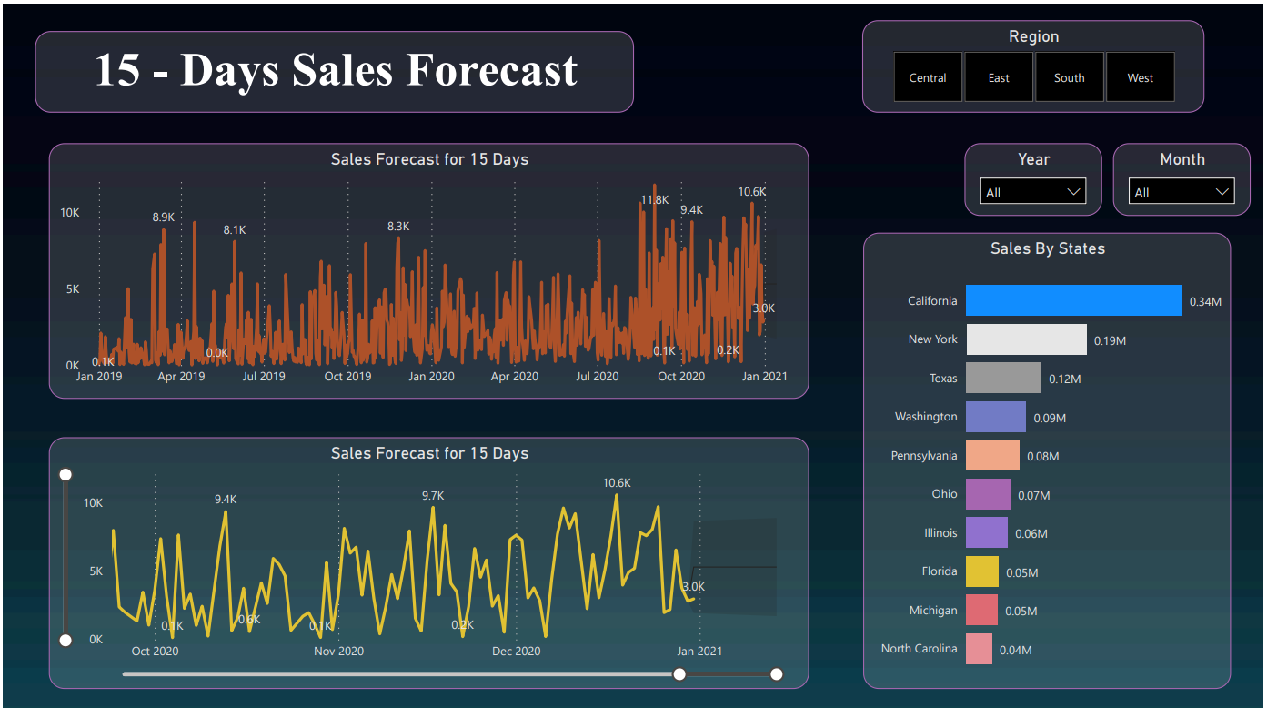
SCREENSHOT OF THE PROJECT
FIG. 1.3 SALES FORECAST FOR 15-DAYS

Slide 13
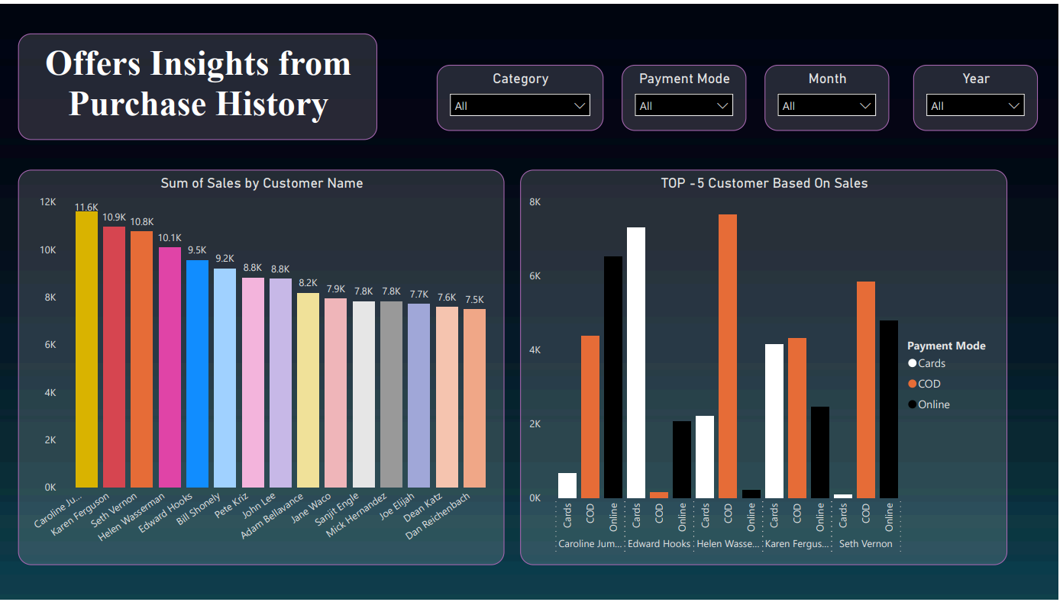
SCREENSHOT OF THE PROJECT
FIG. 1.4 OFFERS INSIGHTS

Slide 14
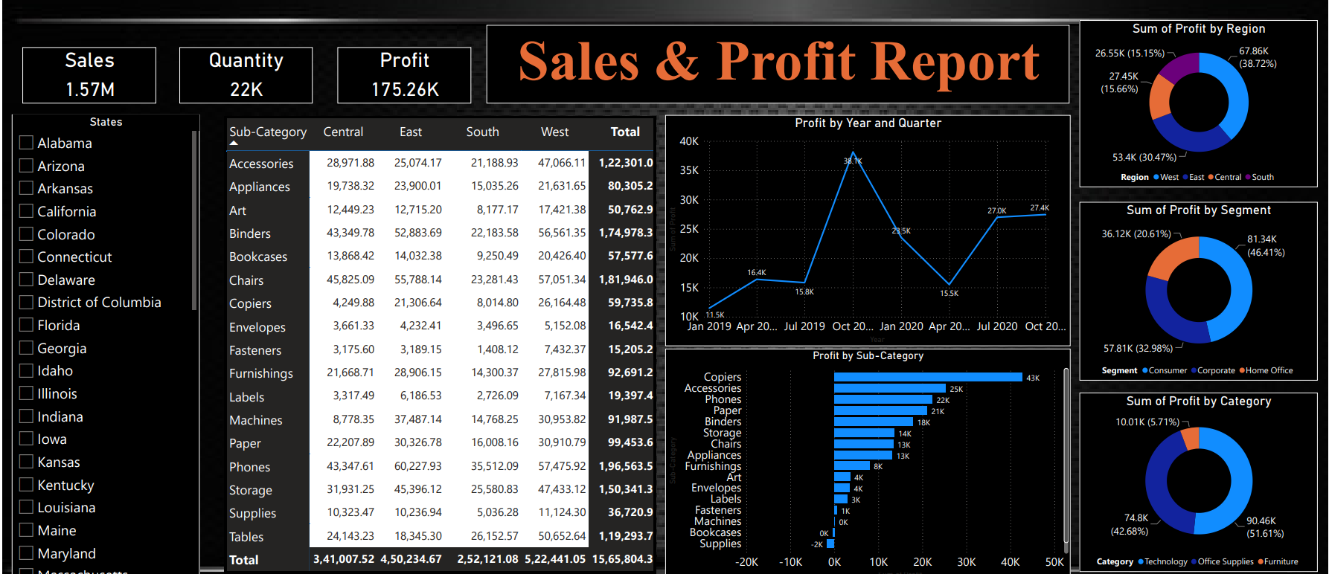
SCREENSHOT OF THE PROJECT
FIG. 1.5 REPORT GENERATION

Slide 15
Effective Learning Outcomes
Data Analysis and Preprocessing.
Understanding Power BI Fundamentals.
Data Transformation and Cleansing.
Creating Interactive Visualizations.
Easeness for Decision Making.
Dashboard and Report Creation.
Advanced Analytics and Insights Generation.
Communication and Visualization.
Project Management.

Slide 16
BIBLIOGRAPHY
Fundamental Concepts of Power BI: https://www.datacamp.com/tutorial/tutorial-power-bi-for-beginners
Power BI Tutorial: https://www.youtube.com/watch?v=H84UJn1CiWo&list=PL6Omre3duO-OGTAMuFuDOS8wMuuxmyaiX
Understanding Concept of Numpy: https://www.tutorialandexample.com/numpy-tutorial
Understanding Concept of Pandas: https://www.tutorialandexample.com/python-pandas-tutorial
Understanding Concept Of Plotly Library: https://plotly.com/python/basic-charts/

