Slide 1
NetdifusseR An R Package to Estimate Diffusion Network Models
George Gerald Vega Yon, MA
Thomas W Valente, PhD
Department of Preventive Medicine
University of Southern California

Slide 2
Acknowledgements
NetDiffuseR was created with the support of grant R01 CA157577 from the National Cancer Institute/National Institutes of Health.
It has benefited from input provided by participants of the Center for Applied Network Analysis at the University of Southern California

Slide 3
Outline
Background (15 mins)
Introduction to Diffusion Networks
Motivation for NetdiffuseR
Empirical Showcases (30 mins)
Analyze the 3 classic network diffusion datasets
They come with the package
Event History Analysis/Survival Analysis
Survival Analysis
Structural test
Simulating Diffusion Network Objects (15 mins)
How to simulate objects
Demonstrate NetdiffuseR core functions

Slide 4
Outline (2)
Reading Data (30 mins)
Data format Types
Break (10 mins)
FCTC diffusion network data (30 mins)
Background
Reading Data
Conducting Analyses
Social Networks and Networking Study (30 mins)
Background
Reading Data
Conducting Analyses
Q&A New Data (20 mins)

Slide 5
Diffusion Networks
Unique set of studies that combine social network data with behavioral data
Typically have data from zero or low prevalence to saturation or high prevalence.
Multiple time points presents unique opportunities and challenges.
Models often do not include dis-adoption but can.
Network data may be static or dynamic.
Can have one or multiple networks
We do not yet address multiple behaviors (e.g., tobacco & alcohol, awareness & adoption, VHS & Betamax)
Because we combine networks and behavior
Can have people in the network with no adoption data
People with adoption data but not in the network

Slide 6
Diffusion of Innovations
Explains how new ideas and practices spread within and between communities.
One of the oldest and richest social science theories.
Many factors have been shown to influence diffusion
Spatial
Economic
Cultural
Developmental
Biological
Etc.
One of the most significant is social networks

Slide 7
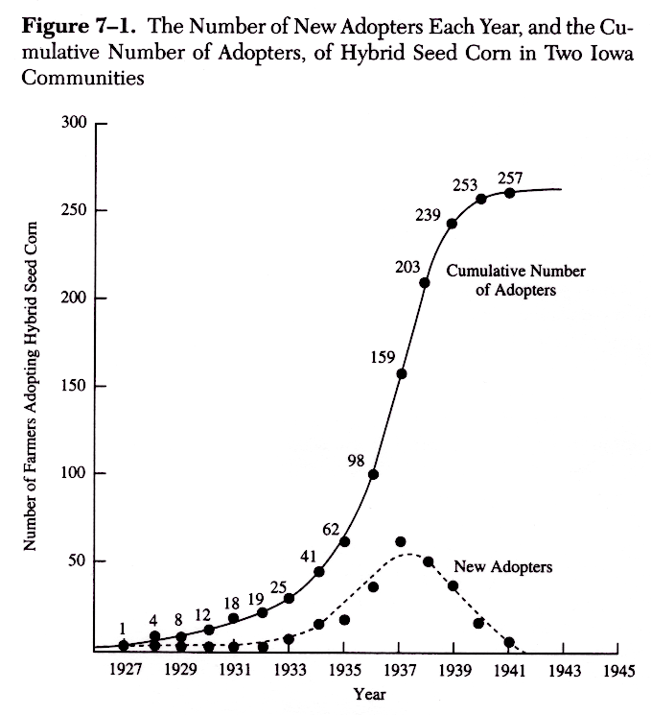
7
Notes:
7

Slide 8
Number of Diffusion Publications Over Time
8
Notes:
8

Slide 9
Diffusion Networks
A
B
F
Ego
C
E
D

Slide 10
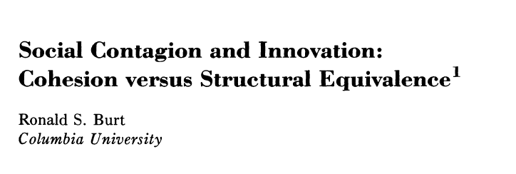

Burt’s article re-invigorated diffusion network study

Slide 11
Structural Equivalence is Associated with Influence
A
D
B
Ego
C
Burt, R. (1987) Social contagion and innovation: Cohesion versus structural equivalence.
American Journal of Sociology, 92, 1287-1335.

Slide 12
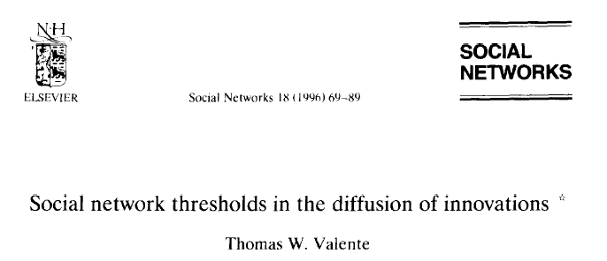
My article discovered network thresholds

Slide 13
Graph of Time of Adoption by Network Threshold for One Korean Family Planning Community
100%
Threshold
0%
Time
1973
1963

Slide 14
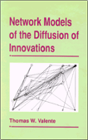
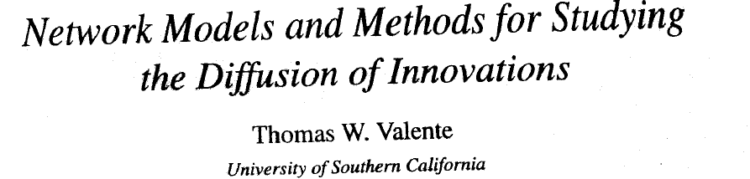
1995 Reported on the 3 Classic Studies
3 classic diffusion network datasets
MI: Medical Innovation
BF: Brazilian Farmers
KFP: Korean Family Planning

Slide 15
Diffusion Curves for Classic Studies

Slide 16
Motivation for NetdifusseR
Build a platform in which:
these, and other, exposure terms can be easily calculated and compared.
multiple dynamic and static networks can be analyzed simultaneously
Graphical displays of diffusion processes can be made
Statistical tests both conventional and new can be conducted
Integrate network diffusion models with other analytic approaches

Slide 17
6 Diffusion Network Studies 3 Early Studies Lost
Rogers’ dissertation on 2-4D Weed Spray
Rogers’ work in Colombia
Becker’s study of public health officers in New York, Ohio, and Michigan (compared 2 innovations)
Notes:
17
Valente, T.W. (1995). Network models of the diffusion of innovations. Cresskill, NJ: Hampton Press

Slide 18
3 Classic Diffusion Network Studies
 | Medical Innovation | Korean Family Planning | Brazilian Farmers
Country | USA | Korean | Brazil
# Respondents | 125 Doctors | 1,047 Women | 692 Farmers
# Communities | 4 | 25 | 11
Innovation | Tetracycline | Family Planning | Hybrid Corn Seed
Time for Diffusion | 18 Months | 11 Years | 20 Years
Year Data Collected | 1955 | 1973 | 1966
Ave. Time to 50% | 6 | 7 | 16
Highest Saturation | 89 % | 83 % | 98 %
Lowest Saturation | 81 % | 44 % | 29 %
Citation | Coleman et al (1966) | Rogers & Kincaid (1981) | Rogers et al (1970)
Notes:
18
Valente, T.W. (1995). Network models of the diffusion of innovations. Cresskill, NJ: Hampton Press

Slide 19
Reconfigure to Event History Data
Original Data |  |  | Reconfigured Data
ID Number | ID No. | Year of Adoption | New Observation Number | ID No. | Adoption Year | Indicator
1 | 1 | 6 | 1 | 1 | 1 | 0
2 | 2 | 4 | 2 | 1 | 2 | 0
3 | 3 | 2 | 3 | 1 | 3 | 0
 |  |  | 4 | 1 | 4 | 0
 |  |  | 5 | 1 | 5 | 0
 |  |  | 6 | 1 | 6 | 1
 |  |  | 7 | 2 | 1 | 0
 |  |  | 8 | 2 | 2 | 0
 |  |  | 9 | 2 | 3 | 0
 |  |  | 10 | 2 | 4 | 1
 |  |  | 11 | 3 | 1 | 0
 |  |  | 12 | 3 | 2 | 1

Slide 20
Medical Innovation (Coleman, Katz, & Menzel, 1966),
Data collected from physicians in the 4 cities in Illinois in 1955 (Galesburg, Bloomington, Quincy, & Peoria). 125 MDs interviewed about the medical practice characteristics:
3 network questions: advice, discussion, and friends.
Adoption data collected by analyzing the prescription records of local pharmacies on the first 3 days of each month.

Slide 21
Brazilian Farmers (Rogers, Ascroft, & Röling, 1970)
As part of the USAID funded 3-country study, farmers in selected villages in India, Nigeria, and Brazil were interviewed about their farming practices, use of media, and other personal characteristics. Networks were measured by asking:
their three best friends, (2) the three most influential people in their community, (3) the three most influential people regarding various farm innovations, and (4) the best person to organize a cooperative project.
Adoption data were collected by asking farmers when they first planted hybrid seed corn
Korean Family Planning (Rogers & Kincaid, 1981)

Slide 22
Korean Family Planning (Rogers & Kincaid, 1981)
Scholars at Seoul National University's School of Public Health collected data on the adoption of family planning methods among all married women of child-bearing age in 25 Korean villages in 1973 (N=1,047). Networks Network data were obtained by asking respondents to name five people from whom
they sought advice about (1) family planning, (2) general information, (3) abortion, (4) health, (5) the purchase of consumer goods, and (6) children's education.
Adoption data were obtained by asking respondents to state the year they first used a modern family planning method.

Slide 23
Likelihood of Adoption
 | Medical Innovation N=868 | Korean Fam. Planning N=6,356 | Brazilian Farmers N=10,085
Time 2 | 1.11 | 1.27 | 0.10*
Time 3 | 1.31 | 1.26 | 0.10*
Time 4 | 1.61 | 1.15 | 0.59
. . .
Time 9 |  | 2.71**
Time 10 |  | 2.00**
. . .
Time 17 | 1.24 |  | 18.1**
Time 18 |  |  | 16.9**
Time 19 |  |  | 22.26**
No Time
Tendencies
Notes:
23

Slide 24
Likelihood of Adoption
 | Medical Innovation N=868 | Korean Fam. Planning N=6,356 | Brazilian Farmers N=10,085
Time 2 | 1.11 | 1.27 | 0.10*
Time 3 | 1.31 | 1.26 | 0.10*
Time 4 | 1.61 | 1.15 | 0.59
. . .
Time 9 |  | 2.71**
Time 10 |  | 2.00**
. . .
Time 17 | 1.24 |  | 18.1**
Time 18 |  |  | 16.9**
Time 19 |  |  | 22.26**
Adoption
Occurs
Late
Notes:
24

Slide 25
Likelihood of Adoption
 | Medical Innovation N=868 | Korean Fam. Planning N=6,356 | Brazilian Farmers N=10,085
Time 2 | 1.11 | 1.27 | 0.10*
Time 3 | 1.31 | 1.26 | 0.10*
Time 4 | 1.61 | 1.15 | 0.59
. . .
Time 9 |  | 2.71**
Time 10 |  | 2.00**
. . .
Time 17 | 1.24 |  | 18.1**
Time 18 |  |  | 16.9**
Time 19 |  |  | 22.26**
Negative
Tendency
Early
Shifts to
Positive
Later
Notes:
25

Slide 26
Likelihood of Adoption
 | Medical Innovation N=868 | Korean Fam. Planning N=6,356 | Brazilian Farmers N=10,085
Detail Agents | 1.27
Science Orientation | 0.60**
Journals Subs. | 1.63*
# Sons |  | 1.43**
Media Camp. Exp. |  | 1.10**
Income |  |  | 1.18**
Visits to City |  |  | 1.00
Out Degree | 0.96 | 1.05 | 0.98
In Degree | 1.04 | 1.06** | 1.02*
Exposure (Cohesion) | 0.94 | 1.16 | 2.16**
Notes:
26

Slide 27
R Code: “Classics Run V6”

Slide 28
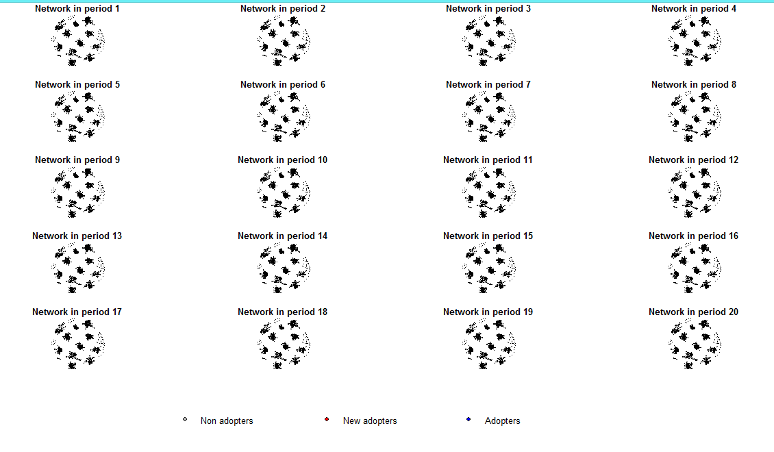
Plots for BF Diffusion Data

Slide 29
Simulating Diffusion
Simulation is important to explore theoretical dimensions of diffusion networks:
Seed nodes (comparing OL, random, and marginal)
Network structure (comparing scale-free, Bournoulli, Small world)
Threshold levels/distribution (increase variance)

Slide 30
Conditions
 | Marginal | Random | Central
Bournouli
Small-world
Scale-free

Slide 31
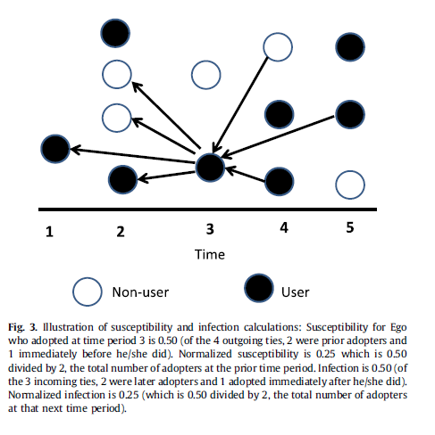
Influence & Susceptibility

Slide 32
Reading Data Challenges
Merging attribute and network data
Nominated but no attribute data
Attribute data no network data
Data file formats
Single flat file
2 files: edgelist and attribute file (flat)
Cohort studies: 1 file separate waves of data

Slide 33
Formats
Survey Data (static & dynamic)
Edge-list and Attribute data
Panel Data
STATNET, Igraph, ….

Slide 34
Input Types: Single Flat File
Flat File with IDs, Nodelist, and Time of Adoption
Typically a retrospective study
Examples, Medical Innovation, Korean Family Planning; Brazilian Farmers

Slide 35
Input Types: Double Files
Edgelist Attributes
Files will have mostly matching IDs
One or both files may contain time information
Edgelist may also, potentially, contain values or
spell information

Slide 36
Input Types: Classic Cohort/Longitudinal
IDs and Nodelist Network data
Behavior is typically binary (e.g., ever smoked) or potentially valued (e.g., # of cigarettes
Examples SNS

Slide 37
Survival Analysis
Rather the event history approach, some recommend survival models
Buyer Beware

Slide 38
FCTC Diffusion Study
Multiple networks (6 in this analysis)
Static and dynamic networks
Incorporate static and dynamic attributes

Slide 39
FCTC (Framework Convention on Tobacco Control)
In May 2003, the 56th World Health Assembly unanimously adopted the WHO Framework Convention on Tobacco Control (FCTC)
Limits tobacco marketing and advertising
Imposes warning labels on packaging (30%+)
Encourages smoke-free workplaces
Addresses tobacco smugglings and increased tobacco taxes
As of January 2012, 163 member states had ratified the FCTC (85%) [today- 180]
39
Notes:
39

Slide 40
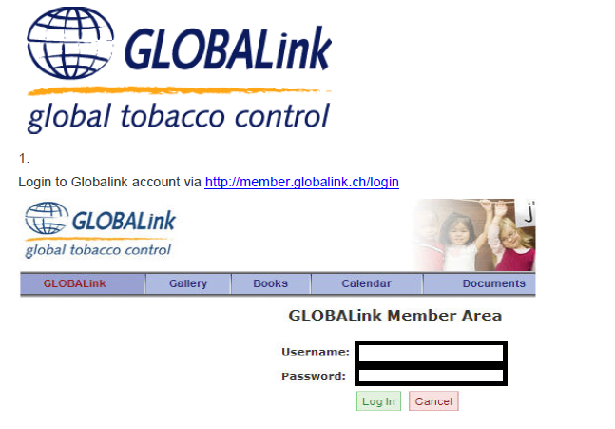

Slide 41
GlobalLink (GL)
Online forum and exchange related to tobacco control policies and procedures
Sponsored by the International Union for Cancer Control (IUCC)
Initially created in 1992
Members have to be recommended by at least 2 people
System was moved to another host and re-started as of January 1, 2012.
At that time had about 7,300 members
41
Notes:
41

Slide 42
Average Number of Members per Country per Year

Slide 43
Earlier Results on Treaty Ratification
Exposure to treaty ratifications by countries who subscribed to the same groups/services on GlobaLink was Associated with Ratification

Slide 44
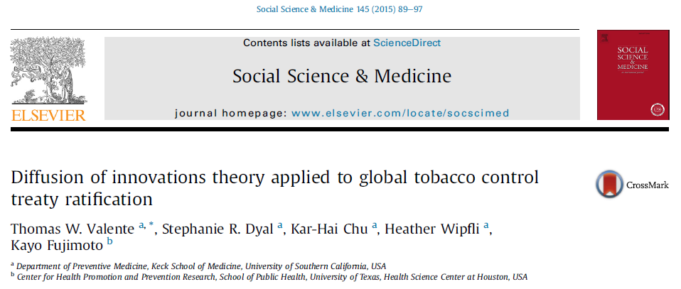

Slide 45
Timing of Treaty Ratification Depends on:
Country attributes (population, tobacco production, income, etc.)
Exposure to treaty ratification via networks:
Distance (Recoded as Closeness)
General Trade
Tobacco Trade
GLOBALink Referrals
GLOBALink Posts
GLOBALink Co-Subscriptions

Slide 46
Predictors of FCTC Adoption: Time
 | Adoption (N=754) AORs
Constant | 0.005**
Year
2004 | 13.2**
2005 | 38.5**
2006 | 25.3*
2007 | 13.7
2008 | 19
2009 | 10.1
2010 | 7.88

Slide 47
Predictors of FCTC Adoption: Exposure
 | Adoption (N=754) AORs
Network Exposures
Geographic distance | 1.56
General trade | 1.1
Tobacco trade | 0.46
GL referrals - | 0.45
GL posts | 0.51
Subscription co-membership | 4.76**

Slide 48
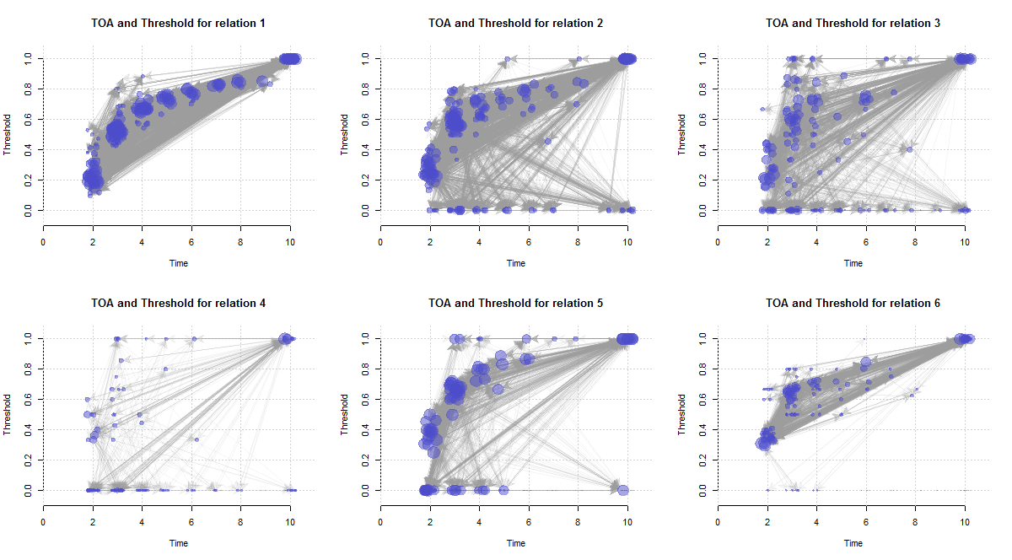
Threshold Graphs for FCTC

Slide 49
R code: “fctc run v6

Slide 50
SNS Behavior Change Study

Slide 51
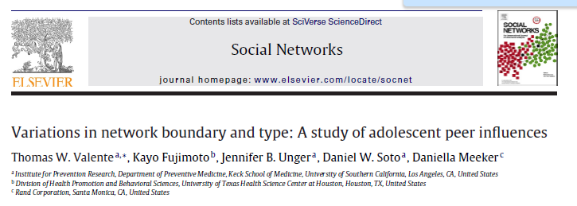


Slide 52

Grade-level friendship nominations

Slide 53
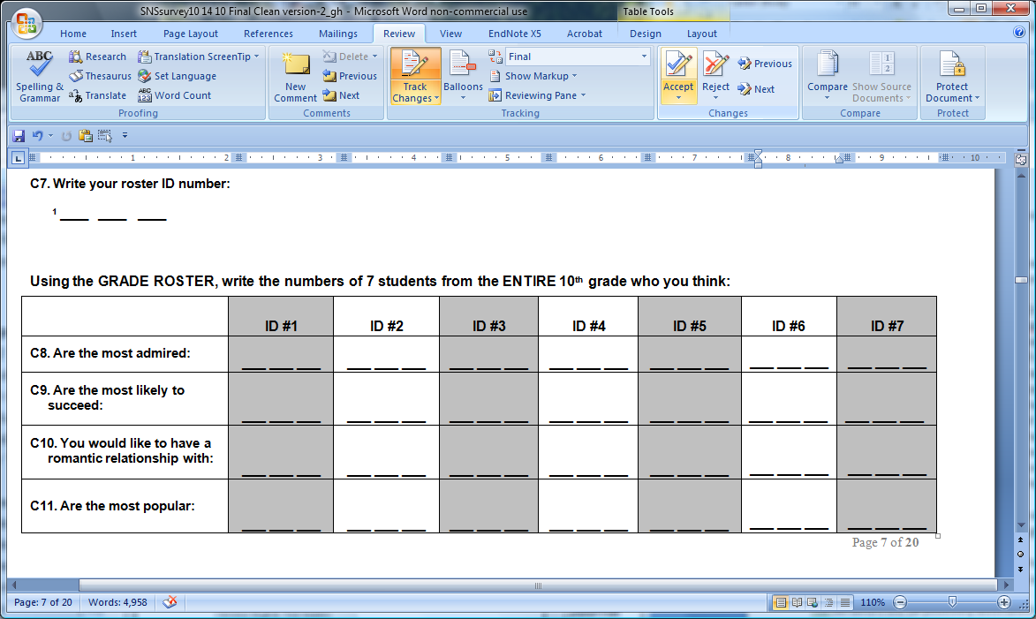
Four additional networks:

Slide 54
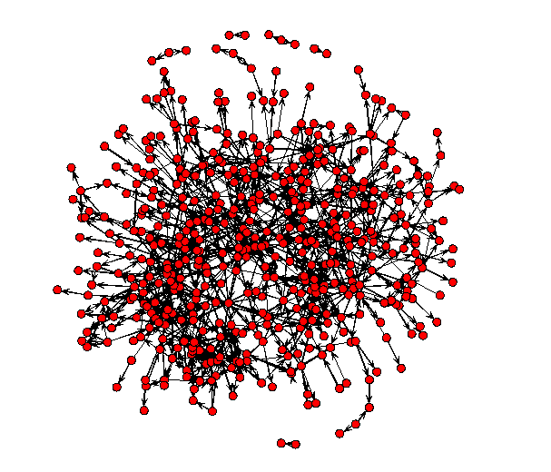
sns_net2: no isolates

Slide 55
Other Features: Extending Exposure
Thresholds
Indirect exposures
Attribute weighted
Network weighted (i.e., centrality)
Infectiousness
Susceptibility
Ego-alter table
Graphing!

Slide 56
Indirect Exposures Matter
A
B
G
F
Ego
C
H
L
I
E
D
J
K

Slide 57
Alter Attributes May Affect Influence
Male
A
B
Female
F
Ego
C
C
E
D

Slide 58
Centrality Weighted Exposures
A
B
F
Ego
C
E
D

Slide 59
Ego-Alter Behavior Table
 |  |  | Alter
 | Behav T1 |  | No |  | Yes
 |  | Behavior T2 | No | Yes | No | Yes
Ego | No | No | Constant Homophily Non-use | Alter Created Heterophily | Alter Influenced | Constant Heterophily
 |  | Yes | Ego Created Heterophily | Simultaneity | Divergence: Changing Heterogeneity | Ego Selection
 | Yes | No | Selection on Quiting | Alter Changes | Simultaneous Quiting | Alter Not Effected
 |  | Yes | Constant Heterophily | Alter Selection | Alter Quits | Constant Homophily Use

