Slide 1
A_Systematic_Study_of_DDR4_DRAM_Faults_in_the_Field
2023 IEEE International Symposium on High-Performance Computer Architecture (HPCA)
23集成3班 黄海鸿

Slide 2
行业PPT模板http://www.1ppt.com/hangye/
目录页丨Contents
01
研究背景与目的
研究方法
02
03
研究结果与结论
参考文献
04

Slide 3
abstract
This paper presents a study of DDR4 DRAM faults in a large fleet of commodity servers, covering several billion memory device-hours of data. The goal of this study is to understand faults in DDR4 DRAM devices to measure the efficacy of existing hardware resilience techniques and aid in designing more resilient systems for future large-scale systems.
The study has several key findings about the fault characteristics of DDR4 DRAMs and adds several novel insights about system reliability to the existing literature. Specifically, the data show sixteen unique fault modes in the DDR4 DRAM under study, including several that have not been previously reported. Over 45% of the faults that occurred affected multiple DRAM bits. The time-to-failure characteristics of faults internal to the DRAM die differ from those external to the DRAM die. We also examine faults from multiple DRAM vendors, finding that fault rates vary by more than 1.34x among vendors. Finally, we use the data to compare chipkill ECC and an ECC that covers a DDR5 “bounded fault.” Given the fault rates in this data, a bounded fault ECC increases the rate of faults that cause uncorrectable errors by up to 5.71 FIT per DRAM device compared to chipkill ECC.

Slide 4
01
背景与目的

Slide 5
As data centers computation requirements grow, the total memory capacity provisioned is expected to grow as well.
数据中心计算需求增长，内存容量需求增加
DRAM故障是服务器失败的主要原因之一
One key to designing a reliable system is to understand the nature of faults that can occur.
了解DRAM故障特点对设计高可靠性系统至关重要

Slide 6
DDR内存带ECC是什么意思?是服务器专用的吗?
在电子数字的世界里，所有的信息都是以简单的“0”与“1”表示；不过当数据在电子元件间进行传递时，是有可能发生数据“误传”的情形，也就是说原来该是0的比特数据，却被误植为1的比特数据，而产生错误。其可能发生的原因相当多，包括电子噪声、元件硬件上的问题，或是传输接口不稳等，都可能造成如此的结果。
这种状况若发生在存储器中，所带来的灾难则是可大可小。比如在游戏中，你可能对画面上突然显色不正常的小方块不以为意，但此时若不是在游戏中，而是正在进行硬盘重组的工作，相信结果将令你花容失色，惊叫起来。也正因为如此，在存储器中便发展出ECC与Parity Check等的检错方式，希望能降低数据传输的错误。
ECC工作原理
ECC采用数据块（block）概念与复杂的演算方法来修正数据。因此不仅能检测多位比特错误，还能进行修正单一比特的错误。以168针的DIMM存储器模块来说，若以64bits为一数据块单位，便需要8bits的容量来作为ECC之用（32bits则需7bits），因此总数据宽度便与168针的Parity存储器相同。

Slide 7
研究方法
02

Slide 8
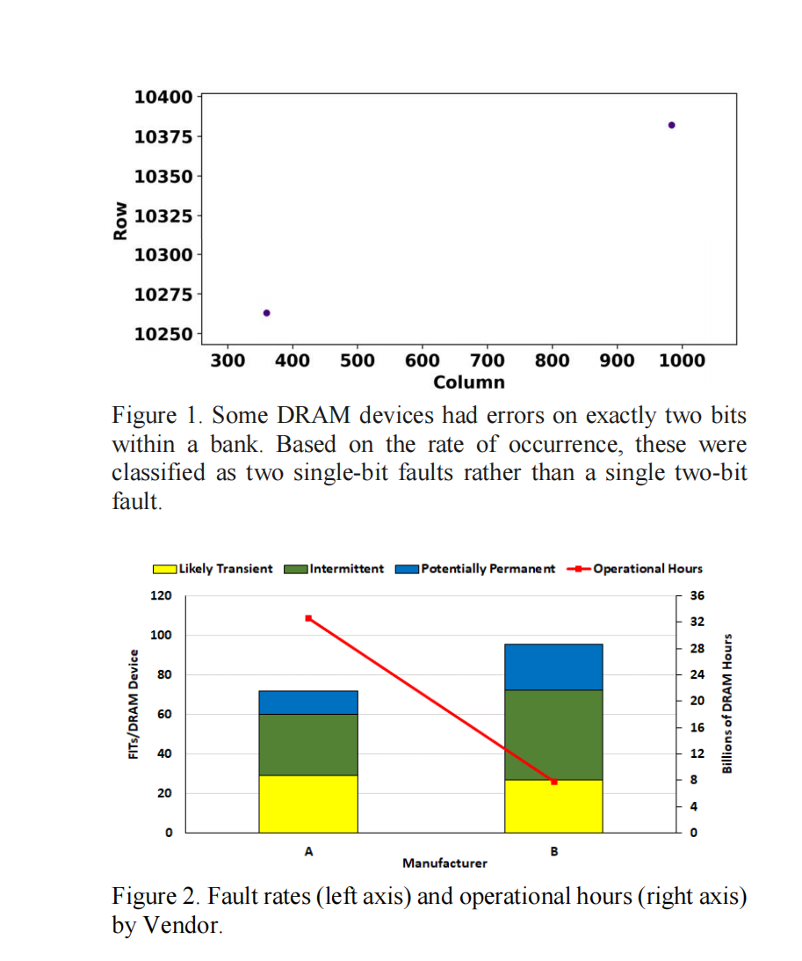
方法
01
数据采集
02
根据发生率，将其划分为两个单位故障，而不是单个二位故障。
故障分类 For multi-bit fault modes that span more than one fetch
from DRAM (e.g., multiple cache lines), we classify a fault
as likely transient if all errors from that fault occur within a
24-hour interval (i.e., one patrol scrub interval).
由供应商提供的故障率（左轴）和运行时间（右轴）

Slide 9
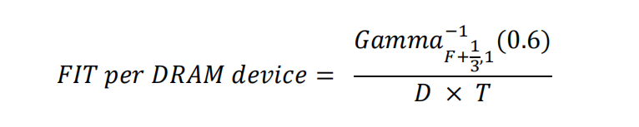
03
Using this formula, based on the Kerman neutral prior [35], improves the accuracy of the confidence bound for fault modes with low observed failure rates (e.g., zero maximum likelihood estimate FIT).
故障率计算

Slide 10
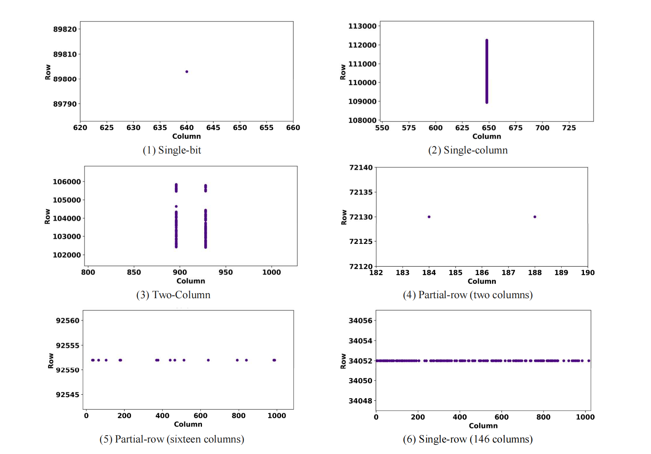
故障模式
Single-bit: The fault affects a single DRAM
bitcell (Fig. 3.1).
Single-column: The fault affects a single DRAM
column, but spans multiple rows (Fig. 3.2).
Two-column: The fault affects two columns in a
bank spanning multiple rows (Fig. 3.3).
Partial-row: The fault affects between two and
128 columns in a row (Fig. 3.4 and 3.5).
Single-row: The fault affects between 128 and
1024 columns in a row (Fig. 3.6 and 4.1).

Slide 11
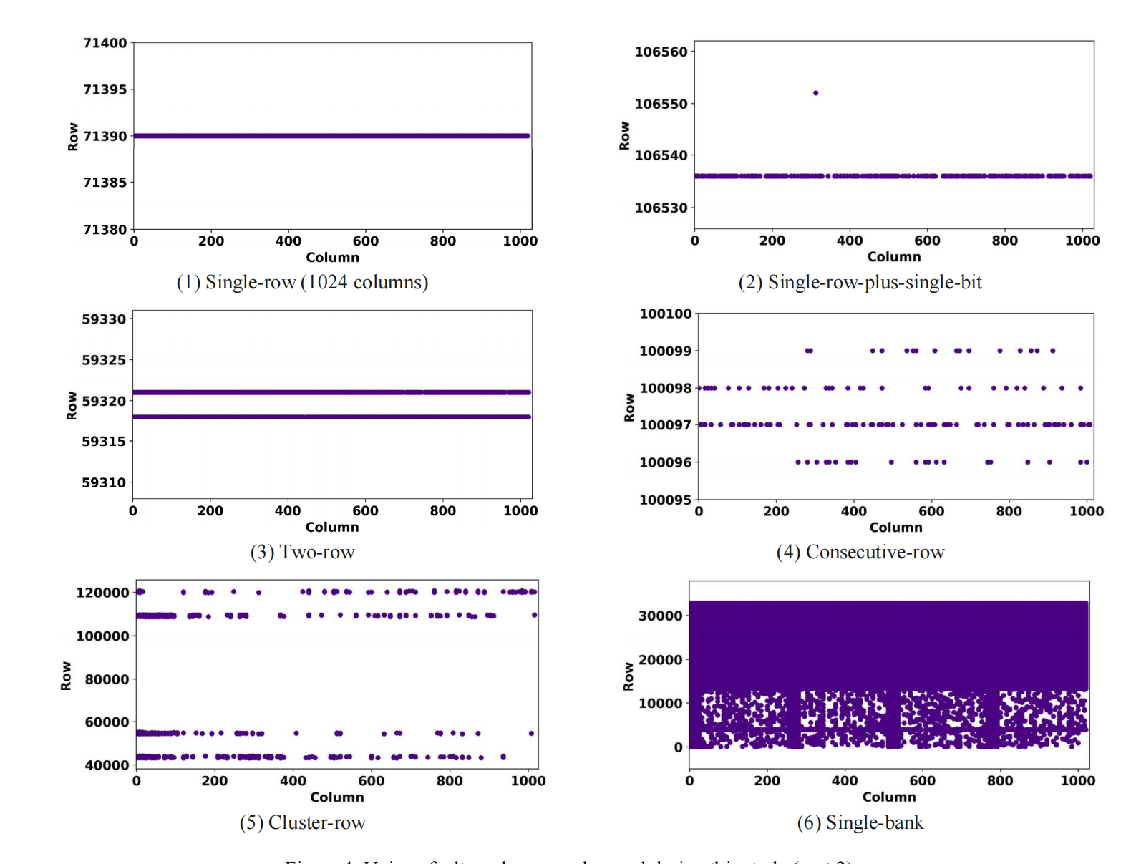
Single-row: The fault affects between 128 and
1024 columns in a row (Fig. 3.6 and 4.1).
Single-row-plus-single-bit: The fault affects a
single row, plus an additional bit in the same bank
(Fig. 4.2). The additional bit is typically only a
few rows away from the faulty row.
Two-row: The fault affects exactly two rows in
the same bank (Fig. 4.3). The rows are typically
close together but non-adjacent.
Consecutive-row: The fault affects 4 or 8
consecutive rows in a single bank (Fig. 4.4).
Cluster-row: The fault affects multiple clusters
of rows in a bank (Fig. 4.5).
Single-bank: The fault affects multiple rows in a
bank (more than a quarter of all rows) and does
not fall into one of the preceding categories (Fig.
4.6).

Slide 12
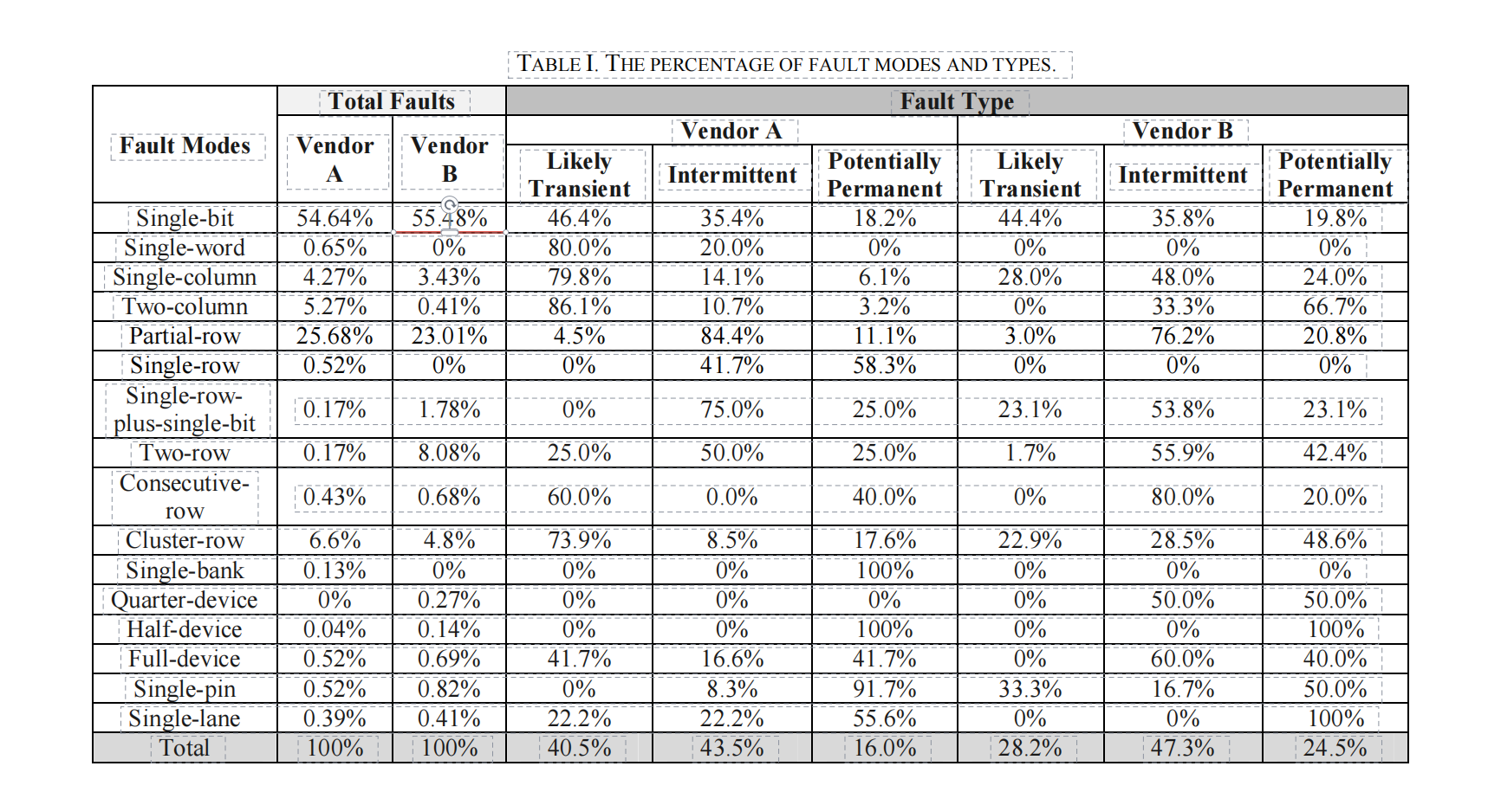

Slide 13
03
结果与结论

Slide 14
结果
多位故障
内部故障(如行故障)和外部故障(如引脚故障)的故障率曲线存在显著差异
约45%的故障影响多位，与DDR3相比有显著变化
YOUR
TITLE
多种故障模式
比较不同的ECC方案
发现了16种独特的故障模式，包括影响DRAM设备四分之一、一半和全部的故障
仅校正限定故障的ECC可能会增加导致不可纠正错误的故障率

Slide 15


结论
DRAM vendors can design more resilient DRAM devices by
understanding faults in current devices; processor vendors
can implement a range of ECCs targeting different reliability
levels; system designers can choose which ECCs to use based
on reliability targets for their system; and the industry (e.g.,
JEDEC) can influence future DRAM architectures.
需要强ECC、面临持续的内存可靠性挑战、Chipkill ECC仍有效
our hope is that this work will help to influence
the industry to continue improving DRAM reliability to
ensure that DRAM technologies continue to be appropriate
for mission-critical server applications.
希望推动行业继续提高DRAM可靠性，确保其适用于关键任务服务器应用

Slide 16
04
引用文献

Slide 17
REFERENCES
[1]
V. Sridharan, N. DeBardeleben, S. Blanchard, K. B. Ferreira, J. Stearley, J. Shalf and S. Gurumurthi, "Memory errors in modern systems: The good, the bad, and the ugly," in international Conference on Architectural Support for Programming Languages and Operating Systems (ASPLOS), 2015.
[2]
V. Sridharan and D. Liberty, "A Study of DRAM Failures in the Field," in SC’12: the International Conference on High Performance Computing, Networking, Storage and Analysis, 2012. [3] B. Schroeder and G. A. Gibson, "A Large-Scale Study of Failures in High-Performance Computing Systems," in International Conference on Dependable Systems and Networks (DSN), 2006.
[3] B. Schroeder and G. A. Gibson, "A Large-Scale Study of Failures in High-Performance Computing Systems," in International Conference on Dependable Systems and Networks (DSN), 2006.
[4]
J. Chen, X. Jiang, Y. Zhang, L. Liu, H. Xu and Q. Liu, "CARE: Coordinated Augmentation for Elastic Resilience on DRAM Errors in Data Centers," in IEEE International Symposium on HighPerformance Computer Architecture (HPCA), 2021.
[5] J. Meza, Q. Wu, S. Kumar and O. Mutlu, "Revisiting memory errors in large-scale production data centers: Analysis and modeling of new trends from the field," in 45th Annual IEEE/IFIP International Conference on Dependable Systems and Networks (DSN), 2015.

Slide 18

谢谢聆听

