Slide 1
생물정보학실습

Slide 2
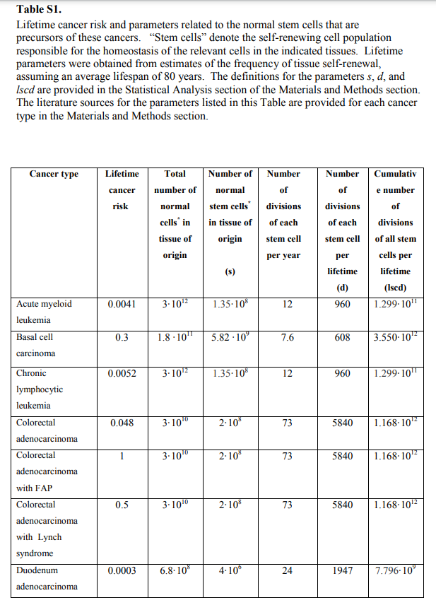
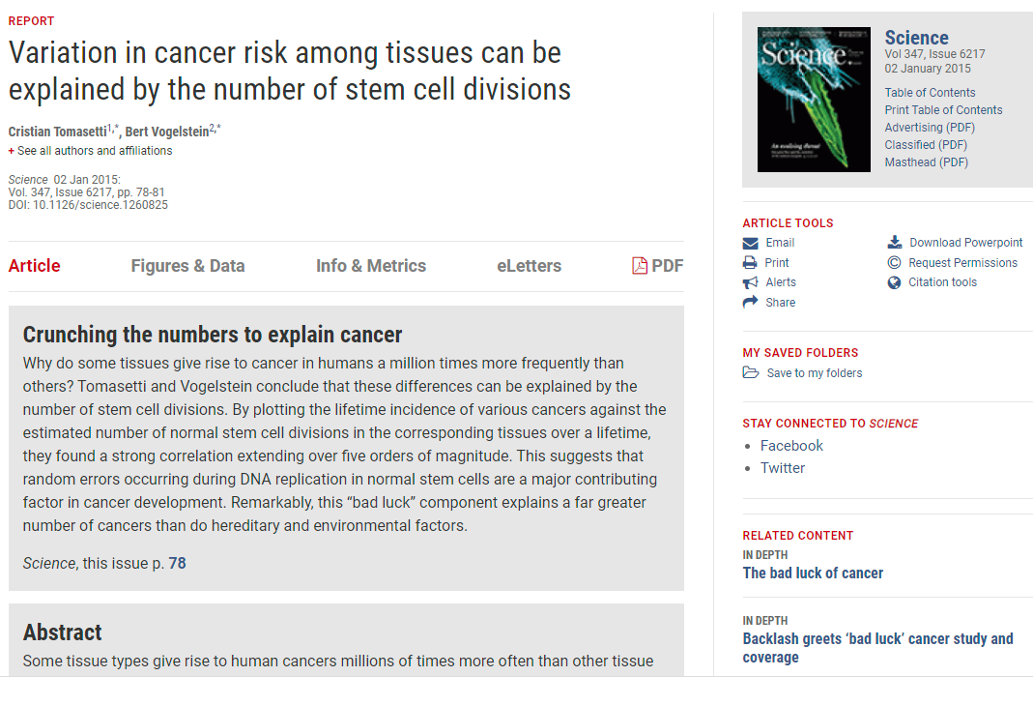
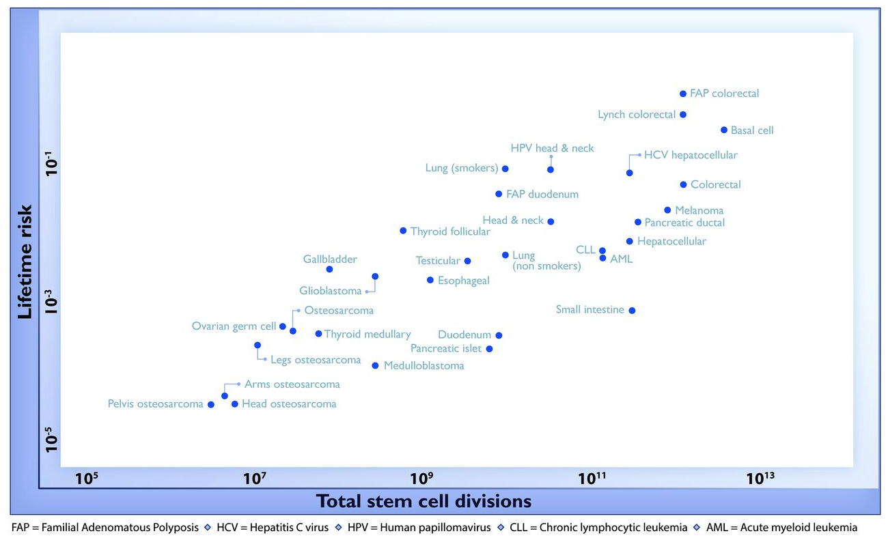

Slide 3
31개 cancer types을 평가
Acute myeloid leukemia
Basal cell carcinoma
Chronic lymphocytic leukemia
Colorectal adenocarcinoma
Colorectal adenocarcinoma with FAP
Colorectal adenocarcinoma with Lynch syndrome
Duodenum adenocarcinoma
Duodenum adenocarcinoma with FAP
Esophageal squamous cell carcinoma
Gallbladder non papillary adenocarcinoma
Gilblastoma
Head & neck squamous cell carcinoma
Head & neck squamous cell carcinoma with HPV-16
Hepatocellular carcinoma
Hepatocellular carcinoma with HCV
Lung adenocarcinoma (nonsmokers)
Lung adenocarcinoma (smokers)
Medulloblastoma
Melanoma
Osteosarcoma
Osteosarcoma of the arms
Osteosarcoma of the head
Osteosarcoma of the legs
Osteosarcoma of the pelvis
Ovarian germ cell
Pancreatic ductal adenocarcinoma
Pancreatic endocrine (islet cell) carcinoma
Small intestine adenocarcinoma
Testicular germ cell cancer
Thyroid papillary/follicular carcinoma
Thyroid medullary carcinoma
Lifetime cancer risk
Total number of normal cells in tissue of origin
Number of normal stem cells in tissue of origin
Number of divisions of each stem cell per year
Number of divisions of each stem cell per lifetime
Cumulative number of divisions of all stem cells per lifetime
FAP=Familial Adenomatous Polyposis, HCV=Hepatitis C virus

Slide 4
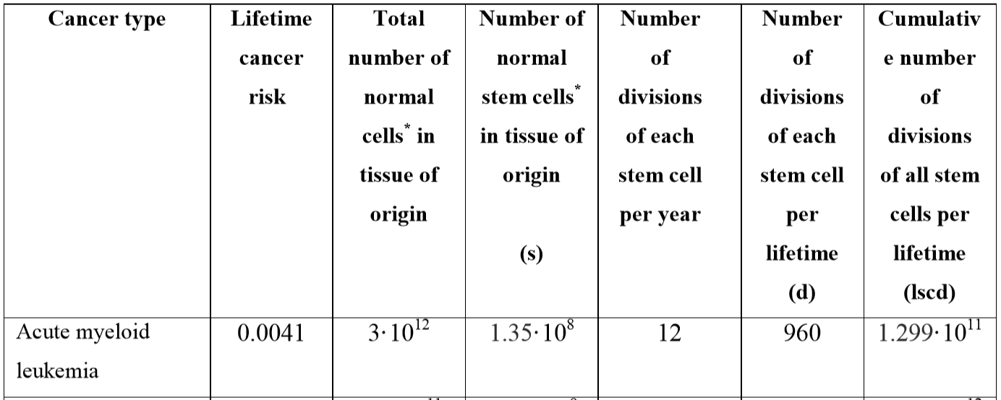
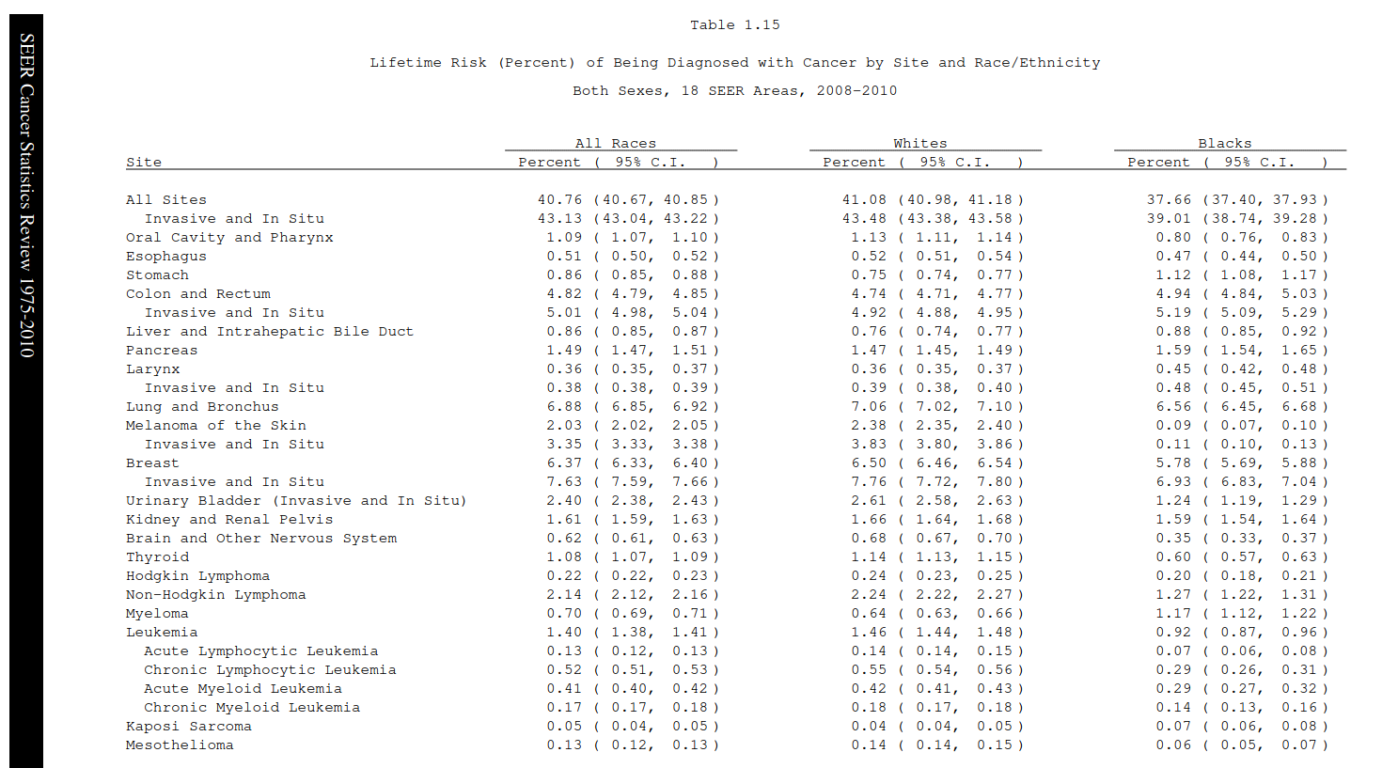
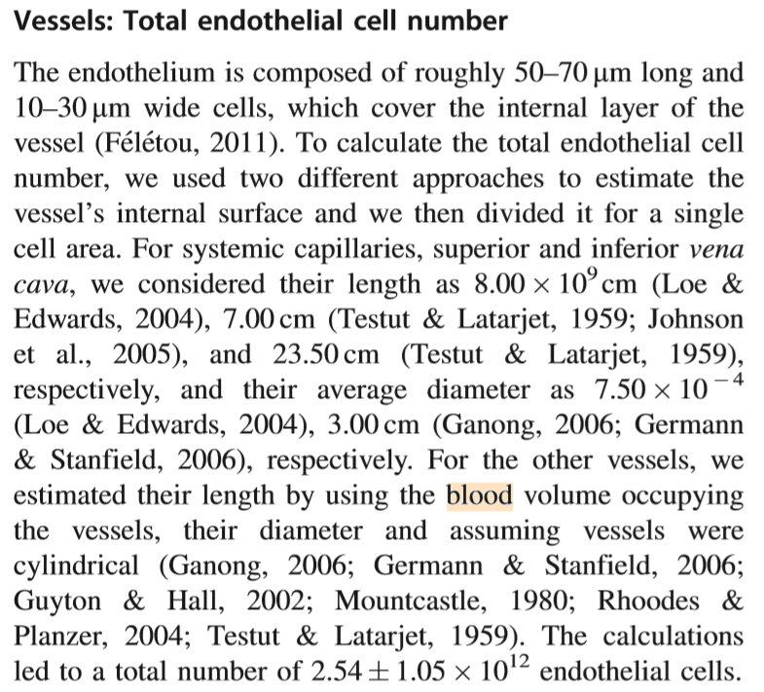
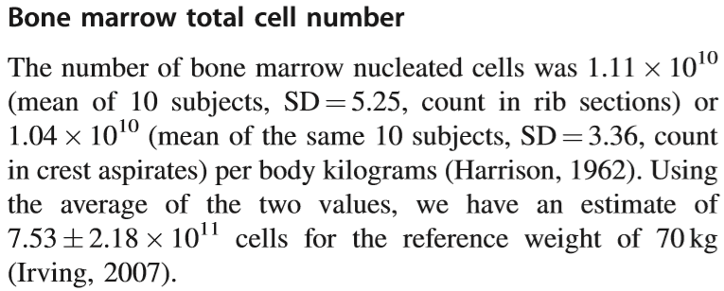
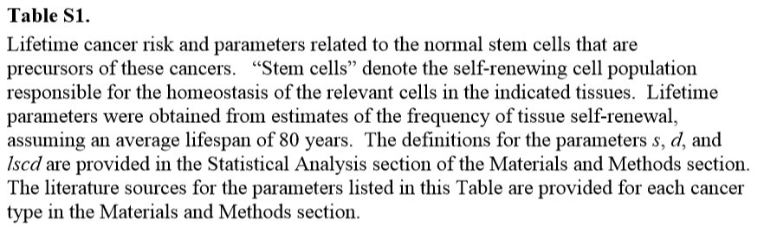
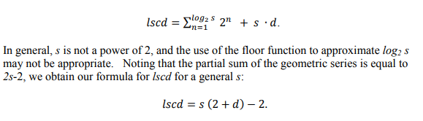
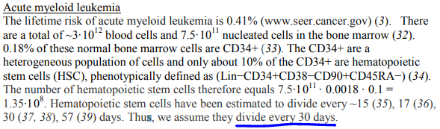
Acute myeloid leukemia
[3]
[32]
80*12
[32]
[supple]
[33]
[supple]
[supple]

Slide 5

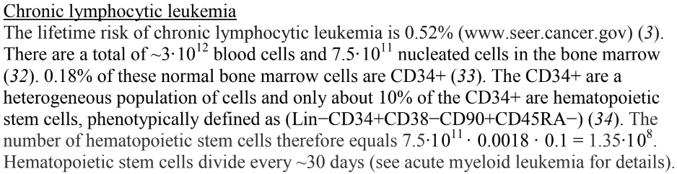
Chronic lymphocytic leukemia
[3]
80*12
[supple]
[supple]
[32]
[supple]
[32]
[33]

Slide 6
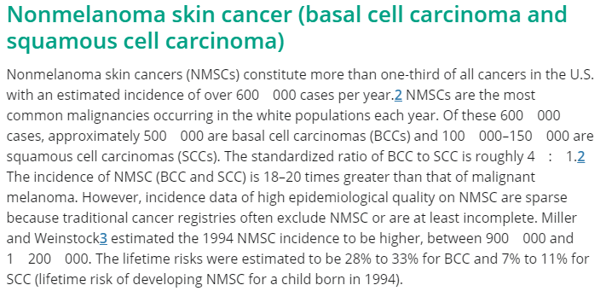
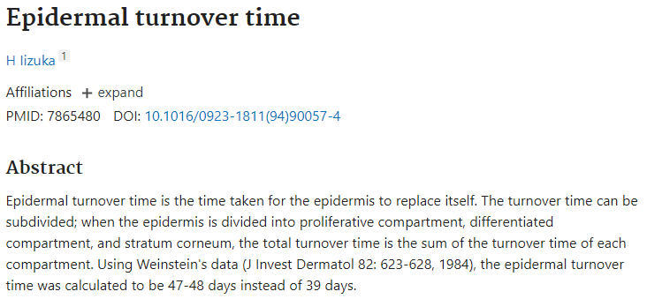
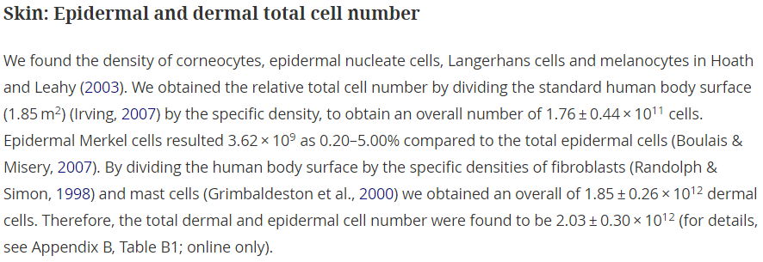
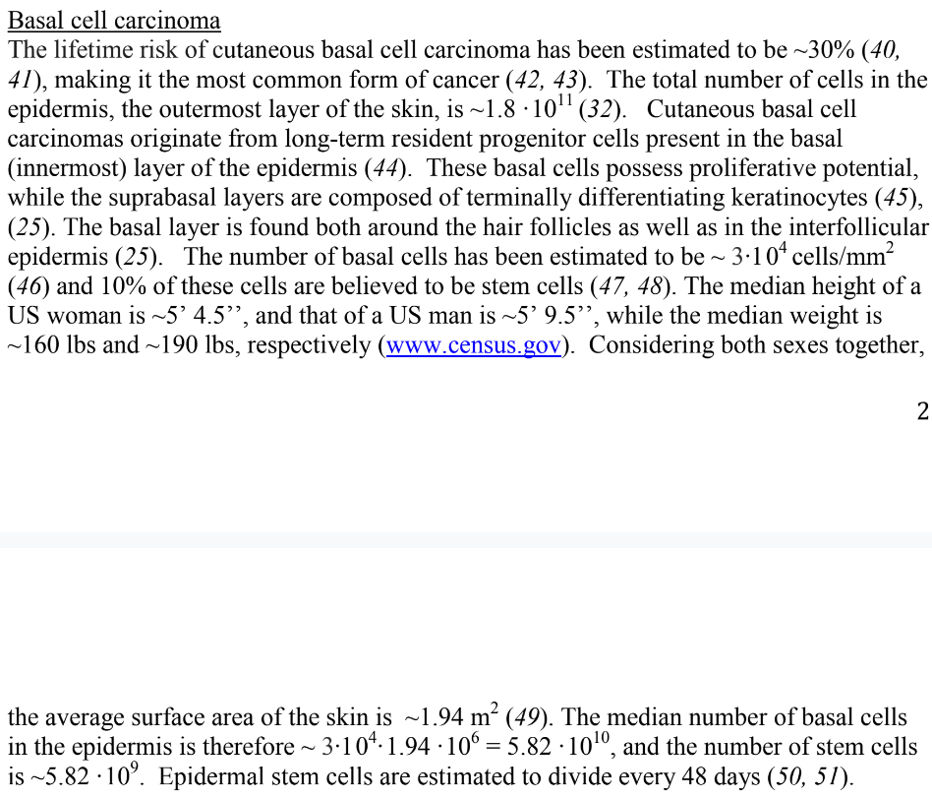
Basal cell carcinoma
[40]
80*7.6
[51]
[supple]
[32]
[supple]

Slide 7
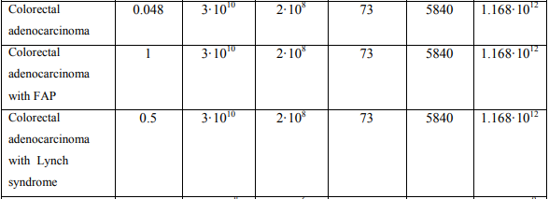
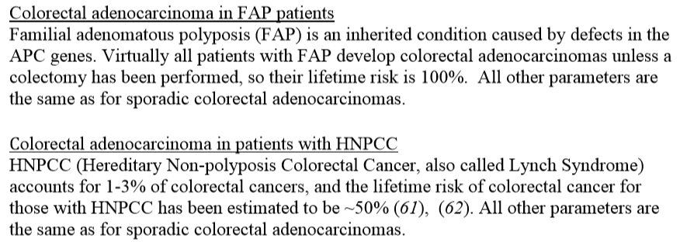
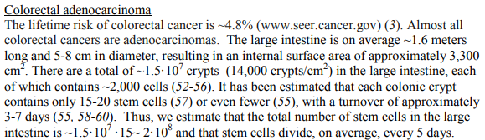
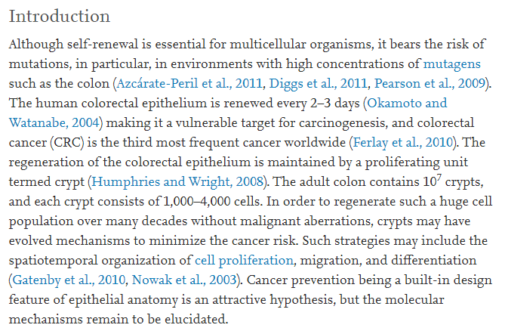
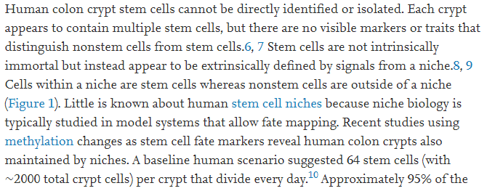
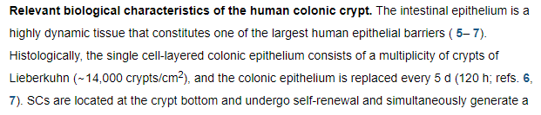
Colorectal adenocarcinoma
[3]
[supple]
[supple]
[supple]
[56]
[52]
[53]
[57]

