Slide 1
Data Analysis Presentation
Analyzing Relationships between Age and Various Numerical Columns

Slide 2
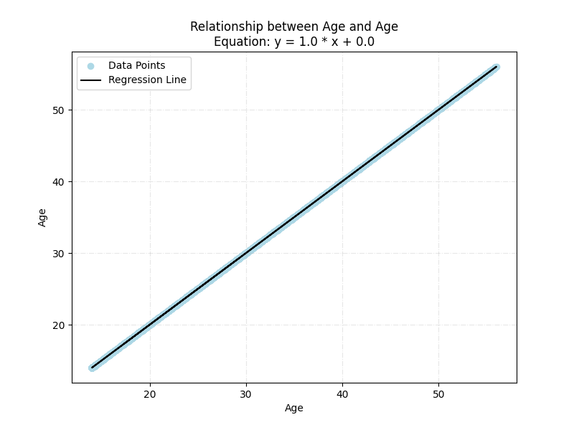
Relationship between Age and Age

Slide 3
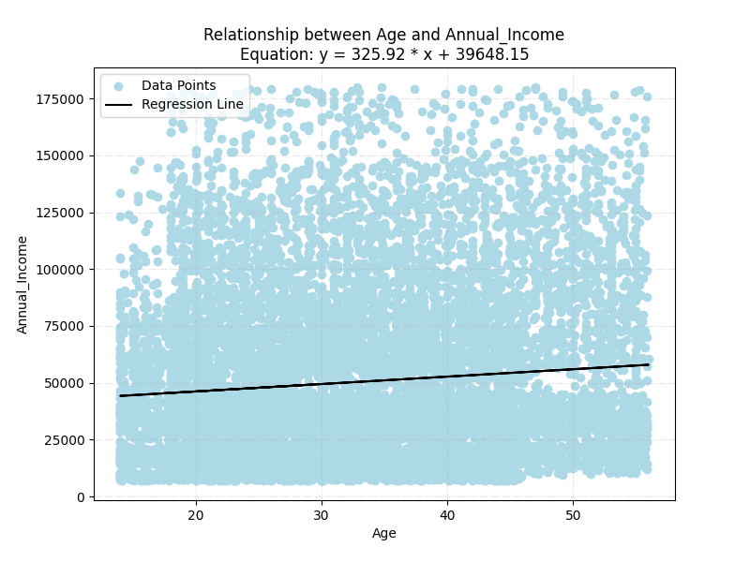
Relationship between Age and Annual_Income

Slide 4
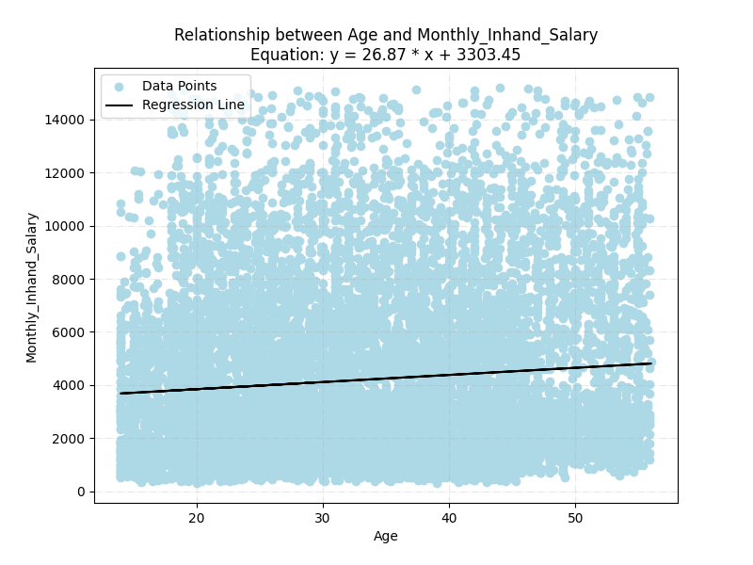
Relationship between Age and Monthly_Inhand_Salary

Slide 5
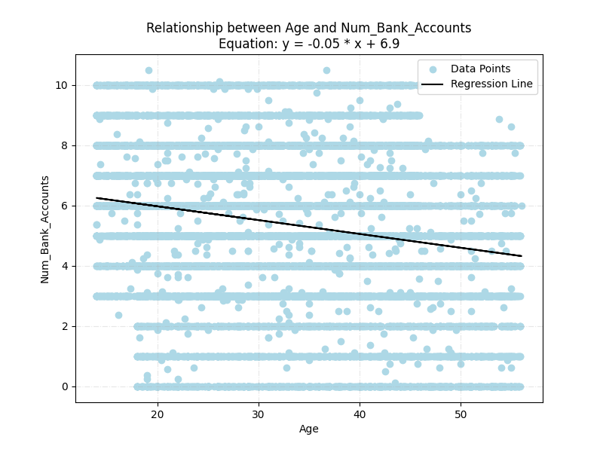
Relationship between Age and Num_Bank_Accounts

Slide 6
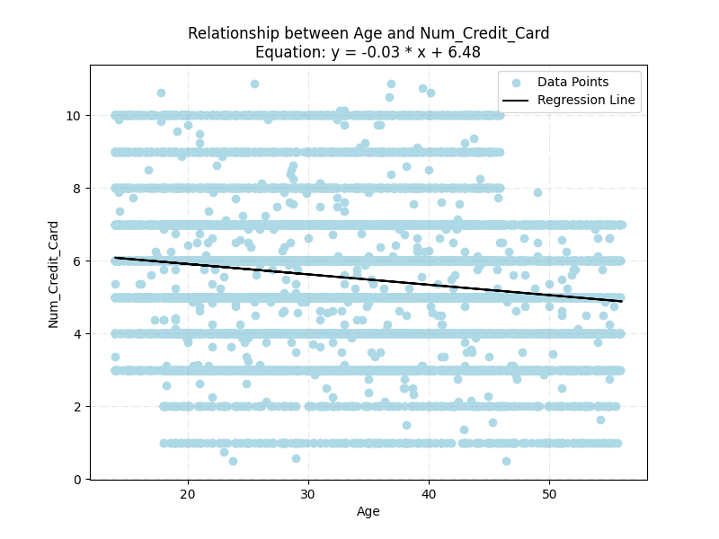
Relationship between Age and Num_Credit_Card

Slide 7
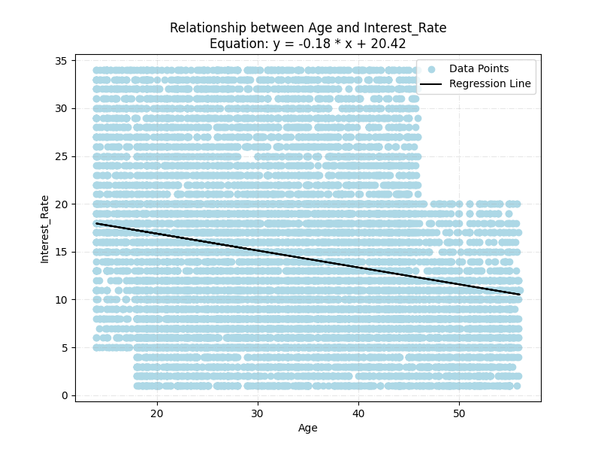
Relationship between Age and Interest_Rate

Slide 8
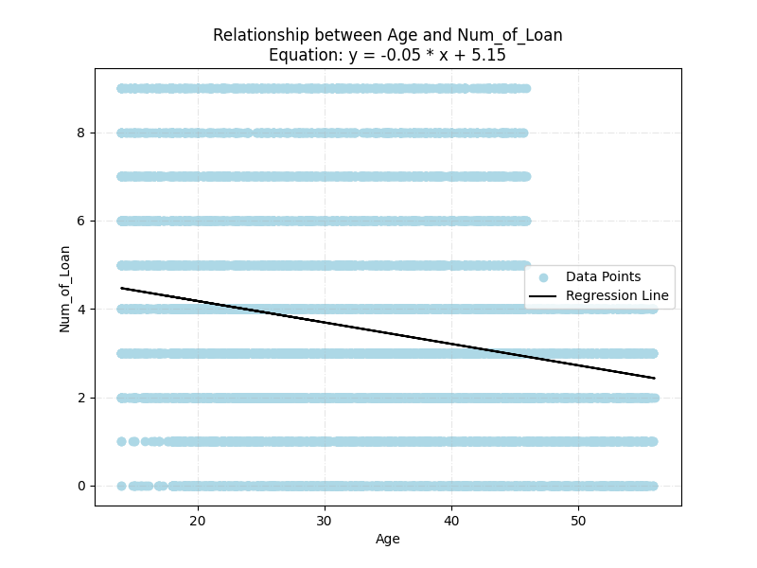
Relationship between Age and Num_of_Loan

Slide 9
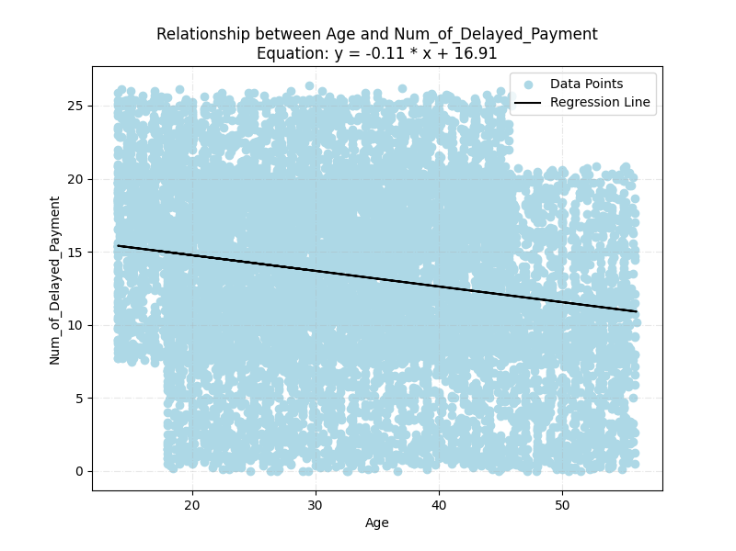
Relationship between Age and Num_of_Delayed_Payment

Slide 10
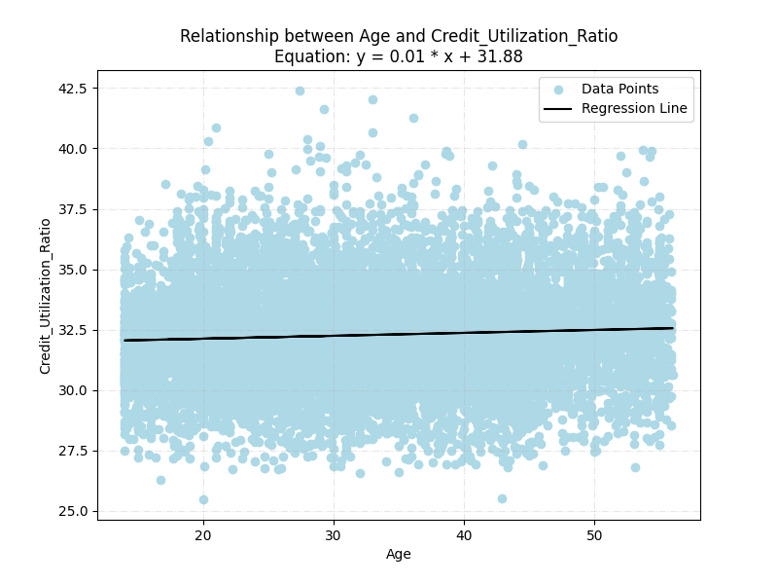
Relationship between Age and Credit_Utilization_Ratio

Slide 11
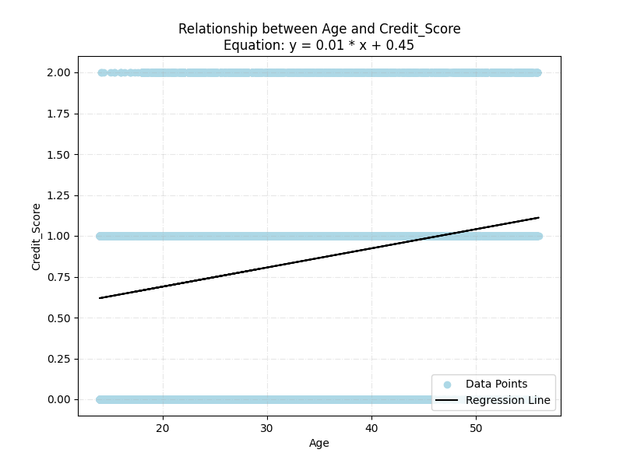
Relationship between Age and Credit_Score

